Slide 1

A Benchmark Suite for Android
Abdul Dakkak
Cuong Manh Pham
Prakalp Srivastava

Slide 2

Overview

Slide 3
RenderScript
Alternative of CUDA and OpenCL on Android
Hide architectural details
Does not unify memory
Automatically selects best device to run on to maximize performance while minimizing energy usage

Slide 4
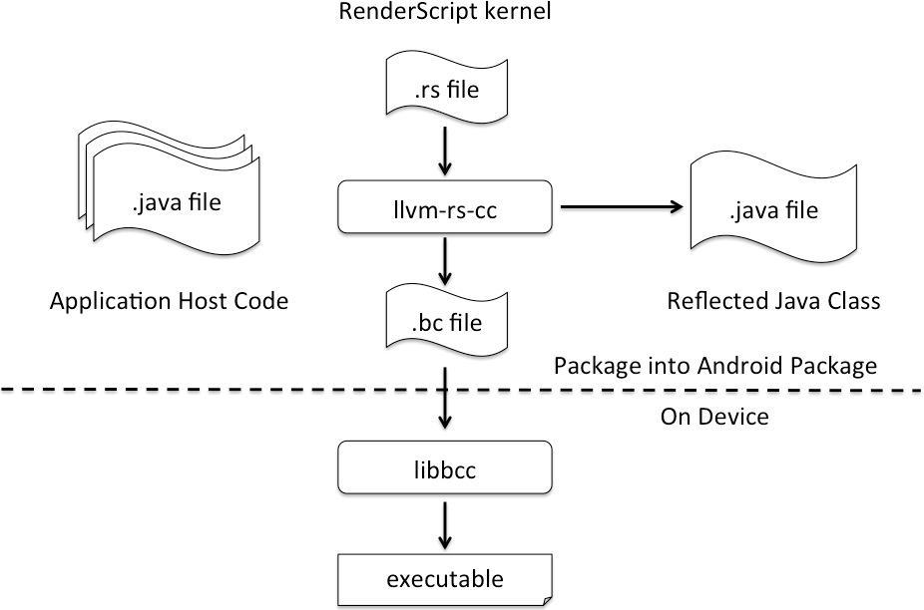
RenderScript

Slide 5
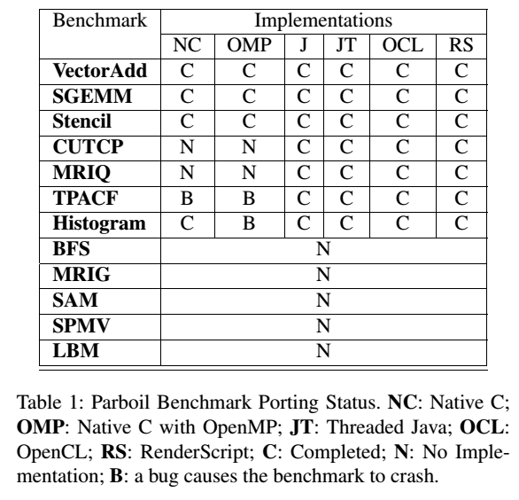
Benchmarks
Rewrote 7 Parboil benchmarks into our benchmark framework
A total of 38 implementations
Copied around 400 lines of code, and the rest required rewrites

Slide 6
Implementation

Slide 8

Evaluation

Slide 9
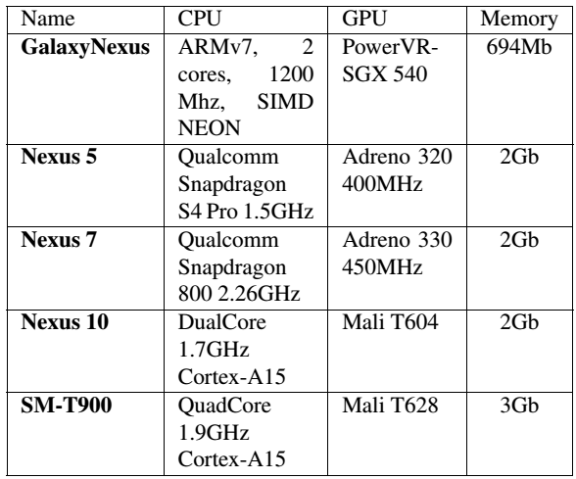

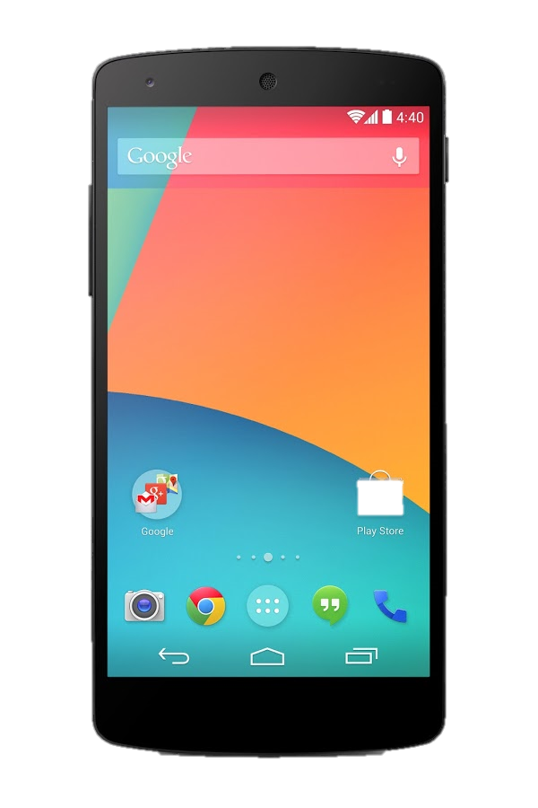



Evaluation Devices

Slide 10
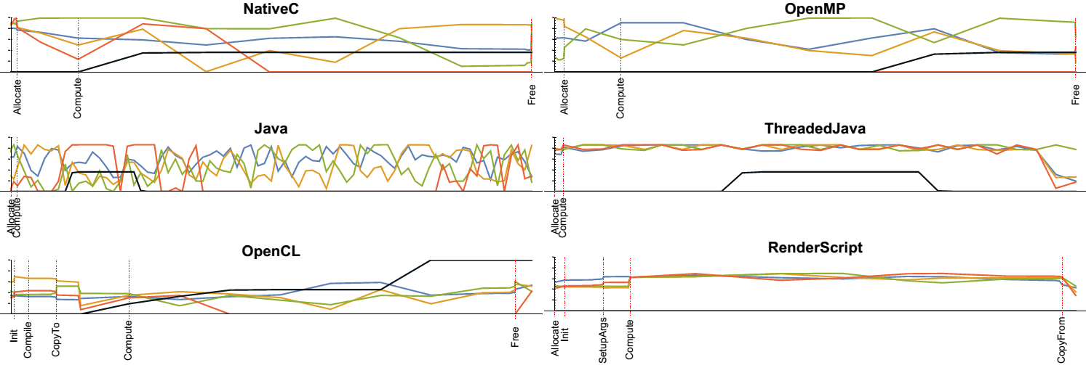
Processor Utilization
SGEMM Utilization on Nexus 5

Slide 11
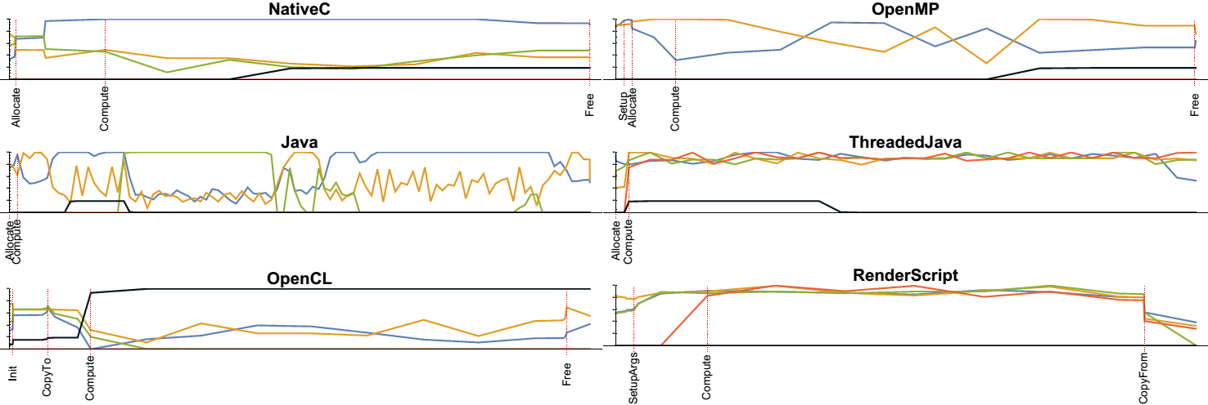
Processor Utilization
SGEMM Utilization on Nexus 7

Slide 12
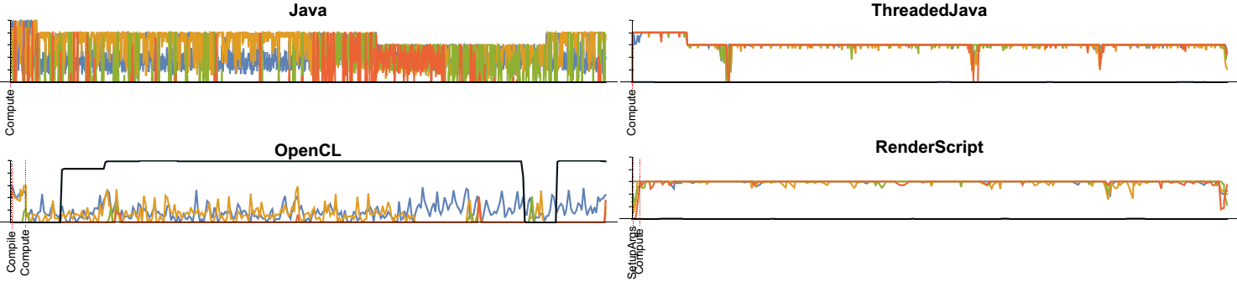
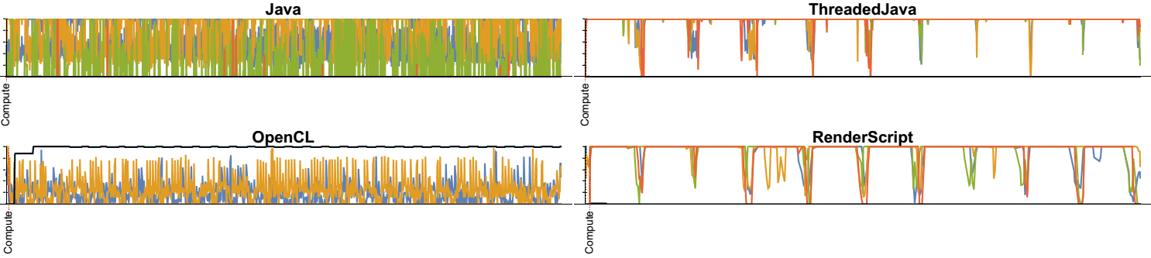
MRIQ Utilization on Nexus 5 (top)
And Nexus 7 (bottom)

Slide 13
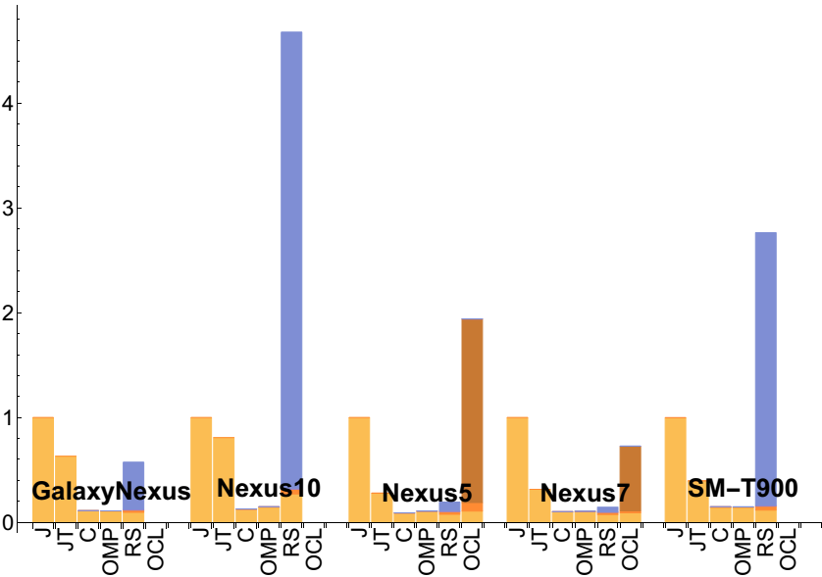
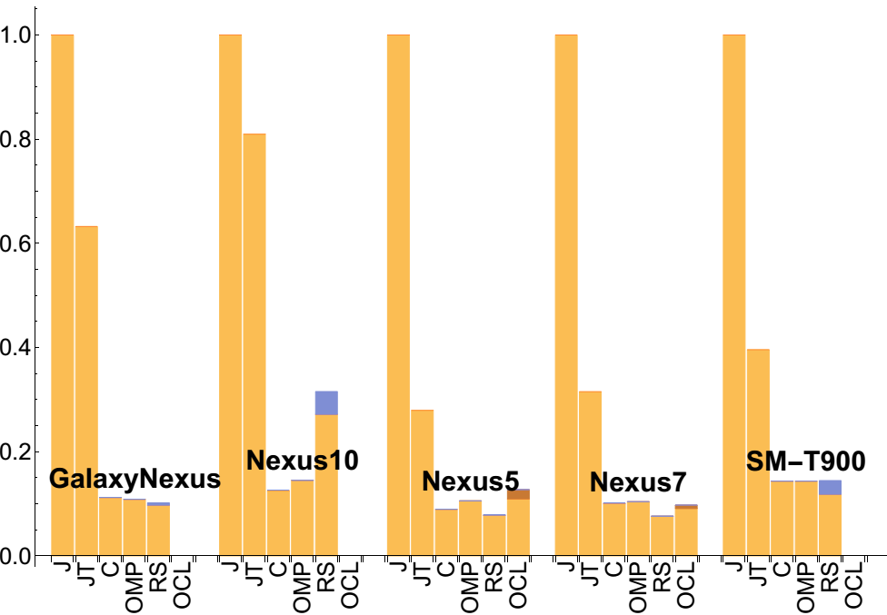
SGEMM Performance

Slide 14
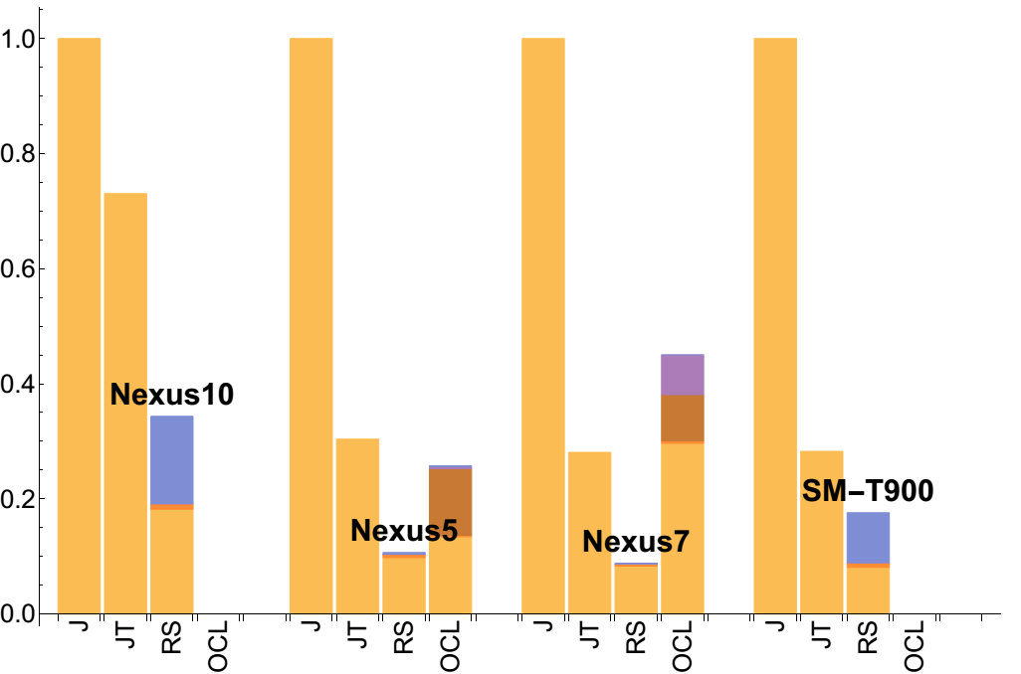
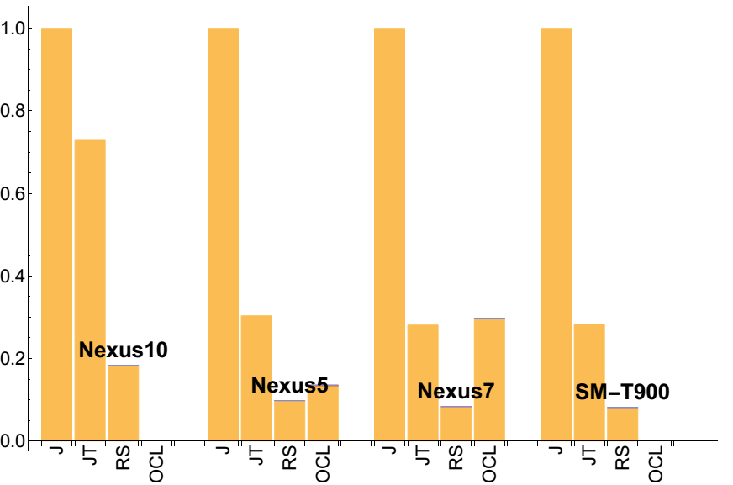
MRIQ Performance

Slide 15

Power Usage

Slide 16
Insights

Slide 17

Questions?

