Slide 1

Performance Analysis of Parallel Languages for Android
Abdul Dakkak
Cuong Manh Pham
Prakalp Srivastava

Slide 2

Overview

Slide 3
RenderScript
Alternative of CUDA and OpenCL on Android
Hide architectural details
Does not unify memory
Runtime selects best device to run on to maximize performance while minimizing energy usage

Slide 4
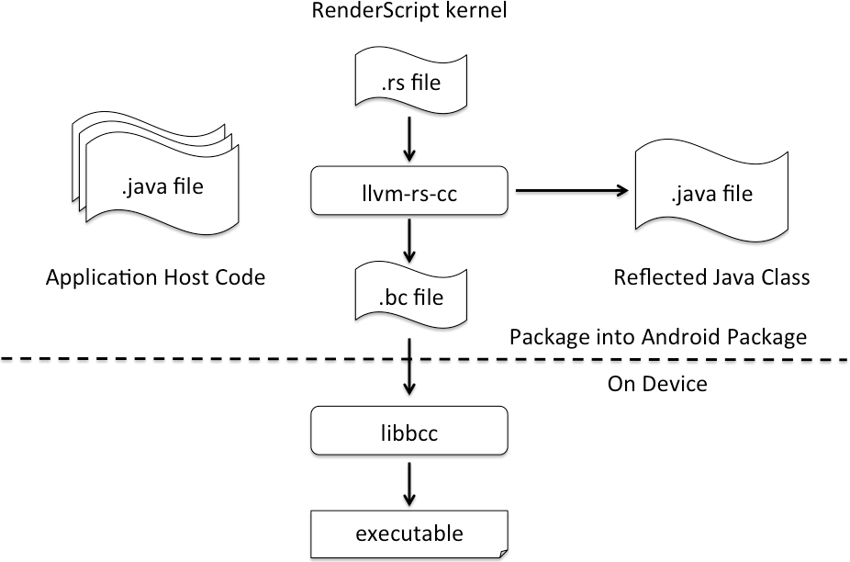
RenderScript

Slide 5

Implementation

Slide 6
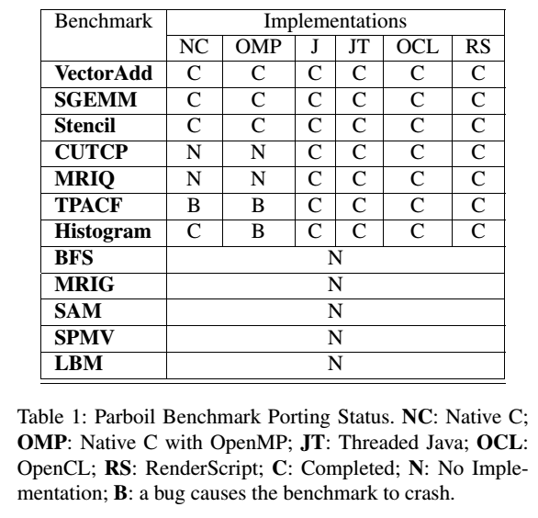
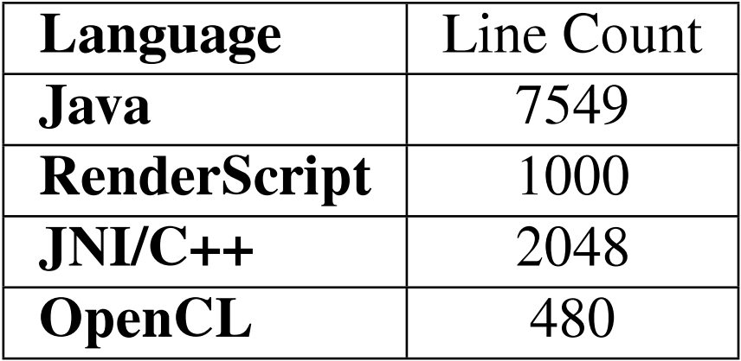
Benchmarks
Ported 7 Parboil benchmarks in 6 different programming models for Android
A total of 38 implementations

Slide 7



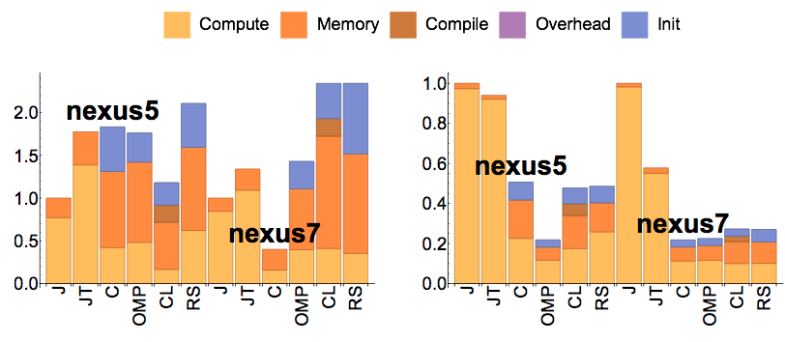
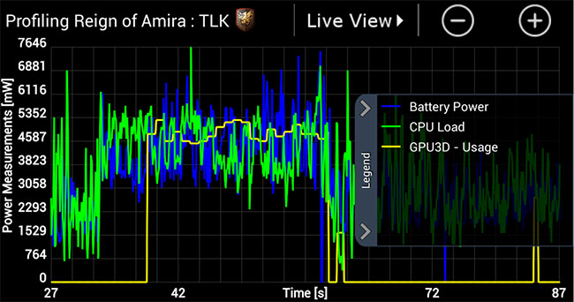
Benchmarking Flow
Time sections of the code
Save to a database
Run benchmarks
signaling
Analyze the results
Trepn
Profile load, power
Trepn
Export to .csv files

Slide 8
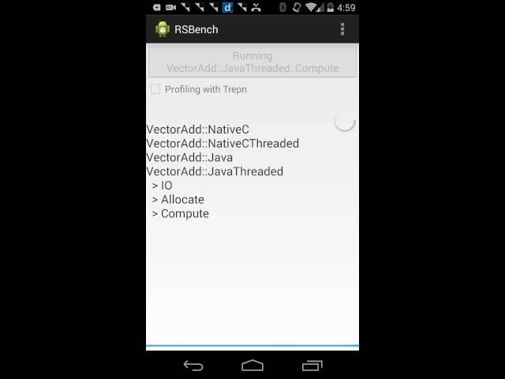

Slide 9
Analysis

Slide 10
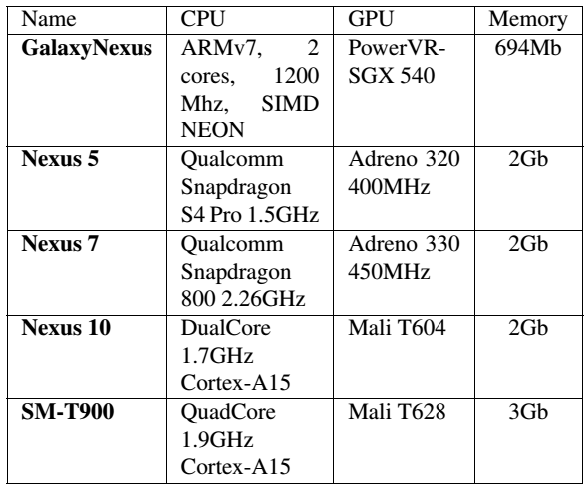
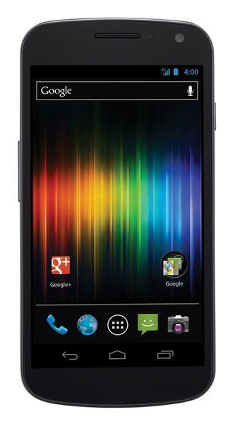
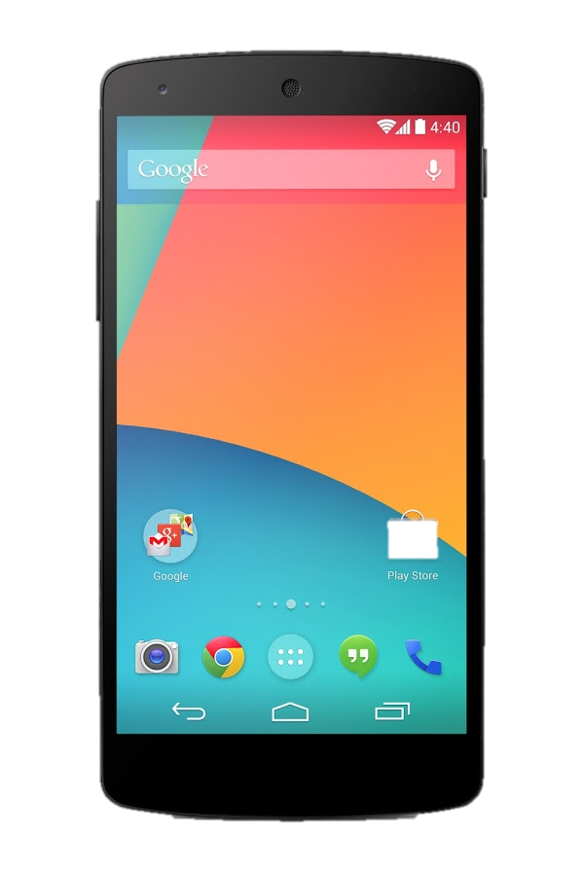
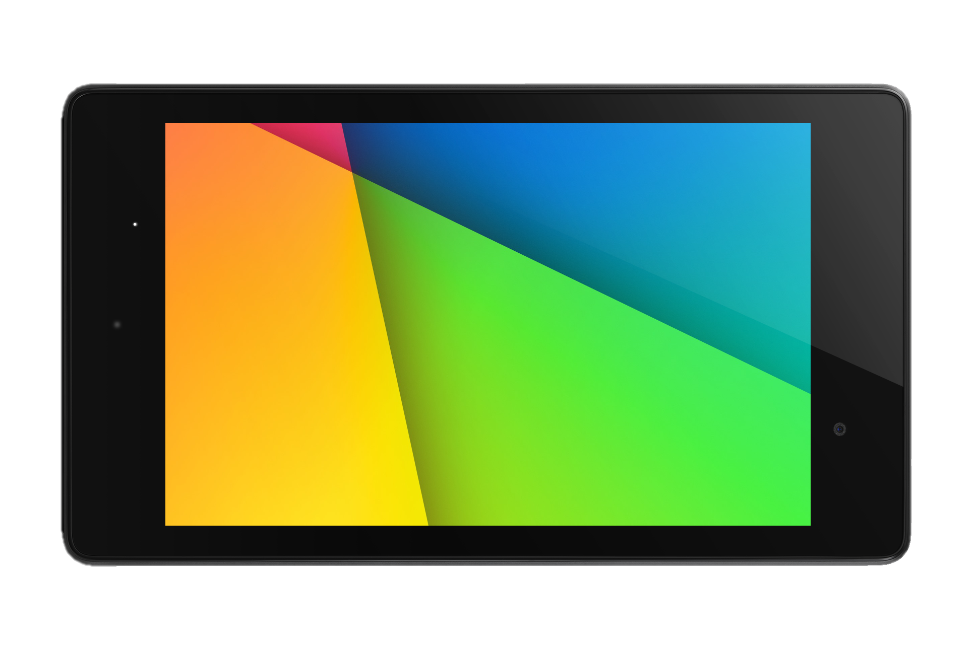
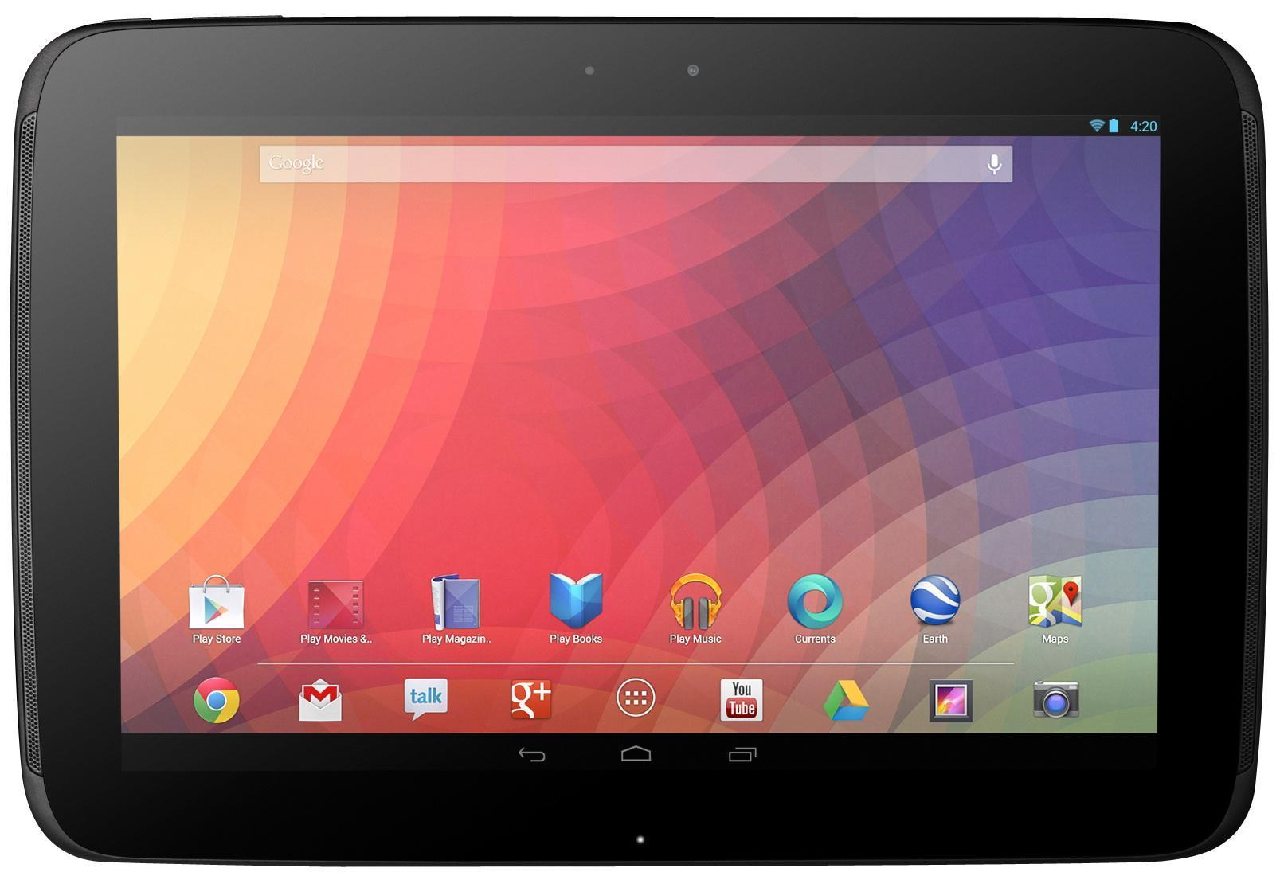
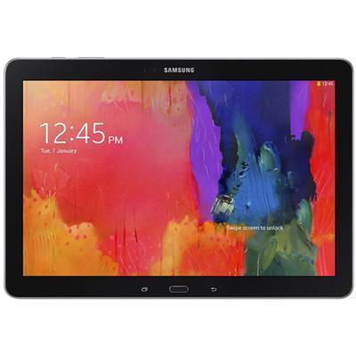
Devices
$150
Trepn
$350
Trepn
$230
$450
$550

Slide 11
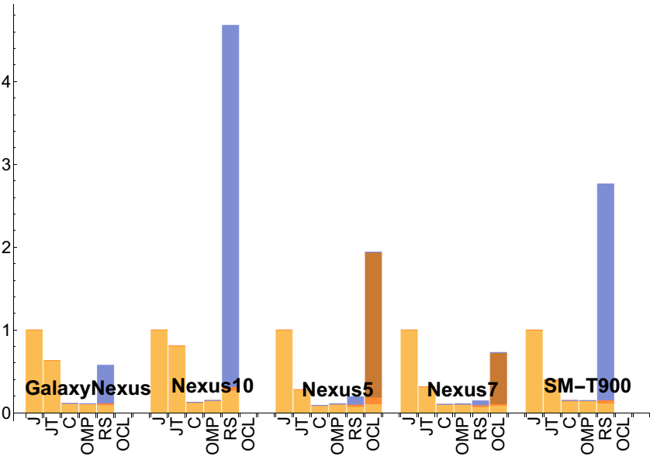
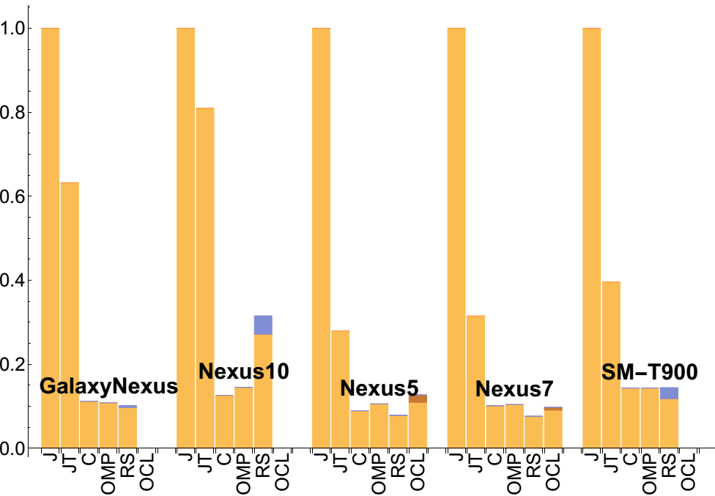
SGEMM Performance

Slide 12
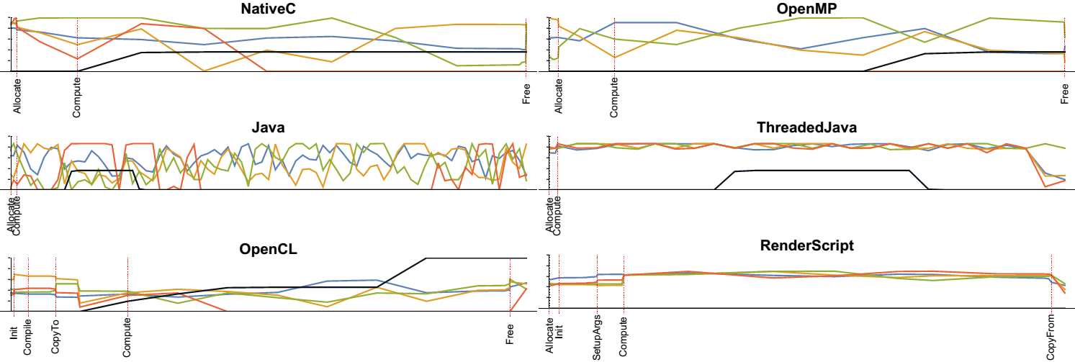
SGEMM Processor Utilization
Nexus 5

Slide 13
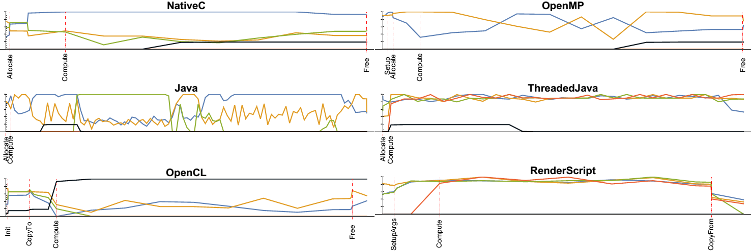
SGEMM Processor Utilization
Nexus 7

Slide 14
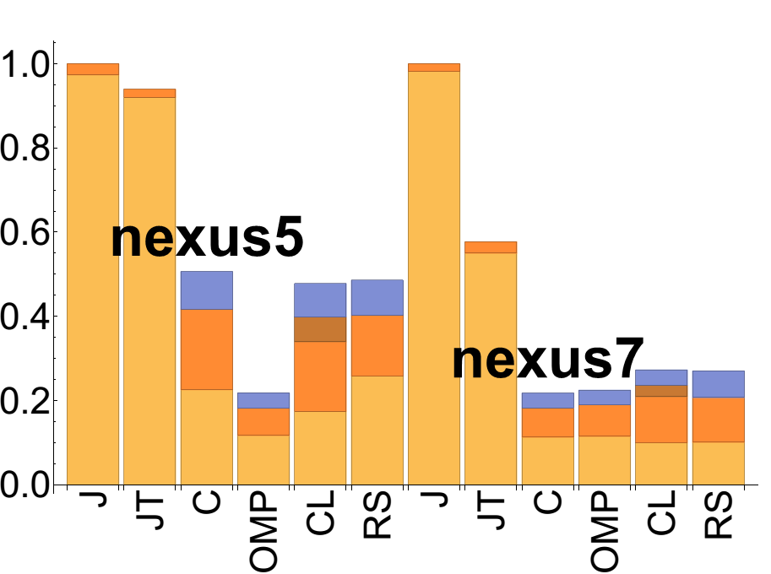
SGEMM Energy

Slide 15
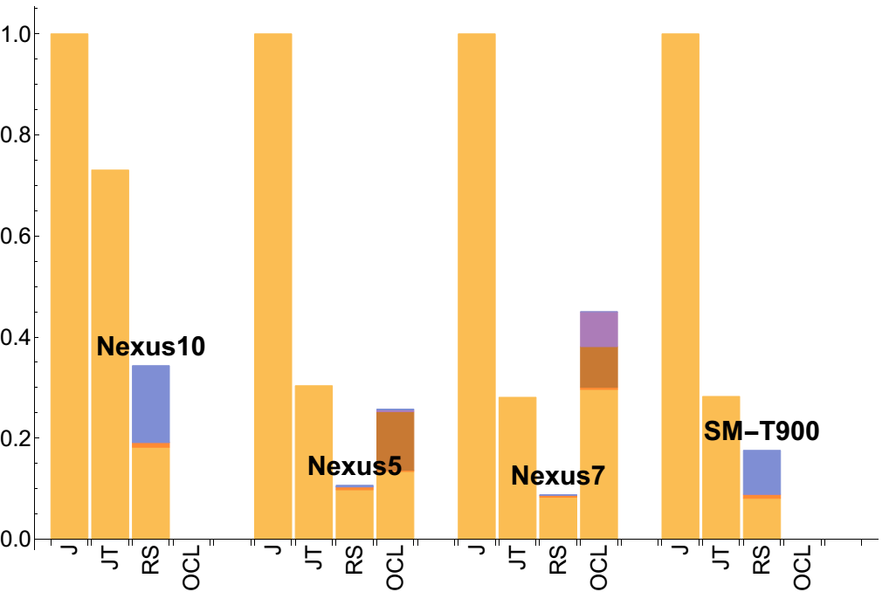
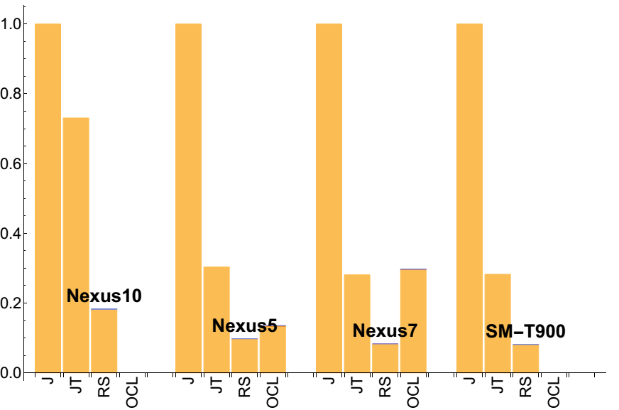
MRIQ Performance

Slide 16
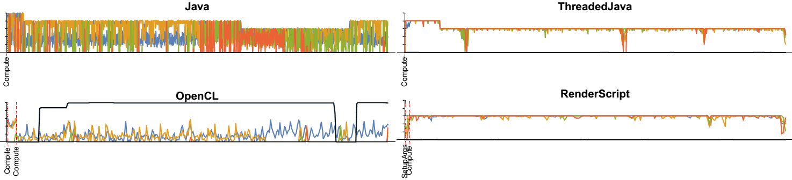
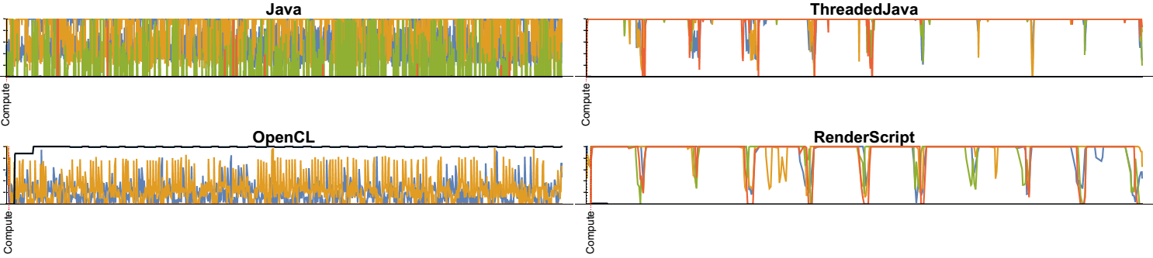
Nexus 5
Nexus 7
MRIQ Processor Utilization

Slide 17
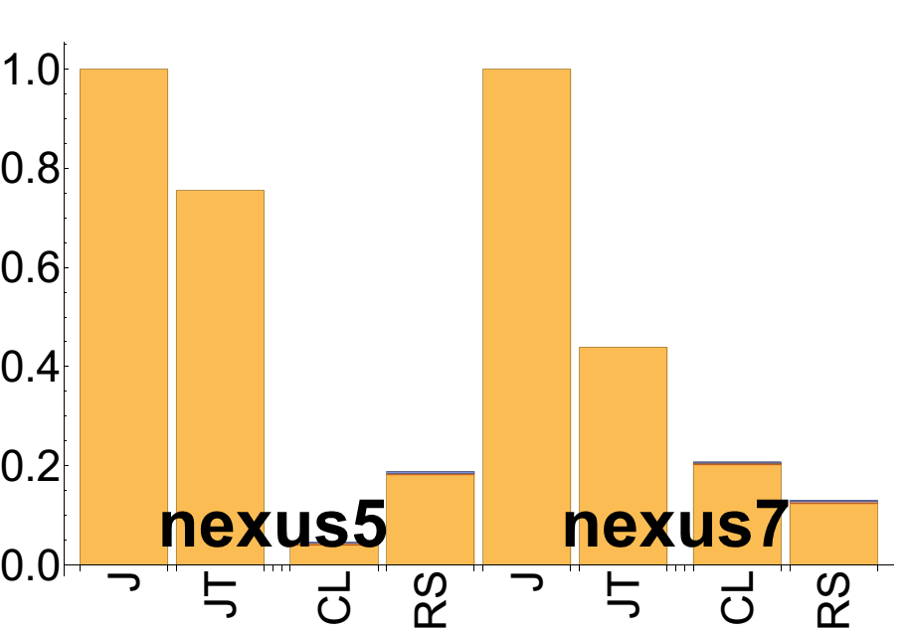
MRIQ Energy

Slide 18
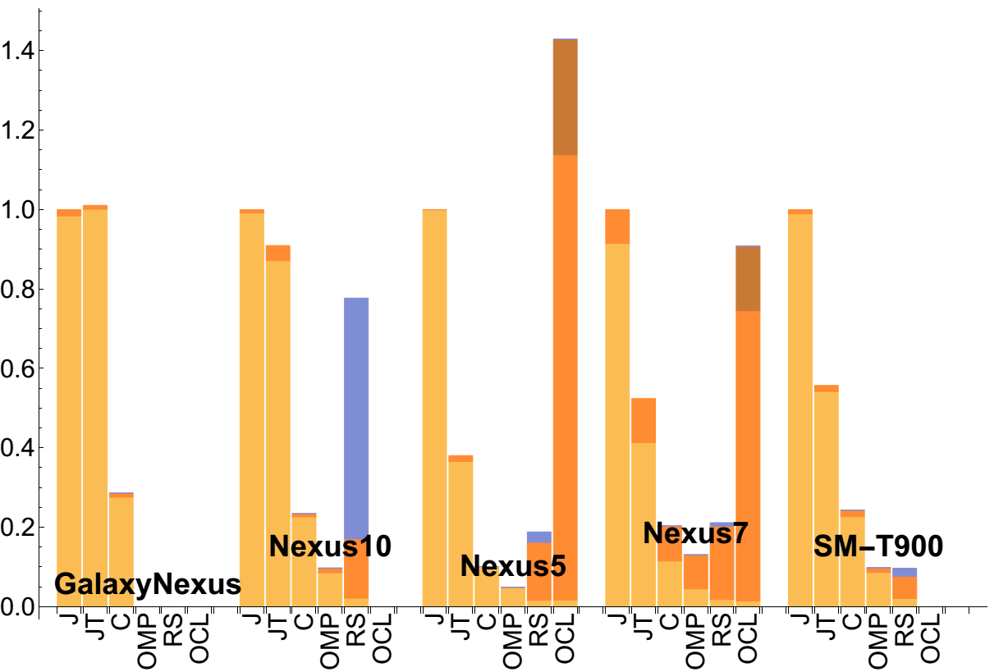
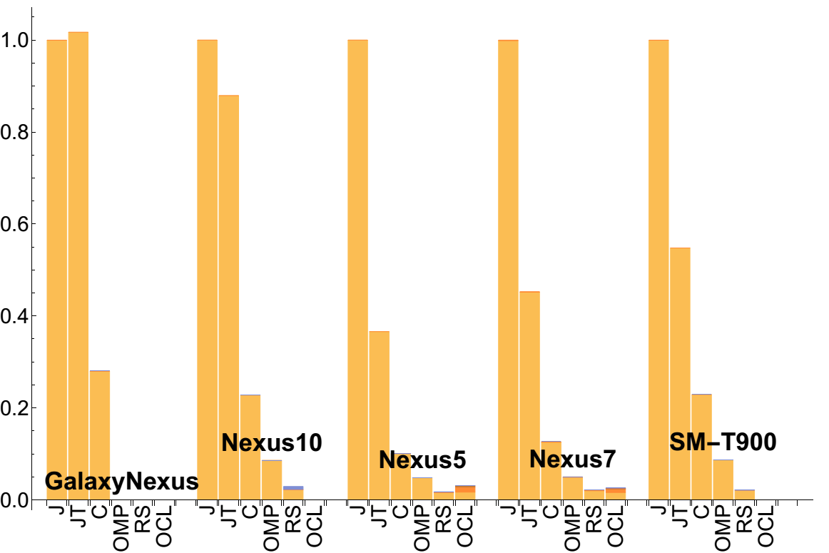
Stencil Performance

Slide 19
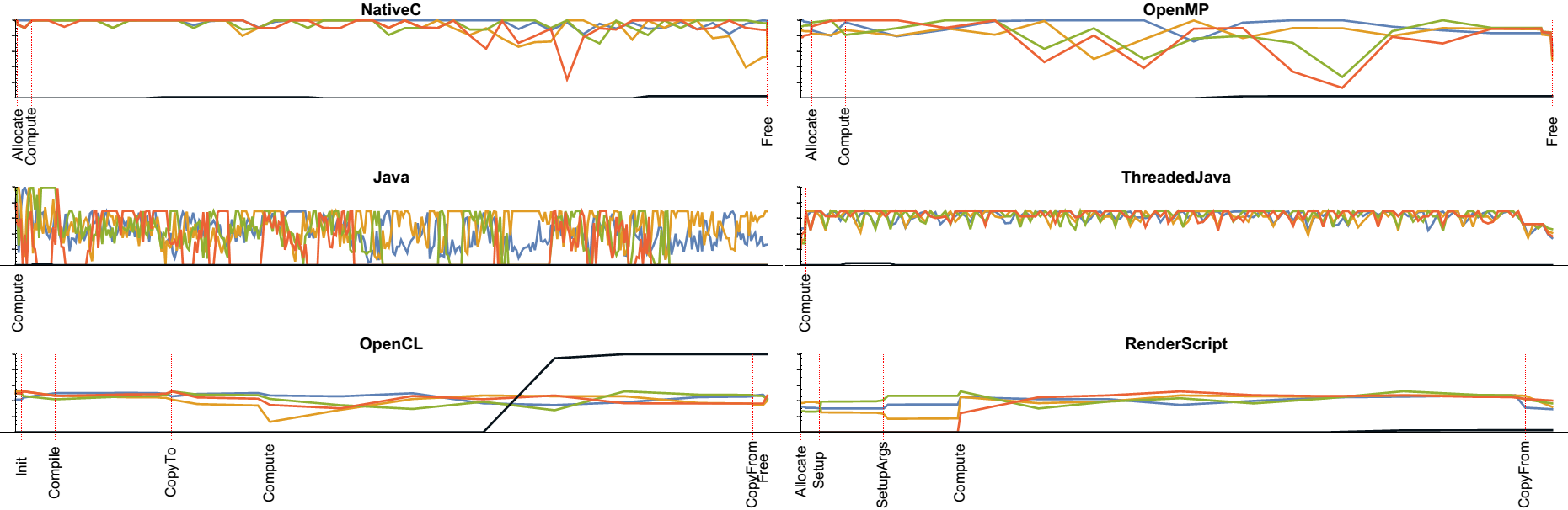
Stencil Utilization on Nexus 5

Slide 20
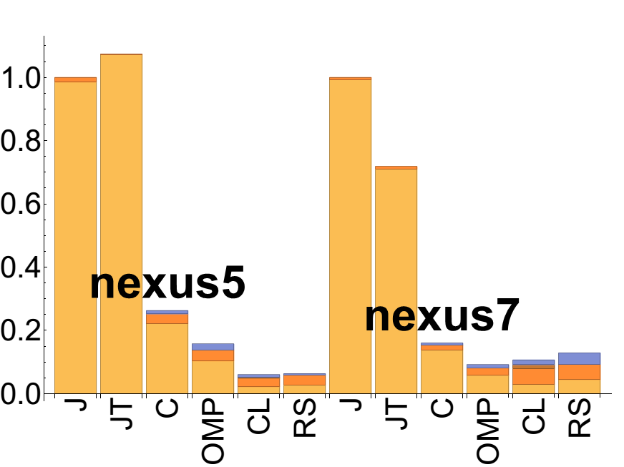
Stencil Power Utilization on Nexus 5

Slide 21

RenderScript Programmability
Performance Portability
Debug Support
Memory Operations
Familiar Language
Multi-Dimensional Parallelism
Lack of Synchronization Intrinsics
Non-Unified Memory
Lack of Standardization
Why remove support for OpenCL?

Slide 22

Questions
If you mustache us

Slide 23
Thank you
github.com/cmpham/RSBench

Slide 24

Backup Slides

Slide 25
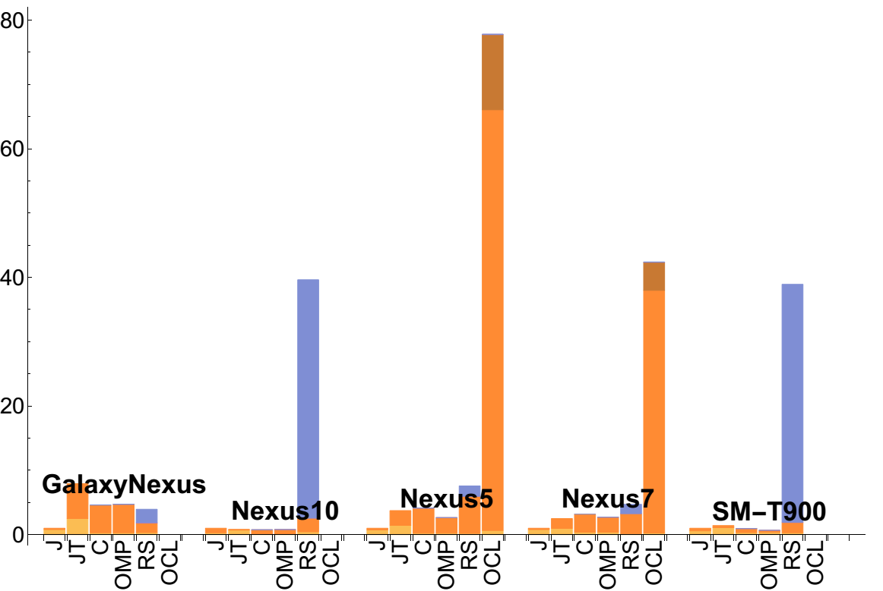
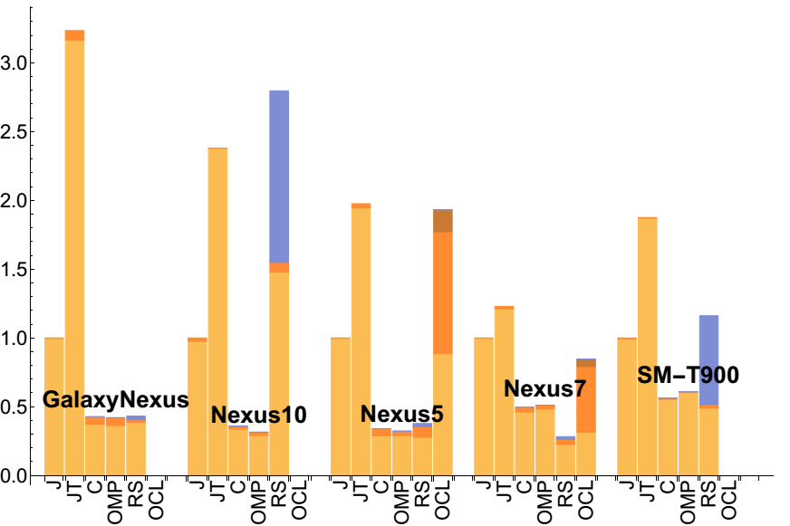
Vector Add Performance

Slide 26
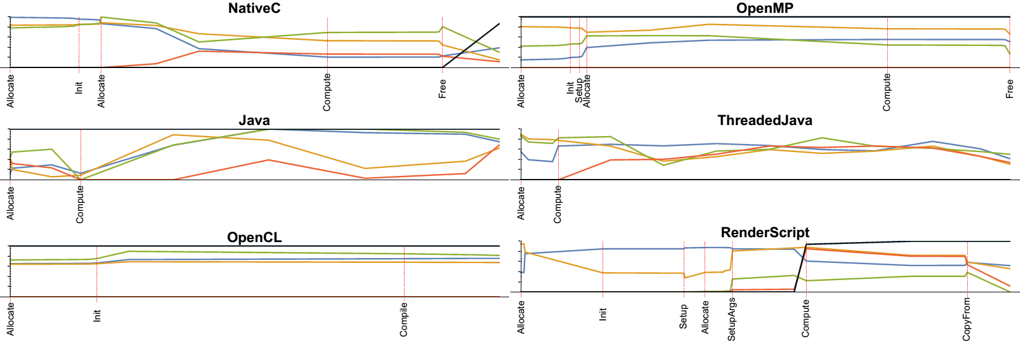
Vector Add Utilization on Nexus 5

Slide 27
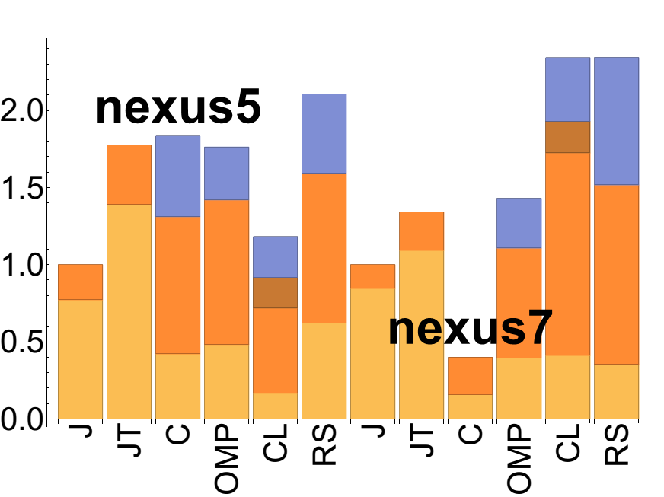
Vector Add Utilization on Nexus 5

Slide 28
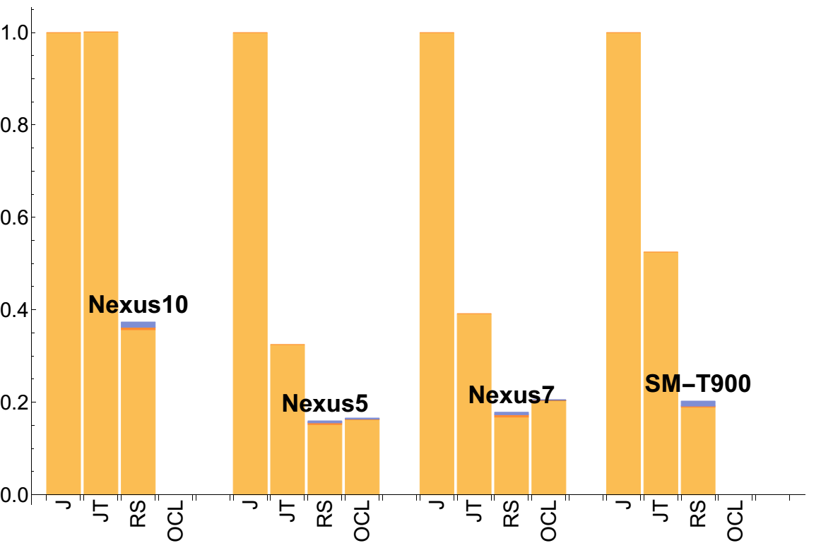
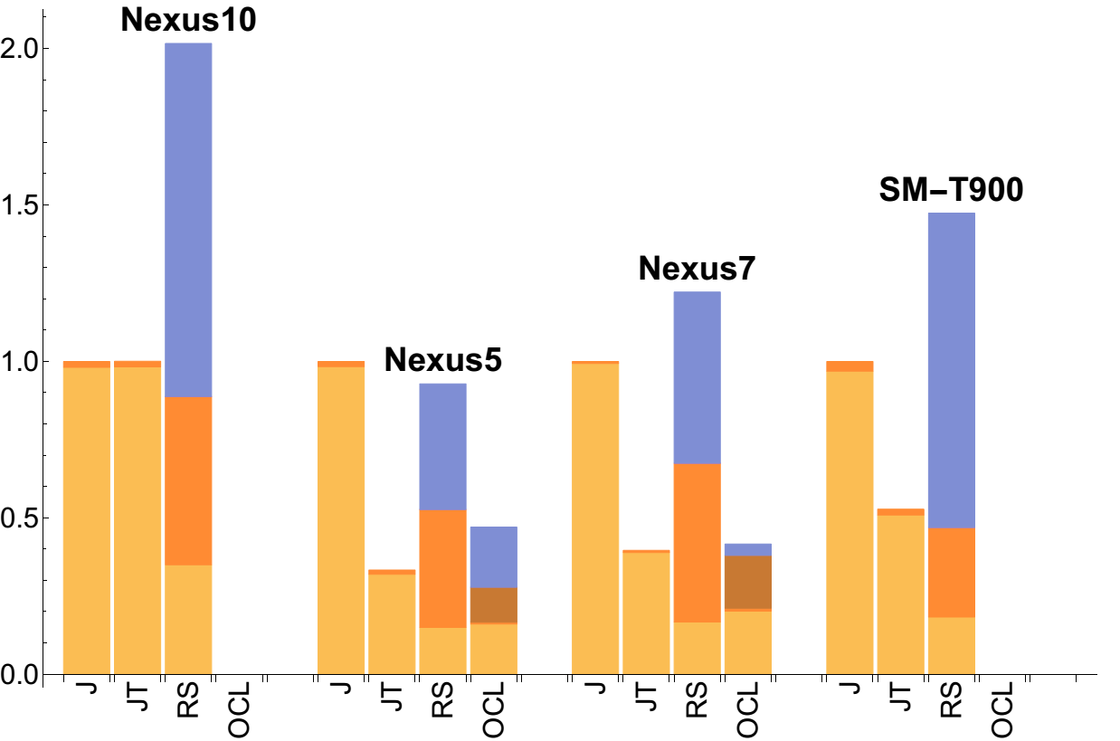
TPACF Performance

Slide 29
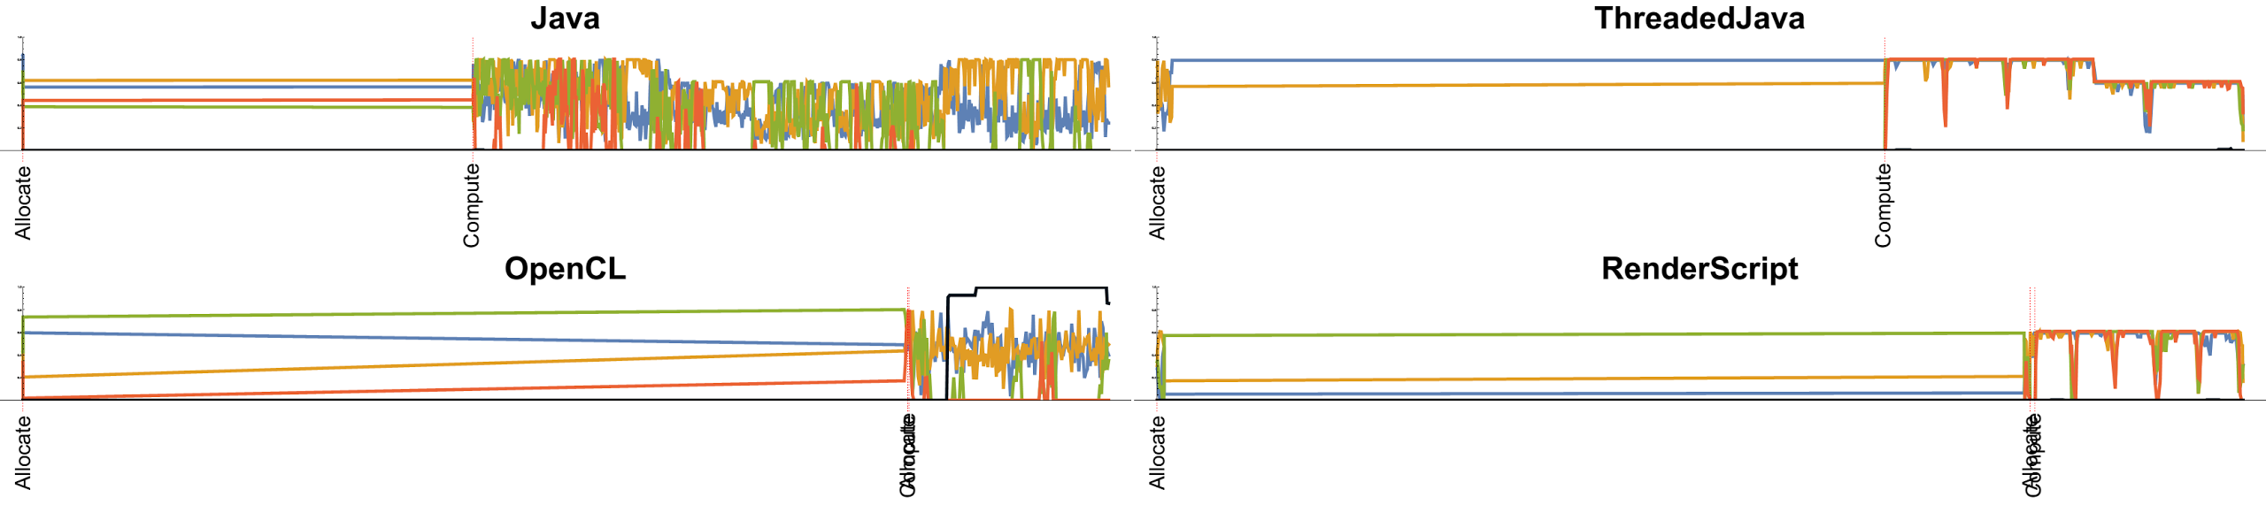
TPACF Utilization on Nexus 5

Slide 30
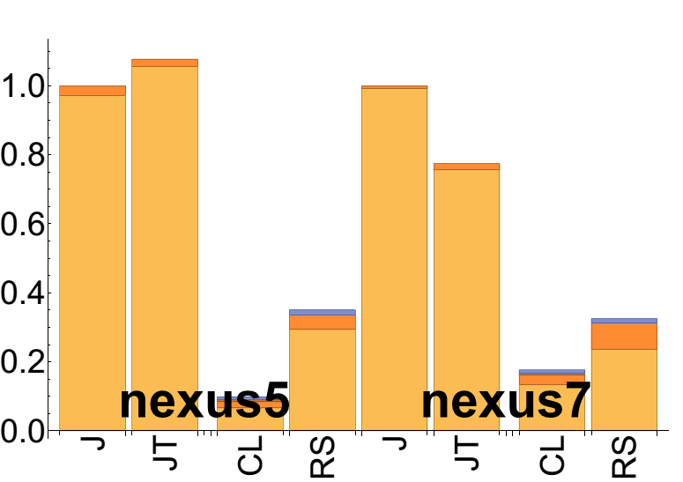
TPACF Utilization on Nexus 5

