Slide 1

A Benchmark Suite for Android
Abdul Dakkak
Cuong Manh Pham
Prakalp Srivastava

Slide 2

Overview

Slide 3
Benchmarks

Slide 4
RenderScript

Slide 5
Implementation

Slide 6

Evaluation

Slide 7
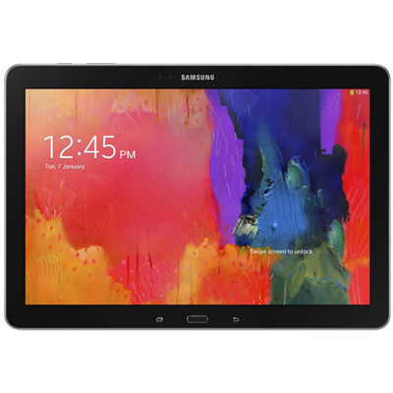
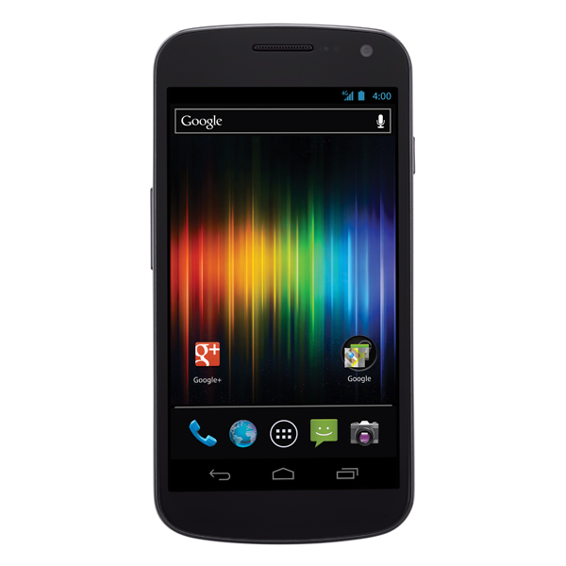
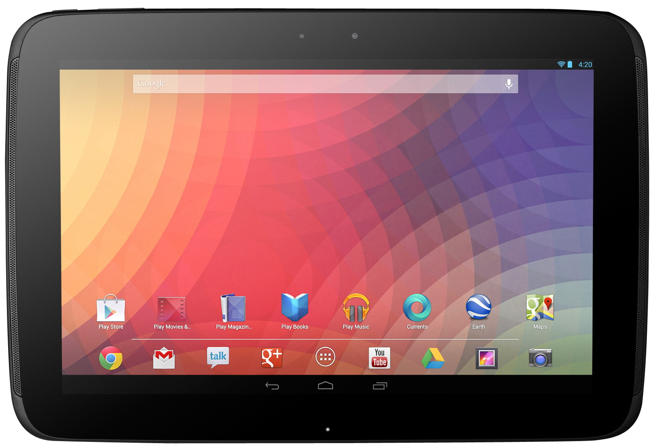
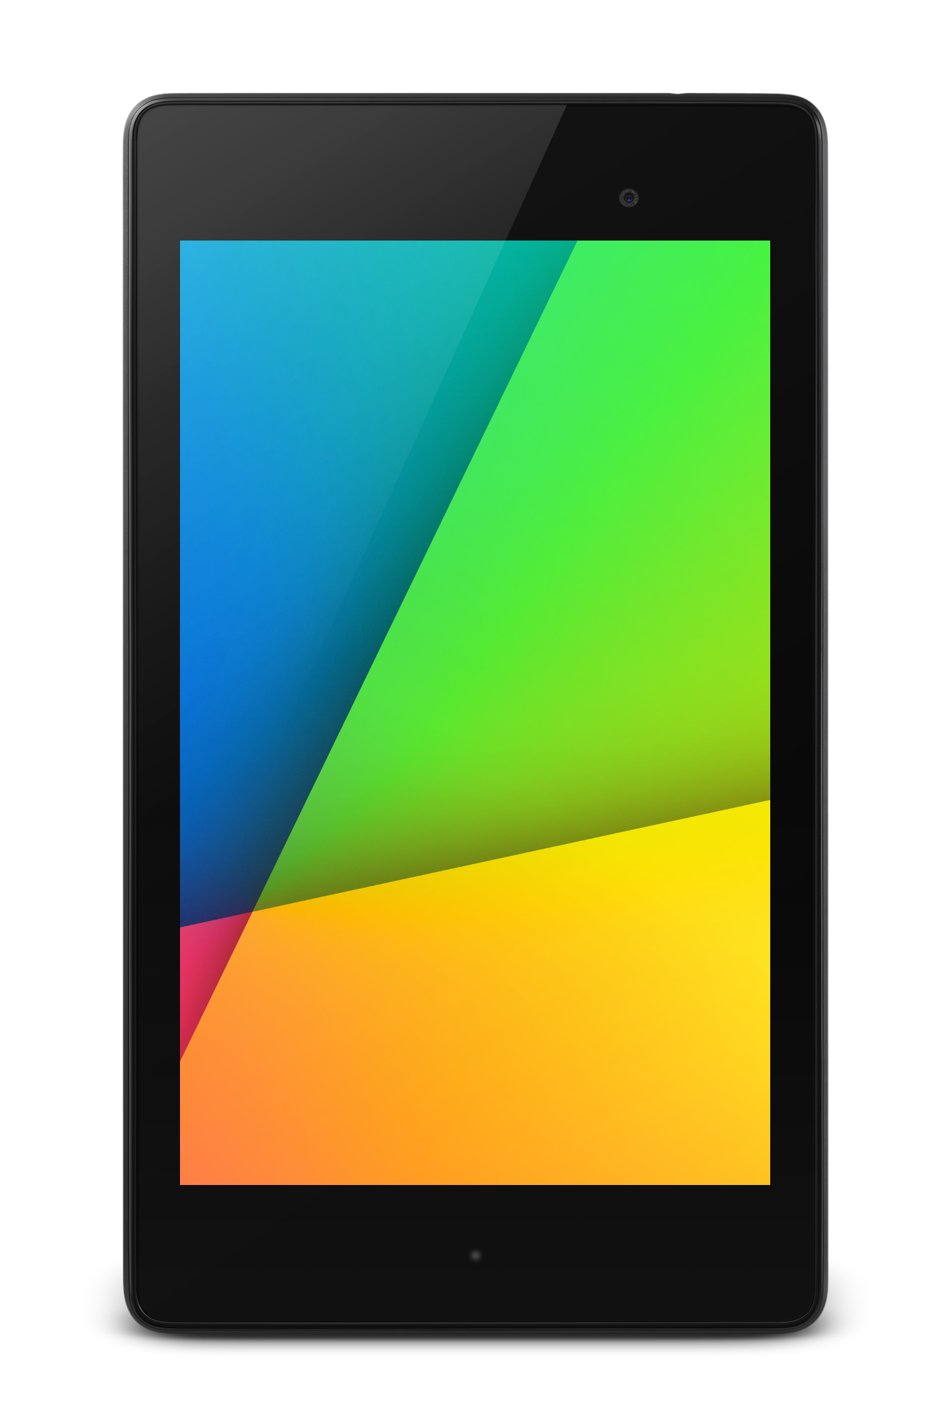

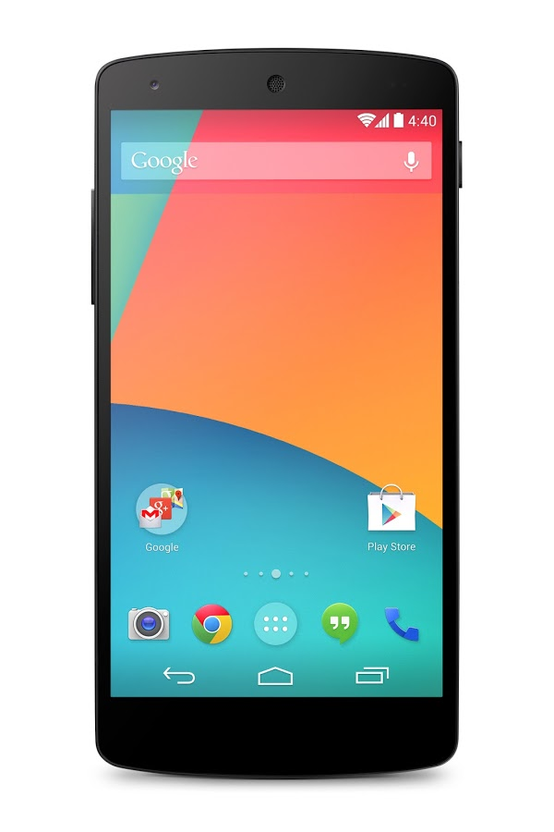
Evaluation Devices

Slide 8
Performance

Slide 9

Power Usage

Slide 10
Insights

Slide 11

Questions?

