Slide 2
Language
S ::= x = y // copy y into x
| x = &y // x points y
| x = *y // load y into x
|*x = y // store y into x
| x = op(y...) // binary function
| x = allocate(y) // allocate on the heap
| x = fun(a...)->(r...) S* // fun definition
| x... = p(a...) // fun call returns

Slide 3
C to Steensgaard's Language
f = fun(x) → (r)
  r = addOne(x)
a = 1
p = &x
q = *p
g = f(a)
No representation for aggregates
Chained C pointer operations can be desugared
x = **q → x0 = *q; x = *x0;

Slide 4
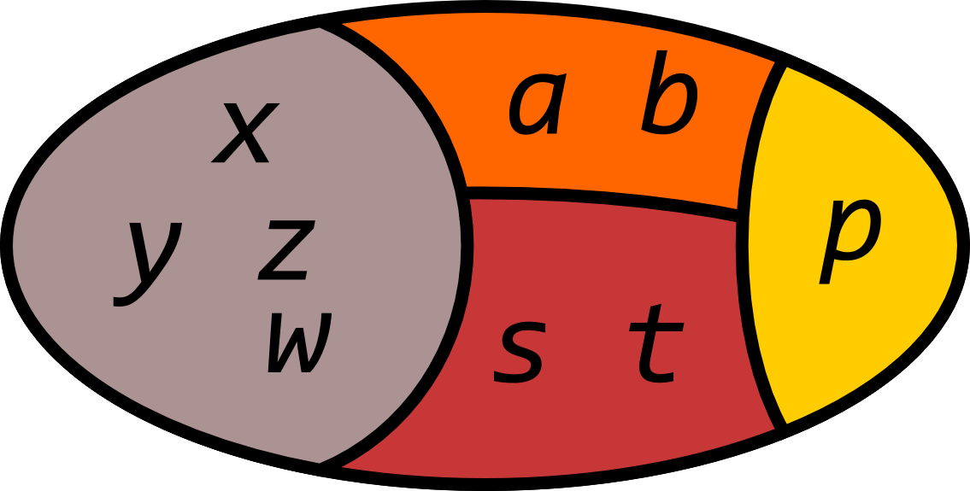
Steensgaard's Method
Context, flow, and field insensitive pointer analysis
Unifies values assigned to pointers and function parameters
Partial ordering to make values with address not taken have their own equivalence class

Slide 5
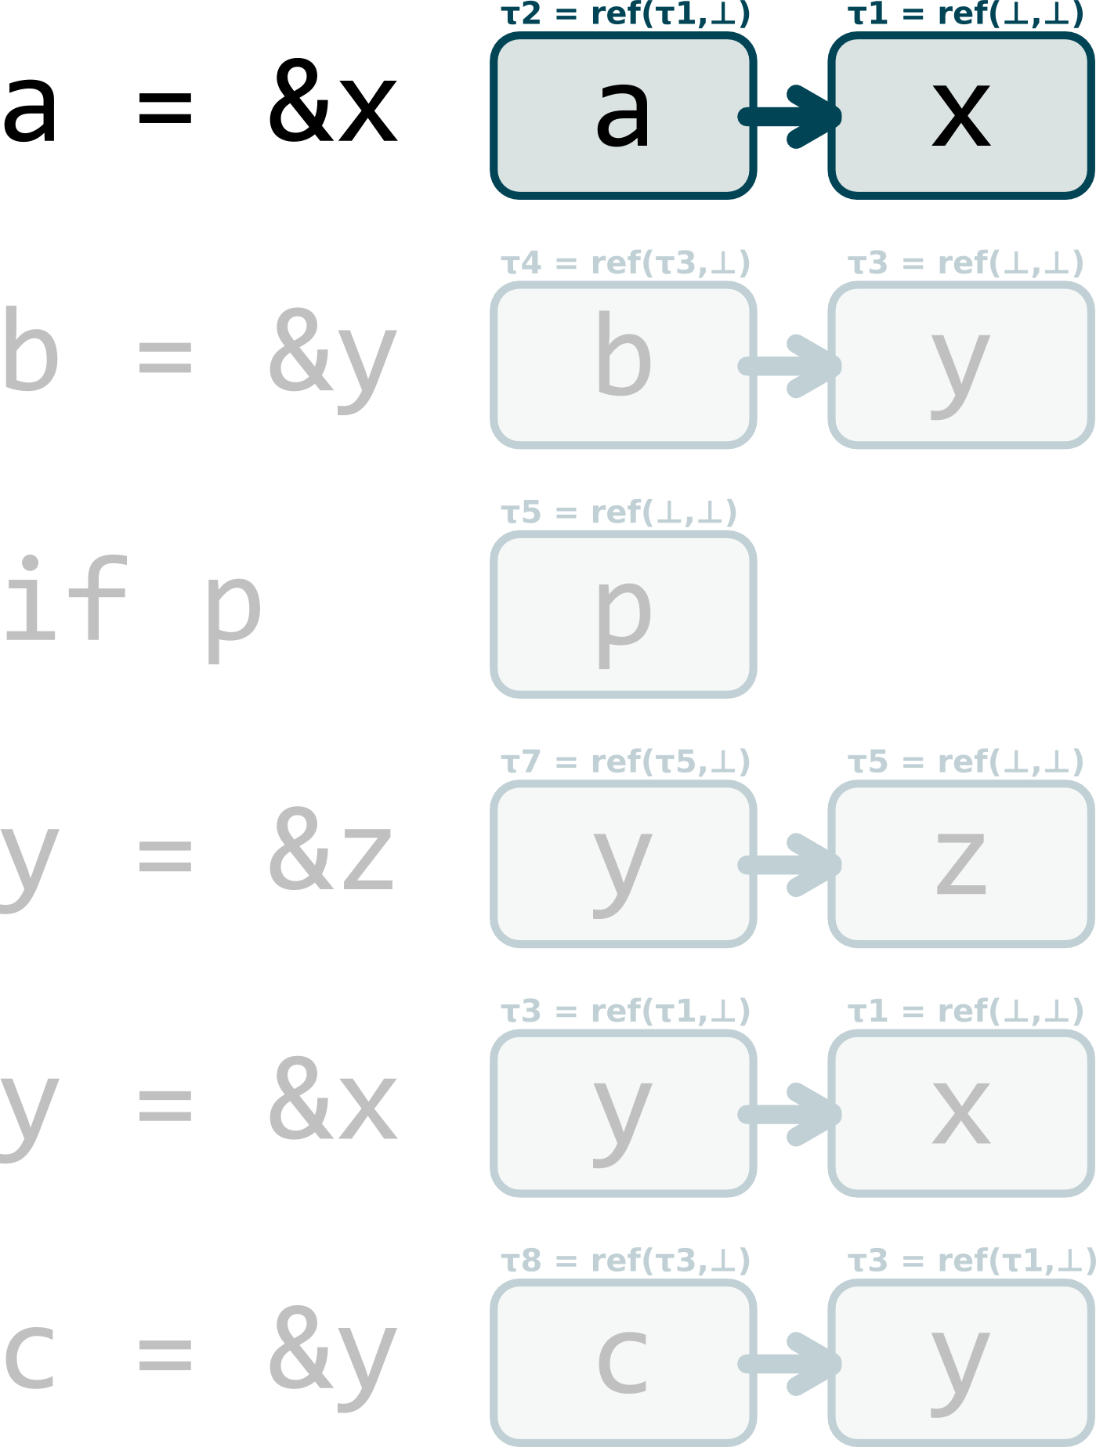
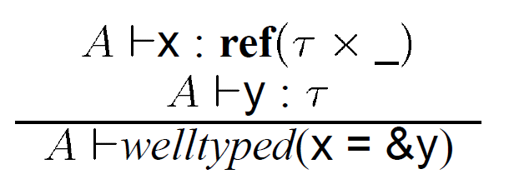
Example

Slide 6
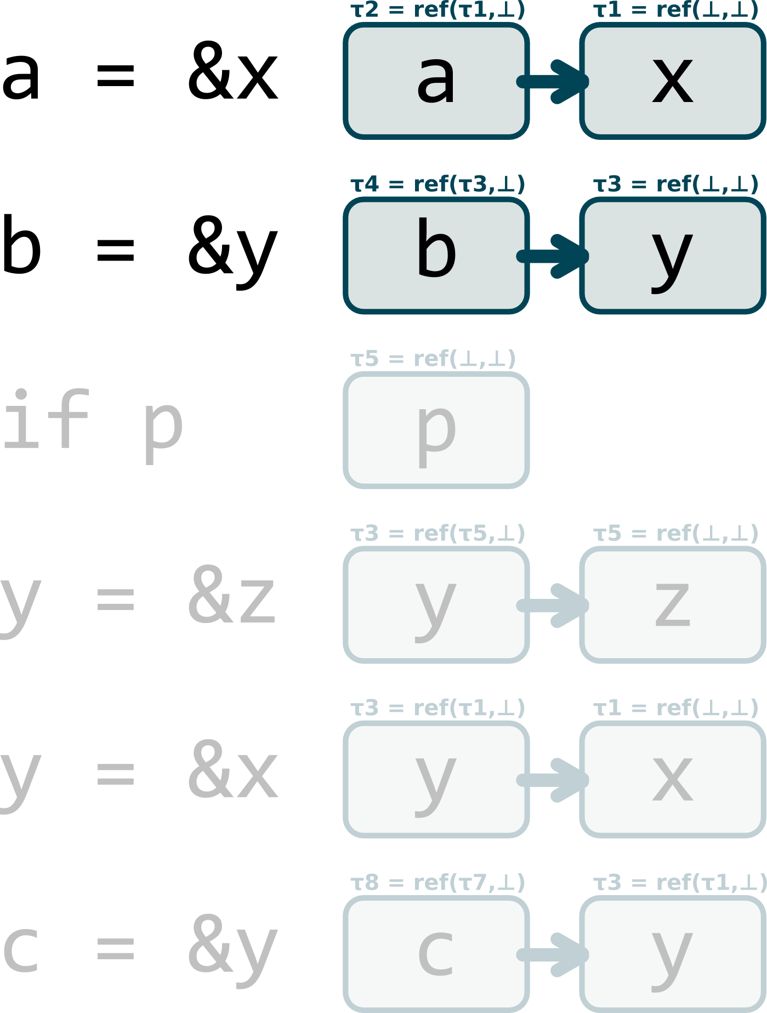
Example

Slide 7
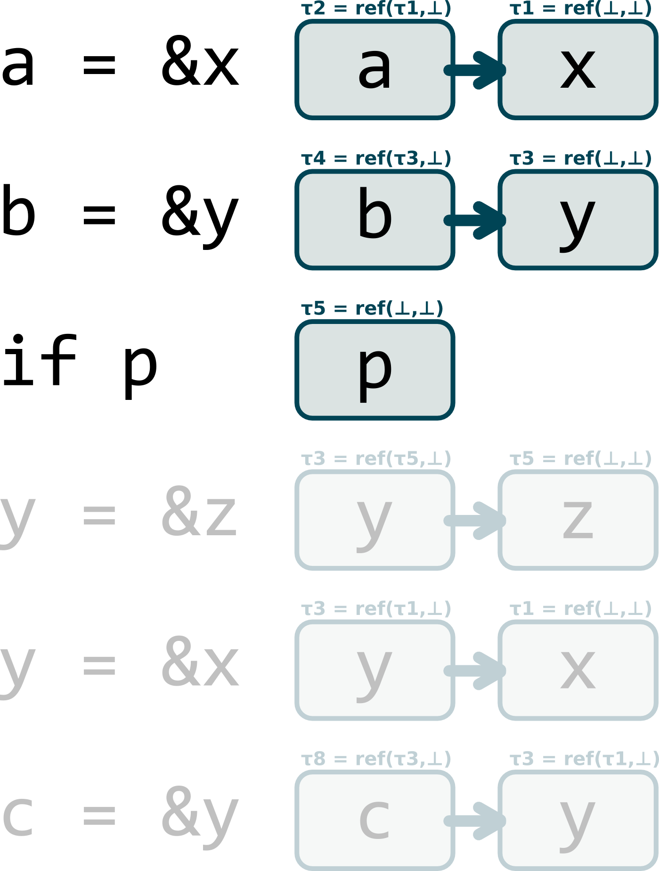
Example

Slide 8
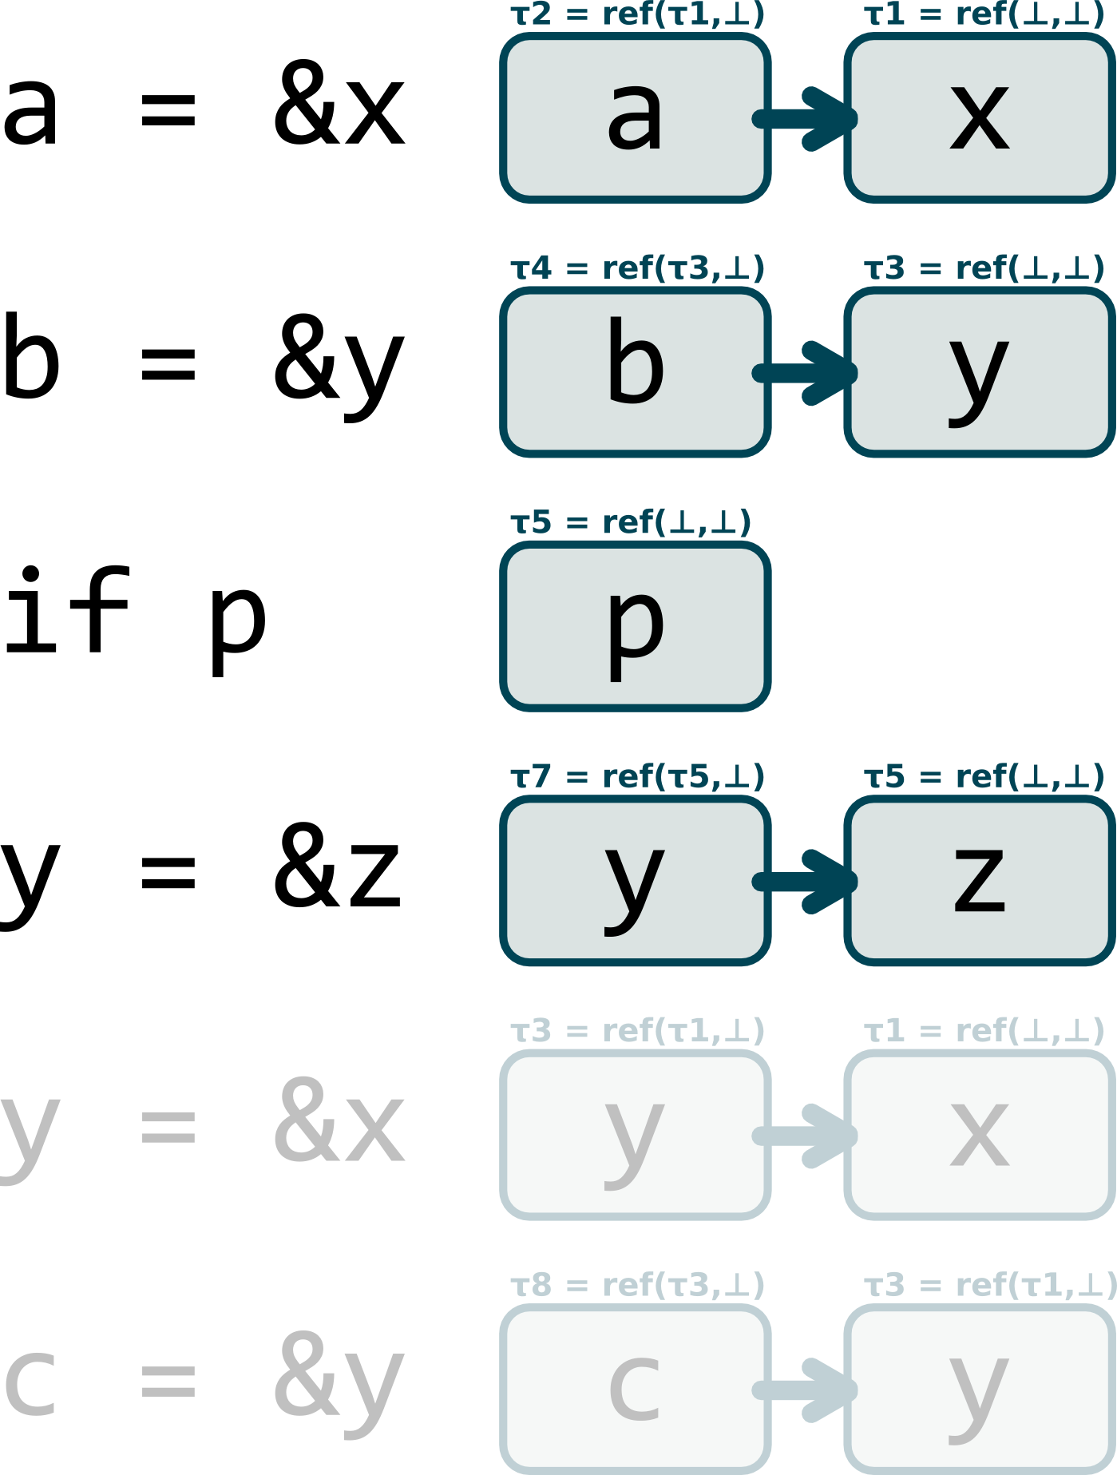
Example

Slide 9

Example

Slide 10
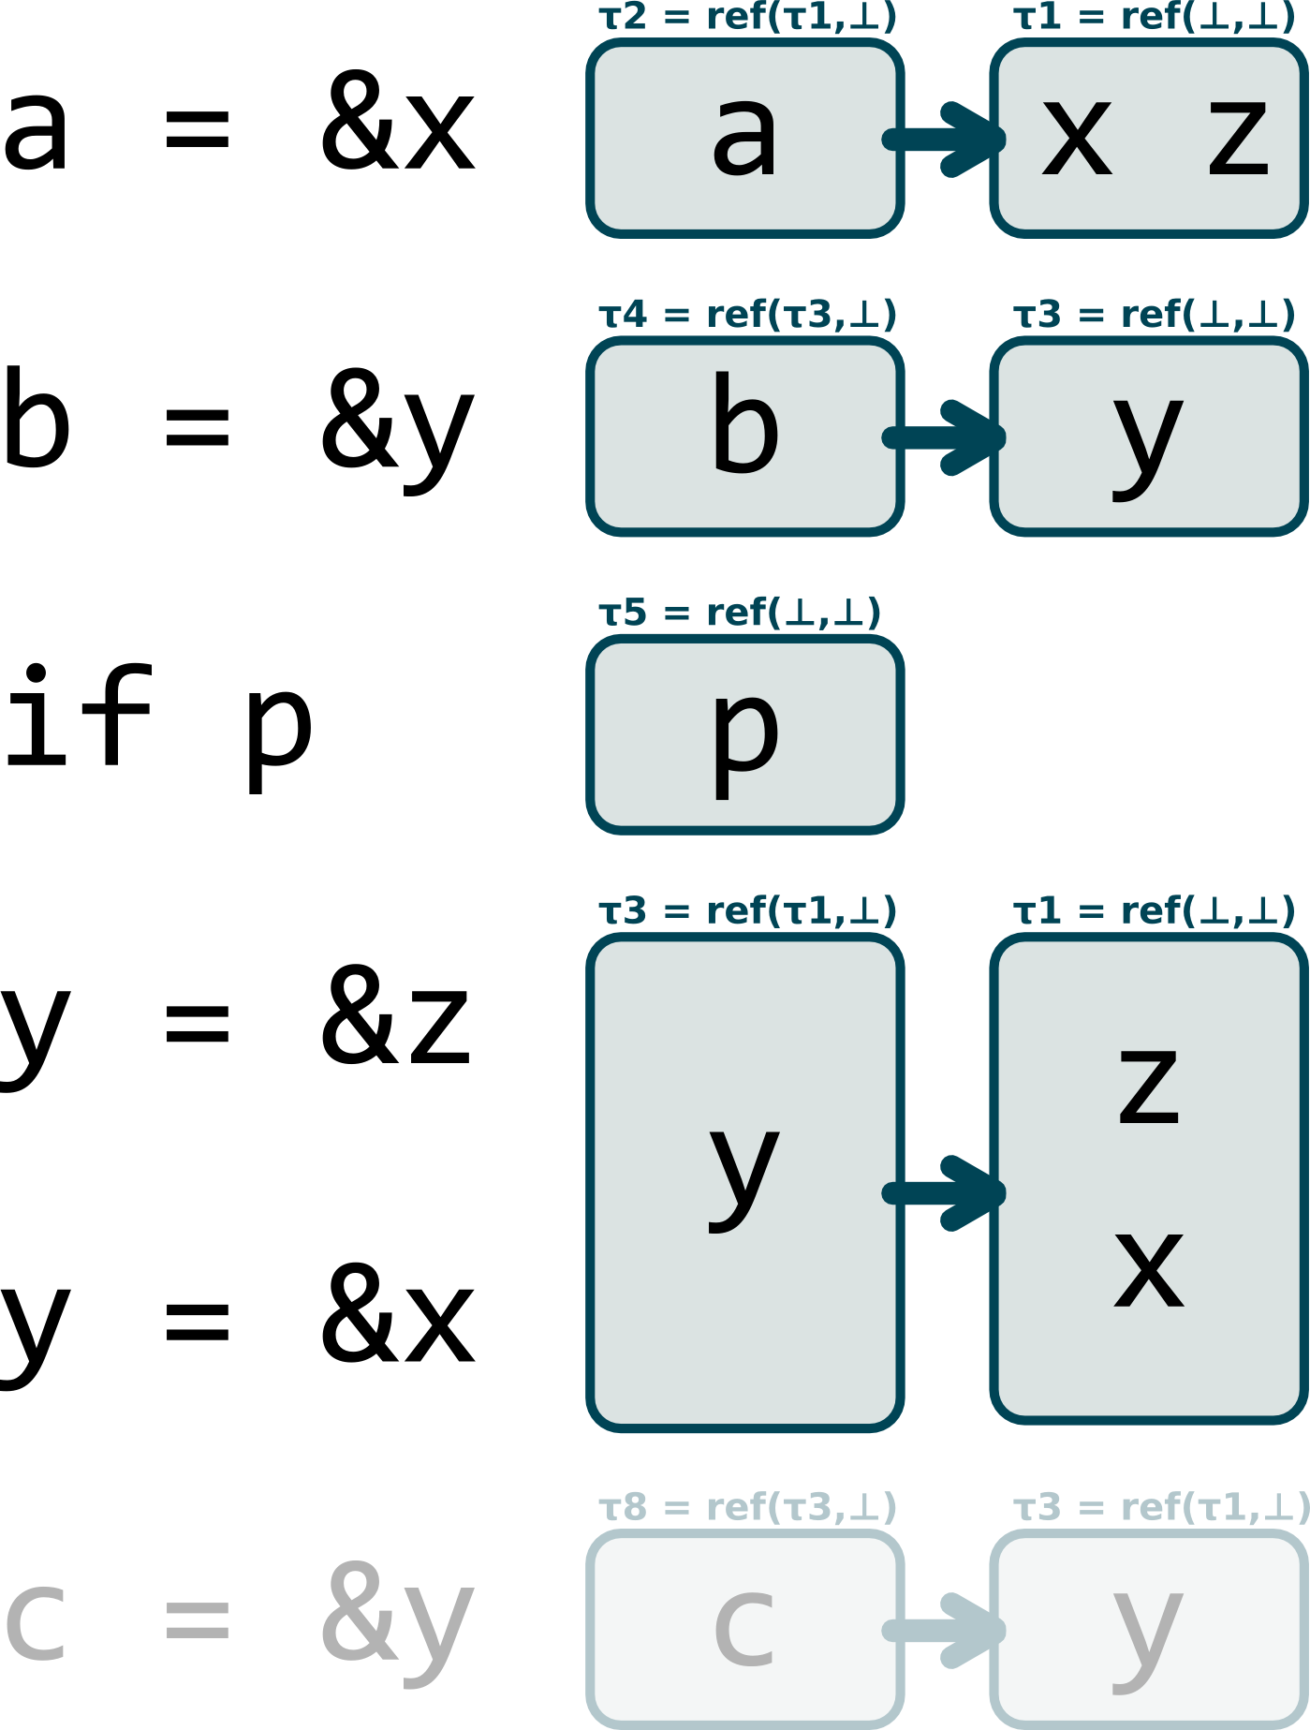
Example

Slide 11
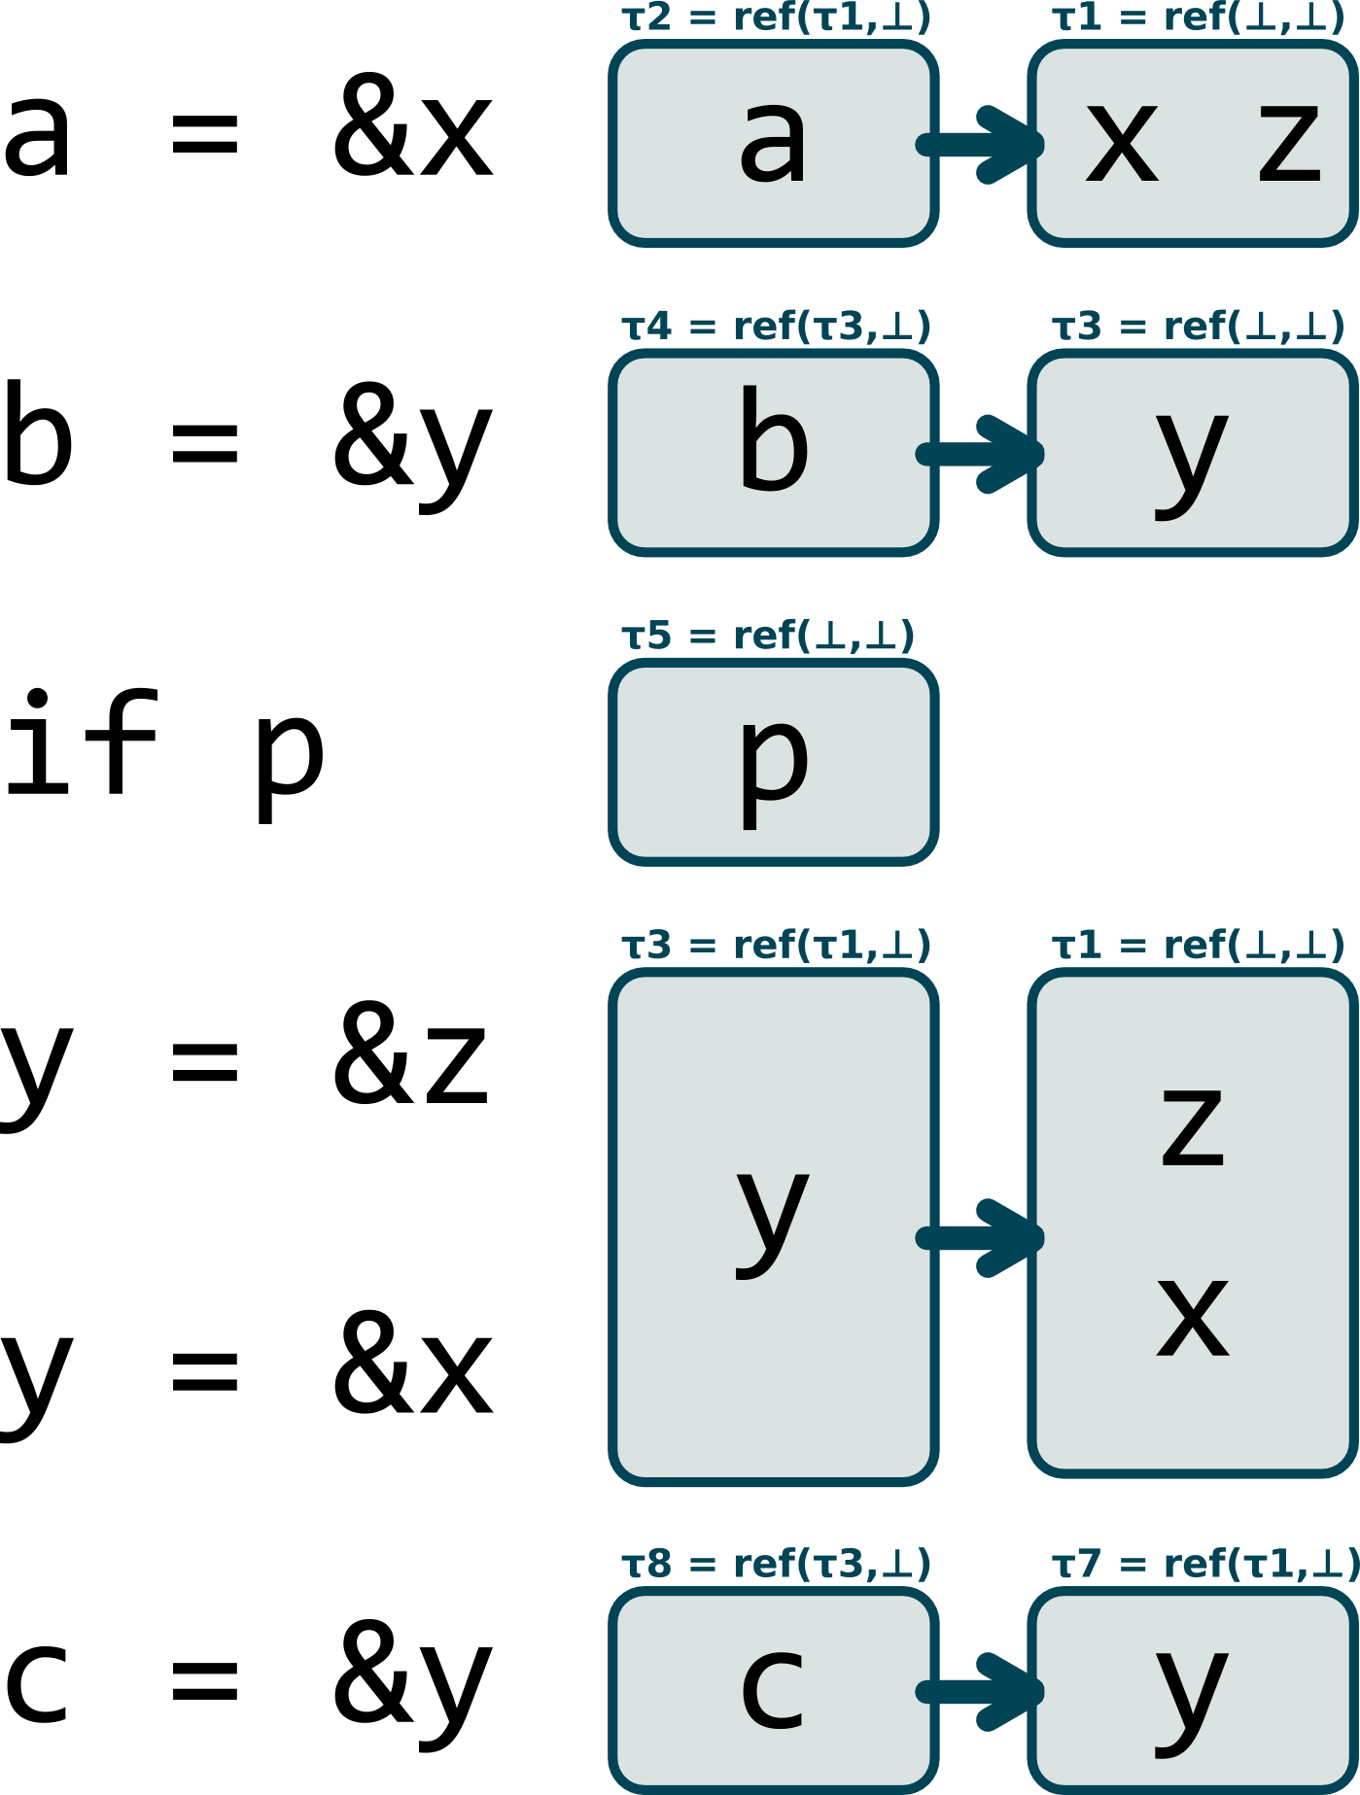
Example

Slide 12
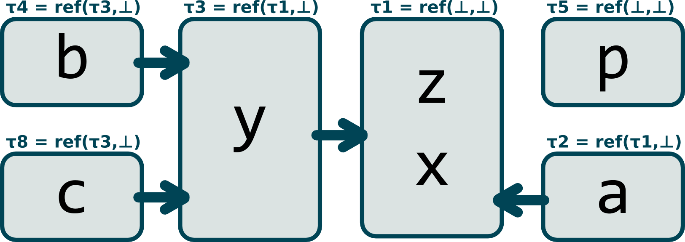
Example
pts(b) = pts(c) = {y}
pts(a) = pts(y) = {x, z}
x, y, p have no pts information

Slide 13
Final Points to Set
pts(b) = pts(c) = {y}
pts(a) = pts(y) = {x, z}
x, y, p have no pts information

Slide 14
Disadvantages
Equality constraints results in no distinction between x = y and y = x
Unifies all function arguments and return types
  a = alloc(); b = alloc(); x = alloc(); y= alloc();
  f(a, b);
  f(x, y);
  The unifier will wrongly state that a and x alias as well as b and y.
Does not model aggregates

Slide 15
Advantages
Fast : uses union-find data structure to implement unification in almost linear time
Basic modeling of pointer arithmetic (p++)

