Slide 1

Points-to Analysis in Almost Linear Time
Bjarne Steensgaard
Presented by Abdul Dakkak

Slide 3

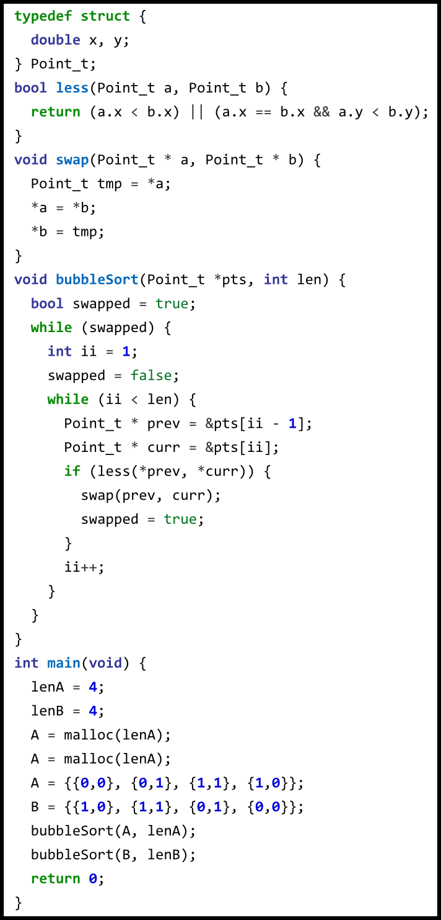
Bubble Sort
Declare a Point structure
Swap elements if two points are lexographically less than each other
In main: allocate two lists and perform bubble sort on them

Slide 4

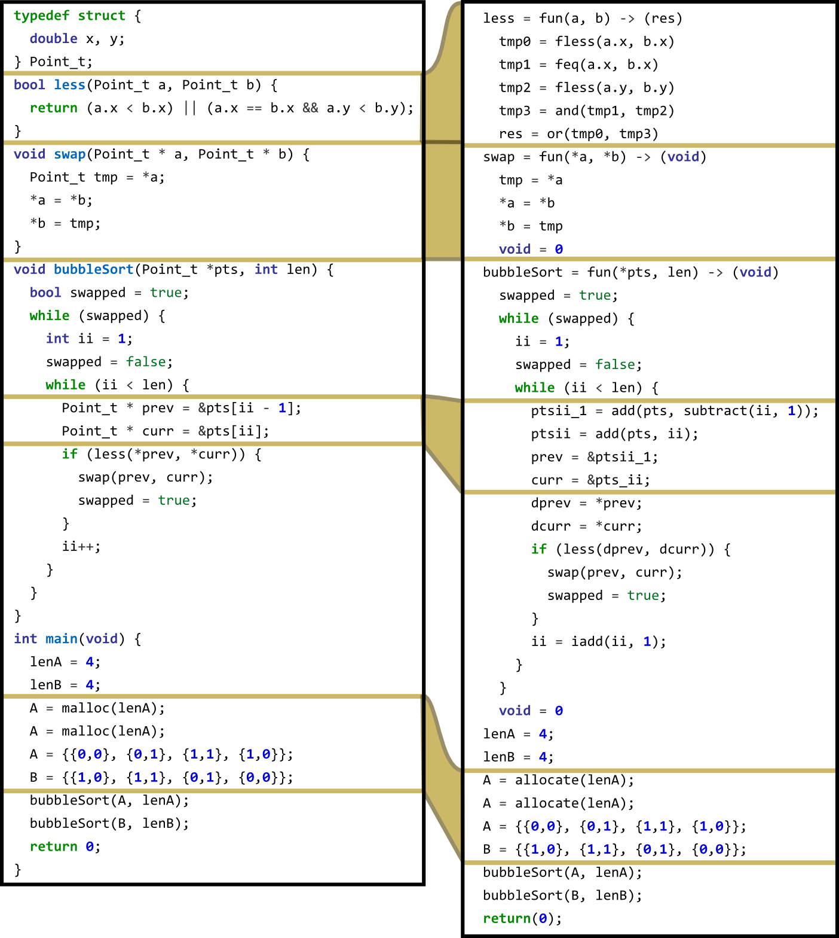
Translating into Steensgaard's Language
Models C language
C pointer operations can be desugared
S ::= x = y
| x = &y
| x = *y
|*x = y
| x = op(y...)
| x = allocate(y)
| x = fun(a...) -> (r...) S*
| x... = p(a...)

Slide 5

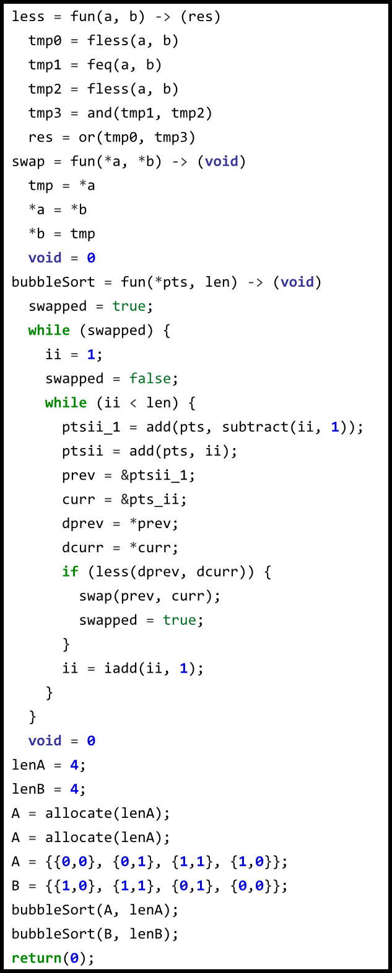
Bubble Sort
No aggreate types
Struct accessors flattened
Pointer operations desugared to function calls
Malloc converted to allocate
Void return converted to use a dummy variable

Slide 6
Algorithm Outline
Traverse the instructions from top to bottom
At each point

Slide 7
Author's Conclusions

Slide 8
Conclusion

