Slide 1
BODY MASS INDEX
(BMI) CALCULATOR
AMEENUDEEN A - 24MCA002

Slide 2
ABSTRACT
The BMI (Body Mass Index) Calculator project is a web-based application developed using the MERN stack — MongoDB, Express.js, React.js, and Node.js. The primary goal of this project is to help users easily calculate their BMI and assess their body weight category based on standard health guidelines. The system allows users to input their height and weight, and it dynamically computes the BMI value, categorizing it as underweight, normal, overweight, or obese. The application’s frontend, built with React.js, provides an interactive and user-friendly interface, ensuring a seamless user experience. The backend, powered by Node.js and Express.js, manages all requests efficiently, while MongoDB is used to store user data and BMI history securely. This enables users to track their BMI records over time and monitor their health progress. The project emphasizes responsive design, real-time calculations, and data persistence for long-term health monitoring. It can be further enhanced with additional features such as authentication, health recommendations, and data visualization. Overall, the BMI Calculator using the MERN stack serves as a reliable, scalable, and modern solution for promoting personal health awareness through technology.

Slide 3
INTRODUCTION
The BMI (Body Mass Index) Calculator is a simple web application built using the MERN stack— MongoDB, Express.js, React.js, and Node.js. This application allows users to enter their height and weight and instantly get their BMI value along with the corresponding health category. The project shows how the MERN stack can be used to create a basic full-stack application with a clean user interface, a functional backend, and optional data storage. It helps users quickly understand their body status and promotes health awareness through an easy-to-use online tool.

Slide 4
EXISTING SYSTEM
BMI is often calculated manually or using simple online tools.
Most existing calculators only provide the BMI value without detailed insights. No user login or personalized experience.
User data is not stored—requires re-entering details every time. No history tracking or trend analysis.
Interfaces are basic and not very interactive.
No backend system for data management or analytics. Limited accessibility and features.

Slide 5
PROPOSED SYSTEM
A complete web-based BMI Calculator built using the MERN stack. Simple and responsive user interface created with React.js.
Backend APIs built with Node.js and Express.js for smooth data handling. MongoDB database to store user details and BMI history.
Instant BMI calculation with clear category results.
Provides insights such as underweight, normal, overweight, or obese. Allows users to track previous BMI records over time.
Offers a personalized and user-friendly experience.
Secure and scalable system architecture using MERN technologies. More reliable and modern than traditional manual or basic tools.

Slide 6
MODULE DESCRIPTION
USER MODULE:
The User Module is responsible for managing all user-related activities within the BMI Calculator system. It allows users to enter their personal details such as name, age, height, and weight, which are essential for generating accurate BMI results. In more advanced implementations, this module also supports user registration, login, and authentication to ensure that only authorized users can access their data. The module directly interacts with the frontend interface built using React.js and communicates with the backend server to store, update, or retrieve user data from MongoDB.
Features:
User registration with email and password Secure login functionality
Frontend form validation for all required fields
Authentication handled using backend APIs with JWT (JSON Web Token) Error handling for invalid or incorrect credentials
Ability to update user profile details
Fetching and saving personal health information (height, weight, age)

Slide 7
MODULE DESCRIPTION
HISTORY MODULE:
The History Module is responsible for storing, managing, and displaying the past BMI records of each user. Every time a user calculates their BMI, the system saves the result along with details such as height, weight, date, and BMI category. This module allows users to track their health progress over time by viewing previous entries in an organized format. It directly interacts with the backend to fetch and display stored records and uses MongoDB to maintain a complete history for each authenticated user. The module enhances user experience by offering clear insights into long-term BMI trends.
Features:
Automatic saving of BMI results after each calculation
Stores details such as height, weight, BMI value, category, and timestamp Fetches past BMI records from MongoDB for logged-in users
Displays history in a clean, user-friendly table or list Allows users to compare current and past BMI values Provides visual insights (optional charts/graphs)

Slide 8
MODULE DESCRIPTION
STATUS MODULE:
The Status Module is responsible for determining and displaying the BMI category based on the BMI value calculated by the system. Once the user enters height and weight, and the BMI is computed, this module classifies the result into predefined health categories such as Underweight, Normal, Overweight, or Obese. The module helps users quickly understand their health status and provides meaningful insights. It interacts with both the calculation logic and the frontend interface to show clear, easy-to-read status messages.
Features:
Displays clear status messages such as: Underweight
Normal Weight Overweight Obese

Slide 9
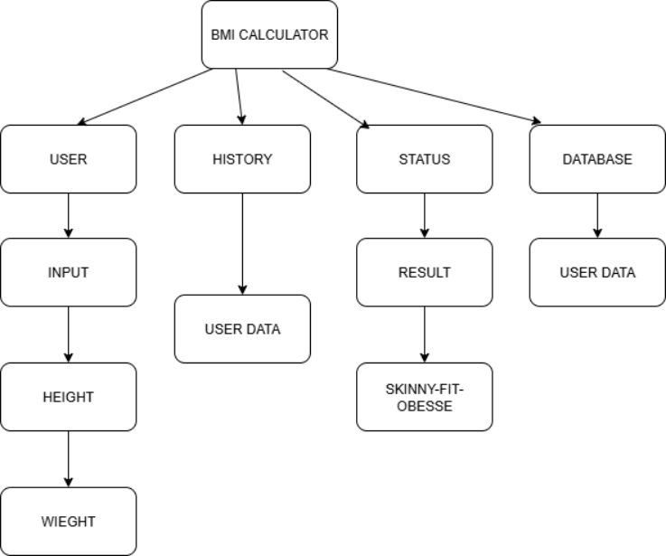
ARCHITECTURE DIAGRAM

Slide 10
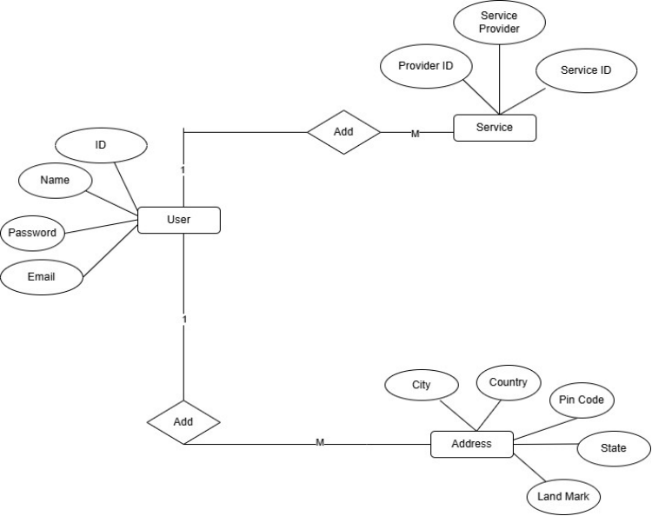
ER DIAGRAM

Slide 11
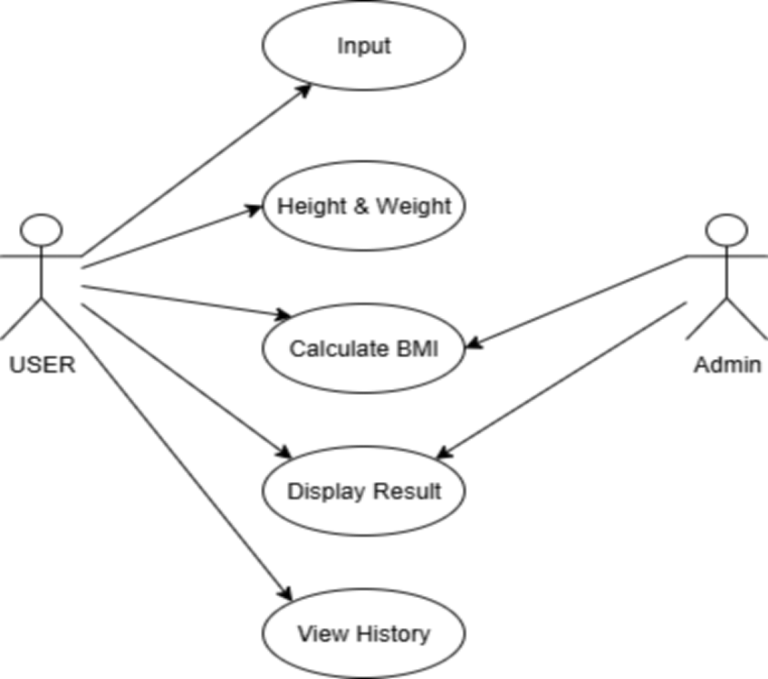
USECASE DIAGRAM

Slide 12
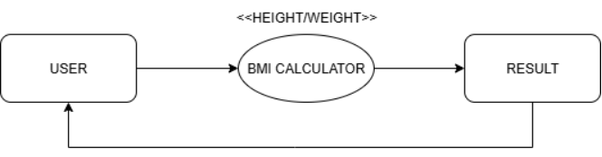
DATA FLOW DIAGRAM
DFD LEVEL: 0

Slide 13
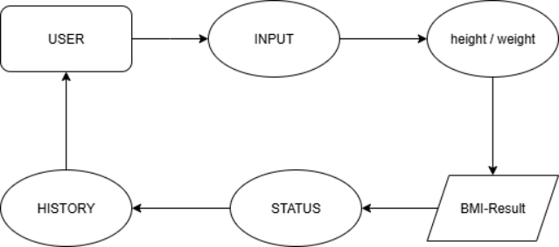
DATA FLOW DIAGRAM
DFD LEVEL: 1

Slide 14
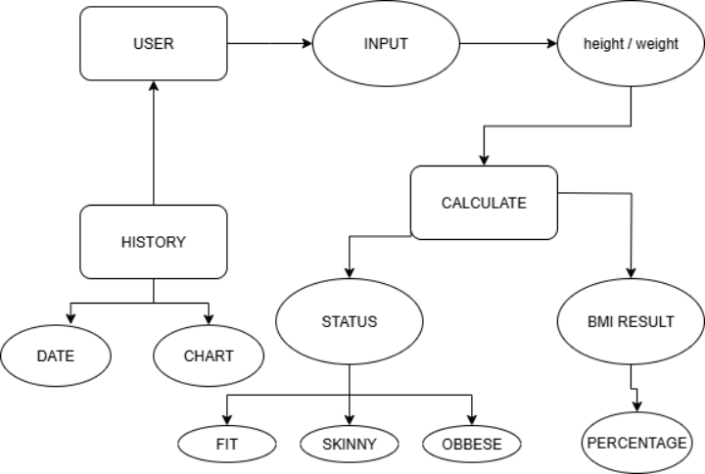
DATA FLOW DIAGRAM
DFD LEVEL: 2

Slide 15
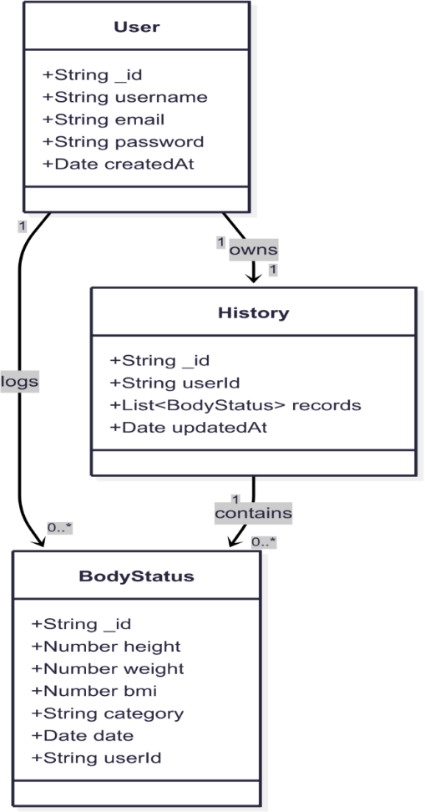
CLASS DIAGRAM

Slide 16
HARDWARE REQUIREMENTS
Processor: Dual-Core 2.0 GHz or higher
RAM: 8 GB or more
Storage: Minimum 100 GB of available space
Network: Stable high-speed internet connection.
SOFTWARE REQUIREMENTS
Operating System: Windows 11
Frontend: React.js (using Vite for bundling) Backend: Node.js with Express.js Database: MongoDB
Browser: Chrome, Firefox, or Edge
Code Editor: VS Code or any preferred IDE

Slide 17
FUTURE ENHANCEMENT
The BMI Calculator system can be improved and expanded in several ways to provide users with a more comprehensive health-tracking experience. Future enhancements may include integrating additional health metrics such as body fat percentage, muscle mass, and daily calorie requirements for a more accurate assessment of overall fitness. The system can also introduce personalized diet and workout recommendations based on the user’s BMI category and age group.Advanced features such as graphical trend analysis, AI-based health suggestions, and integration with wearable devices like smartwatches or fitness bands can make the application more intelligent and user-friendly. The addition of real-time notifications, reminders for periodic BMI checkups, and multi-platform support through mobile apps can further enhance usability. Implementing advanced authentication methods, such as biometric login or OAuth-based social logins, can make the system more secure and convenient.Overall, these enhancements aim to transform the basic BMI Calculator into a more robust health monitoring and wellness application.

Slide 18
CONCLUSION
The BMI Calculator project aims to provide users with a simple,efficient, and responsive tool to monitor their health throughthe calculation of their Body Mass Index. Developed using theMERN stack (MongoDB, Express.js, React.js, Node.js), theapplication allows users to register, log in, input their height andweight, and instantly receive their BMI value along with anappropriate health category (such as Underweight, Normal,Overweight, or Obese)

Slide 19
THANK YOU

