Slide 1
Furniture Business Dashboard
Cash Flow, Sales Analysis & Production Insights

Slide 2
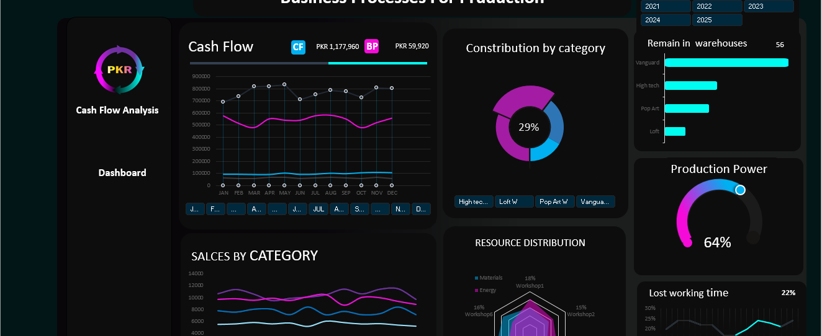
Cash Flow Analysis Report
Sir, this is the dashboard report for Furniture's cash flow (the remaining amount after receiving and spending cash); this report covers the period from 2018 to 2025; in this report, we will provide you with detailed data and charts about cash flow; business plan; sales by category; remaining items in the warehouse; power production; and lost working time

Slide 3
01
Cash Flow

Slide 4
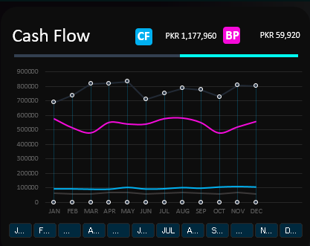
Our Cash Flow of 2018-2025
First of all, let me explain about cash flow; it refers to the amount of cash remaining after receiving payments from customers and spending on things like bills and employee salaries; this remaining amount is called cash flow; the business plan represents our expectations; these lines show the earnings how much we are earning; the blue line represents the cash flow, and the pink line represents the business plan; at the bottom, there are months displayed when we click on a month, the detailed information for that month will appear.

Slide 5
02
Distribution By Category:

Slide 6
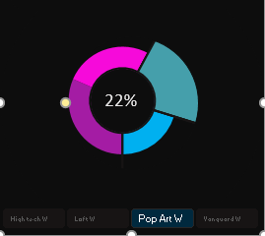
There are basically four categories of furniture These four categories in our furniture business are: High Tech, Loft, Pop Art, and Vanguard. We have provided the selling percentage for each category. When you click on any furniture category, its percentage will be displayed. When combined, all the percentages will make up 100% of the total sales production.
Distribution By Category:

Slide 7
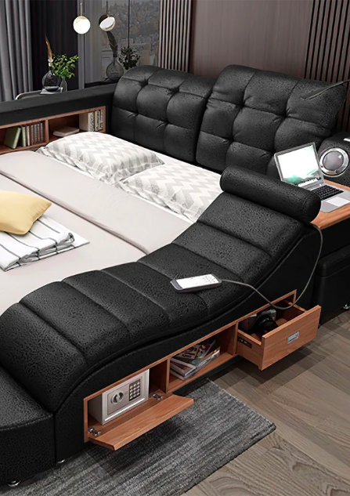
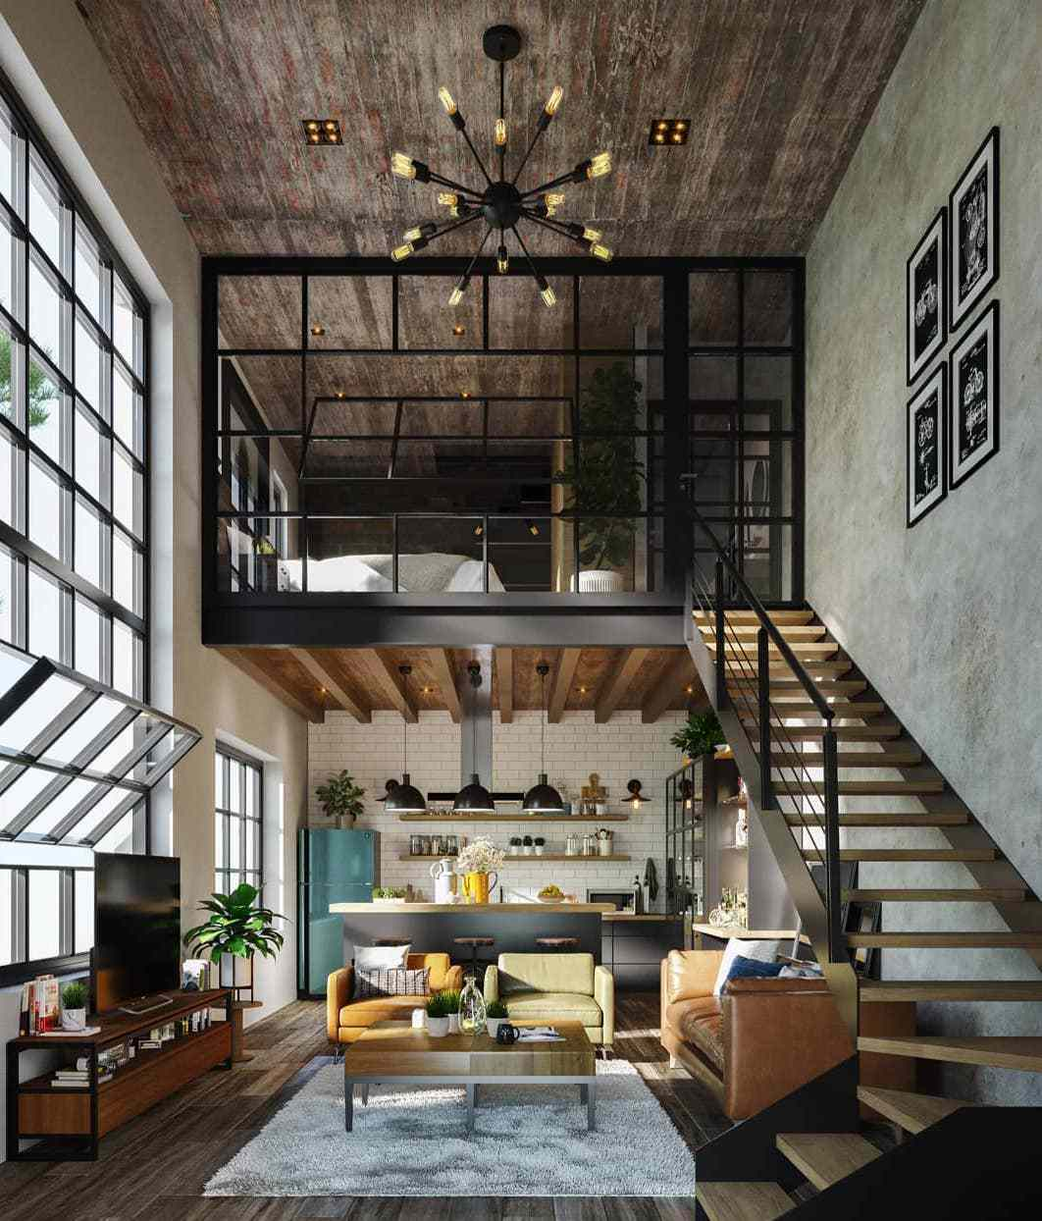



This are the four Categories
High Tech
Loft
Pop art
Vanguard

Slide 8
03
Remain in Warehouses

Slide 9
Remain in Warehouses
03

Slide 10
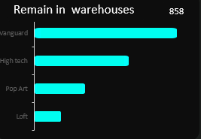
Remaing in Warehouse
There are four categories of furniture that are currently in our warehouse but have not yet been sold. We are in the process of evaluating the demand for these items. Depending on the market response, we will consider targeted promotional strategies to improve their sales performance.

Slide 11
Production Power
04

Slide 12
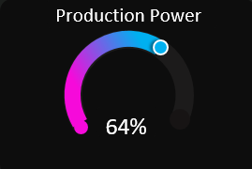
Production Power
This represents our production capacity — in other words, the speed or volume at which we can manufacture furniture within a selected year. Based on the chosen timeframe, our production power will be calculated accordingly.

Slide 13
Sales By Category
05

Slide 14

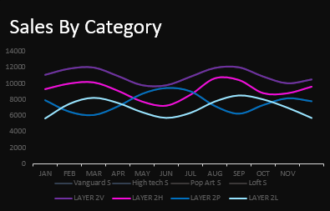
Sales By Catégories
This chart displays the sales data for four furniture categories, along with their respective prices. Each line on the line chart represents a distinct category, helping to visualize sales trends over time

Slide 15
Resource Distribution
06

Slide 16
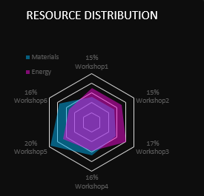
Resource Distribution
This chart displays two primary resource categories: Energy and Materials, with a focus on workshop operations.
Energy:
Tracks energy consumption across 6 workshops
Suggests workshops are relatively energy-efficient, but deeper drill-down by workshop type may reveal optimization opportunities.
Materials:
Represents the bulk of resources
Includes raw materials, equipment, or tools used in production.

Slide 17
Lost Working Time
07

Slide 18
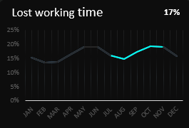
Lost Working Time
This represents the working hours that were lost at our workshop. These losses may have resulted from unplanned downtime, operational delays, or resource-related issues.

Slide 19

Conclusions
The deep dive into cash flow and sales performance reveals significant areas for improvement and strategic action. Winning strategies include focusing on top-selling categories, understanding consumer behavior, and optimizing operational efficiencies to sustain growth. This approach aligns resources with demand, paving the way for increased profitability.

Slide 20
Thank you!
Do you have any questions?

