Slide 1

REALTIME PHISHING ATTACK DETECTION USING MACHINE LEARNING
Team members: guide:
ABDUL GHANI(15W91A0501), b. Sindhuja(15w91a0509), k. Sai amulya(15w91a0523) Dr. kiran kumar reddy

Slide 2
abstract
Today, there is an exponential growth of e-services requiring the exchange of personal and sensible information over the Internet. Phishing techniques are emerging as the easiest solution to break the weakest link of the security chain: the end user. Social engineering attacks are deployed by financial/cyber criminals at a very low cost to induce naïve Internet users to reveal user ID, passwords, bank account and credit card numbers. This problem needs to be addressed in the mobile field as well, due to the large diffusion of mobile platforms such as smartphones, tablet, etc. To overcome this problem we propose a framework for phishing detection in Android mobile devices which, on the one hand exploits well-known techniques already implemented by popular web browsers plug-in, such as public blacklist search, and, on the other hand, implement a machine learning based engine to ensure zero-hour protection from new phishing campaigns.

Slide 3

Existing system
The phishing detection system is confined to Google Chrome Browser. It uses Google’s Safe Browsing Database to warn user before entering a possible phishing site.

Slide 4
Disadvantages of existing system
Although, it protects user from entering into phishing sites on Chrome Browser, it fails to do so on other browsers.
It cannot detect newly created phishing sites (Someone has to report it)
Doesn’t work in other mobile browsers
Doesn’t scan all the links opened by the device(Mobile)
Cannot intercept all network traffic like GET requests.

Slide 5

Proposed system
To overcome the drawbacks of existing system, we propose a framework RPAD-ML (REALTIME PHISHING ATTACK DETECTION USING MACHINE LEARNING).
It is based on Machine learning classification model and can detect phishing attacks in mobile in realtime.
RPADML

Slide 6
Advantages of proposed system
Detects phishing attacks even on mobile devices
It is not limited to one browser; can work on all browsers
Not confined to browsers, scans links in other apps too.
Detects all the network traffic and intercepts phishing sites.

Slide 7
Hardware requirements
Processor : Intel I3 or greater
RAM : 8GB
Hard Disk : 50GB

Slide 8
Software requirements
Server Operating System : Linux 16.04 LTS
Web Server : Python Flask 1.0.2
Backend Language : Python 3.7
Database : MongoDB 4.0
Modeling Tool : Weka 3.8.3
Client Operating System : Android 5.0+

Slide 9
System architecture
Database
Client
(Android)
Request
Server
Machine Learning Model
Response
Google API

Slide 10
System modules
API: Provides interface to connect with backend server and call different functions.
Machine Learning Model: Uses classification model to predict if a site is phishing site or not.

Slide 11
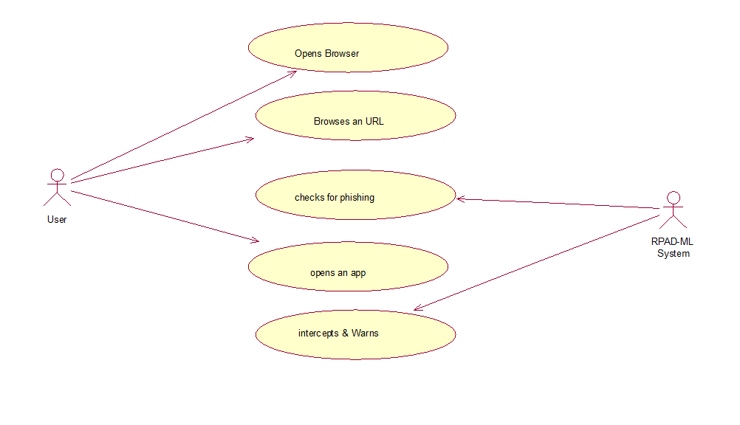
Usecase diagram

Slide 12
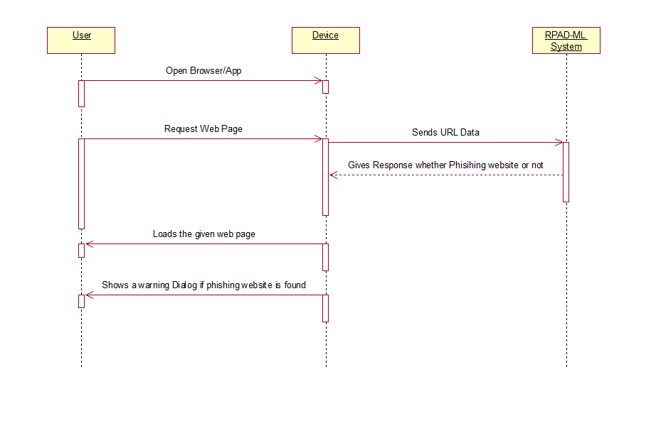
Sequence diagram

Slide 13
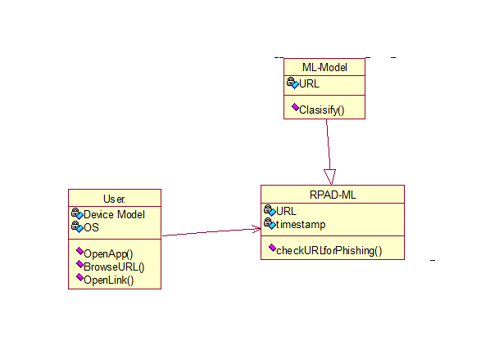
Class diagram

Slide 14
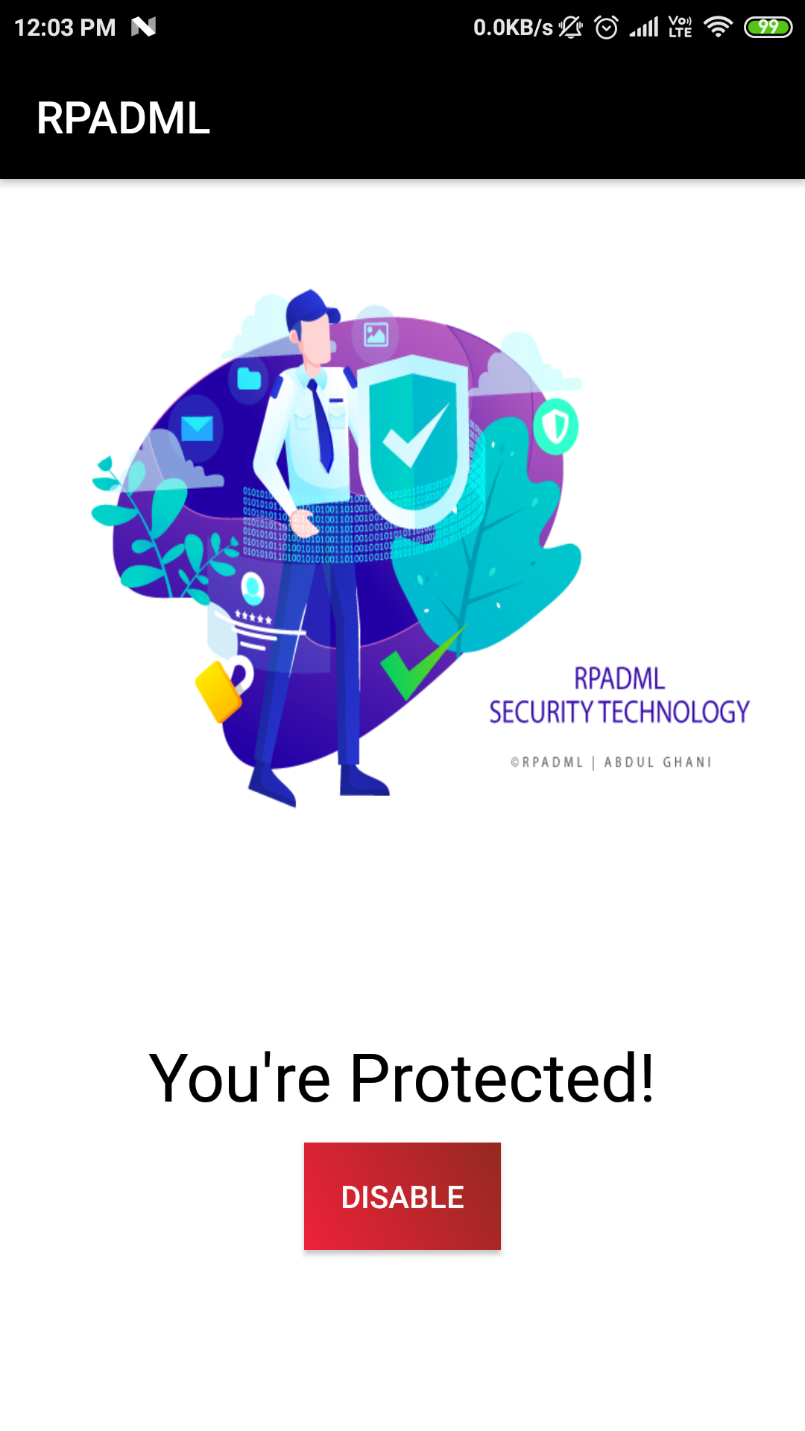
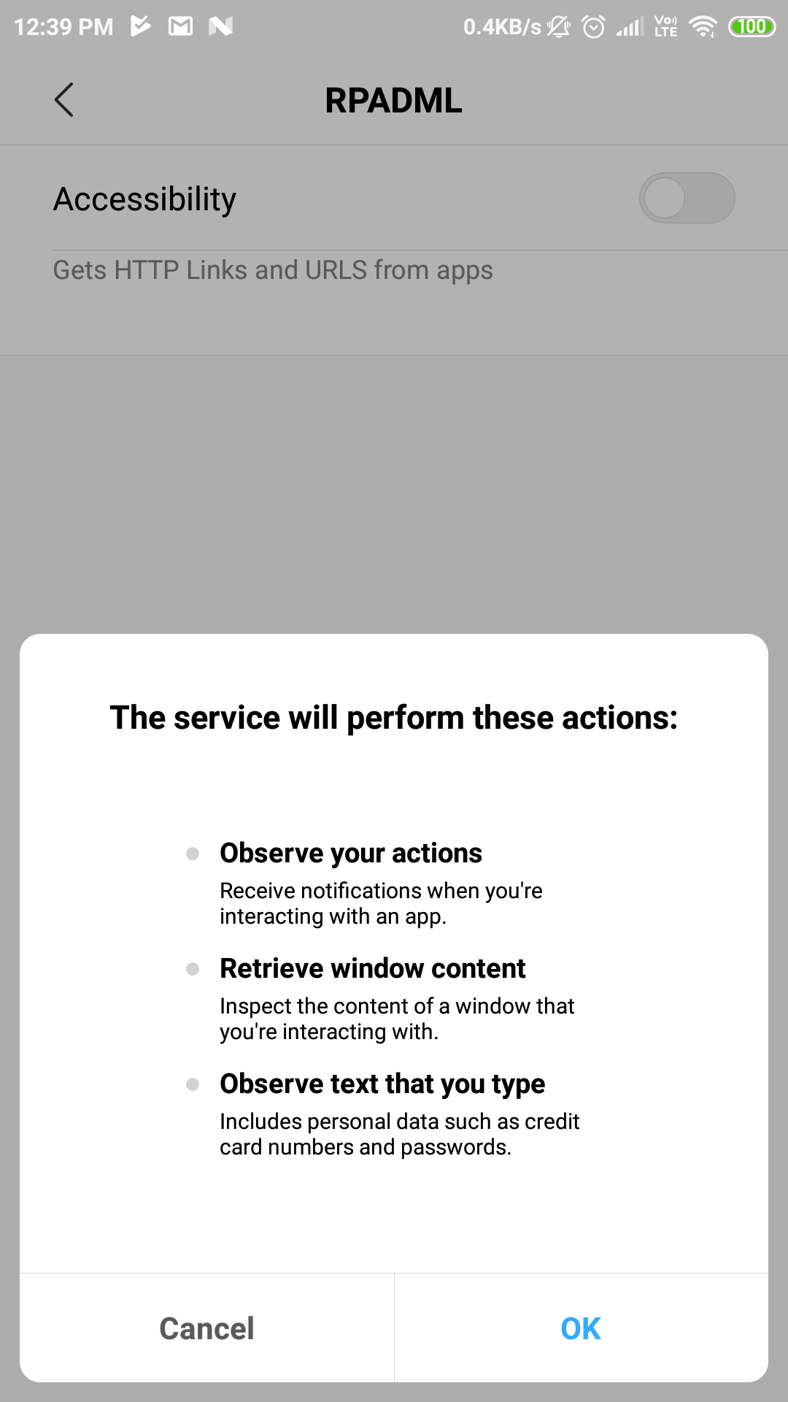
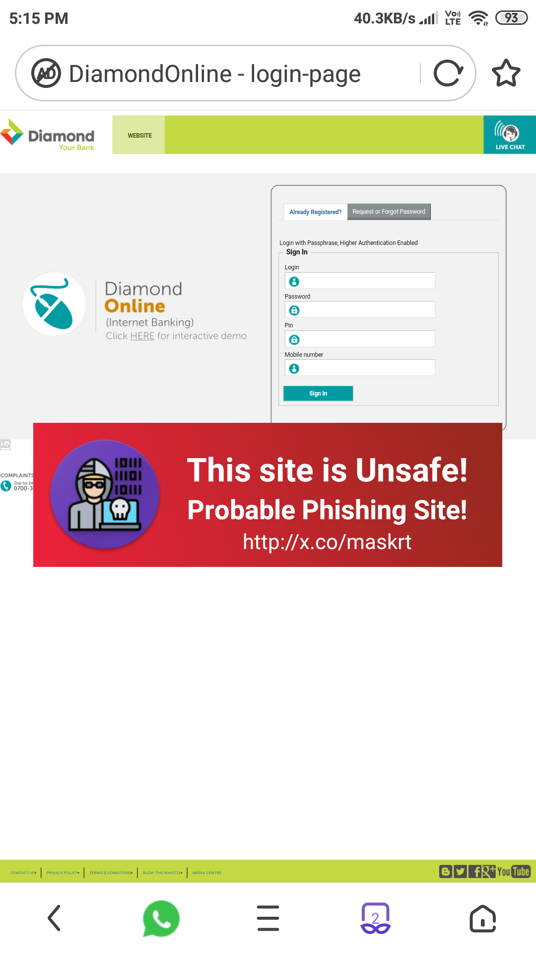
results

Slide 15
Conclusion
By using RPADML system, we solve the problem of detecting phishing sites on mobile devices in real-time. Now, the users are able to identify phishing sites/links without interacting. RPADML system itself shows floating warning sign before entering such websites.

Slide 16
Future enhancements
Adding compiled machine learning model in local devices
Increasing the efficiency of API i.e., Response Time by leveraging Server Resources
Ability to report false-positive results.
Better garbage management in client device.

Slide 17

Thank You
Team RPADML

