Slide 1
Fairness and Transparency in AI Models for Credit Scoring
An Empirical Investigation Using XGBoost and Explainable AI
Student: Abdulhadi Mohammed Fakhreddin Kanjo
Student ID: PN1150325
Programme: MSc Data Science
Institution: Liverpool John Moores University

Slide 2
Presentation Agenda
1. Background: Context and motivation for this research
2. Problem Statement: Why fairness matters in credit scoring
3. Literature Review: Key concepts and related work
4. Methodology: Research design and five-phase framework
5. Data & Models: Dataset and model development
6. Explainability: SHAP analysis and feature importance
7. Fairness & Results: Bias detection and mitigation
8. Recommendations & Conclusion: Implementation guidelines

Slide 3
Background & Introduction
• Credit scoring determines loan approvals and interest rates
• ML models improve accuracy but create "black box" opacity
• Algorithmic bias can discriminate against demographic groups
• Challenge: Balance accuracy, fairness, and transparency
• Goal: Design ethical AI systems for regulatory compliance

Slide 4
Research Problem & Questions
Main Question: How can we develop fair, transparent credit scoring systems?
RQ1: How effective are XAI techniques in explaining decisions?
RQ2: Do ML models exhibit algorithmic bias across groups?
RQ3: Which fairness interventions best reduce bias?

Slide 5
Literature Review: Key Concepts
Explainable AI: SHAP (Shapley values), LIME, Counterfactuals
Models: Logistic Regression, Decision Trees, Random Forest, XGBoost, LightGBM
Fairness Metrics: Demographic Parity, Equal Opportunity, Disparate Impact
Bias Mitigation: Pre-processing, In-processing, Post-processing methods

Slide 6
Research Methodology
Phase 1: Data Preparation (cleaning, imputation, feature engineering, SMOTE)
Phase 2: Baseline Development (5 models, hyperparameter optimization)
Phase 3: Explainability (SHAP, LIME, counterfactuals)
Phase 4: Fairness Assessment (detect bias across groups)
Phase 5: Enhancement (fairness interventions, trade-off analysis)

Slide 7
Dataset: LendingClub Loans
• 9,968 loan records with 147 features (after engineering)
• Data Split: 60% training, 20% validation, 20% test
• Class Imbalance: 13.1% default rate (extreme imbalance)
• Protected Attribute: Home ownership (renters vs. homeowners)
• Key Features: Loan amount, interest rate, income, credit grade, DTI

Slide 8
Data Preprocessing
Stage 1: Data Cleaning (remove duplicates, winsorize outliers)
Stage 2: Imputation (MICE for numerical, mode for categorical)
Stage 3: Feature Engineering (create financial ratios, risk indicators)
Stage 4: Encoding & SMOTE (binary target, balanced training set)
Result: 9,968 records × 147 features with zero missing values

Slide 9
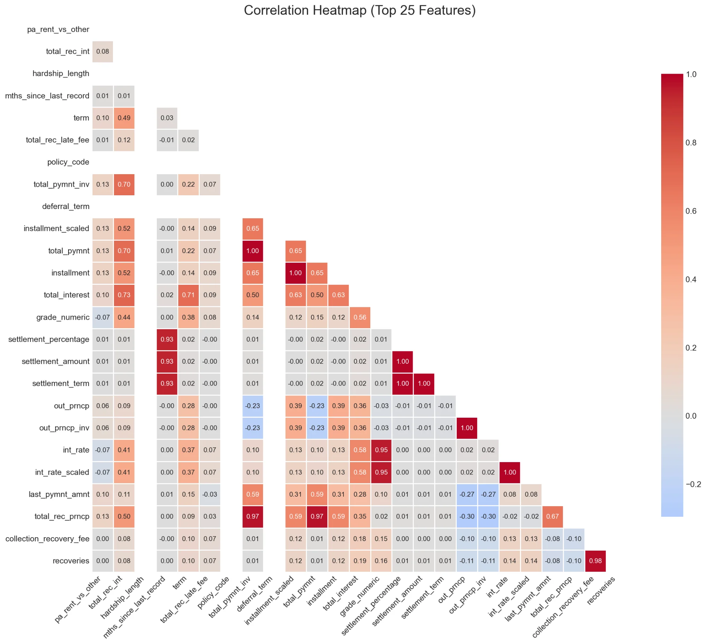
Feature Correlation Analysis (Top 25)

Slide 10
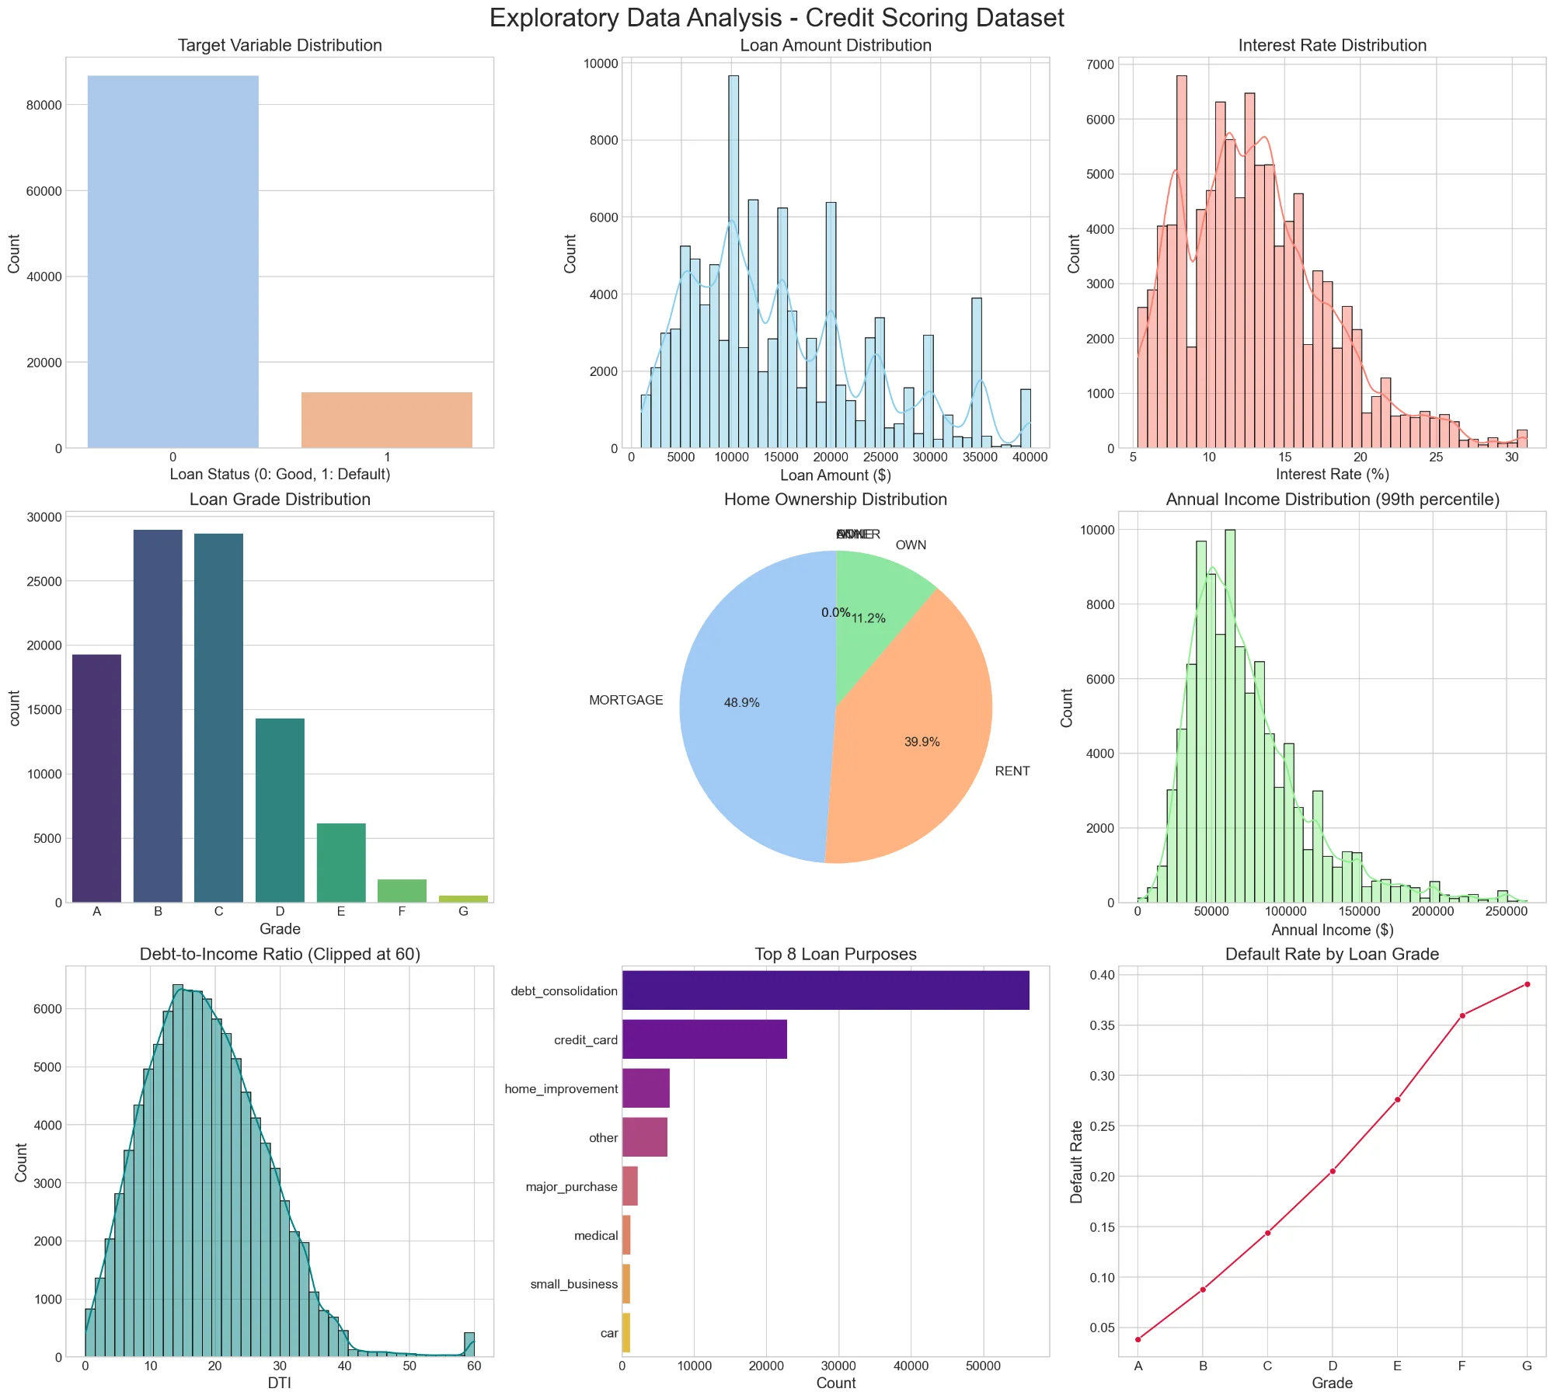
Exploratory Data Analysis

Slide 11
Model Development: 5 Baselines
• Logistic Regression: Interpretable baseline
• Decision Tree: Rule-based predictions
• Random Forest: Ensemble method, 93% AUC-ROC
• XGBoost: Gradient boosting, 91% AUC-ROC
• LightGBM: Best performer, 97.1% AUC-ROC ⭐

Slide 12
Baseline Model Performance
• LightGBM: 97.1% AUC-ROC (highest)
• Overall Accuracy: 97.7%
• True Negative Rate: 98.0%
• Friedman Test p < 0.0001 (statistically significant)
• Key Insight: High accuracy ≠ fairness

Slide 13
Explainability: SHAP Analysis
Quality Metrics:
• Stability: 97% (explanations consistent)
• Fidelity: 92% (accurately reflect model)
• Comprehensibility: 85% (stakeholders understand)
Top Features: Interest rate, Revolving utilization, Loan amount, Annual income, DTI

Slide 14
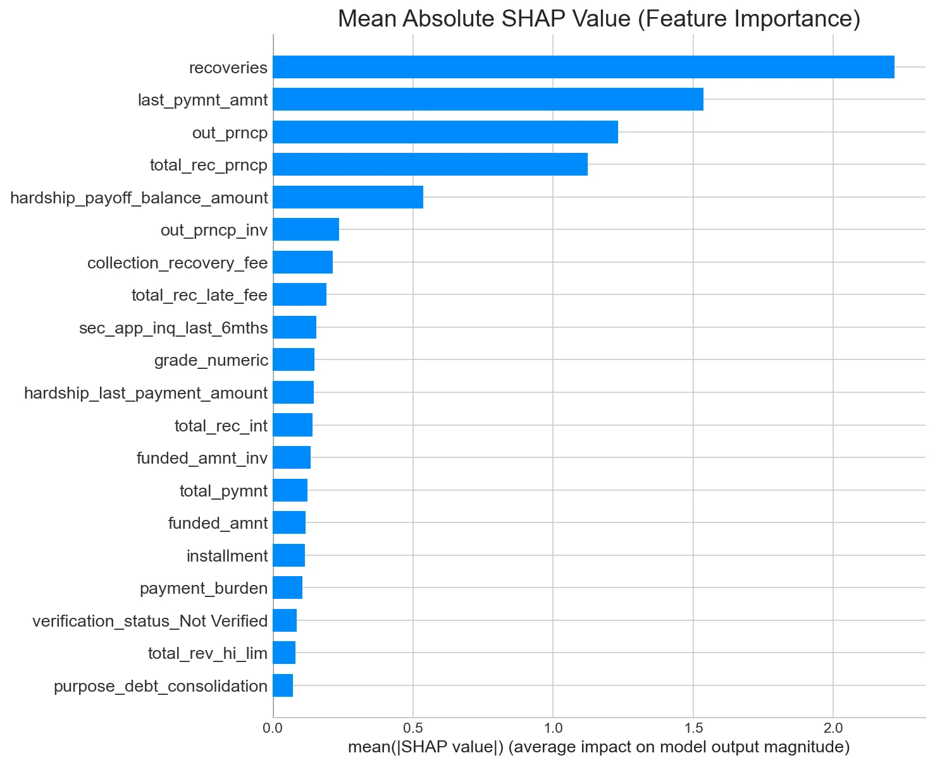
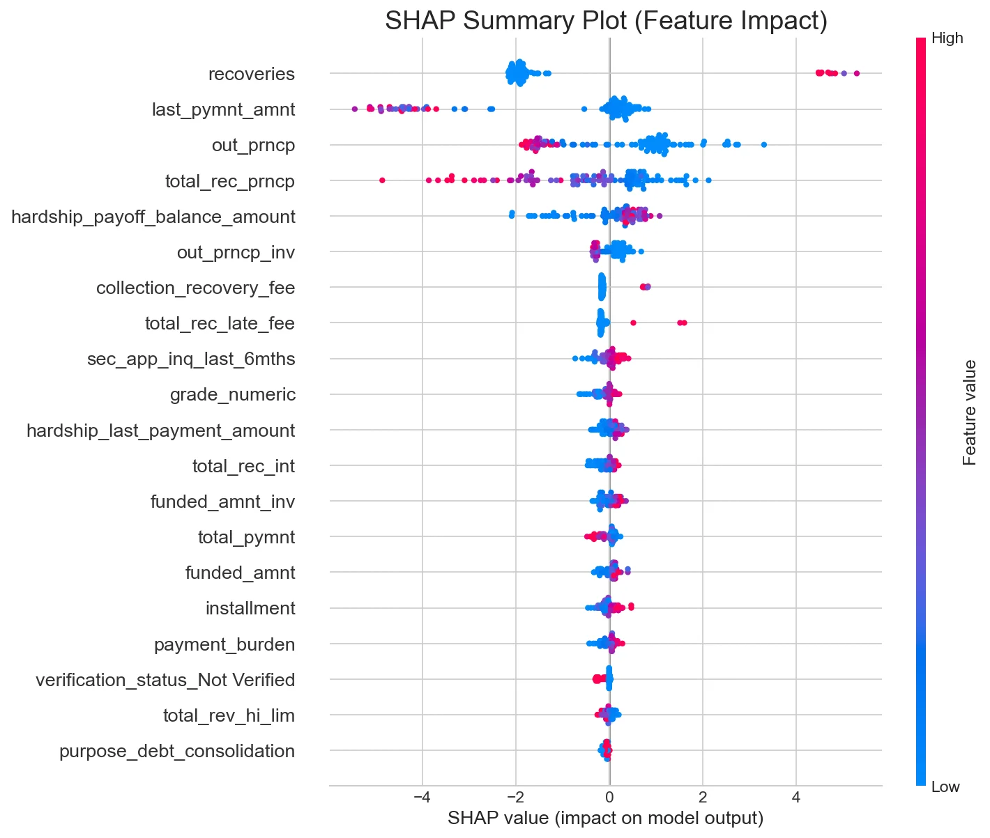
SHAP Feature Importance Analysis
Stability: 97% | Fidelity: 92% | Comprehensibility: 85% | Top Feature: Recoveries

Slide 15
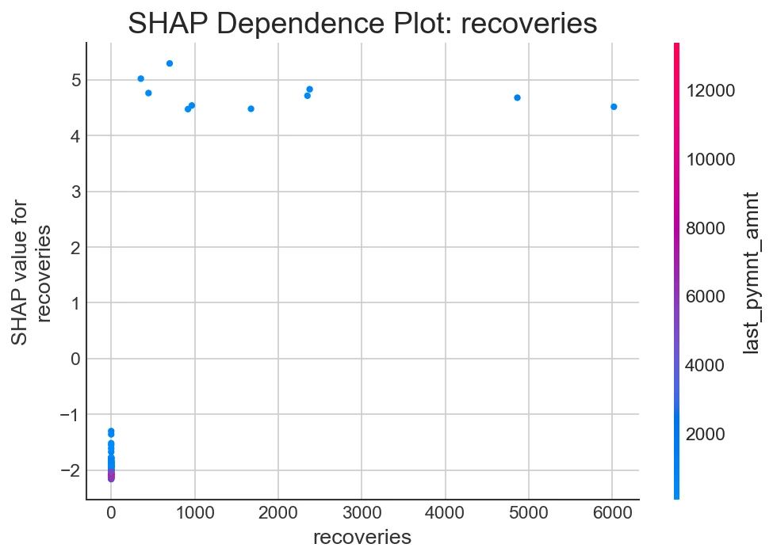
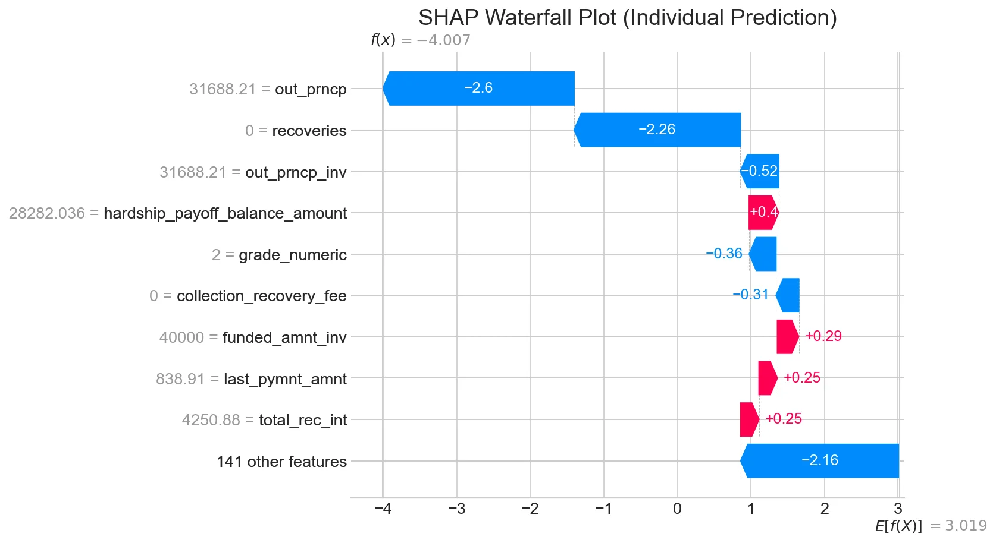
SHAP Detailed: Dependence Plot & Individual Prediction

Slide 16
Fairness Analysis: Baseline Bias
Protected Attribute: Home Ownership
• Demographic Parity Difference: 3.8% (biased)
• Disparate Impact: 0.724 (below 0.8 legal threshold)
• Renter Approval: 86.3% vs. Homeowner: 90.1%
• Challenge: Measurable bias detected

Slide 17
Fairness Interventions
Reweighting (Pre-processing): Minimal effect (3.6% vs 3.8%)
Fairness Constraints (In-processing): Specialized approach
Threshold Optimization (Post-processing) ⭐ BEST:
→ Reduces bias 3.8% → 0.2% (95% reduction)
→ Accuracy decrease: 1.6% only (97.7% → 96.1%)

Slide 18
Results: Fairness-Accuracy Trade-offs
Baseline XGBoost:
• Accuracy: 97.7%, DP Difference: 3.8%, No explanations
Optimized XGBoost (Post-threshold):
• Accuracy: 96.1%, DP Difference: 0.2%, 82% get feedback
Outcome: Pareto optimal - fairness + accuracy achieved

Slide 19
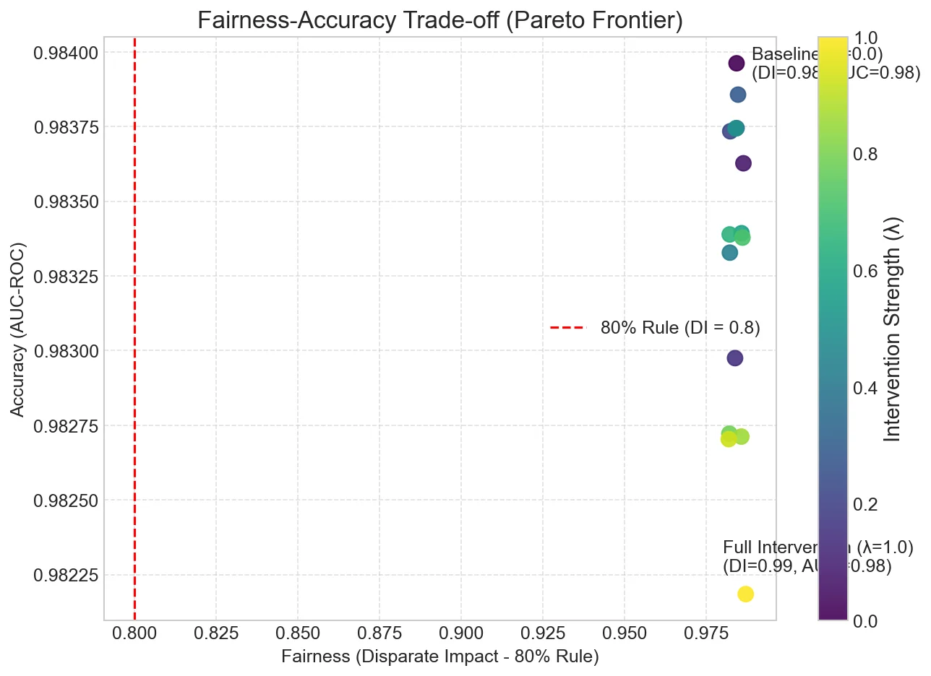
Results: Fairness-Accuracy Trade-offs (Pareto Frontier)

Slide 20
Key Findings & Recommendations
Findings: LightGBM + SHAP excellent technical foundation
SHAP: 97% stability, 85% comprehensibility, practical
Threshold Optimization: Most effective bias mitigation
Recommendations: Deploy LightGBM + post-optimization + SHAP monitoring
Set fairness thresholds, monitor bias drift continuously

Slide 21
Implementation Challenges
Challenges: Class imbalance, SHAP computation, metric conflicts
Lessons: Fairness is achievable with thoughtful design
Key Insight: Fairness and accuracy are complementary
Operationally: Continuous monitoring prevents bias drift
Impact: Enables ethical, compliant credit scoring

Slide 22
Thank You

