Slide 1
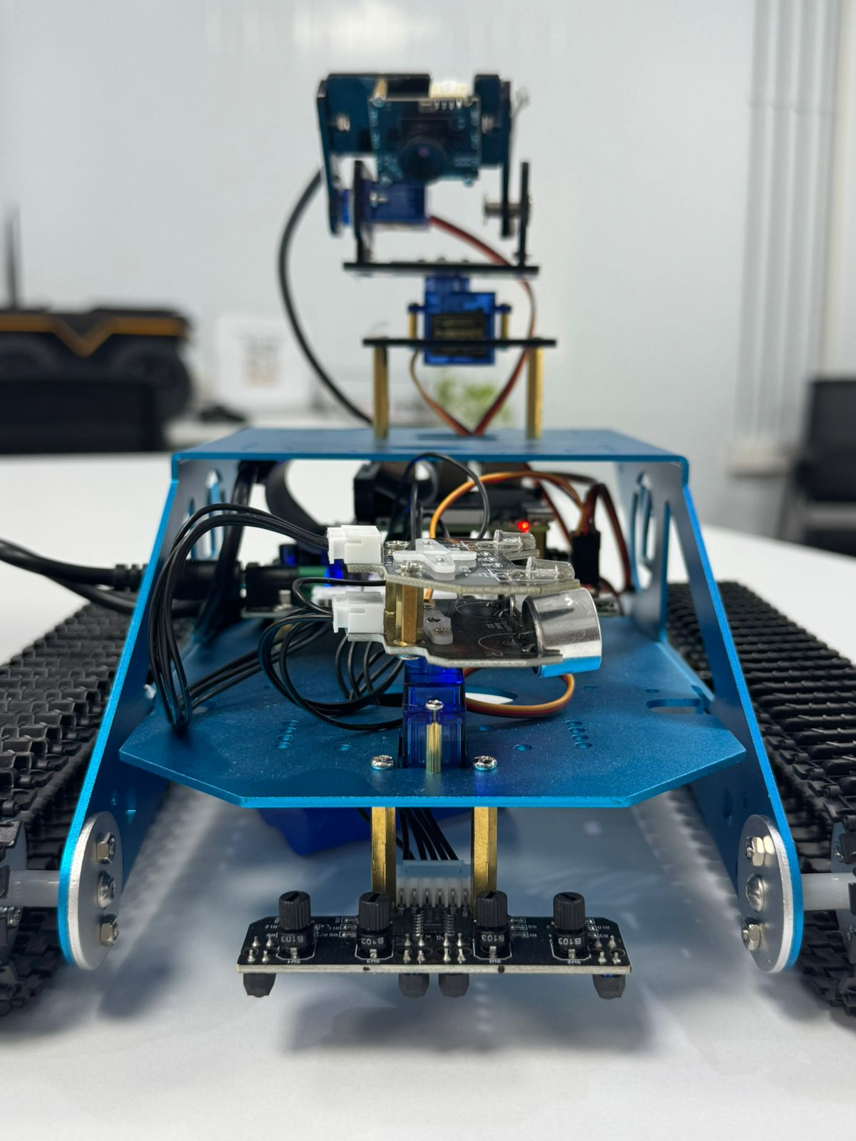
Connecting to the Yahboom Raspberry Pi Robot Kit
Using PuTTY Abdulhady Abas, Hussein Mohammed Ali

Slide 2
Requirements
Yahboom Raspberry Pi Robot Kit
PuTTY installed on PC
Robot connected to the same network (Wi-Fi/USB)

Slide 3
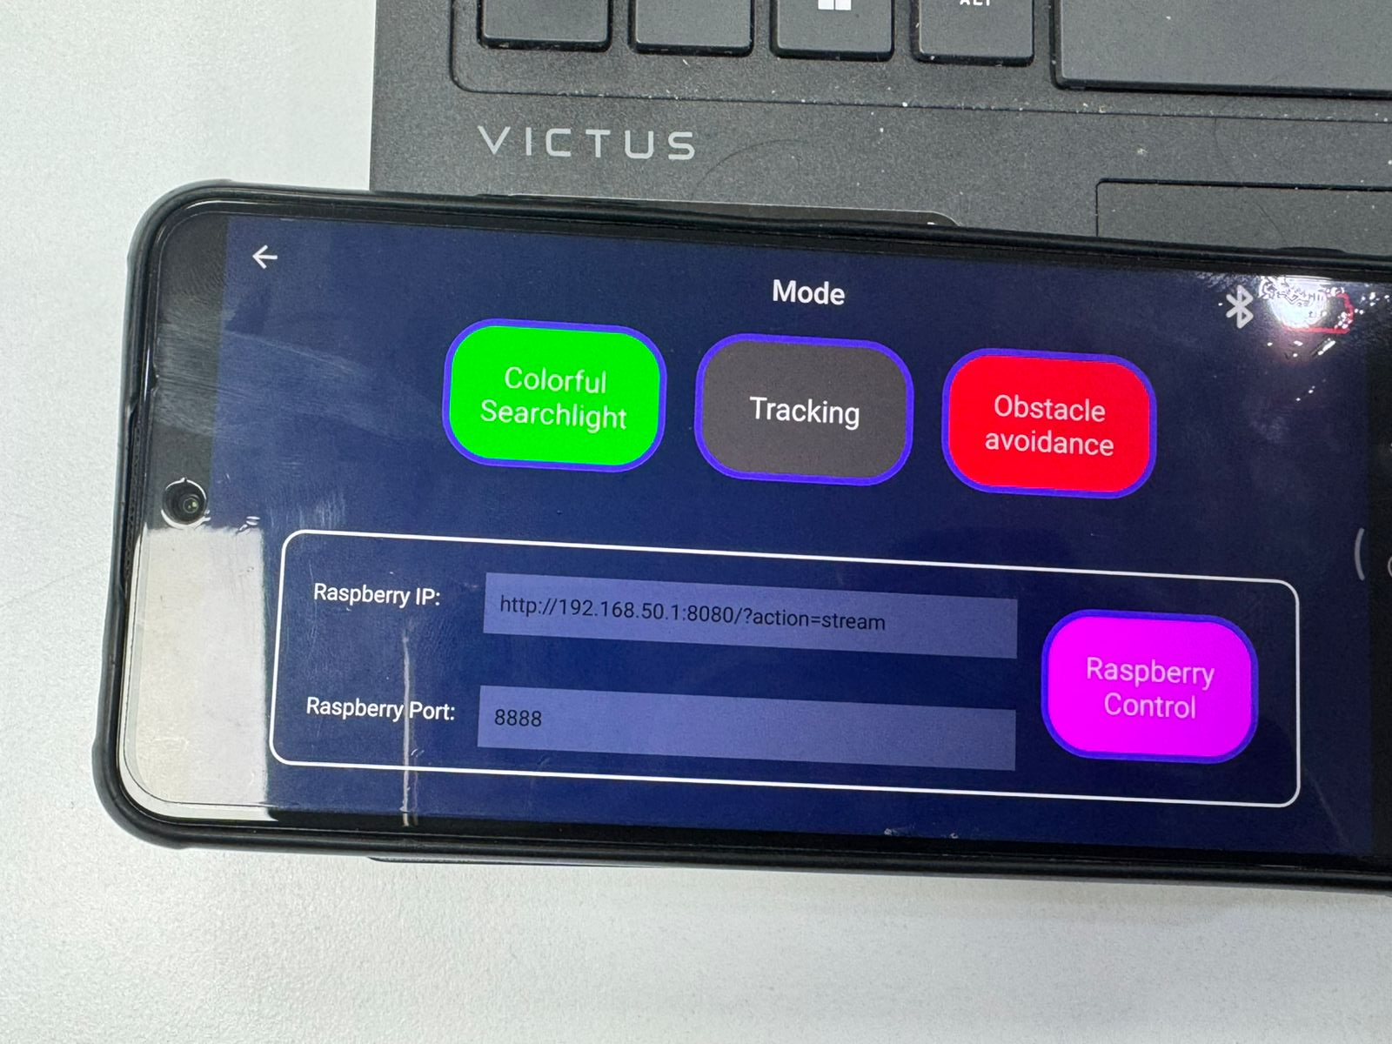
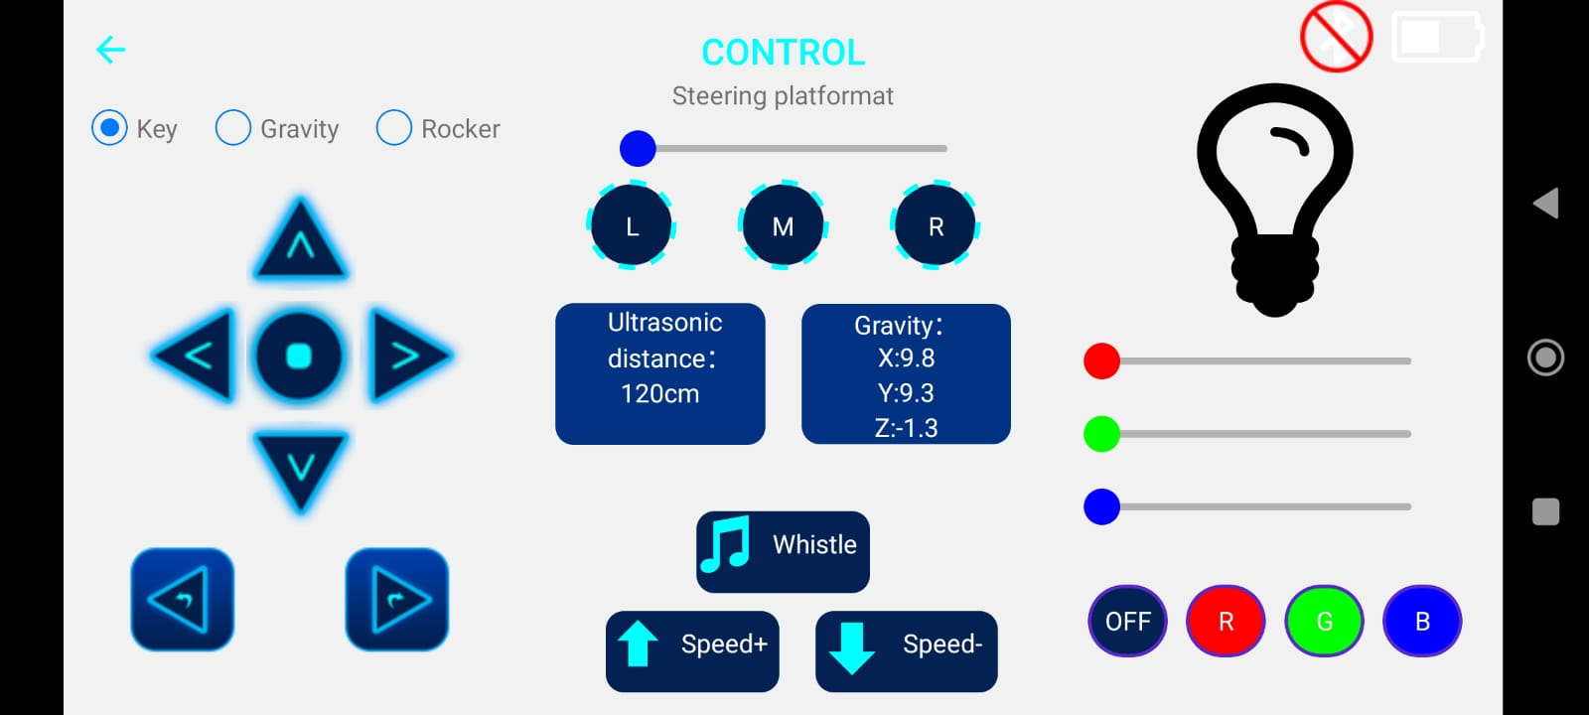
Mobile app
Ready app can be used for demonstration purposes.

Slide 4
PuTTY Configuration
Follow these steps:
Open PuTTY application
Enter Host Name (or IP address): 192.168.50.1
Set Port to 22
Connection type: SSH

Slide 5
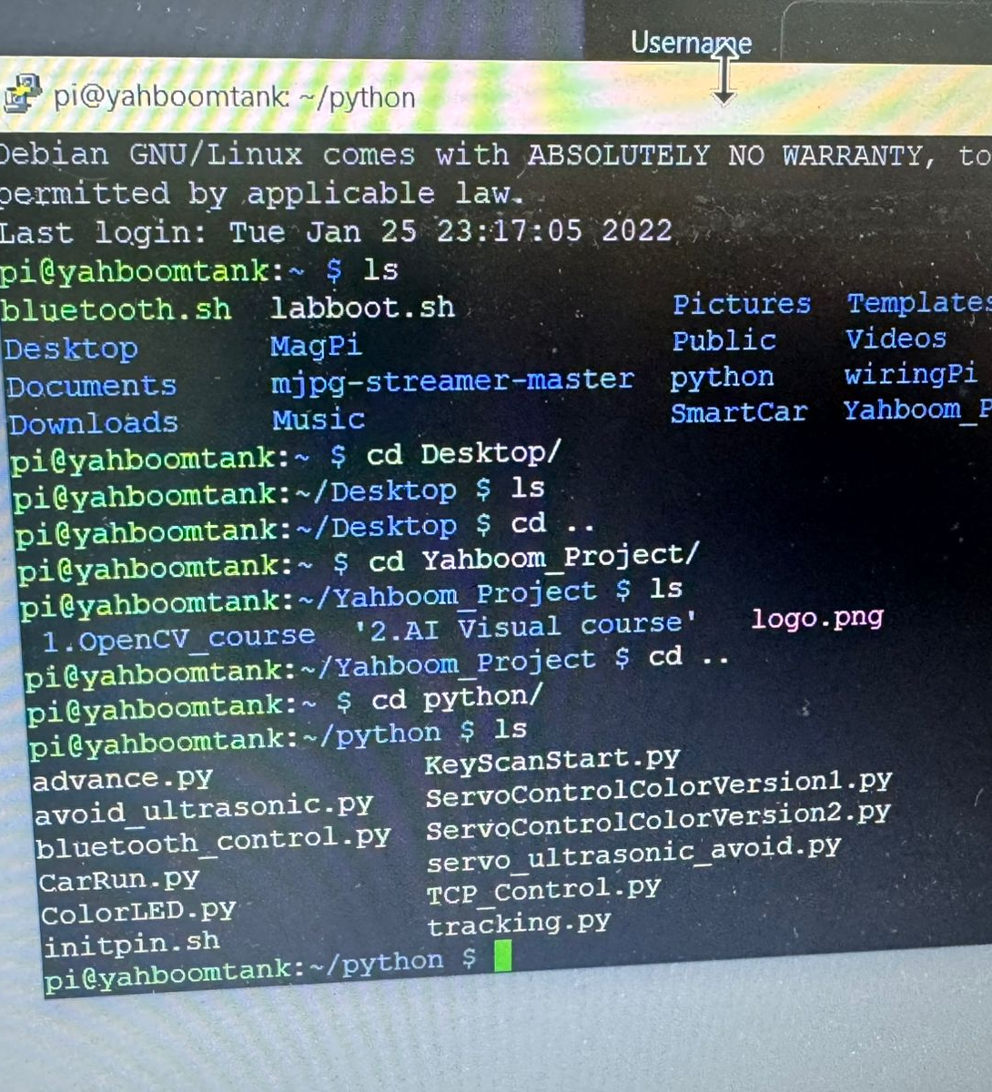
Login Credentials
Enter the following when prompted:
• Username: pi
• Password: raspberry

Slide 6
Navigating to Configuration Folder
After successful login:
• Change directory to Python folder:
cd python

Slide 7

Next Steps
List files: ls
Run scripts: python <script_name>.py
Edit configuration as needed
For creating a new file, use command:
nano <script_name>.py
It opens the newly created file, and you can directly write in it, after finishing, use this command to save changes:
Ctrl + o
Press enter
Ctrl + x

