Slide 1
NYC collisions vs the Weather
Ibrahim Abdulrahmon
Chris Hart
Ugochi Akaluso
Hunter Cash

Slide 2
Motivation & hypothesis
Approximately 40,000 people killed by traffic collisions and hundreds of thousands more injured every year.
In a effort to eliminate traffic related deaths, Vision Zero aims to create safe, healthy equitable mobility by studying trends in traffic collisions
Does the weather conditions affect the amount of collisions and collision related injuries?
There is no statistical significance between the weather and the amount of collisions, and collision related injuries, and deaths.
We were able to find a correlation between temperature and accidents

Slide 3
Questions
Which weather type has the highest occurrence of collisions?
Does cloudiness have a significant effect on the number of Collisions or Injuries?
Does the minimum temperature have a significant effect on the number of Collisions or Injuries?

Slide 4
Data
NYC Open Data:
monthly breakdown of every collision in NYC by location and injury or death. Each record represents a collision in NYC by city, borough, precinct and cross street. This data is typically used by the NYPD and general public to see dangerous/safe intersections in NYC.
DarkSkyAPI:
This api request provides minutely, hourly, and daily current and historical data for weather conditions. For our research, we will focus on humidity, cloudiness, temperature.

Slide 5
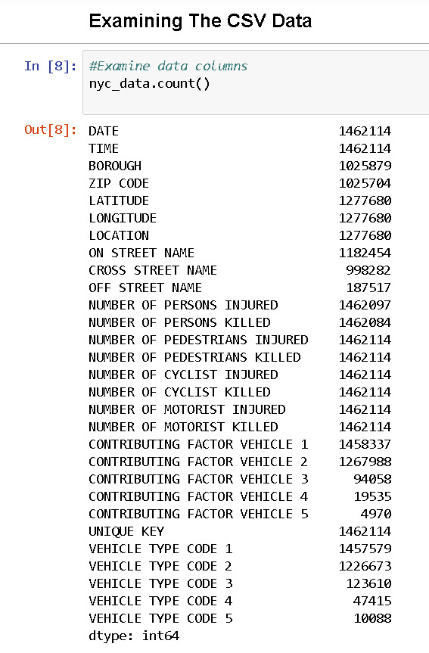
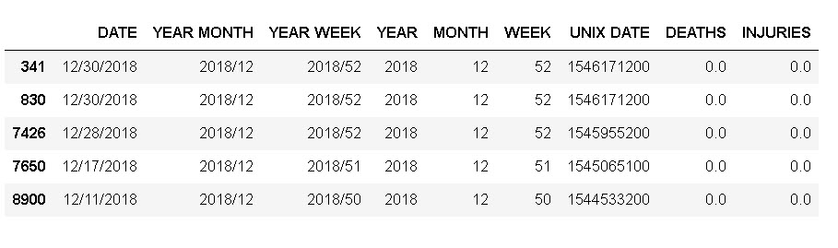
Data Cleanup & exploration
Download NYPD Motor Vehicle Collisions report from NYC Open Data
BEFORE: 1462114 rows x 29 columns
Concat date and time columns for easy analysis
Add UNIX Date to pass into Dark Sky API
Drop dates before 2014 and after 2018
Split dates by Year, Month and Week
Drop Unwanted Columns
AFTER:

Slide 6
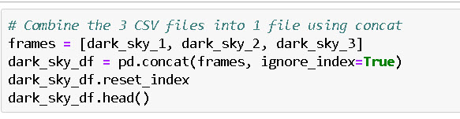
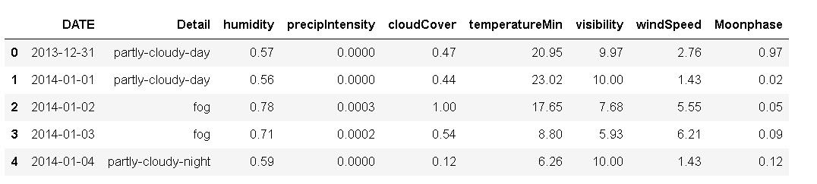
Weather data via API calls from Darksky.net
BEFORE: 1912 rows x 22 columns
Merged Three separate API calls (3 days)
Check for data accuracy and drop duplicate rows
Format Date from UNIX to standard date format

Slide 7
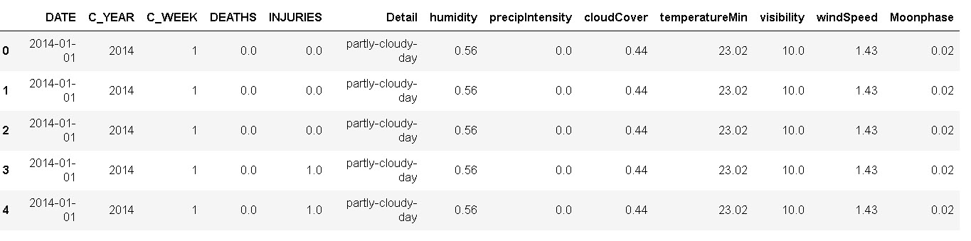
FINAL DATA FRAME
Merge NYC collisions data and Dark sky Weather data
Sort on date
Create “Year” and “Week” columns
Create function to correct weeks and years at year boundaries

Slide 8
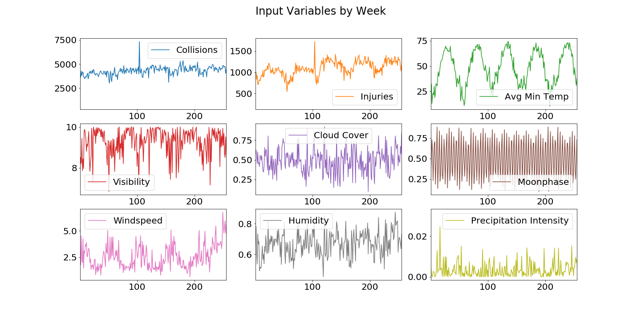

Slide 9
Data Analysis

Slide 10
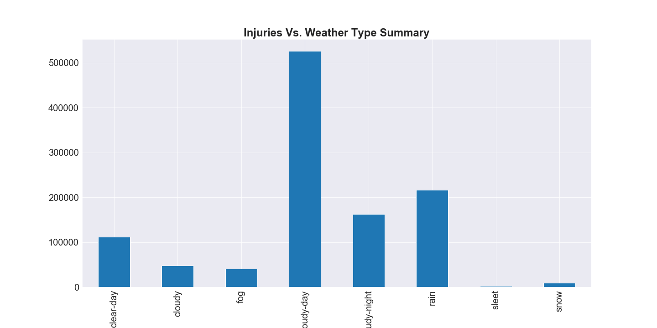
Highest injuries by weather type

Slide 11
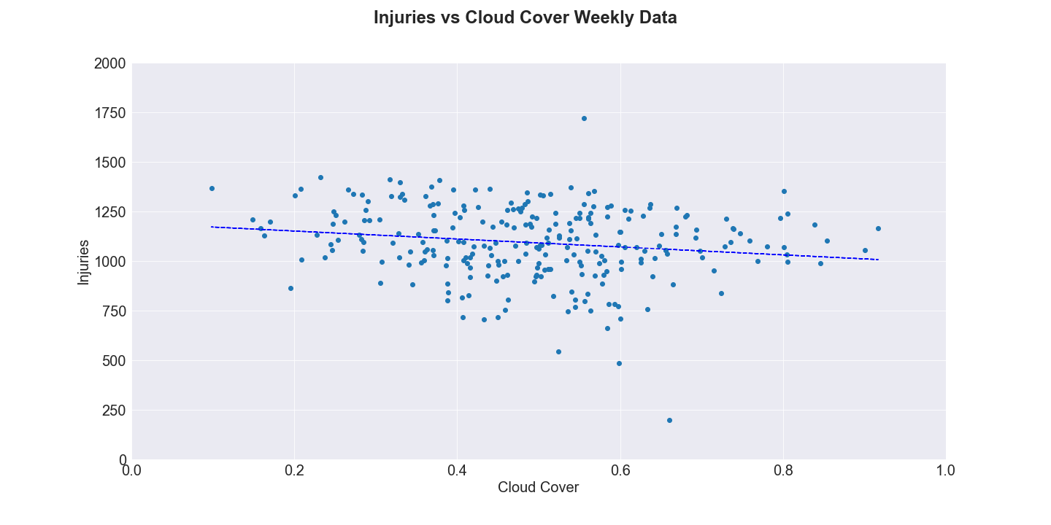
Does the cloudiness have a significant effect on the number of Collisions or Injuries?
WEATHER FACTOR | R-SQURED | P-VALUE | STANDARD ERROR
Cloud Cover | 0.027 | 0.01 | 73.47

Slide 12
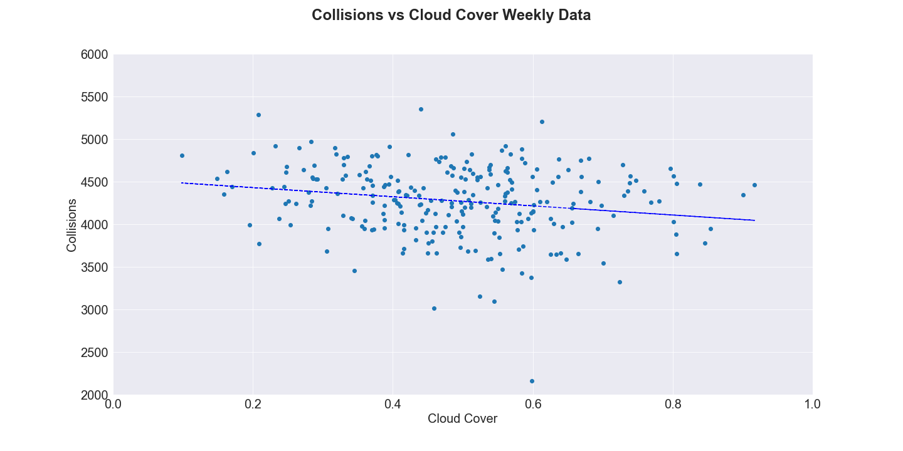
Does the cloudiness have a significant effect on the number of Collisions or Injuries?
WEATHER FACTOR | R-SQURED | P-VALUE | STANDARD ERROR
Cloud Cover | 0.026 | 0.01 | 203.88

Slide 13
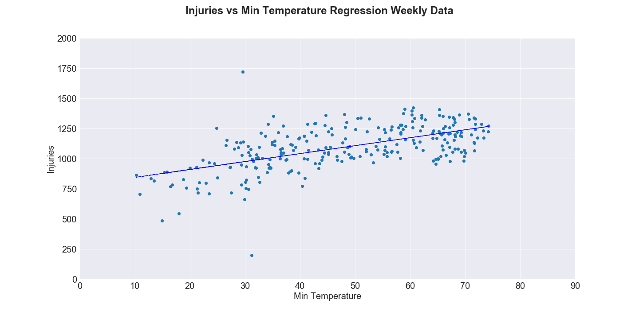
Does the minimum temperature have a significant effect on the number of Collisions or injuries?
WEATHER FACTOR | R-SQURED | P-VALUE | STANDARD ERROR
Avg. Min Temperature | 0.35 | 1.02e-25 | 0.56

Slide 14
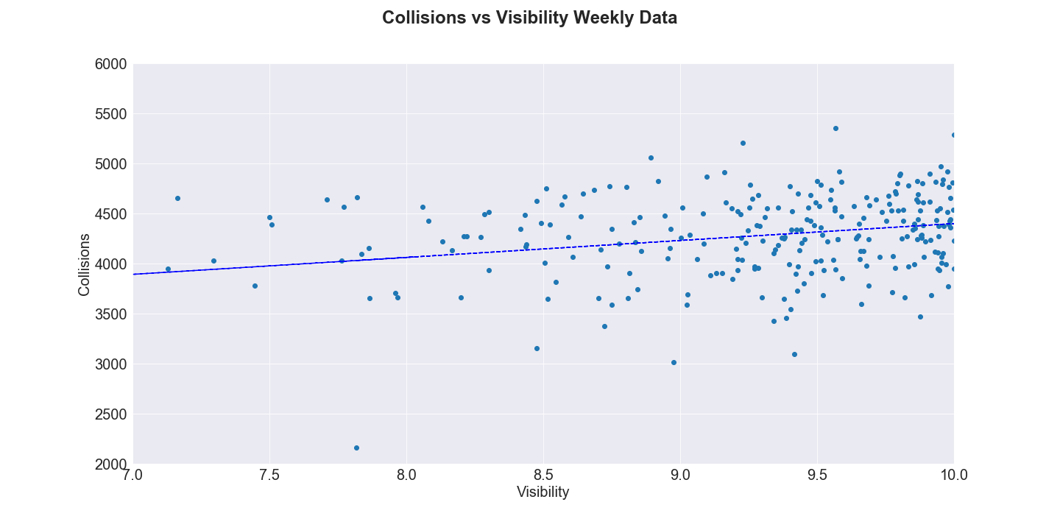
Does the minimum temperature have a significant effect on the number of collisions or injuries?
WEATHER FACTOR | R-SQURED | P-VALUE | STANDARD ERROR
Avg. Min Temperature | 0.1 | 2.09e-7 | 1.82

Slide 15
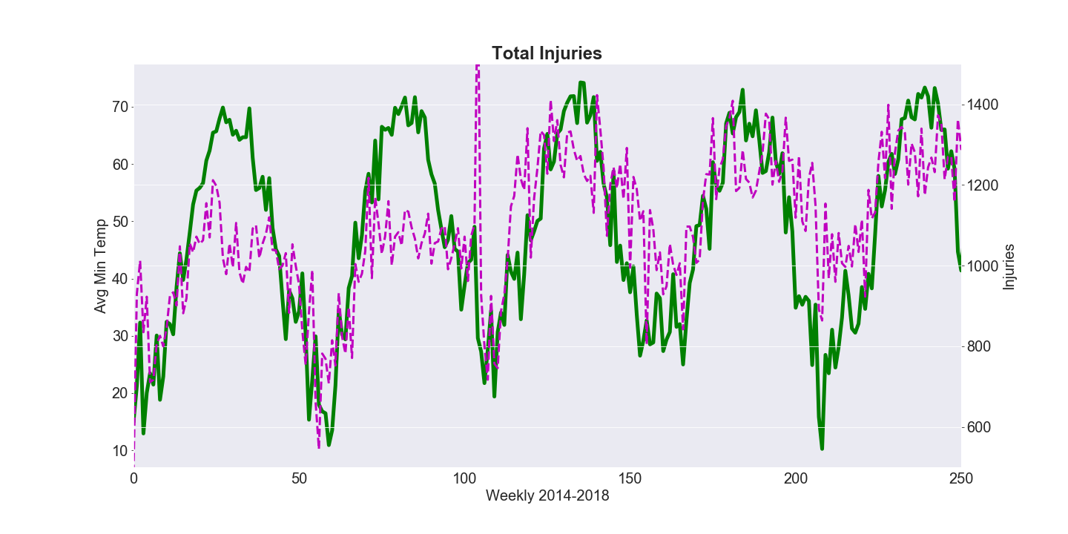
Total INJURIES vs. Avg Min Temperature

Slide 16
Input variables

Slide 17
Table of injury & collision regression results
INJURY
COLLISONS
WEATHER FACTOR | R-SQUARED | P-VALUE | STANDARD ERROR
Avg. Min Temperature | 0.35 | 1.02e-25 | 0.56
Cloud Cover | 0.027 | 0.01 | 73.47
Visibility | 0.09 | 4.38e-07 | 16.39
Wind
WEATHER FACTOR | R-SQUARED | P-VALUE | STANDARD ERROR
Avg. Min Temperature | 0.35 | 1.02e-25 | 0.56
Cloud Cover | 0.027 | 0.01 | 73.47
Visibility | 0.09 | 4.38e-07 | 16.39
Wind

Slide 18
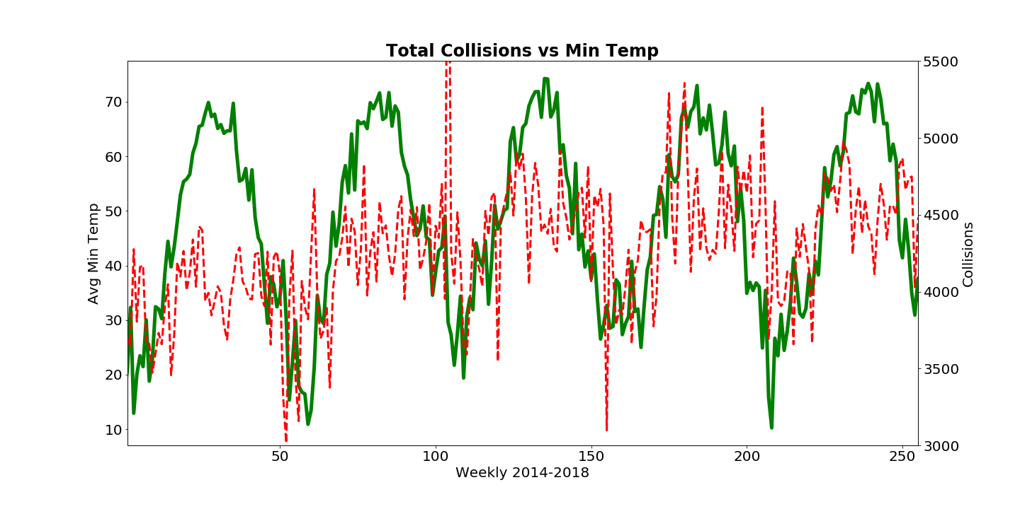
Collisions vs min avg temp

Slide 19
Conclusion
There is no statistical significance between the weather and the amount of collisions, and collision related injuries, and deaths.
We refute the null hypothesis based on temperature
We accept the null hypothesis on all other weather conditions

Slide 20
Conclusions
Expected Results
We expected higher traffic collisions during adverse weather conditions
Inferences
The higher amounts of traffic collisions in the summer may be due to other factors such as:
Increase in total miles driven per person
Increased tourism
Increase in night time activities

Slide 21
Further exploration & difficulties
Difficulties:
API limits
Git LFS
Correcting weeks and years at year boundaries

Slide 22
FurTher RESearch/ questions
Does the temperature affect the number of Pedestrians killed or injured?

