Slide 1


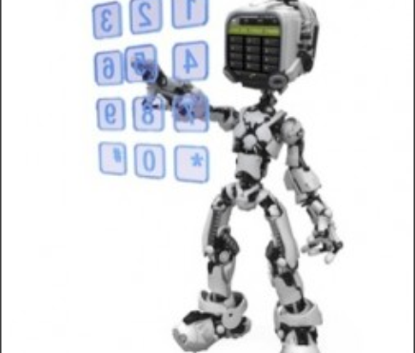


MOBILE APPLICATION AUTOMATION TOOLS
SUBHAN ABDUL

Slide 2
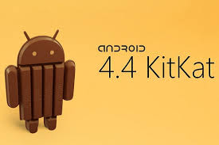
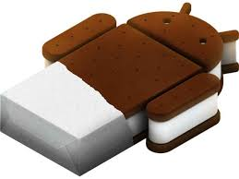
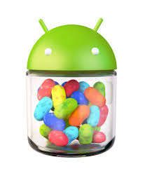


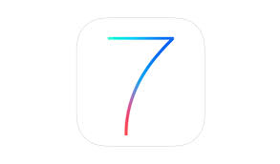
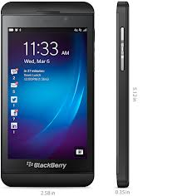

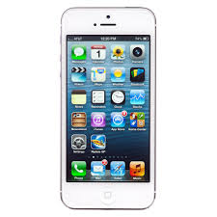
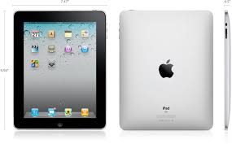
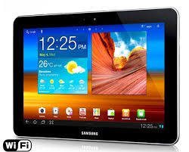
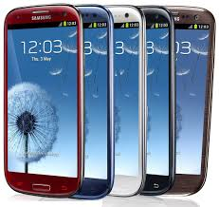
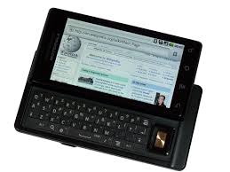
Need for Mobile Automation
New version of OS / Devices / Application
Functional Test case : 800 : 6 Man days : Single Device
Regression Test cases: 350 : 3 Man days : Single Device
Notes:
Android:
Hand set
Tablet
Hand set different manafactures like Samsung, LG, HTC, Motorola, Google Nexus
Tablets : Samgung, Nexus,
Connection: Wifi / 3 G
Handset has different version of App, Tablet has different version of Application
Different Operating system : Jelly Bean, ice ceram sand wich latest : Kit kat which runs on only Google devices at this moment ???
IOS : Iphone , 4s /5S
IOS : 6, 7
IPAD : mini

Slide 3
APPROACH
Open Source vs.
Enterprise
Demo
Evaluation
Final

Slide 4


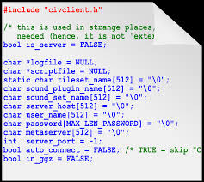
OPEN SOURCE
SL NO | TOOL | IOS | ANDRIOD
1 | MONKEY TALK |  
2 | APPIUM
3 | SIKULI
4 | NATIVE DRIVER : GOOGLE
6 | ROBOTINUM
7 | CUCUMBER – WEB DRIVER
8 | MONKEY RUNNER
9 | FRANK
10 | ZUCHINI
11 | UI AUTOMATOR- ANDROID
Notes:
APPIUM
http://appium.io/
http://code.google.com/p/robotium/
http://developer.android.com/tools/help/monkeyrunner_concepts.html
http://mobpot.wordpress.com/2011/08/03/automating-ios-native-app-testing-using-frank/
http://code.google.com/p/nativedriver/
www.zucchiniframework.org
www.

Slide 5
ENTERPRISE
SL # | TOOL | IOS | ANDRIOD | BLACK BERRY | WINDOWS
1 | TEST PLANT |  
2 | RANOREX
3 | SEE TEST
4 | SILK MOBILE
5 | DEVICE ANY WHERE
6 | SQUISH
7 | MTAS

Slide 6
ENTERPRISE
SL # | TOOL | IOS | ANDRIOD | BLACK BERRY | WINDOWS
8 | M-eUX TEST
9 | RATIONAL(RTW)
10 | SOASTA –TOUCH TEST
11 | TELERIK
12 | PERFECTO MOBILE
13 | ZAP FIX
14 | TPLAN ROBOT
Notes:
TestQuest Pro
In progress ,
Please email or call:
888.820.4500
+1.425.519.5900
http://www.bsquare.com/products/testquest-automated-testing-platform/testquest-10
http://www.jamosolutions.com/
https://jazz.net/library/article/1253
https://pic.dhe.ibm.com/infocenter/rtwhelp/v8r5m0/index.jsp?topic=%2Fcom.ibm.rational.test.lt.moeb.doc%2Ftopics%2Fcmobovw.html
http://www.telerik.com/automated-testing-tools/purchase.aspx
http://www.soasta.com/testing-solutions/mobile-application-testing/
http://www.zaptechnologies.com/products/zaptest-suite
http://www.t-plan.com/robot/

Slide 7

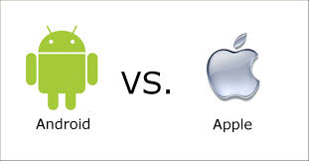










DEMO FROM VENDOR
Notes:
Demo from vendors and evaluation check list

Slide 8

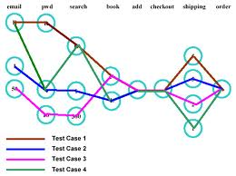

TOOL EVALUATION CHECK LIST

Slide 9


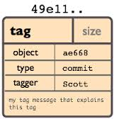










TOOL EVALUATION
PARAMETERS
IDENTIFICATION
NON INSTRUMENTED APPLICATIONS
STABILITY
PERFORMANCE
TEST MANAGEMENT- QUALIY CENTER
1
2
4
3
COST
3
2
1
4
SCRIPTING

Slide 10
THANK YOU

