Slide 1

“Welcome
to
Mars.”

Slide 2
“Welcome
to
Mars.”

Slide 3
“Welcome to Mars.”
promptEngineers
Presented by:
Hamza Abdelkader - 2230150
Leonardo Marasca - 2217140
Marco Catalano - 2269487
Presented to:
Prof. Massimo Mecella
Date: 11/03/2026
Sapienza University of Rome (DIAG)

Slide 4
TABLE OF CONTENTS
Project Context & Challenges
System Requirements: User Stories & Schemas
Platform Architecture: Event-Driven Design
Core Components: Ingestion, Processing & UI
Live Demo
Notes:
"Here is a brief overview of what we are going to discuss today. We will start by outlining the main challenges of managing the Martian habitat, move on to our system requirements and architectural choices, dive into the specific microservices we built, and finally conclude with a live demonstration of the working platform."

Slide 5
Problem
2036: Mars habitat automation is partially broken.
Devices speak different “dialects”: some must be polled (REST), others stream telemetry.
Actuators are reachable only via REST.
Notes:
The main challenge wasn't just reading sensors, but managing chaos. Devices on Mars speak different languages, with completely unstandardized JSON formats. Furthermore, a critical environment requires a fault-tolerant architecture: if the dashboard crashes, the life-support ventilation system must keep running.

Slide 6
Mission
Ingest heterogeneous sensor data
Normalize into a unified event schema
Evaluate automation rules
Provide a real‑time monitoring dashboard
Notes:
The main challenge wasn't just reading sensors, but managing chaos. Devices on Mars speak different languages, with completely unstandardized JSON formats. Furthermore, a critical environment requires a fault-tolerant architecture: if the dashboard crashes, the life-support ventilation system must keep running.

Slide 7
Constraints
Event‑driven architecture
Multiple backend services
Persistent rule storage
Notes:
The main challenge wasn't just reading sensors, but managing chaos. Devices on Mars speak different languages, with completely unstandardized JSON formats. Furthermore, a critical environment requires a fault-tolerant architecture: if the dashboard crashes, the life-support ventilation system must keep running.

Slide 8
Technical goals
Develop a system able to:
Ingest heterogeneous sensor data (REST & Streams).
Normalize data into a unified schema.
Evaluate automation rules continuously.
Enable operators to manage rules and status via UI.
Display a live, real-time dashboard.
Notes:
"Our technical goals were clear: build a system capable of extracting this messy data, translating it into a unified standard, and using it to fuel an autonomous decision engine, all while providing operators with a real-time, comprehensive control interface."

Slide 9
Technologies Used
Backend:
Python 3.11
FastAPI (API service)
Pika (RabbitMQ client)
Requests (REST/SSE)
Frontend:
React + Vite + TypeScript
Tailwind CSS + shadcn/ui
Nginx (static hosting)
Database:
SQLite (rules persistence)
Database:
SQLite (rules persistence)
Messaging:
RabbitMQ (AMQP, fanout exchange)
Notes:
"Our technical goals were clear: build a system capable of extracting this messy data, translating it into a unified standard, and using it to fuel an autonomous decision engine, all while providing operators with a real-time, comprehensive control interface."

Slide 10
Workflow
1. Requirements: User Stories generation.
2. Contract Design: Rule & Normalization schemas.
3. Architecture: Microservices & Broker setup.
4. Core Logic: Microservices development.
5. Implementation & Testing.
Notes:
"Instead of jumping straight into coding, we took a methodical approach. We started with the operator's needs by defining the User Stories. Then, we designed the 'Contracts'—our JSON schemas—and only after mapping out the architecture did we begin developing the isolated microservices."

Slide 11
User stories samples
1. As an Operator, I want to see a real-time list of all sensor values (e.g., temperature, radiation) so that I can monitor habitat safety.
2. As an Operator, if a rule condition is true, I want the system to automatically send a POST command to turn the actuator ON or OFF.
Notes:
"Here are some of our core User Stories. I want to highlight the last one: in a Martian base, a life-saving automation rule cannot just disappear from RAM due to a power surge. Persistence is a vital requirement."

Slide 12
User stories samples
8. As an Operator, I want to manually toggle actuators (e.g., cooling\_fan) ON or OFF from the UI to override automation in emergencies.
9. As an Operator, I want to see a live line chart for specific sensors (e.g., CO2 levels) to track trends while the dashboard is open.
Notes:
"Here are some of our core User Stories. I want to highlight the last one: in a Martian base, a life-saving automation rule cannot just disappear from RAM due to a power surge. Persistence is a vital requirement."

Slide 13
User stories samples
11. As an Operator, I want to create automation rules (e.g., "IF temp > 28 THEN fan ON") via the UI to maintain habitat stability.
16. As an Operator, I want my automation rules to be saved in a database so that the habitat remains safe even if a specific service needs to restart.
Notes:
"Here are some of our core User Stories. I want to highlight the last one: in a Martian base, a life-saving automation rule cannot just disappear from RAM due to a power surge. Persistence is a vital requirement."

Slide 14
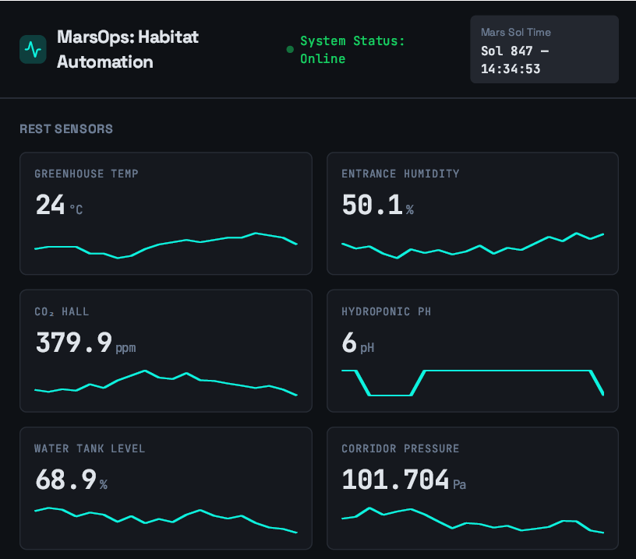
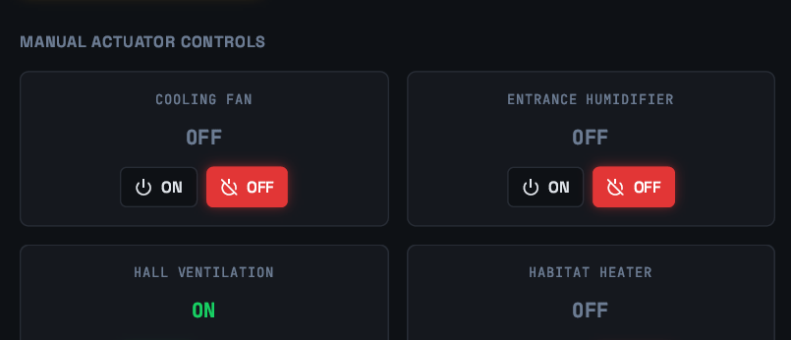
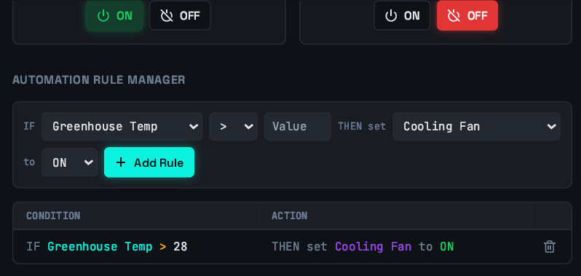
Mock-up
US: 2 & 8
US: 1 & 9
US: 11 & 16

Slide 15
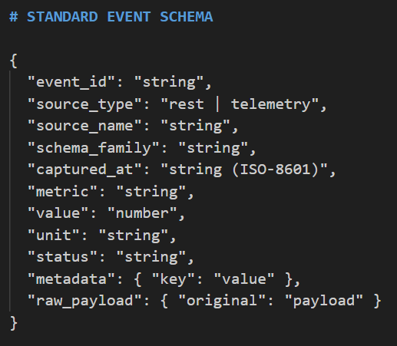
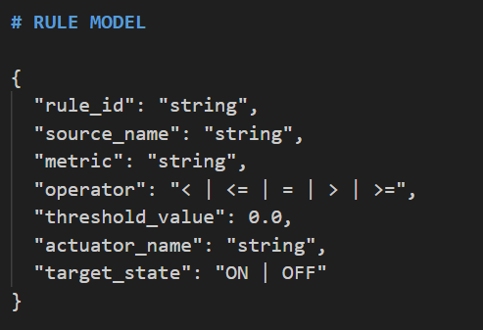
Rule and event schemas
Notes:
"This is our 'Contract'. No matter what sensor is connected to the base, our normalizer will translate it into this exact standard schema on the left. On the right, you can see the data model for our mathematical automation rules."

Slide 16
Architectural constraints
Use at least one message broker, e.g., ActiveMQ, Kafka, etc.
• Use multiple backend services (avoid a single monolithic service)
• Separate ingestion, processing, and presentation
• Persist automation rules
Notes:
"To meet the strict design constraints, we immediately discarded the monolithic approach. We separated data ingestion, processing, and presentation into different services, linking them all together using RabbitMQ as our message broker."

Slide 17
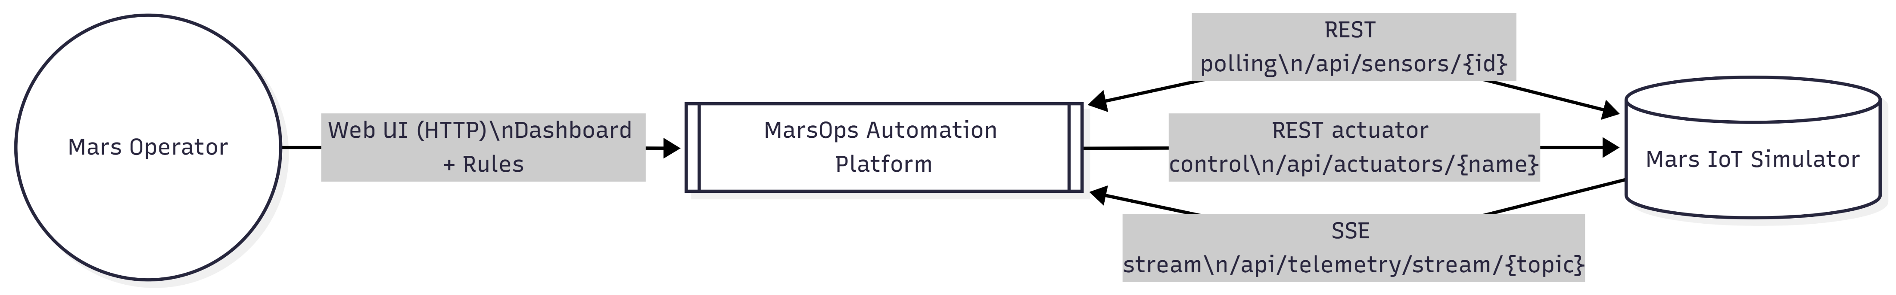
Architecture – High level
Notes:
"This is our infrastructure. The data flow moves from left to right. Our microservices never talk to each other directly via REST APIs; they communicate exclusively by publishing and consuming messages from RabbitMQ queues. This guarantees absolute decoupling."

Slide 18
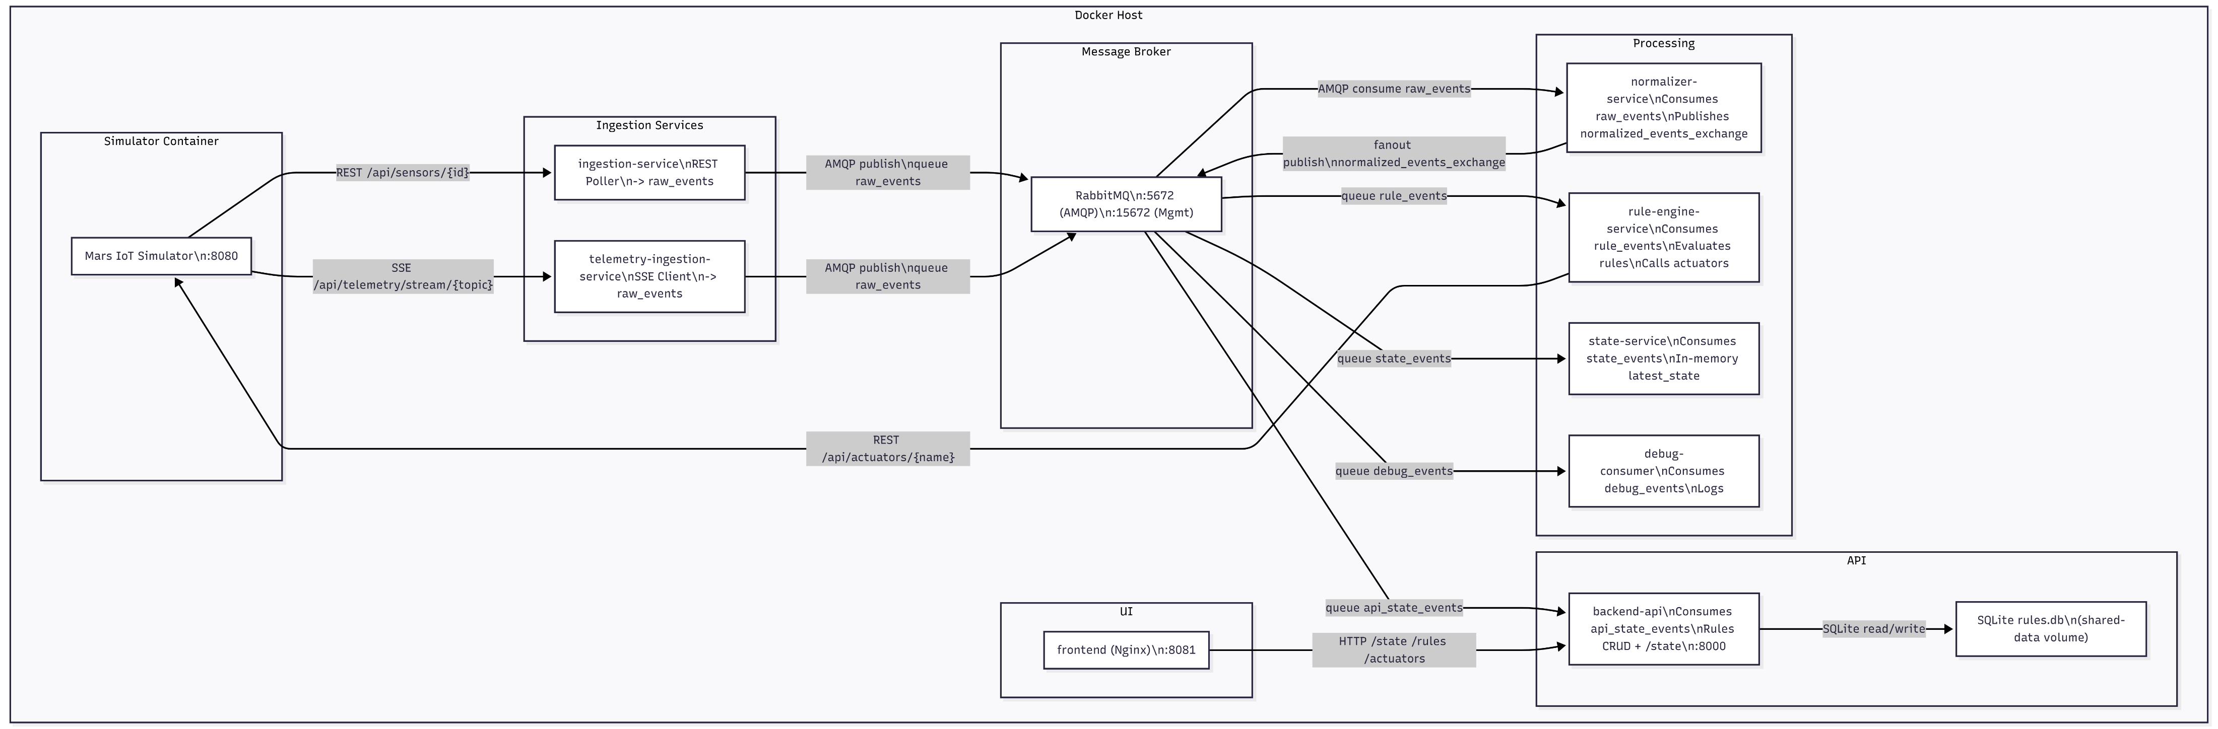
Architecture - Detailed

Slide 19
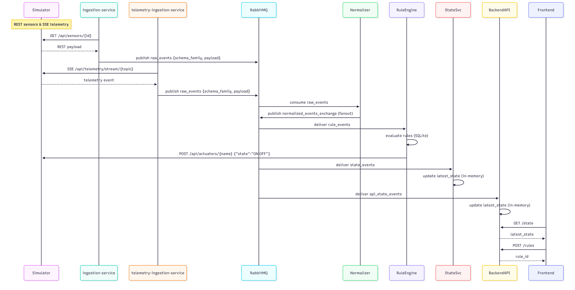
Architecture – Sequence Diagram
Notes:
"This sequence diagram shows the true power of the Pub/Sub pattern. Once the data is cleaned, it's published to a 'Fanout Exchange'. RabbitMQ acts like a megaphone, cloning the message in real-time and delivering it simultaneously to both the API—to update the charts—and the Rule Engine—to trigger the physical actuators."

Slide 20
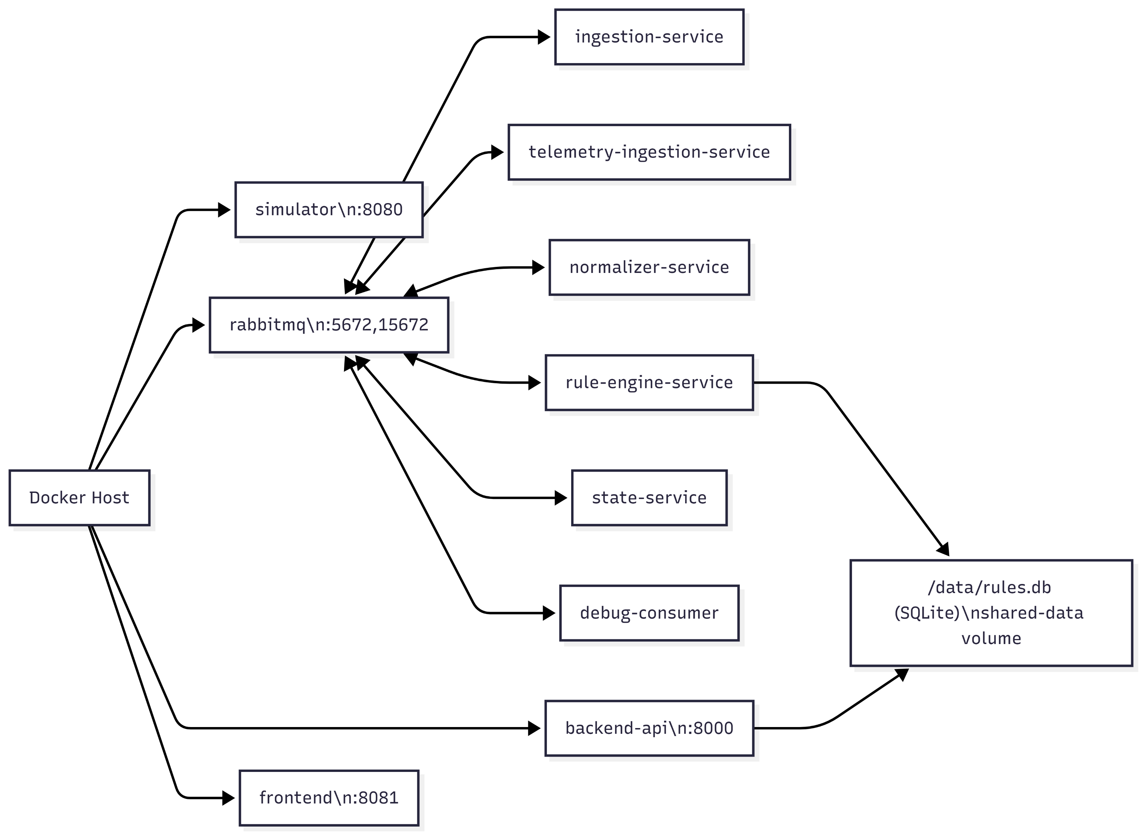
Architecture - Dockerization
Notes:
"The entire ecosystem has been containerized. Using docker-compose, we can spin up the simulator, RabbitMQ, the backend, and the frontend within a single, isolated virtual network."

Slide 21
How persistance is guaranteed
Database: SQLite.
Storage: Docker Shared Volumes (/data/rules.db).
Benefits: Rule Engine and API share the same physical memory, surviving container crashes.
Notes:
"To guarantee persistence without overloading the system, we used SQLite mounted on a Docker Shared Volume. The APIs write the rules into this database file, and the Rule Engine reads from the exact same file. Even if the Python containers crash, the rules remain safely on the disk."

Slide 22
Core component 1 - Ingestion
Component: producer.py
Task: The "Dumb Pipe". Fetches data via REST polling.
Output: Injects raw, untouched JSONs into the raw_events RabbitMQ queue.
Notes:
"Moving on to the components, the Ingestor is our extractor. It acts as a 'Dumb Pipe'. It does the dirty work without asking questions: it grabs the chaotic JSON payloads and injects them completely raw into the first RabbitMQ queue."

Slide 23
Core component 2 - Processing
Normalizer: Translates chaotic JSONs into the Standard Event Schema.
Rule Engine: Listens to rule_events, queries SQLite, and evaluates math logic (e.g., value > threshold).
Action: Triggers Actuators via POST requests.
Notes:
"The processing layer is the beating heart of the system. The Normalizer acts as a universal translator. The Rule Engine listens to the clean data and, completely autonomously, queries the SQLite database and sends POST commands to the simulator if vital parameters fall out of bounds."

Slide 24
Core component 3 – API & UI
Backend: FastAPI for high-performance REST endpoints.
State Memory: Maintains a latest_state dictionary in RAM for zero-latency UI updates.
Frontend: Real-time Dashboard for operators.
Notes:
"Finally, the human interface. The FastAPI server maintains a real-time snapshot of the base's latest known state directly in its RAM. This allows the web dashboard to fetch data and load charts with absolute zero latency."

Slide 25
Live demo
Now we’ll run the system and use it live
Project available at:
https://github.com/abdulkader2230150-creator/2230150_promptEngineers
Notes:
"That concludes the presentation of our architecture. Now, let's switch to the terminal and the dashboard to show you MarsOps in action."

