Slide 1

SUPERVISED MACHINE LEARNING PROJECT
Presented By :
Name : ABDUL KADHAR M
Course : DADS July A Cohort

Slide 2
INTRODUCTION
The project uses the Telco Customer Churn dataset to explore key factors such as tenure, contract type, monthly charges, and internet services that influence customer decisions. By applying machine learning techniques, the project aims to predict whether a customer will churn and provide insights to help the company develop effective retention strategies.
PROJECT GOALS
  To load, understand, clean and preprocessing the dataset.
  To analyze patterns in customer behavior using data visualization.
  To predict whether a customer will churn or stay using machine learning.
  To compare different models and select the one with the best accuracy.
  To save and load the best model as a .pkl file.
  To deploy the best model using Streamlit for live churn prediction.
  To help the telecom company improve customer retention and reduce revenue loss.
Lars Peeters
Teddy Yu
Chidi Eze

Slide 3
PROBLEM STATEMENT
Customer churn is a major challenge in the telecommunications industry, directly impacting revenue and business growth. This project aims to analyze customer data to identify the key factors influencing churn and to develop a machine learning model capable of predicting whether a customer is likely to leave the company. The insights gained from this analysis will support the development of effective strategies to reduce churn and enhance customer loyalty.
PROJECT OBJECTIVE
  This project focuses on predicting customer churn in a telecom company using the Telco Customer Churn dataset.
  It involves data cleaning, exploratory data analysis, and the application of machine learning models such as Logistic Regression, SVM, KNN, Decision Tree, and Random Forest.
  The goal is to identify the key factors influencing churn and build a model that accurately predicts whether a customer will stay or leave.
  The insights gained will help the company improve customer retention and reduce revenue loss.

Slide 4
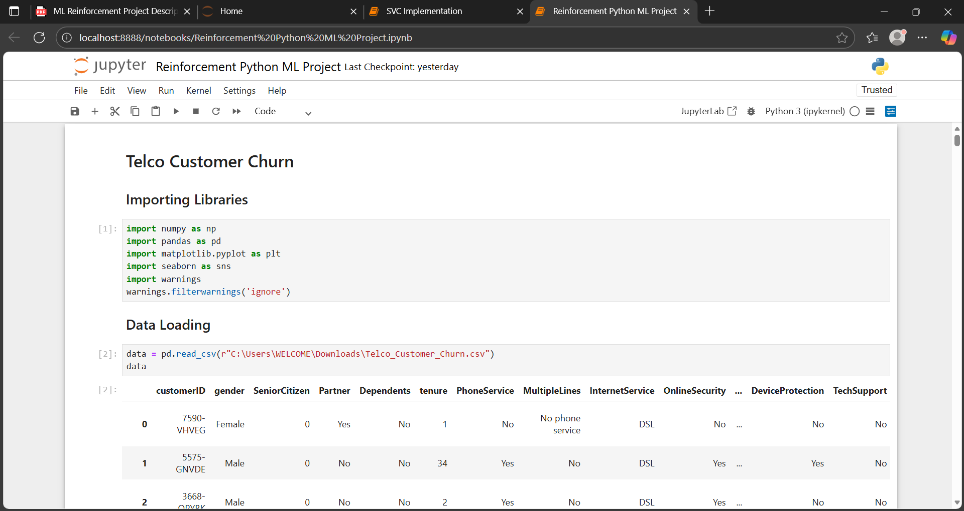
IMPORTING & LOADING
Imported Libraries to analyze and visualize the trends
  pandas for Handles and analyzes data in tables (DataFrames).
  numpy for math operations on arrays and matrices.
  matplotlib.pyplot for creating basic plots and charts.
  seaborn to make attractive statistical plots easily.
  warnings to hide unnecessary warning messages.
Loading Dataset
  Loaded csv dataset using the command pd.read_csv.

Slide 5
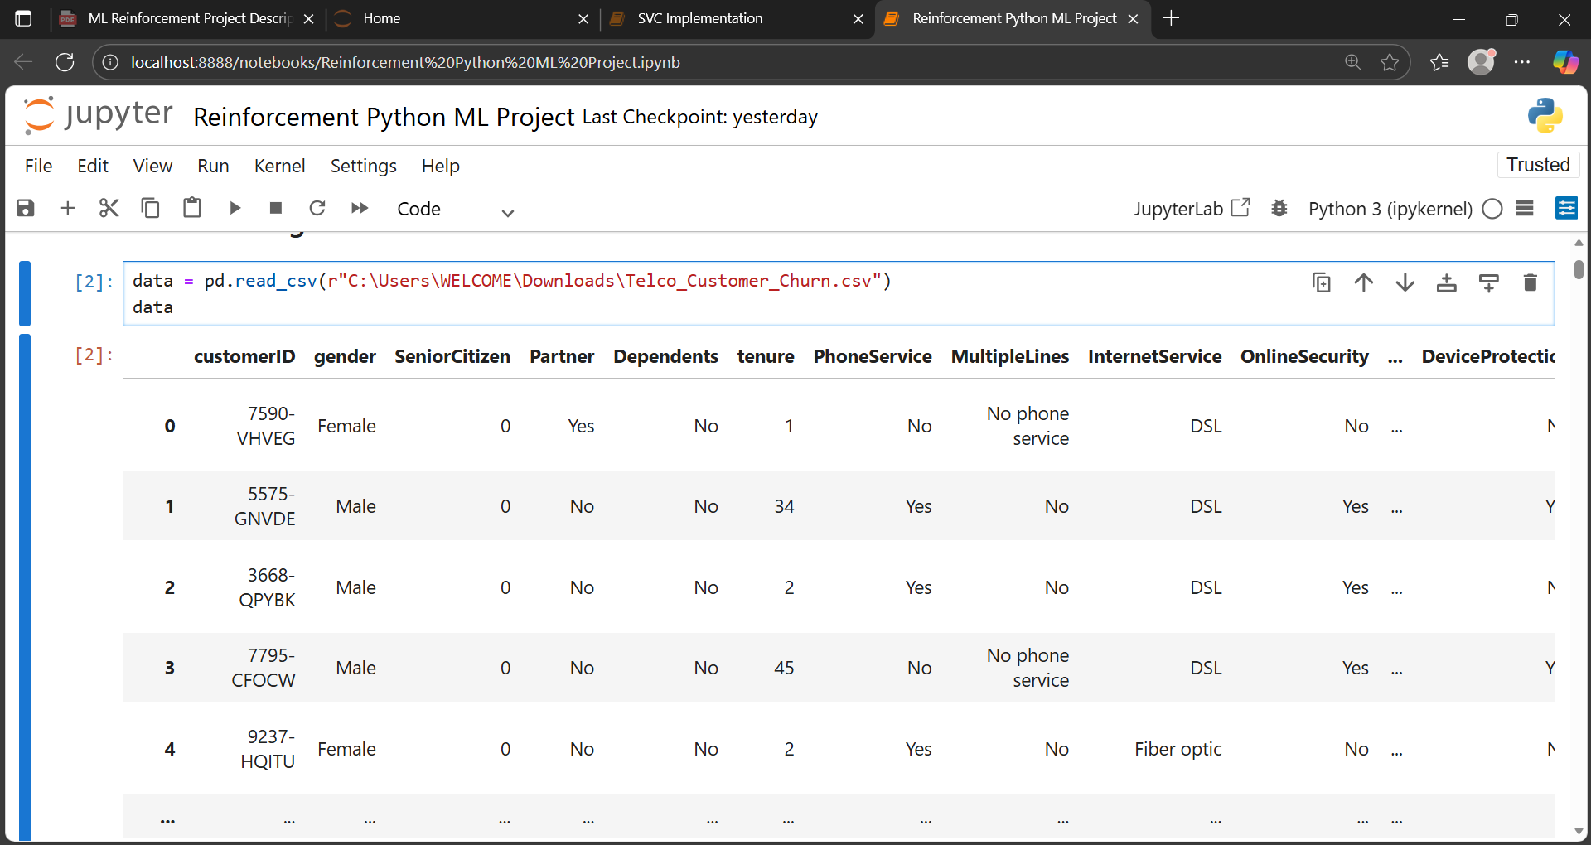
DATA UNDERSTANDING
Data Understanding involves exploring the Telco Customer Churn dataset to get familiar with its structure, variables, and contents.
Checked :
  shape for shape of the dataset
  columns for column names
  isnull() for missing values
  info() for quick overview of data
  head() for first five rows
  tail() for last five rows
Dataset Overview :
Rows : 7043 & Columns : 21
Key Features :
gender, tenure, TechSupport, Contract, PaymentMethod, MonthlyCharges, TotalCharges, Churn

Slide 6
DATA CLEANING
  Checked for duplicate values using dropduplicates command and there were no duplicates in the dataset.
  Dropped unwanted features for better analysis.
  Changed appropriate datatypes (TotalCharges to ‘numeric’ and all other object features to ‘category’ data types).
  Handled missing values for TotalCharges using Median values.
  Described features like tenure, MonthlyCharges and TotalCharges.
  Checked for outliers by using Boxplot in the numeric features and there were no outliers in my dataset.
  Before cleaning After cleaning
Rows - 7043 Rows - 7043
Columns - 21 Columns - 20

Slide 7
EXPLORATORY DATA ANALYSIS
Visualized data in EDA as UNIVARITE, BIVARIATE & MULTIVARIATE for analyzing the Churn behaviour and patterns across tenure, TotalCharges, etc.
UNIVARIATE
  Countplot for visualize Churn Distribution
BIVARIATE
  Barplot to analyze Churn vs Contract
  Monthly Charges vs Churn
MULTIVARIATE
  Correlation Heatmap for numeric features like tenure, MonthlyCharges, TotalCharges and SeniorCitizen

Slide 8
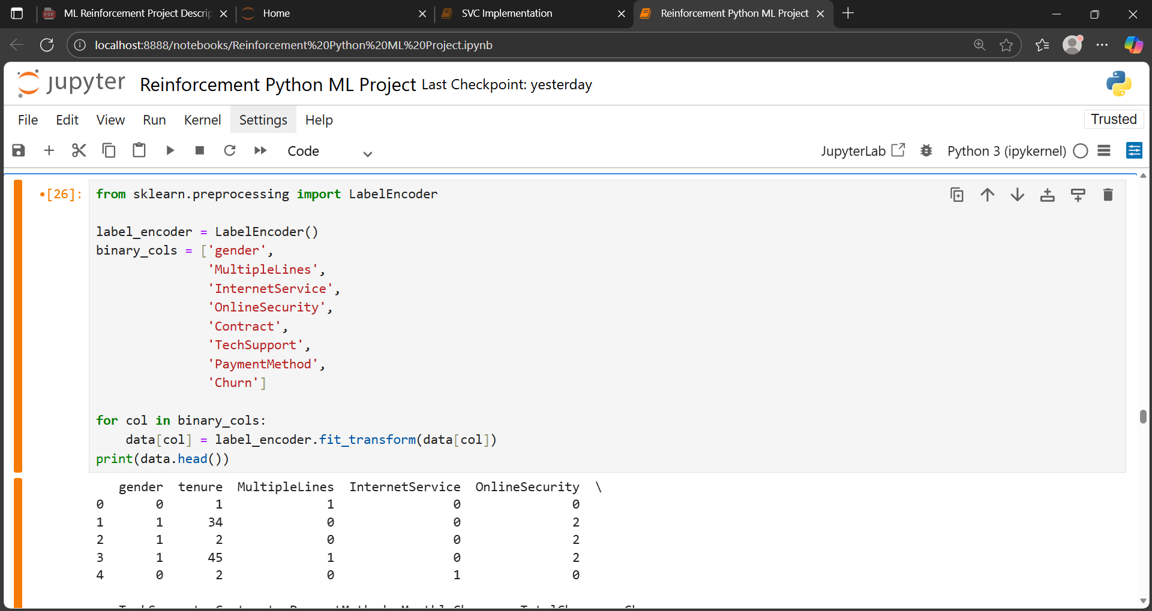
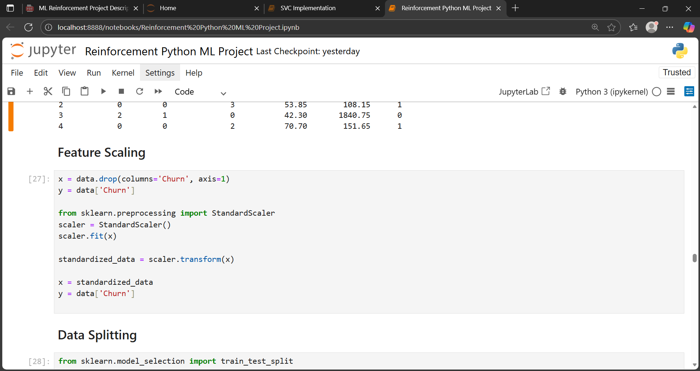
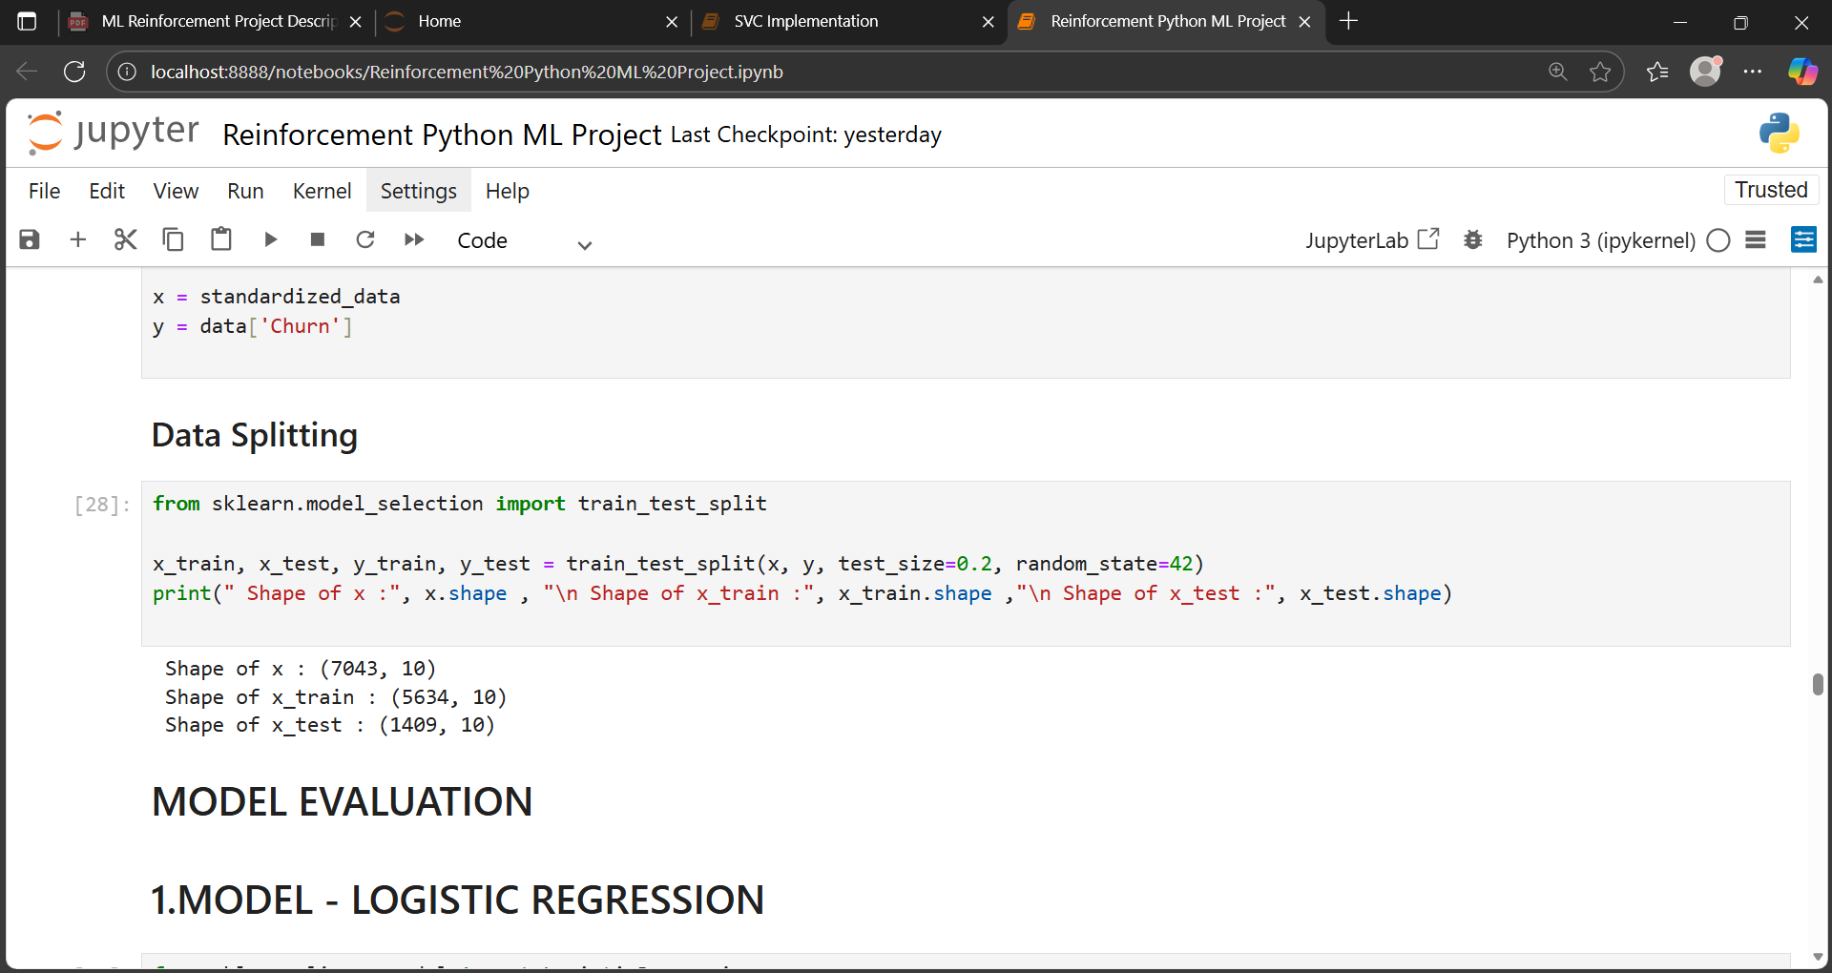
DATA PREPROCESSING
  Encoded Categorical data types to numeric data types using LABEL ENCODING, so that machine learning models can understand and process it.
  Standardization using Feature scaling so that no feature dominates others during model training.
  Splitted data into 20% for testing and 80% for training to perform model evaluation.

Slide 9
MODEL EVALUATION
Performed supervised machine learning classification models to predict whether a customer will churn.
Models Performed :
  Logistic Regression
  Support Vector Machine
  K-Nearest Neighbor
  Decision Tree
  Random Forest
  XG Boost
Evaluation Metrics :
  Accuracy Score
  Classification Report
  Confusion Matrix
  f1 Score

Slide 10
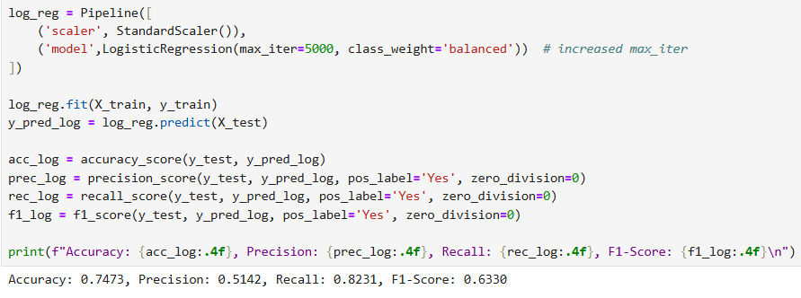
LOGISTIC REGRESSION
  Estimates the probability of customer churn by establishing a decision boundary between churned and retained customers.
  The accuracy score obtained is 0.7473.

Slide 11
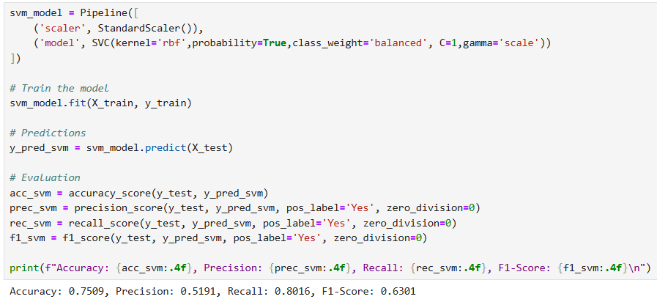
SUPPORT VECTOR MACHINE
  Identifies the optimal boundary to distinguish churned customers from non-churned ones for accurate classification.
  The accuracy score is approximately 0.7509

Slide 12
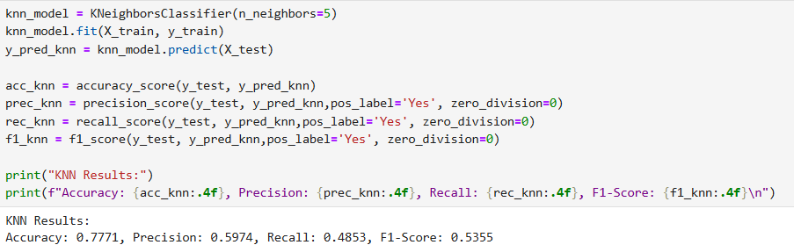
K- NEAREST NEIGHBOR
  Predicts churn by evaluating the behavior of the most similar customers within the dataset.
  The accuracy score is 0.8055.

Slide 13
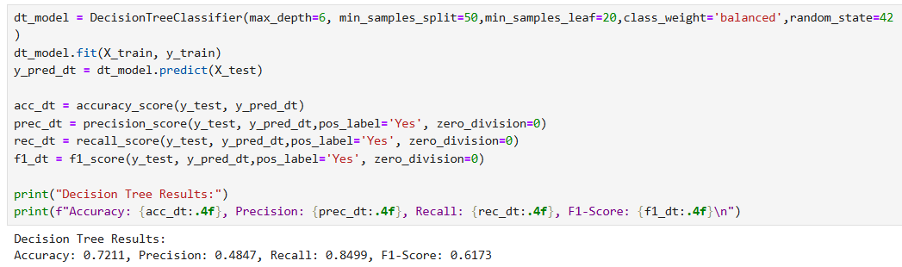
DECISION TREE
  Utilizes a hierarchical structure of decision rules to predict customer churn based on feature conditions.
  The accuracy score is approximately 0.7211.

Slide 14
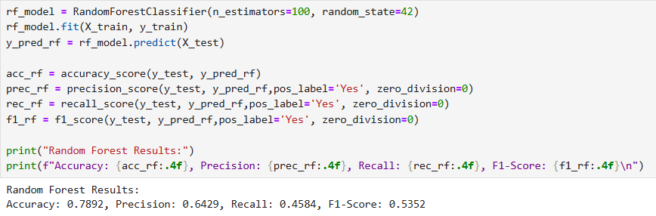
RANDOM FOREST
  Aggregates predictions from multiple decision trees to enhance accuracy in churn prediction.
  The accuracy score obtained is 0.7892.

Slide 15
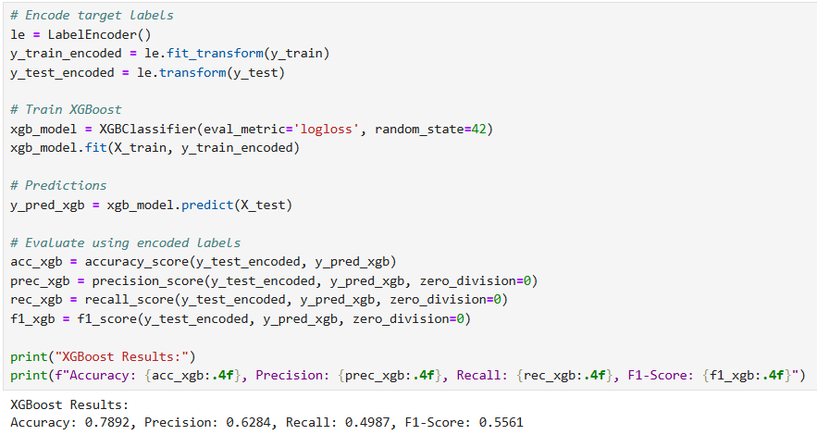
XG BOOST
  Sequentially constructs decision trees that correct previous errors to achieve high-precision churn predictions.
  The accuracy score is 0.7892.

Slide 16
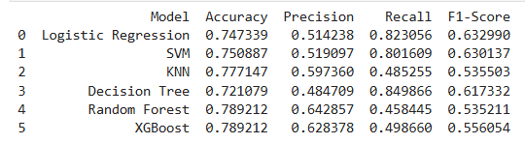
MODEL COMPARISON
  Compared accuracy score of all six models and plotted for visualization of comparison.
  The best accuracy score obtained in XGBOOST & RANDOM FOREST model.

Slide 17
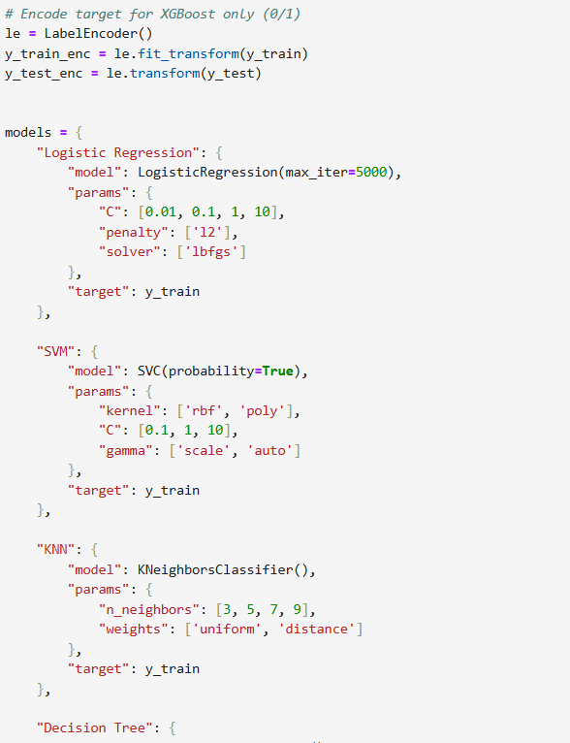
HYPER PARAMETER TUNING
  Hyperparameter tuning is used to optimize model settings to improve customer churn prediction accuracy.

Slide 18
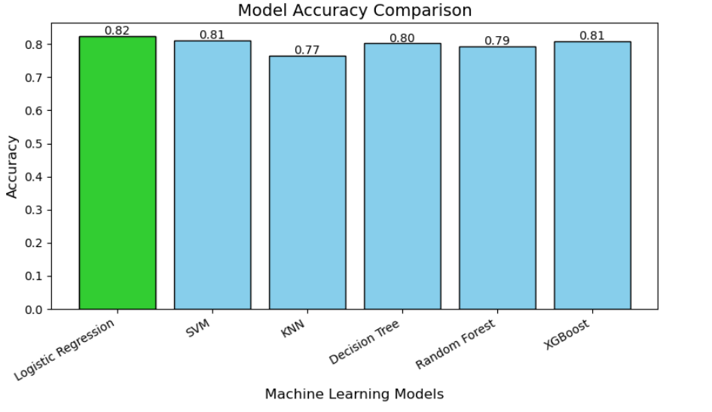
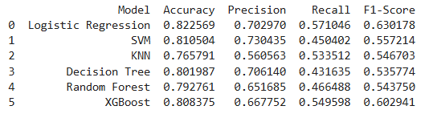
MODEL COMPARISON
  Compared accuracy score of all six models and plotted for visualization of comparison After Tuning.
  The best accuracy score obtained in LOGISTIC REGRESSION model.

Slide 19
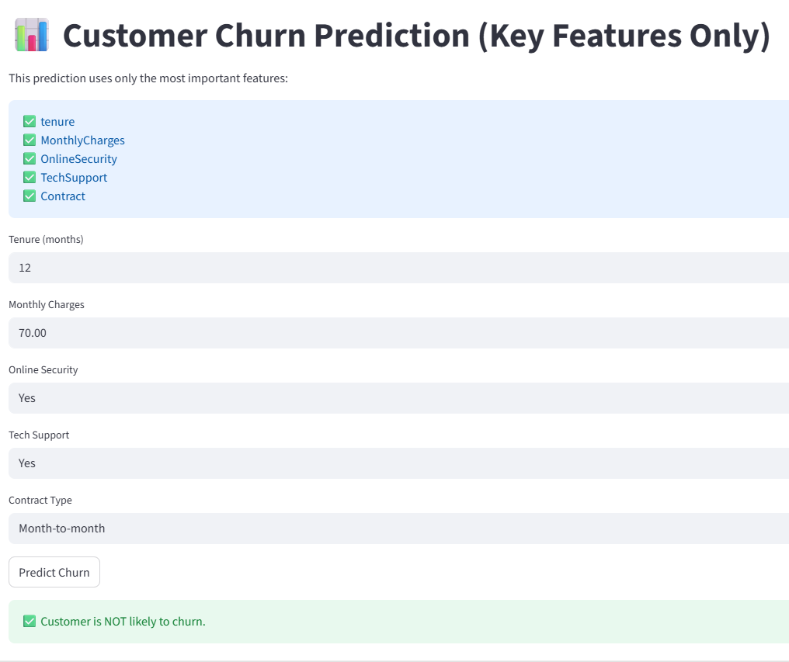
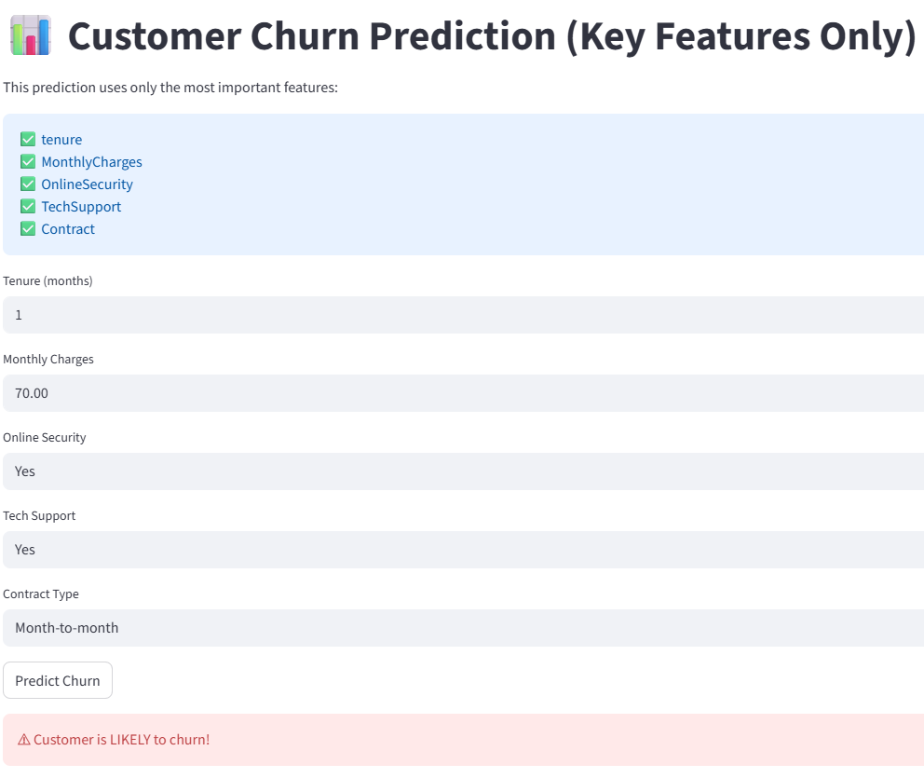
MODEL DEPLOYMENT
  After performing Hyperparameter tuning for the best model Logistic Regression saved the model, label encoder and scaler as .pkl file using joblib.
  Deployed app using Streamlit in PYCHARM.

Slide 20
CONCLUSION
  Objective: Predict customer churn to identify at-risk customers and help the company take preventive actions to improve retention.
  Dataset Overview: Included customer demographics, contract details, payment methods, tenure, and charges; 25–30% of customers were churners.
  Churn Drivers: Short tenure, month-to-month contracts, high monthly charges, and electronic check payments increase churn risk.
  Retention Indicators: Longer tenure, longer contracts, and automatic payments are linked to lower churn.
  Model Performance: Tested Logistic Regression, SVM, KNN, Decision Tree, Random Forest, and XGBoost; Logistic Regression Model performed best with 82.2% accuracy.
  Key Findings: Churn is mostly influenced by contract type, monthly charges, tenure, and payment method; loyal long-term customers are less likely to churn.
  Conclusion & Recommendations: Logistic Regression is the most effective predictor; insights suggest encouraging long-term contracts and monitoring high-risk customer segments for retention strategies.

Slide 21
THANK YOU

