Slide 1
Digital Portfolio
STUDENT NAME: S.ABDUL KADHAR
REGISTER NO AND NMID: asunm163u24cs147
DEPARTMENT: B.SC.COMPUTER SCIENCE
COLLEGE: COLLEGE/ UNIVERSITY Hindustan College of Arts and sciences

Slide 2
PROJECT TITLE
Student Digital Portfolio

Slide 3


AGENDA
Problem Statement
Project Overview
End Users
Tools and Technologies
Portfolio design and Layout
Features and Functionality
Results and Screenshots
Conclusion
Github Link

Slide 4

PROBLEM STATEMENT
Many students face difficulties in presenting their academic journey, skills, and projects in a structured, professional way. Traditional resumes lack interactivity and fail to showcase live projects effectively

Slide 5

PROJECT OVERVIEW
The portfolio is designed to be responsive and user-friendly.
It personal details, education, skills, and achievements.
It integrates project showcases with live demos and GitHub links.
The portfolio is designed to be responsive and user-friendly.
Notes:
Hj

Slide 6
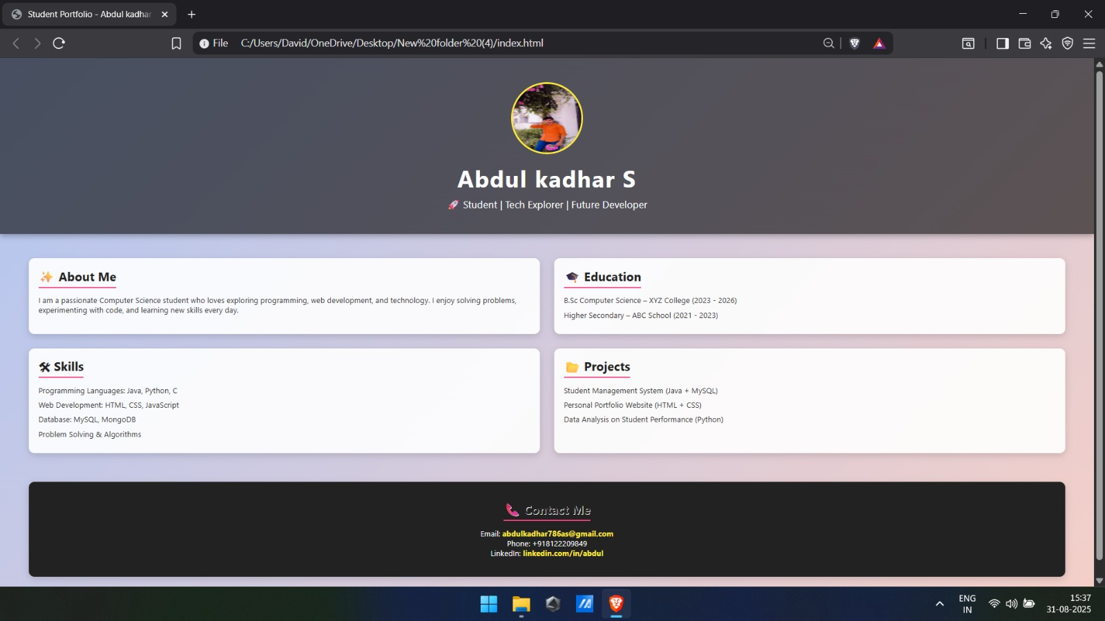
SCREENSHOT

Slide 7

WHO ARE THE END USERS?
Students: To showcase their skills and projects.
Recruiters & Companies: To evaluate candidates’ technical expertise.
Academic Institutions: To maintain digital records of students’ work.

Slide 8

TOOLS AND TECHNIQUES
Frontend: HTML5, CSS3, JavaScript
Backend: Node.js / PHP (optional for dynamic content)
Database: MySQL / MongoDB
Version Control: GitHub
Design Tools: Figma / Canva for layout design

Slide 9
POTFOLIO DESIGN AND LAYOUT
Clean, modern UI with responsive design
Two-column grid for About, Skills, Projects
Profile photo & contact details at the top
Sections with smooth scrolling & navigation bar
9

Slide 10
FEATURES AND FUNCTIONALITY
Profile introduction with photo & contact details
Education & skills section with visual highlights
Projects with descriptions, images, and GitHub links
Contact form for recruiters
Mobile-friendly responsive design

Slide 11

RESULTS AND SCREENSHOTS
Successfully hosted personal portfolio webpage
Improved visibility of academic achievements & skills
Screenshots:
Homepage
About & Skills section
Projects showcase
Contact page
3/21/2024 Annual Review
11

Slide 12
CONCLUSION
The Digital Portfolio provides a structured and modern way for students to represent themselves. It bridges the gap between traditional resumes and interactive online profiles, making recruitment and skill showcasing more effective.
12

