Slide 1

Car24 Data Analysis Using Web Scraping and EDA
By,
Abdul Kaif
Nishath
Yashwanth
From,
Batch no.425

Slide 2

Agenda (This should be the PPT flow)
Objective of the Project
Data scraping using web scraping
Data Preprocessing
Basic Checks
Data Visualization
Conclusion (Key finding overall)

Slide 3
Objective of the Project
The primary objective of this project is to perform Car24 data analysis by leveraging Python-based tools and libraries. The workflow includes:
Web Scraping: Utilize the BeautifulSoup library and re (regular expressions) to extract and structure raw data from the Car24 website.
Data Cleaning & Transformation: Apply NumPy and Pandas to clean, format, and preprocess the dataset, ensuring consistency and readiness for analysis.
Exploratory Data Analysis (EDA): Use Matplotlib and Seaborn to visualize key patterns, trends, and relationships within the dataset, enabling actionable insights.

Slide 4
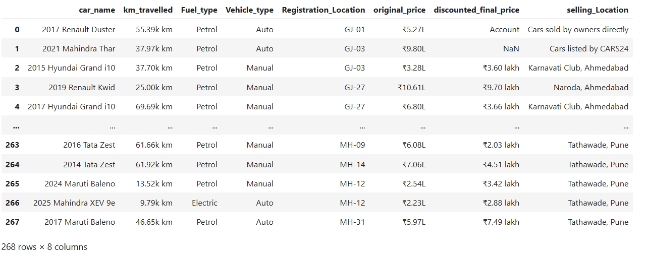
Data scraping using web scraping
Data gathering by using web scraping (uncleaned dataset)

Slide 5
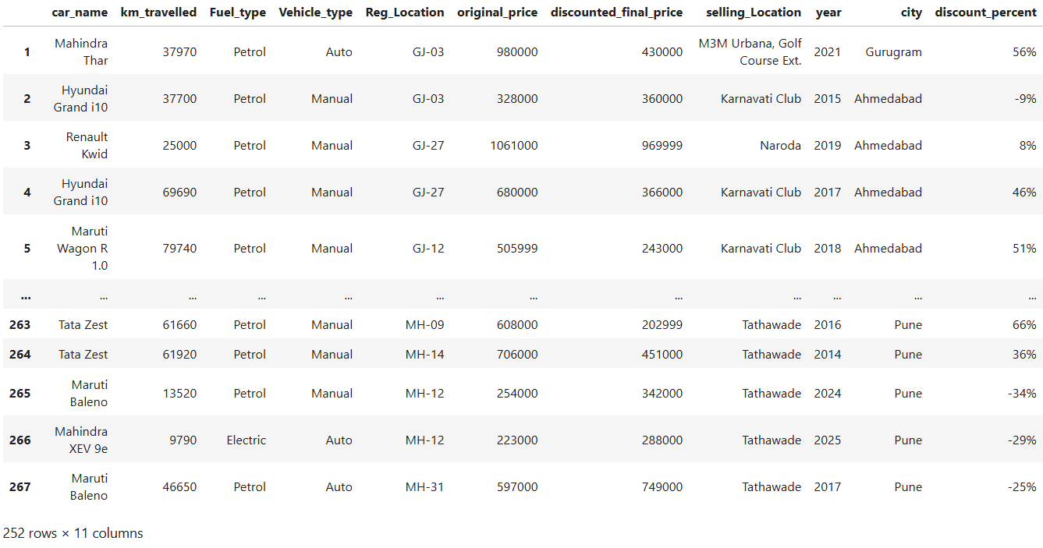
cleaned dataset

Slide 6
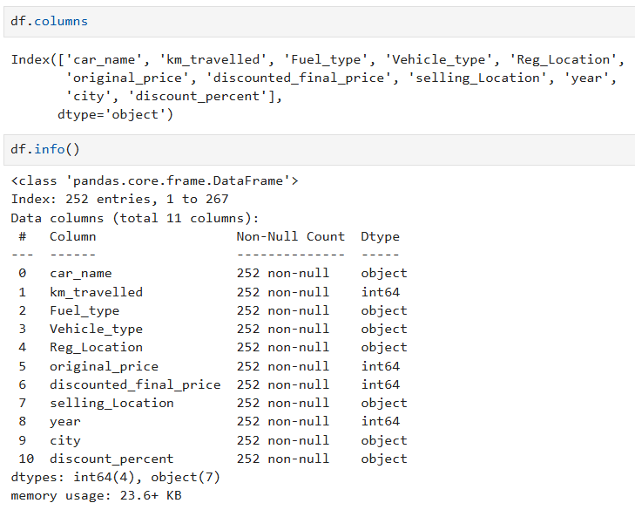
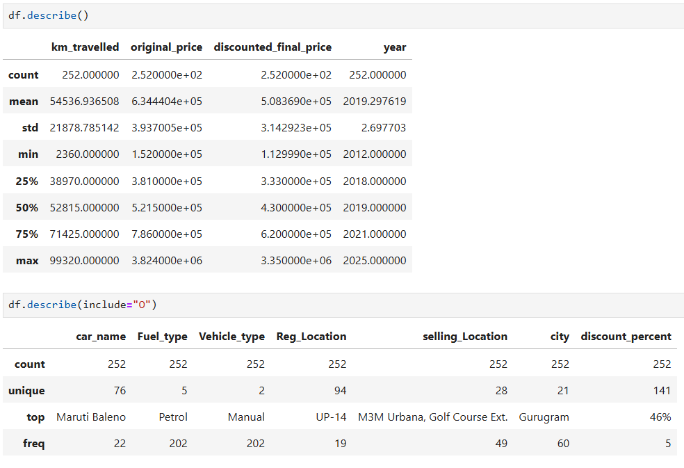
Basic Checks

Slide 7
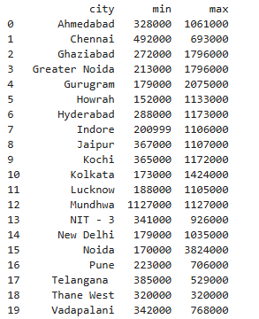
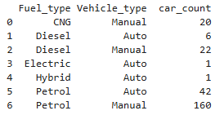
Data Visualization – Non visual

Slide 8
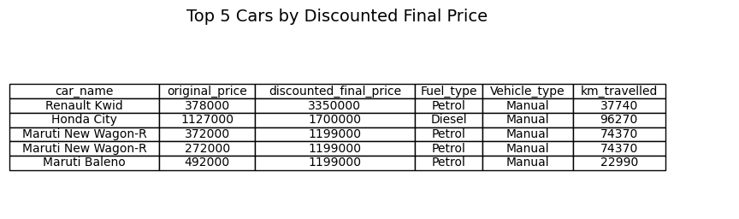

Slide 9
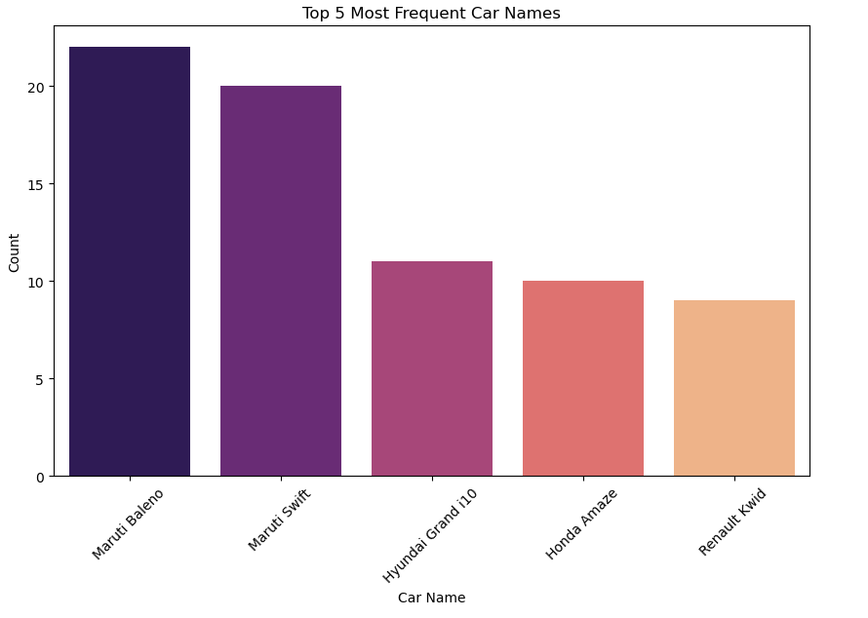
Data Visualization – Visual analysis
Maruti Baleno and Maruti Swift dominate the dataset, indicating high availability.

Slide 10
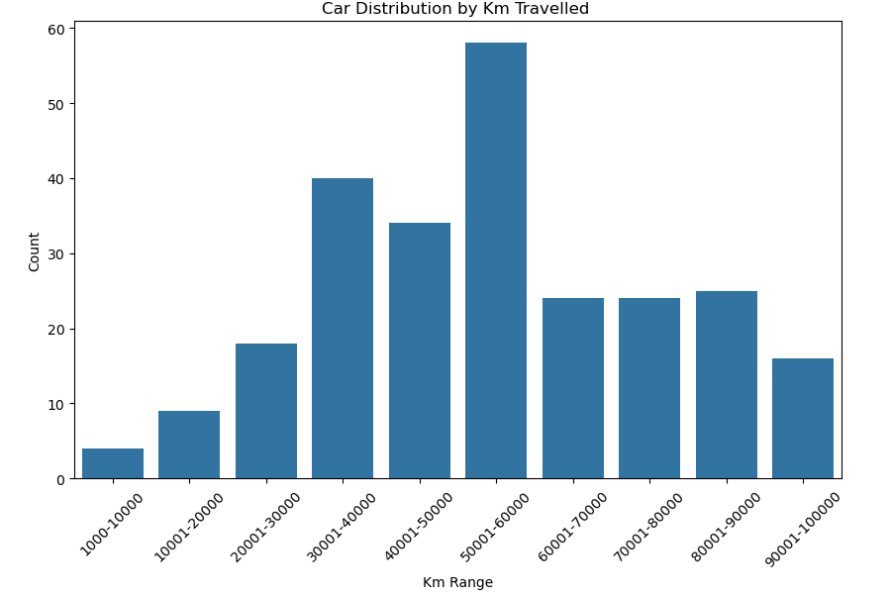
Cars with 50,001–60,000 km traveled are the most common, suggesting a sweet spot for resale mileage.

Slide 11
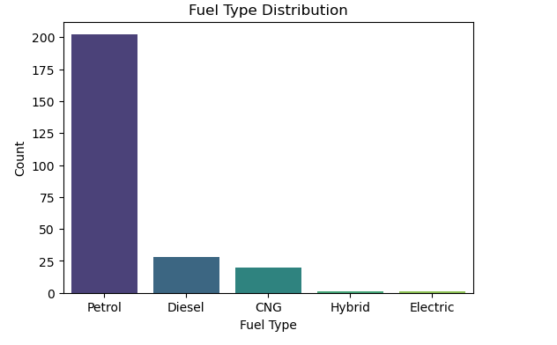
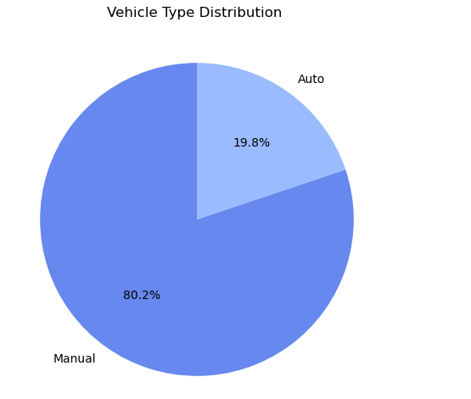
Most all are petrol type vehicles only.
80.2% are of manual type

Slide 12
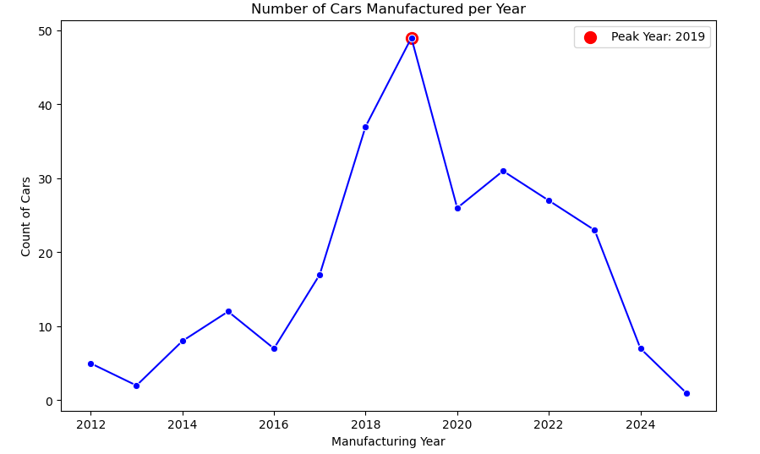
Vehicles which was manufactured in the year 2019 are more and we observe latest model of car are not available.

Slide 13
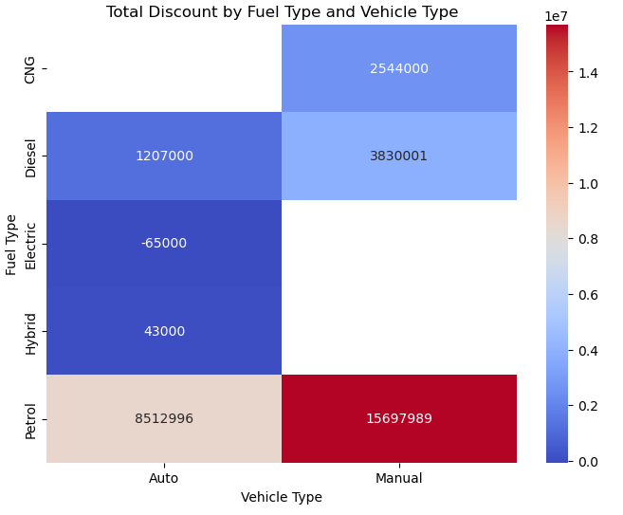
Vehicle with petrol fuel type and manual type has highest amount of discount.

Slide 14
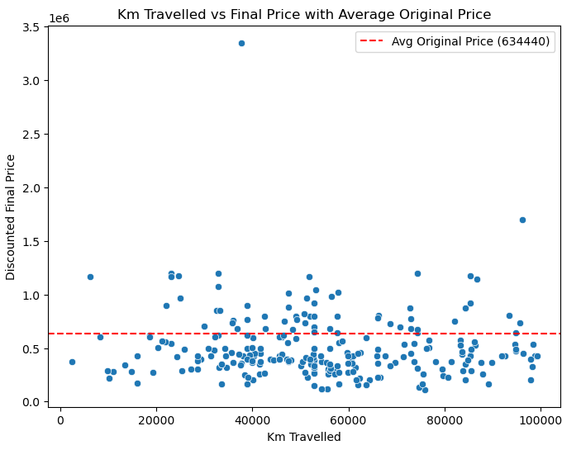
Irrespective of the price and distance travelled of the vehicles, the average final price is 6,34,440

Slide 15
Conclusion
Maruti Baleno has most available
Manual Vehicle Types has highest availability
No latest model of car
No accurate final price with respective distance travelled
Almost 25% of cars from 2019 model

Slide 16


