Slide 1

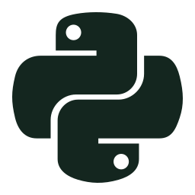


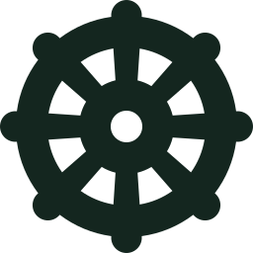


CampusDesk
DEVOPS CAPSTONE
A campus IT helpdesk, delivered from laptop to GitOps-managed Kubernetes
T. Abdul Kalam Azad
24BCS10053
Notes:
Hi, I'm T. Abdul Kalam Azad, 24BCS10053. My capstone is CampusDesk: a campus IT helpdesk. The application is my own; around it I built the full DevOps delivery path from the course: tests, containers, CI/CD with security gates, a container registry, GitOps with Argo CD, Kubernetes with Helm, Terraform for AWS, and monitoring with Prometheus and Grafana.

Slide 2
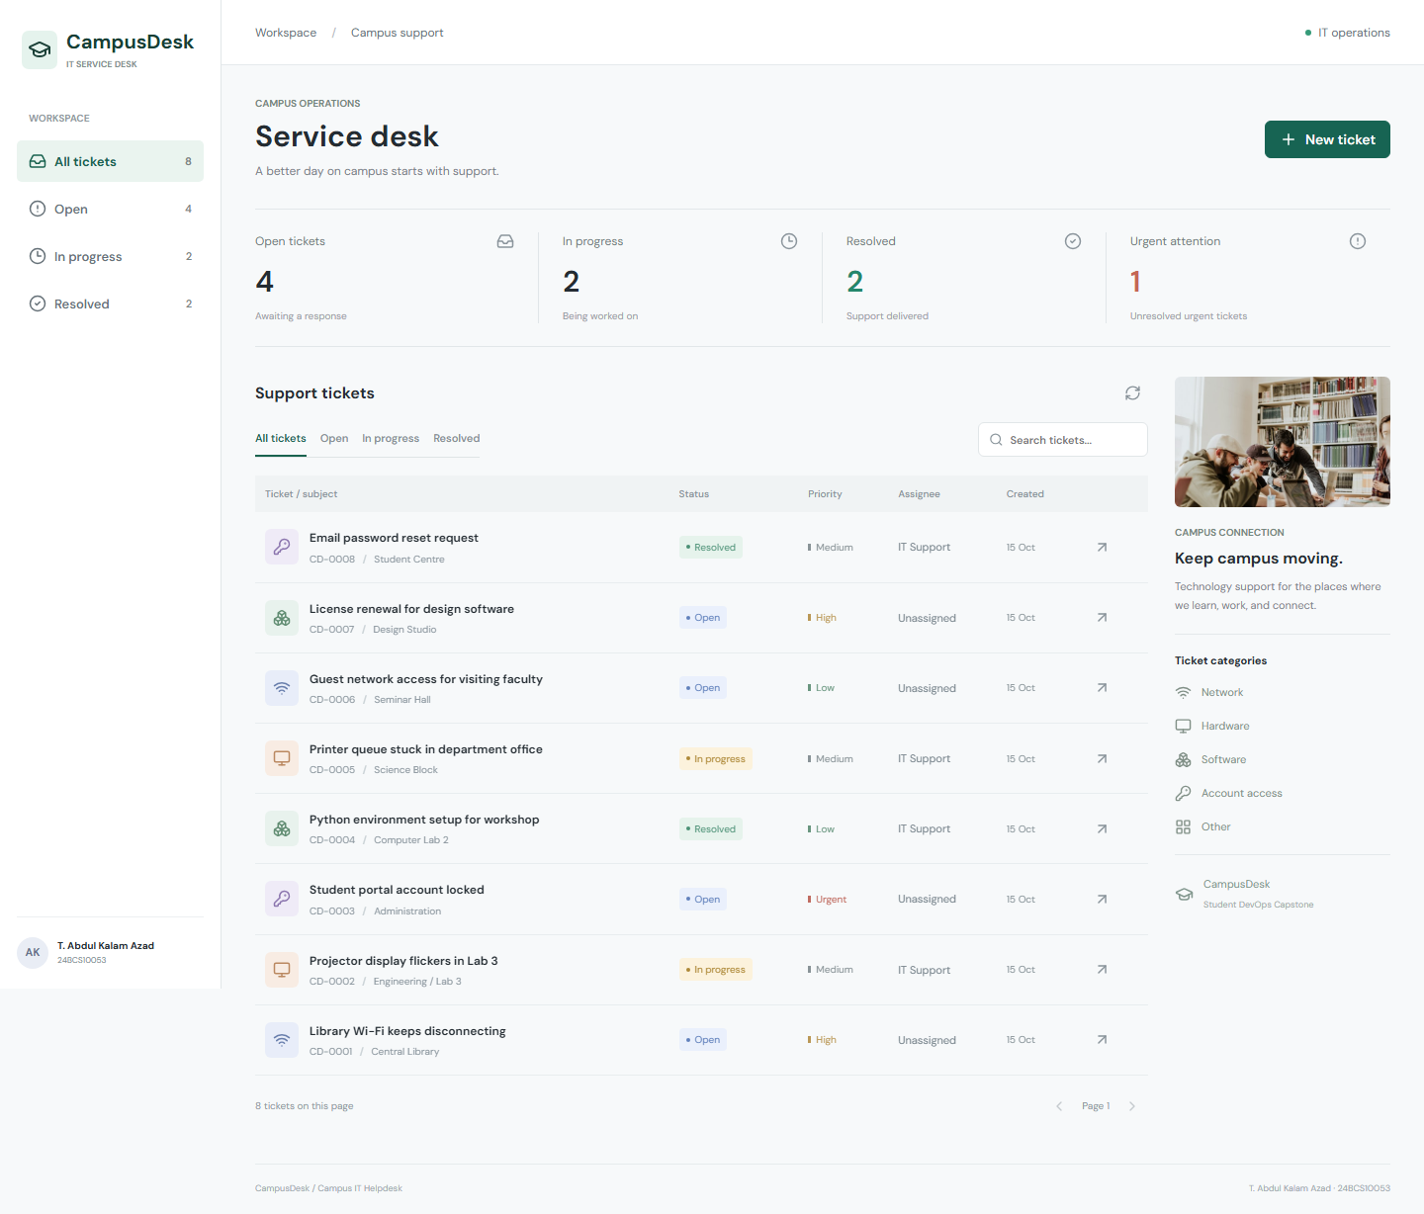




Campus IT requests need one clear queue
Report
Students and staff raise network, hardware, software or access issues
Prioritise
Support sets category, priority (low to urgent) and an assignee
Track
Status filters and search across title, requester and location
Resolve
Tickets move open, in progress, resolved; live stats on top
Notes:
The problem: campus IT requests arrive by email, calls and walk-ins, so nothing has a clear owner or status. CampusDesk gives one queue. A student reports an issue, the support team sets the category, priority and assignee, everyone can search and filter, and tickets move from open to in progress to resolved. The overview cards show the live counts, including unresolved urgent tickets.

Slide 3






One commit travels the whole delivery path
Developer
GitHub Actions
Trivy
GHCR
GitOps commit
Argo CD
Kubernetes
git push to main
security + tests
HIGH/CRITICAL gate
image : commit SHA
values-release.json
auto sync
Helm release
Terraform provisions the platform
Prometheus + Grafana watch it run
VPC with 2 public + 2 private subnets, NAT gateway, EKS and a managed node group in ap-south-1. The same Helm chart deploys to it with values-aws.yaml.
Every backend pod exposes /metrics. Prometheus scrapes each replica; Grafana shows traffic, P95 latency and errors, with two alert rules.
Notes:
This is the whole story on one slide. I push to main. GitHub Actions runs the security gates and tests, builds both images and Trivy blocks anything with a HIGH or CRITICAL CVE. Only then are the images pushed to GHCR, tagged with the full commit SHA, never latest. CI then commits those tags into values-release.json. Argo CD watches the repo and syncs the Helm chart into Kubernetes. Terraform creates the AWS network and EKS cluster underneath, and Prometheus and Grafana watch the running app.

Slide 4
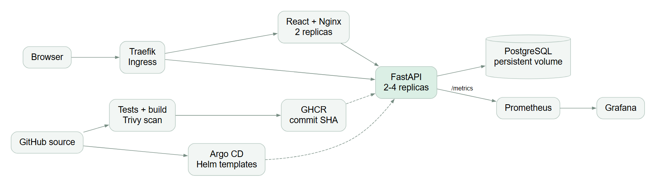



Architecture at a glance
Relative /api calls
Migrations run once
One chart, two clusters
The browser never knows a backend hostname. The Ingress sends /api to FastAPI and / to the React frontend.
An Alembic Job (Argo CD sync hook) upgrades the schema before the backend becomes ready.
The same Helm chart runs locally on kind and on Terraform-built EKS with values-aws.yaml.
Notes:
Inside the campusdesk namespace: Traefik Ingress routes slash to two frontend pods and slash api plus slash metrics to two to four backend pods, scaled by an HPA. PostgreSQL runs as a StatefulSet with a persistent volume. A migration Job runs alembic upgrade once per release before the backend is ready, instead of every replica racing to migrate. Prometheus scrapes each backend pod through a headless service, and Grafana reads from Prometheus. Argo CD renders the Helm chart, and Terraform builds AWS.

Slide 5



Tech stack
Frontend
Backend
Database
React 19, Vite 6, hand-written responsive CSS, served by unprivileged nginx
Python 3.13, FastAPI, SQLAlchemy, Pydantic, Uvicorn
PostgreSQL 17 with Alembic migrations
Testing
Containers
CI/CD + security
pytest (SQLite locally, PostgreSQL in CI), Ruff, Playwright
Non-root Alpine backend, multi-stage frontend, Docker Compose
GitHub Actions, Trivy, Bandit, pip-audit, npm audit, Gitleaks, GHCR
Kubernetes
Infrastructure
Observability
Helm, Traefik Ingress, HPA with metrics-server, Argo CD
Terraform: AWS VPC, NAT, EKS, managed node group, EBS CSI
Prometheus custom metrics, Grafana dashboard, alert rules
Notes:
The stack in nine layers. React and Vite for the UI, served by an unprivileged nginx. FastAPI with SQLAlchemy and Pydantic for the API, PostgreSQL 17 with Alembic for the schema. pytest, Ruff and Playwright for quality. Docker and Compose locally. GitHub Actions with five security tools and GHCR. Helm, Traefik, the HPA and Argo CD on Kubernetes. Terraform for AWS. Prometheus and Grafana for observability.

Slide 6
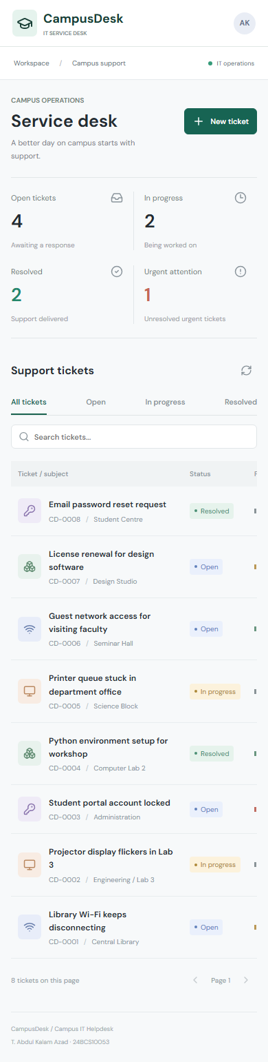
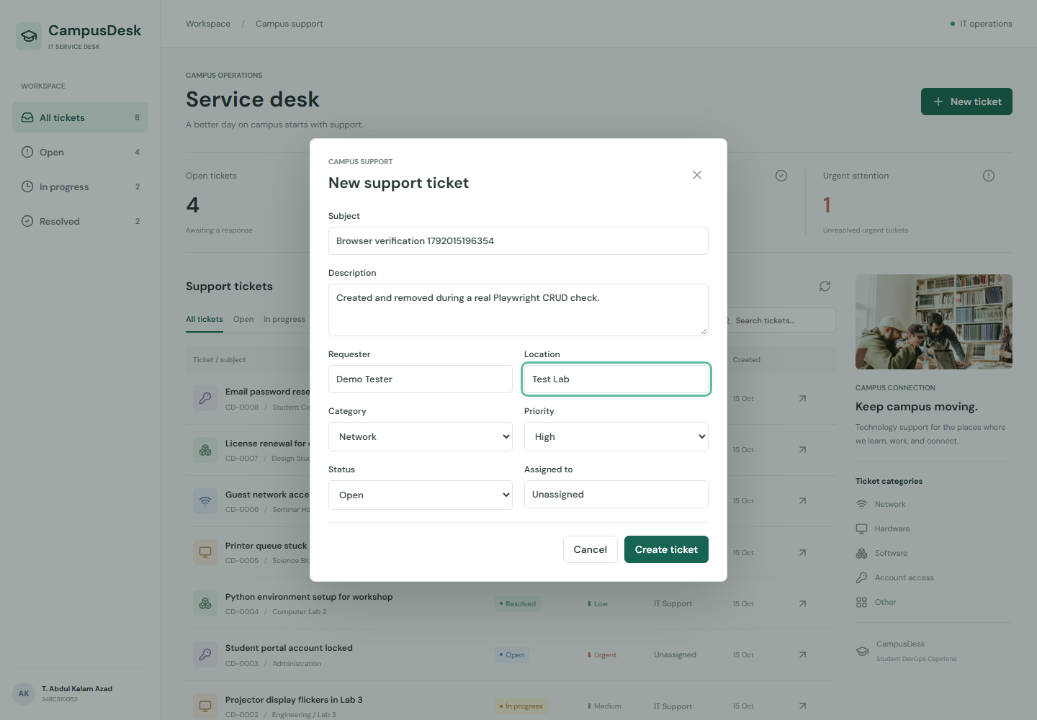
The application and its REST API
Method | Path | Purpose
GET | /api/tickets | list, filter, search, paginate
GET | /api/tickets/{id} | one ticket or 404
POST | /api/tickets | validate and create (201)
PUT | /api/tickets/{id} | update editable fields
DELETE | /api/tickets/{id} | delete (204)
GET | /api/stats | counts incl. urgent
GET | /health /ready | liveness, readiness
GET | /metrics | Prometheus format
Invalid input returns 422, failed writes roll back with 503, and search escapes SQL wildcards. Full docs live at /docs.
Notes:
Here's the app itself: the create ticket dialog, and the same UI on a phone, it works down to 320 pixels. The API has full CRUD on slash api slash tickets plus stats, and three system endpoints: health for liveness, ready for readiness that checks the database, and metrics for Prometheus. The API is strict: categories, priorities and statuses are enums, unknown fields are rejected with 422, and a failed database write is rolled back and returns 503. Swagger docs are at slash docs.

Slide 7
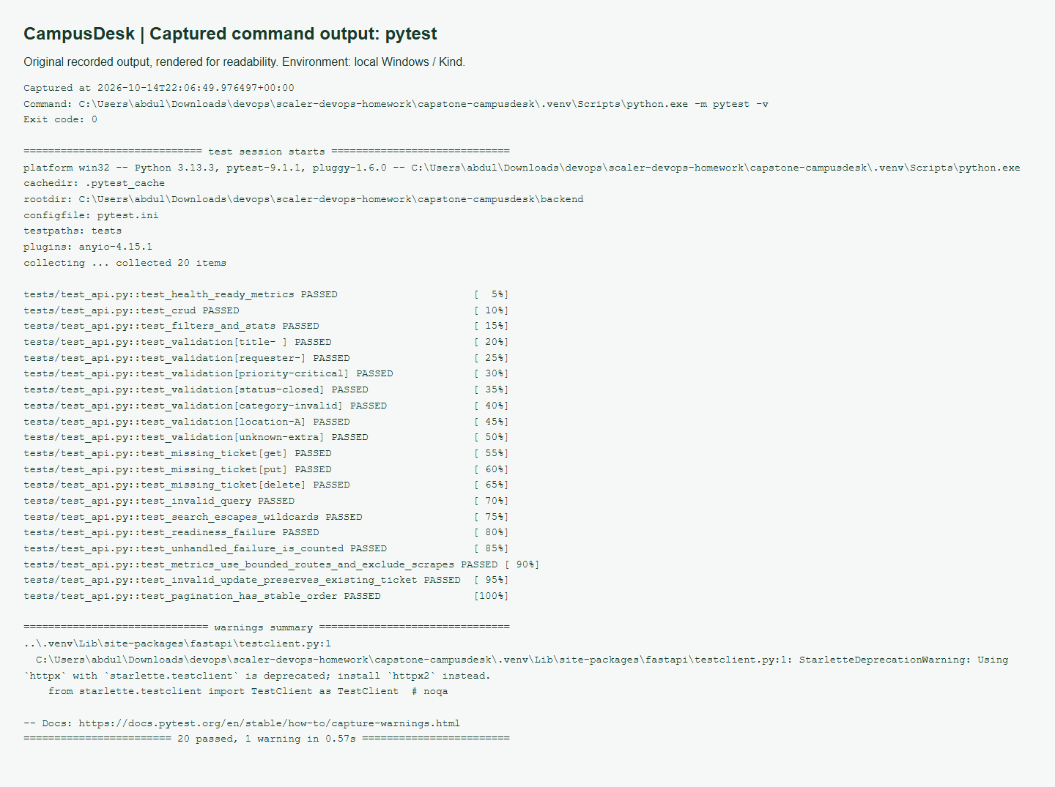


Tests are the first quality gate
40
pytest cases, all passing
Never the app database
Isolated SQLite locally, a dedicated PostgreSQL in CI; the suite refuses to start if both URLs match.
Real migration, rolled back
Schema built by Alembic; every test runs in a transaction that is rolled back.
Browser checks
Playwright drives real CRUD, validation and narrow screens against the kind deployment.
Notes:
Testing is the first gate. Forty pytest cases cover health and readiness, full CRUD, filters and pagination, validation edge cases like NUL characters PostgreSQL can't store, failure handling and metrics. The important design choice: tests never touch the application database. Locally they use in-memory SQLite, in CI a separate PostgreSQL service, and the suite refuses to run if the test URL equals the real one. Playwright browser checks then test the deployed app in CI.

Slide 8

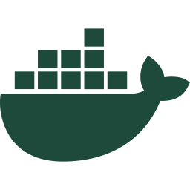
Two small, non-root container images
campusdesk-backend
campusdesk-frontend
python:3.13-alpine, patched with apk upgrade
Dependencies installed before code for layer caching
pip and setuptools removed after install
Runs as uid 10001, HEALTHCHECK on /health
Stage 1: node:24-alpine runs npm ci + build
Stage 2: nginx-unprivileged serves only dist/
Node never reaches the runtime image
Runs as uid 101 on port 8080
docker compose up --build
postgres
migrate (one-shot)
backend :8000
frontend :3000
The backend image cannot install packages at runtime, which also removes the setuptools CVE path shown on the security slide.
Notes:
Two images. The backend is Python 3.13 on Alpine, upgraded at build time, with dependencies installed before the code so layers cache well, and pip removed afterwards so nothing can be installed at runtime. It runs as user 10001. The frontend is a multi-stage build: Node builds the React app, then only the dist folder is copied into an unprivileged nginx image running as user 101, so Node never ships. Docker Compose brings up postgres, a one-shot migration, the backend and the frontend on port 3000.

Slide 9

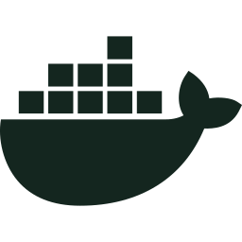
CI/CD: every gate must pass before publish
source-security
publish
Bandit, pip-audit, npm audit and Gitleaks
main only, the one job with write access. Pushes the tested images to GHCR as :<commit SHA>
build-scan-deploy
Build both images, Trivy gate, Helm install on fresh kind, smoke + browser tests
test
GitOps promotion
Ruff, pytest on PostgreSQL, alembic check, npm build, helm lint, terraform validate
Commits the tags to values-release.json with [skip ci]; Argo CD deploys it
Triggered on every push to main, on capstone pull requests, and manually. No continue-on-error, no latest tag, main runs never cancelled.
Notes:
The pipeline has four jobs. source-security and test run in parallel: Bandit, pip-audit, npm audit and Gitleaks on one side; Ruff, pytest against a real PostgreSQL service, the Alembic round trip, the frontend build, helm lint and terraform validate on the other. If both pass, build-scan-deploy builds the two images, Trivy scans them, and the chart is installed on a fresh kind cluster with smoke and browser tests. Only then does publish, the only job with write permission, push the exact tested images to GHCR tagged with the commit SHA, and commit those tags for Argo CD. No gate uses continue-on-error.

Slide 10




DevSecOps: a real CVE, found and fixed
48
0
SAST
Bandit
Dependencies
findings on the first Debian-based backend image
HIGH/CRITICAL on both published images today
pip-audit, npm audit
Secrets
Gitleaks
CVE-2025-47273 (HIGH)
A path-traversal flaw in old setuptools' package-index code: a crafted package name could write files outside the intended directory. Fix: rebuild on patched Alpine and remove pip/setuptools after installing dependencies, because the running service never installs packages.
Containers
Trivy, exit-code 1
Runtime
non-root, seccomp
A clean scan means no known HIGH/CRITICAL CVE at scan time, not proof the app is secure. That is why every build rescans.
Notes:
Security is layered. Bandit scans Python source, pip-audit and npm audit check dependencies, Gitleaks looks for secrets, and Trivy scans both images and fails the job on any HIGH or CRITICAL CVE. The gate actually stopped me: my first Debian-based backend image had 48 findings, including CVE-2025-47273, a path traversal in old setuptools that could let a crafted package name write files outside the target directory. I moved to patched Alpine and removed pip and setuptools after install, since the service never installs packages at runtime. Now both images scan clean. A clean scan is not a guarantee, it only means no known HIGH or CRITICAL CVE today, so every build rescans.

Slide 11
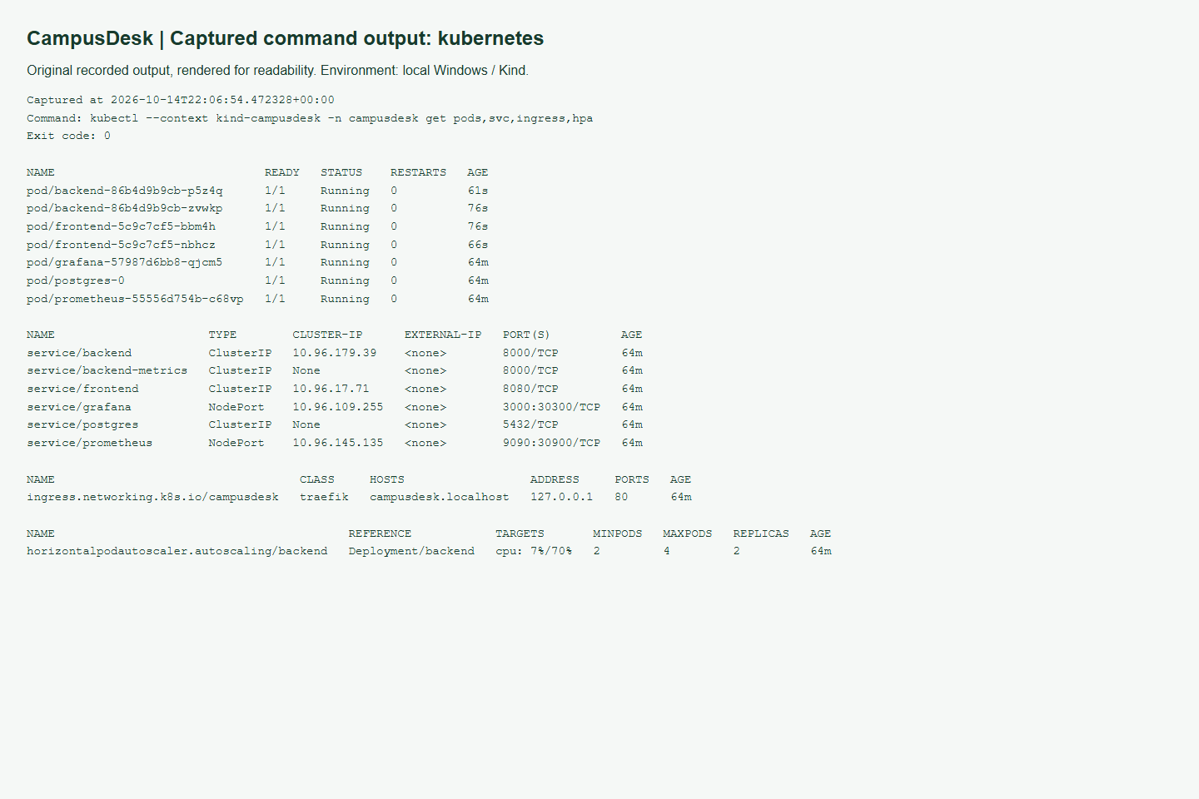

Kubernetes + Helm: what the chart creates
Traefik Ingress
frontend x2
campusdesk.localhost
Deployment + ClusterIP
backend x2 to 4
Deployment + ClusterIP + HPA
Migration Job
PostgreSQL
alembic upgrade, once per release
StatefulSet + 2Gi PVC
/ to frontend /api /metrics to backend
Probes: startup + liveness on /health, readiness on /ready. Secrets are generated by Helm and never committed.
Notes:
One Helm chart creates everything. A Traefik Ingress on campusdesk.localhost routes slash to two frontend pods and slash api to the backend, which starts at two replicas and an HPA can scale to four at 70 percent CPU. PostgreSQL is a StatefulSet with a 2 gigabyte persistent volume. A migration Job runs once per release. Backend probes: startup and liveness on health, readiness on ready, so a database outage stops traffic without restarting healthy pods in a loop. Database and Grafana passwords are generated by Helm on first install and reused on upgrade. On the right is kubectl get pods, services, ingress and HPA, all running.

Slide 12
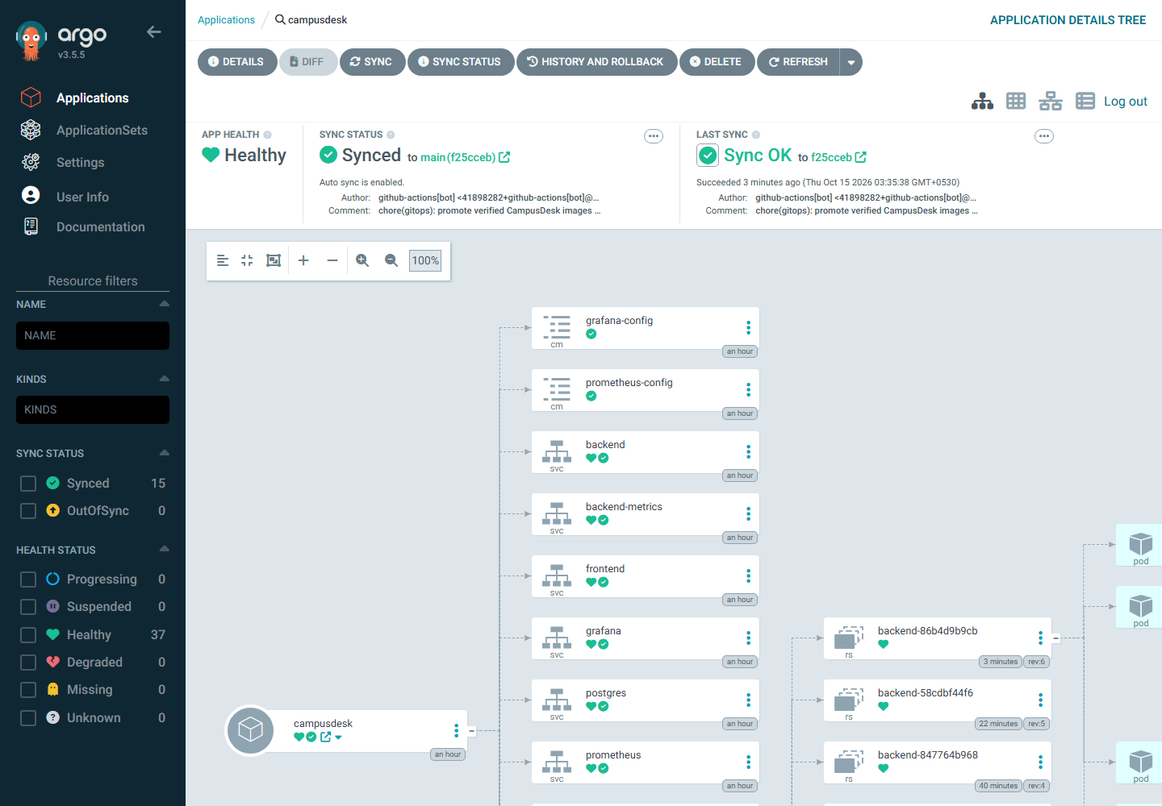
GitOps: Git records what is deployed
1
CI passes every gate
tests, scans and the kind smoke deploy
2
CI commits the image tags
helm/campusdesk/values-release.json, [skip ci]
3
Argo CD sees the commit
Application tracks main, automated sync
4
Cluster converges
self-heal reverts manual drift
Every commit that passes the pipeline is deployed automatically, and nothing else is. Pruning stays off so a bad commit cannot delete the database volume.
Notes:
GitOps means Git is the record of what's deployed. After every gate passes, CI commits the new image tags into values-release.json, with skip ci so it doesn't loop. The Argo CD Application tracks main, sees the commit and syncs the Helm chart; self-heal undoes any manual change in the cluster. So every commit that passes the pipeline is deployed, and nothing else is. I left automatic pruning off on purpose, so a bad commit can never delete resources like the database volume. Here the application is Synced and Healthy.

Slide 13
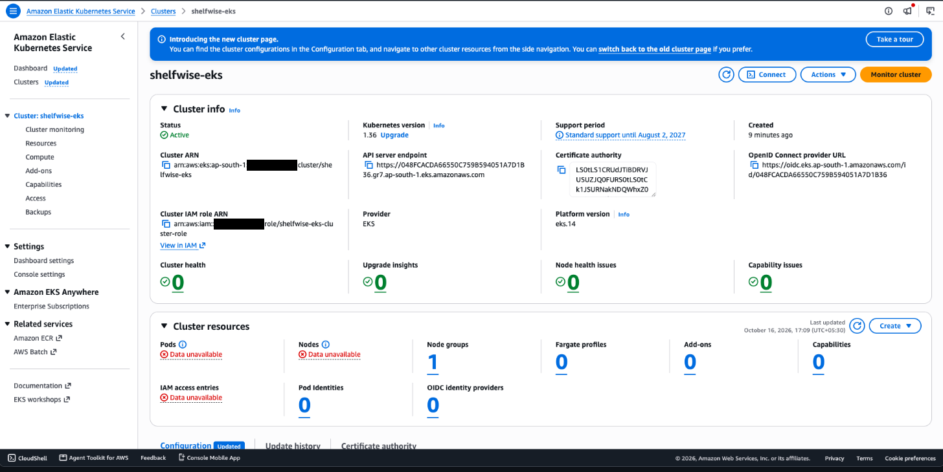

Terraform: AWS VPC + EKS as code
VPC 10.42.0.0/16 | ap-south-1
Availability zone 1
Availability zone 2
Public subnet
Public subnet
10.42.1.0/24 + NAT gateway
10.42.2.0/24 + load balancers
Private subnet
Private subnet
10.42.11.0/24
10.42.12.0/24
init + validate
plan
apply
destroy
EKS worker
t3.medium
EKS worker
t3.medium
clean
22 to add
22 added
22 destroyed
Console evidence is from my ShelfWise EKS Terraform run (22 resources, applied and destroyed). The CampusDesk code above is validated in CI on every push.
Managed node group: desired 2, scales 1 to 3. EBS CSI role for volumes. API access limited to trusted CIDRs.
Notes:
Kubernetes runs workloads, but it doesn't create the network. Terraform does. The CampusDesk config uses the community vpc and eks modules: a 10.42 slash 16 VPC in ap-south-1 across two availability zones, two public subnets with a single NAT gateway, two private subnets for the worker nodes, and an EKS cluster with a managed node group of t3.medium nodes, desired two, scaling one to three. CI runs terraform fmt and validate on every push. The console screenshots are from my ShelfWise EKS run: plan with 22 resources, apply, the active cluster and nodes, then destroy with nothing left, so there are no runaway costs.

Slide 14
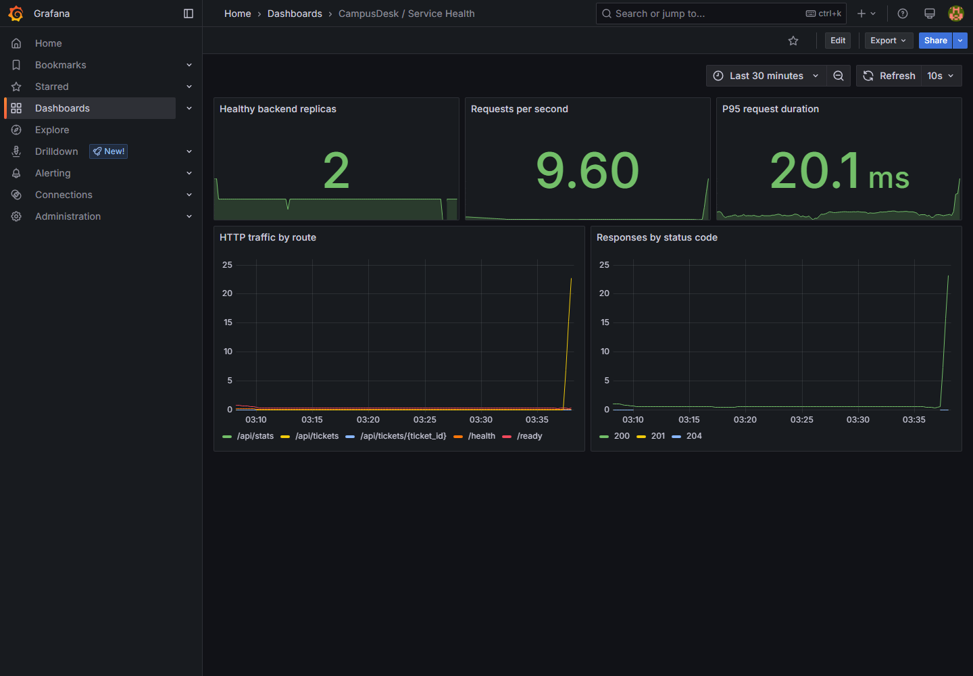




Observability: Prometheus + Grafana
Custom /metrics
campusdesk_http_requests_total and request duration histograms, labelled by route template
Per-pod scraping
A headless backend-metrics Service lets Prometheus scrape every replica
5 dashboard panels
Healthy replicas, requests/s, P95 latency, traffic by route, status codes
2 alert rules
Backend unavailable 2 min; 5xx above 5% for 5 min
Notes:
The backend exposes custom Prometheus metrics: a request counter and a latency histogram, labelled by route template rather than ticket ID, so the number of time series stays bounded. Prometheus discovers every backend pod through a headless service, so one replica can't hide another's counters. The Grafana dashboard, provisioned from the chart, shows healthy replicas, requests per second, P95 latency, traffic by route and status codes. There are two alert rules: backend unavailable for two minutes, and more than five percent 5xx responses for five minutes.

Slide 15
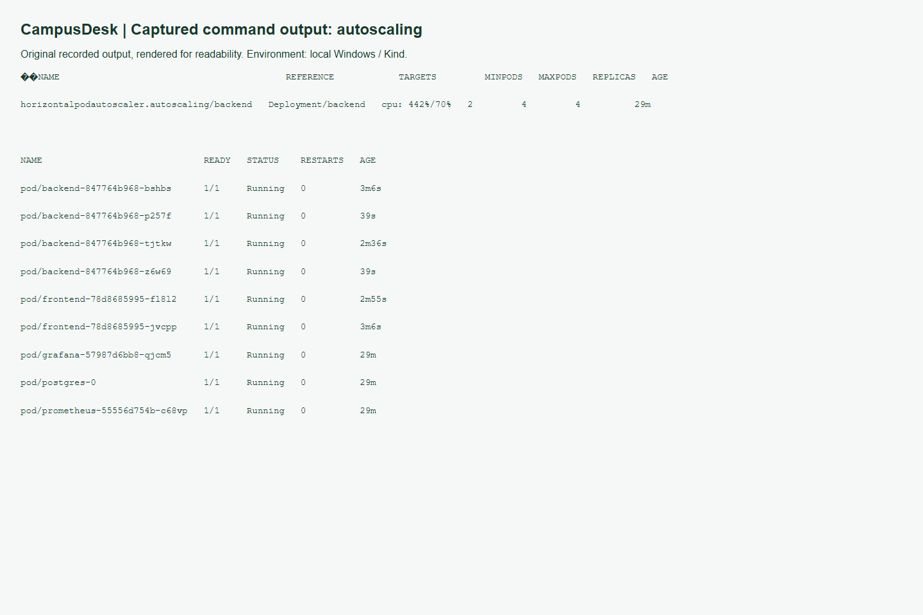
Autoscaling under real load
2 to 4
442%
backend pods (the HPA maximum)
of the 70% CPU target at peak
15,833
0
successful requests
failed requests
python scripts/load.py --seconds 60 --workers 4
Notes:
To prove the HPA works I ran a bounded load generator for 60 seconds with four workers. CPU went to 442 percent of the 70 percent target, and the HPA scaled the backend from two pods to four, its maximum. Across the run there were 15,833 successful requests and zero failures, so scaling happened without dropping traffic. The HPA needs resource requests on the pods and metrics-server, both set up by the chart and the local cluster script.

Slide 16



Troubleshooting labs: symptom, cause, fix
Broken image
Broken Service
Not ready
SYMPTOM
SYMPTOM
SYMPTOM
Pods stuck in ImagePullBackOff
ClusterIP exists, but no endpoints
Pod Running but 0/1, no endpoint
CAUSE
CAUSE
CAUSE
Pod events name a tag that does not exist
Selector app=nonexistent-backend matches no pod labels
Readiness probe on /missing-probe returns 404
FIX
FIX
FIX
kubectl set image to a real tag, watch the rollout
kubectl set selector app=backend
Fix the probe path; the pod becomes Ready
Each lab uses separate demo objects, so the real backend is never broken. helm rollback restores chart config, but not a database migration.
Notes:
Three troubleshooting labs, each on separate demo objects so the real app keeps running. First, a broken image: pods sit in ImagePullBackOff, the events name a tag that doesn't exist, and I fix it with kubectl set image. Second, a broken service: it has a ClusterIP but no endpoints, because its selector doesn't match any pod labels; no matching labels means no traffic. Third, a pod that's Running but not Ready, because the readiness probe points at a path that returns 404. One lesson: helm rollback restores the chart, but it doesn't undo a database migration.

Slide 17



Design decisions and why
/health skips the DB, /ready checks it
Image tag = full commit SHA
A database outage stops traffic instead of restarting healthy pods in a loop
Immutable, traceable deployments: commit A is image A
Publish only after scan + deploy
Migrations in a separate Job
A vulnerable or broken image is never pushed; one job holds write access
One migration per release; backend is ready only once the schema exists
Route templates as metric labels
Argo CD pruning disabled
Ticket IDs as labels would create unbounded time series
A bad commit cannot delete resources such as the database volume
Notes:
A few decisions I want to call out. Health doesn't touch the database but ready does, so an outage stops traffic rather than causing a restart loop. Images are tagged with the full commit SHA, never latest, so every deployment traces to source. Publishing happens only after Trivy and the kind deploy pass, from a single job with write permission. Migrations run in their own Job. Metrics use route templates, not IDs, to keep cardinality bounded. And Argo CD pruning is off so a bad commit can't delete the database volume.

Slide 18


Key learnings and known limits
LEARNED
NEXT STEPS
A gate only helps if a failure really blocks the release: Trivy stopped a vulnerable image
No authentication or RBAC yet
Git as the deployment record makes every release traceable to one commit
Single PostgreSQL instance; production wants RDS + backups
Separate liveness and readiness, and run migrations once, not in every replica
Plain HTTP Ingress; production adds TLS (cert-manager)
Evidence should show real runs and name the environment it came from
Local Prometheus/Grafana storage is ephemeral
Thank you github.com/abdulkalamazad1001/scaler-devops-homework
Notes:
To close: the biggest lesson is that a gate only matters if a failure really blocks the release, and Trivy proved that by stopping a vulnerable image. Git as the deployment record makes every release traceable. Liveness and readiness are different questions. Known limits: there's no authentication yet, PostgreSQL is a single instance, the Ingress is plain HTTP, and local monitoring storage is ephemeral. Production would add auth, a managed database with backups, and TLS. Thank you. Now I'll show the live walkthrough.

