Slide 1

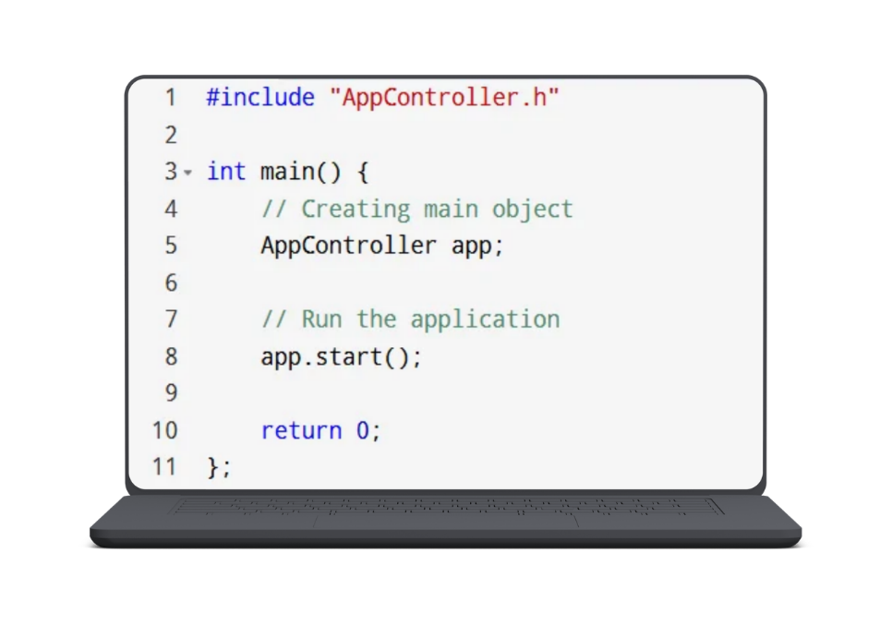
Finance app
Intro
Objective
Classes
Admin
Files
Journay
Conclusion
Finance App
(Console application)
Section: 2
U2510076, Kim Maxim
U2510080, Abdulqayumov Abdukarim
U2510087, Irgashev Akmal
U2510093, Fayzuraxmanov Shahriyor
U2510096, Ibragimov Farrux
U2510097, Raxmonov Sanjar

Slide 2
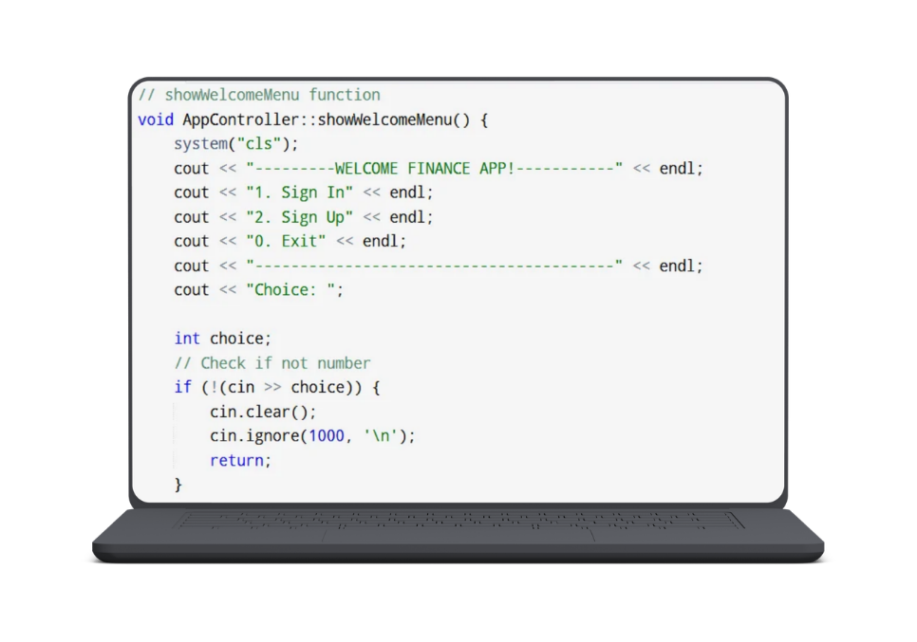
Finance app
Intro
Objective
Classes
Admin
Files
Journay
Conclusion
Objective:
Our team wants to create an app which will organize user’s incomes and expenses.
This app is mostly targeted on investors and people who work with finances. It will make the picture of their earning clear and understandable.

Slide 3
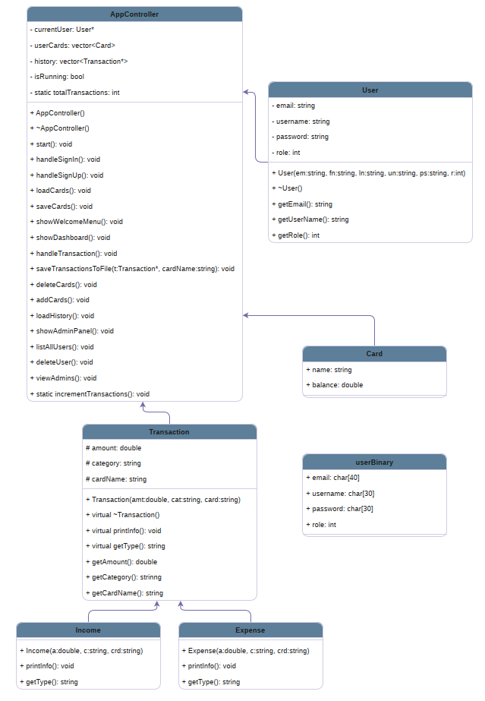
Finance app
Intro
Objective
Classes
Admin
Files
Journay
Conclusion
UML Diagram and Classes
User → AppController:
AppController holds a User* currentUser pointer
Composition:
AppController owns a vector<Card> userCards
Transaction Hierarchy:
Income and Expense inherit from base Transaction class
Polymorphic Container:
History tracked via vector<Transaction*> history

Slide 4
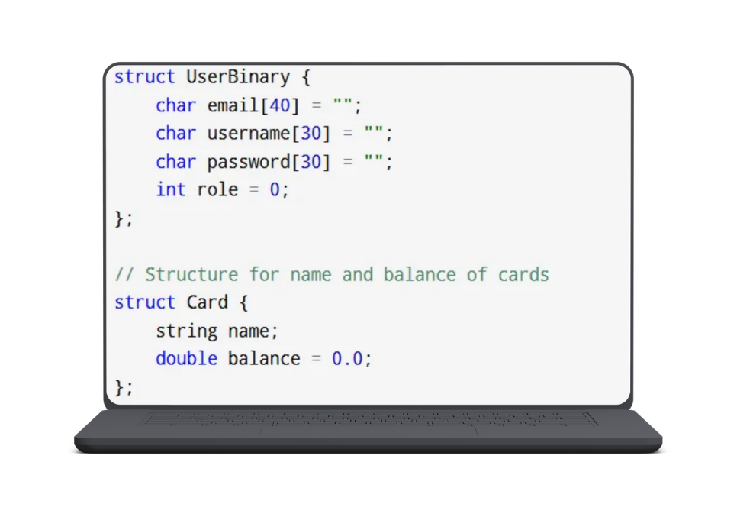
Finance app
Intro
Objective
Classes
Admin
Files
Journay
Conclusion
Why structs?
The dynamic data from the User object is copied into the userBinary struct (converting standard strings into static char arrays).
The entire userBinary structure block is dumped directly into the file as a single block of raw bytes using reinterpret_cast<char*>.

Slide 5
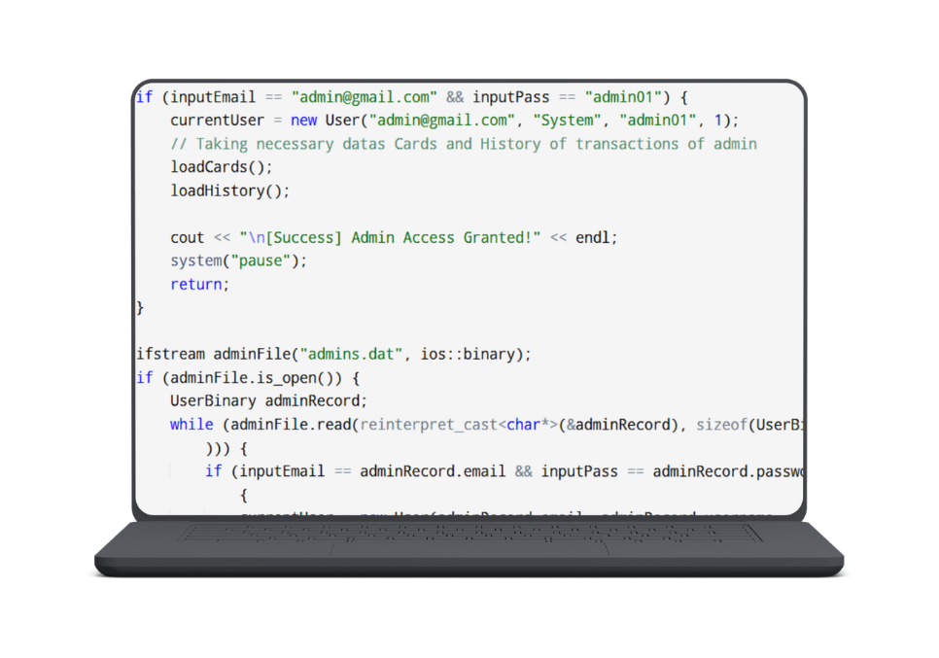
Finance app
Intro
Objective
Classes
Admin
Files
Journay
Conclusion
Admin Panel
Super Admin
Static Logic: Credential (email: "admin@gmail.com") is written directly into the source code logic, not loaded from storage.
Dynamic System Administrators
File-Driven: Loaded dynamically from the encrypted binary registry (admins.dat / users.dat with role: 1).
Authentication (SignIn()):
The system checks the role integer inside the authenticated user object.
role == 0 ➔ Regular User.
role == 1 ➔ Dynamic Admin.

Slide 6
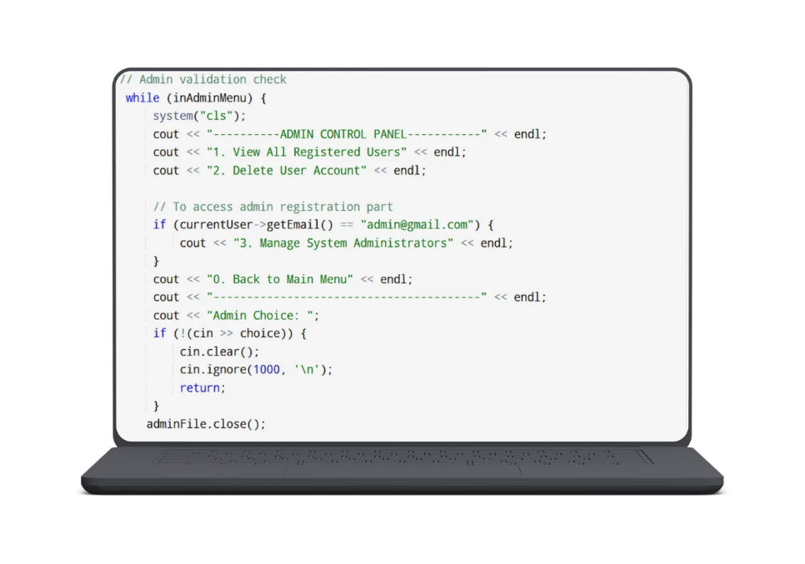
Finance app
Intro
Objective
Classes
Admin
Files
Journay
Conclusion
What Admins can do?
Super Admin:
System Recovery: Can log into the system even if the binary database file (users.dat) is corrupted or completely deleted.
Admin Management: Has exclusive access to create, view (viewAdmins), and completely revoke (delete) credentials of lower-tier dynamic administrators.
Dynamic Admins (Staff Level - Role: 1):
User Directory Oversight (AllUsers()): Can open the binary file stream and load a complete, real-time list of all registered investors on the platform.
Account Enforcements (deleteUser()): Authorized to completely purge/delete user accounts from the binary registry in case of transaction violations.

Slide 7
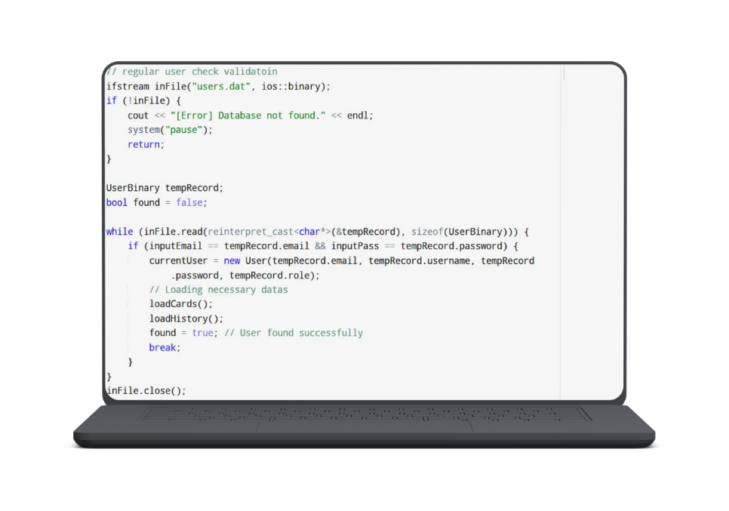
Finance app
Intro
Objective
Classes
Admin
Files
Journay
Conclusion
File Handling
Binary Storage (.dat) — Users & Admins:
Encrypts and hides credentials from human readability.
Prevents unauthorized password modifications via simple text editors.
Stream Mode: ios::binary | ios::in | ios::out.
Text Storage (.txt) — Cards & Transaction History:
Easy to read, parse, and append dynamic financial entries.
Lists of bank cards and transaction logs (expense/income history).
Stream Mode: ios::out | ios::app (Append mode for history).

Slide 8
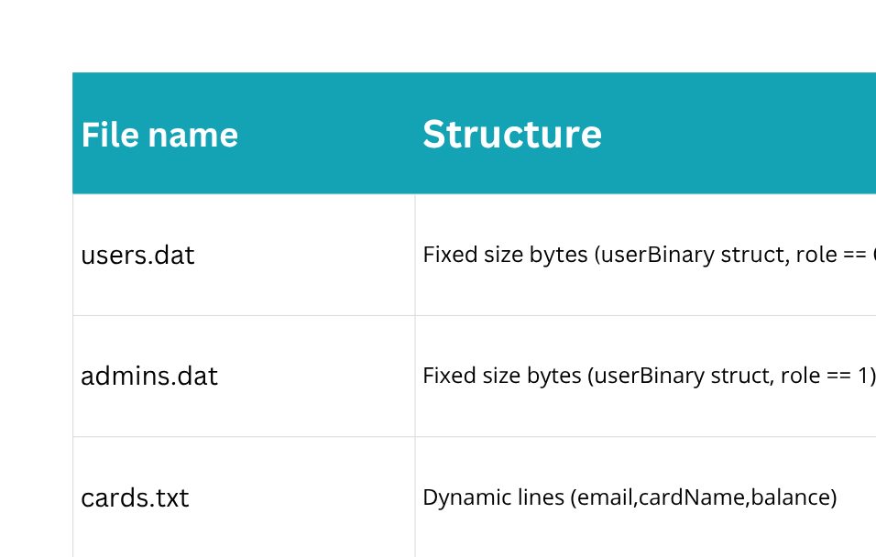
Finance app
Intro
Objective
Classes
Admin
Files
Journay
Conclusion
File Handling

Slide 9
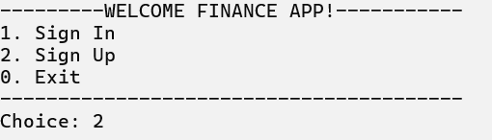
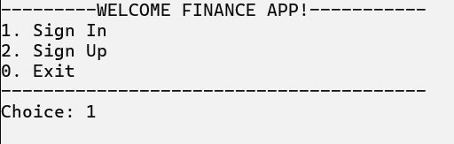
Finance app
Intro
Objective
Classes
Admin
Files
Journay
Conclusion
Regular User Journal
Registration:
Onboarding & Session Verification
Trigger Functions: SignUp() ➔ SignIn()
Program Actions:
User registers a unique email, name, and secure password.
System checks the database. If credentials match a profile with role == 0, it restricts access to investor views and denies entry to the admin panels.
AppController sets currentUser = dynamicUserAddress in RAM to initialize the active session.

Slide 10
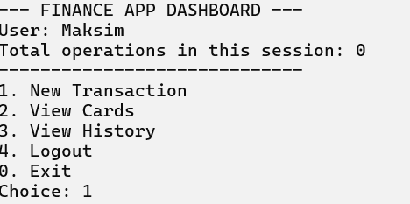
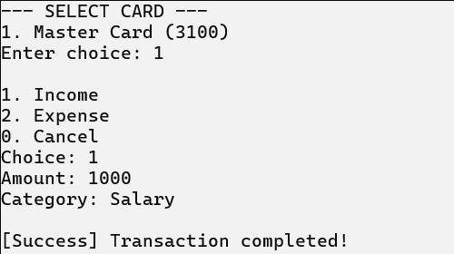
Finance app
Intro
Objective
Classes
Admin
Files
Journay
Conclusion
Regular User Journal
New Transaction:
Financial Activity (Polymorphic Transactions)
Trigger Functions: handleTransaction()
Program Actions:
Income Track: The user logs positive cash flows (e.g., Salary). The program updates the specific card balance and instantiates a new heap-allocated Income object.

Slide 11
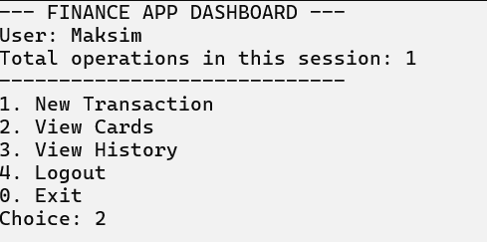
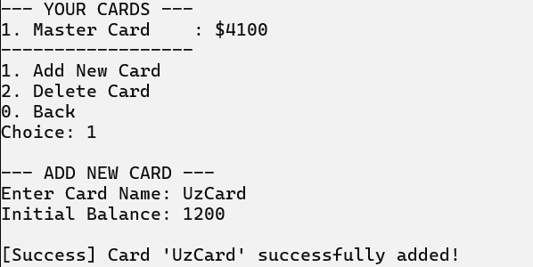
Finance app
Intro
Objective
Classes
Admin
Files
Journay
Conclusion
Regular User Journal
View Cards:
Trigger Functions: loadCards() ➔ addCard()
Program Actions:
System searches cards.txt by the user's email and loads any existing bank cards into a dynamic runtime array (vector<Card> userCards).
The user can execute the Add Card function to bind a new card (Master Card) with an initial baseline balance.

Slide 12
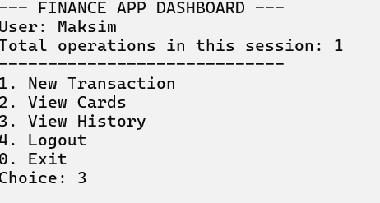
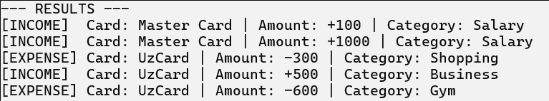
Finance app
Intro
Objective
Classes
Admin
Files
Journay
Conclusion
Regular User Journal
View History:
Trigger Functions: loadHistory() ➔ viewHistory()
/ print()
Program Actions:
When opening the history module, the parser reads all entries from transactions.txt that match the active session email.
It pushes them into a polymorphic runtime ledger array (vector<Transaction*> history).
The interface loops through the vector, executing t->printInfo().

Slide 13
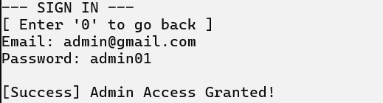
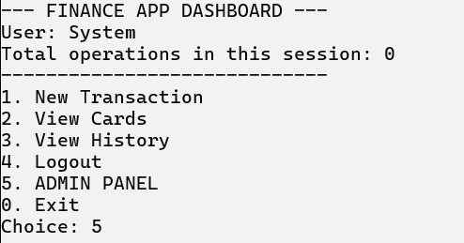
Finance app
Intro
Objective
Classes
Admin
Files
Journay
Conclusion
Admin Journal
Register:
Trigger Functions: SignIn() ➔ AdminPanel()
Program Actions:
The user inputs their login credentials. The system evaluates them first against the hardcoded Super Admin data, then against the admins.dat registry.
If role == 1 or the hardcoded match is triggered, AppController intercepts the active session, blocks regular investor views, and routes execution directly to the secure Admin Panel interface.
Admin Panel Access

Slide 14
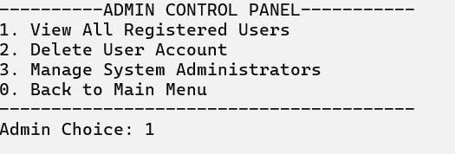
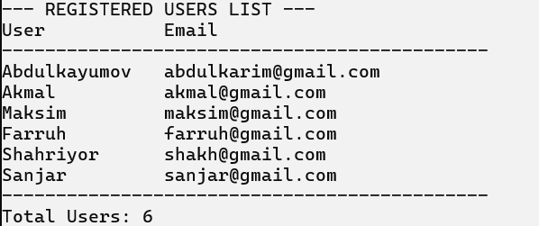
Finance app
Intro
Objective
Classes
Admin
Files
Journay
Conclusion
Admin Journal
View all users:
Trigger Functions: AllUsers()
Program Actions:
The administrator requests a global database audit log.
The program opens a binary input stream (ios::in | ios::binary) to users.dat, reads the userBinary struct blocks sequentially, and outputs a clean, real-time textual directory of all registered standard investors.

Slide 15
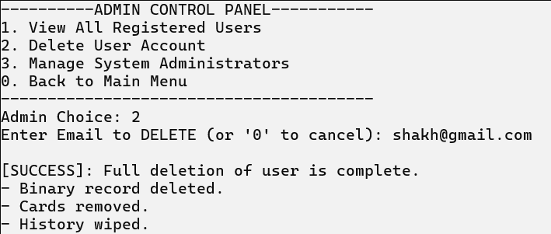
Finance app
Intro
Objective
Classes
Admin
Files
Journay
Conclusion
Admin Journal
Delete User:
Trigger Functions: deleteUser() ➔ deleteCards()
Program Actions:
In case of protocol violations, an admin can completely purge an investor's account.
The program locates and removes the target user record from users.dat.
Cascade Cleanup: To ensure database integrity and avoid ghost records, the function automatically fires deleteCards(), which instantly sweeps cards.txt to wipe all dynamic banking card assets bound to that specific user's email.

Slide 16
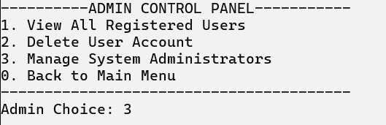
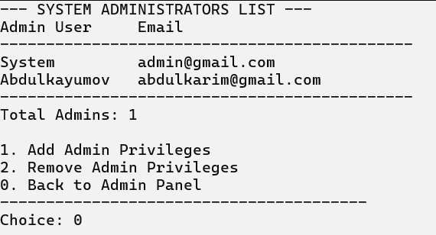
Finance app
Intro
Objective
Classes
Admin
Files
Journay
Conclusion
Admin Journal
System Admins:
Trigger Functions: Admins()
Program Actions:
The code-hardened Super Admin accesses the dynamic staff registry from admins.dat.
The Super Admin can select a standard investor from users.dat, change their status to role = 1, and mirror their byte block configuration directly into the admins.dat binary sequence to grant full staff clearance.
Only Super Admin (admin@gmail.com) is able to use third option from menu (3. Manage System Administartors)

Slide 17
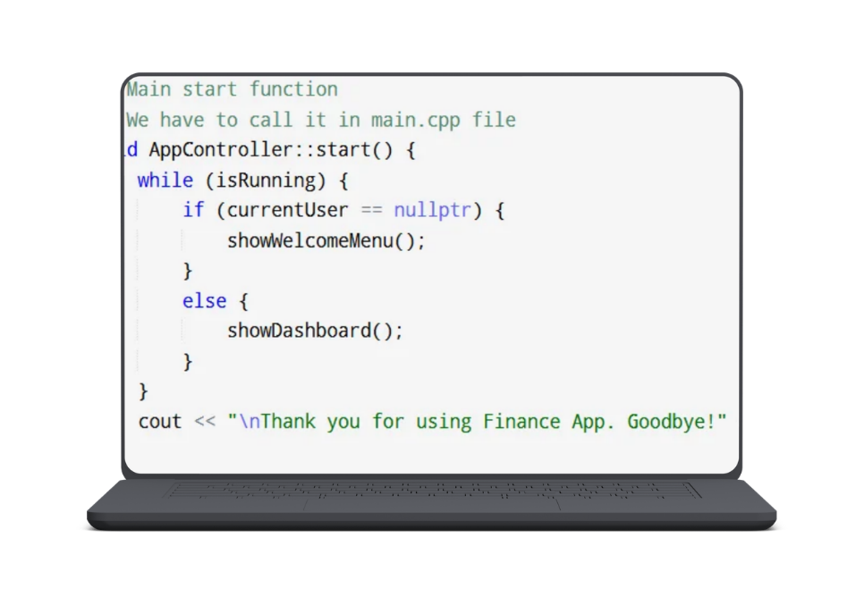
Finance app
Intro
Objective
Classes
Admin
Files
Journay
Conclusion
Conclusion
cout << “To finish, our app is fast, safe, and ready for future updates. We mixed smart file saving with clean code to make a reliable tool for investors” << endl;

