Slide 1

COVID 19'S IMPACT ON PRODUCERS AND MARKET
Data Analyze and Vısualızatıon

Slide 2
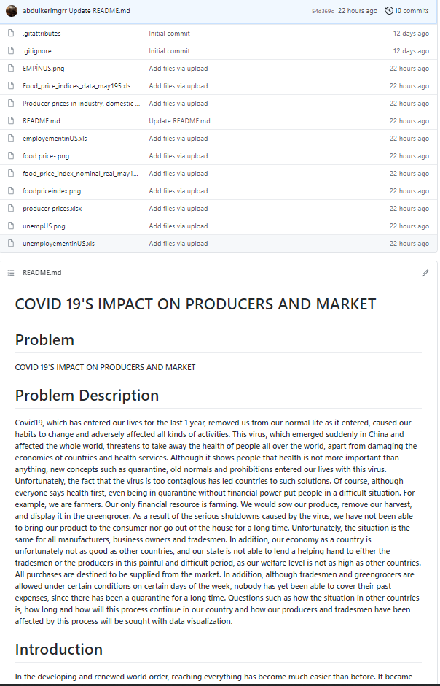

Slide 3
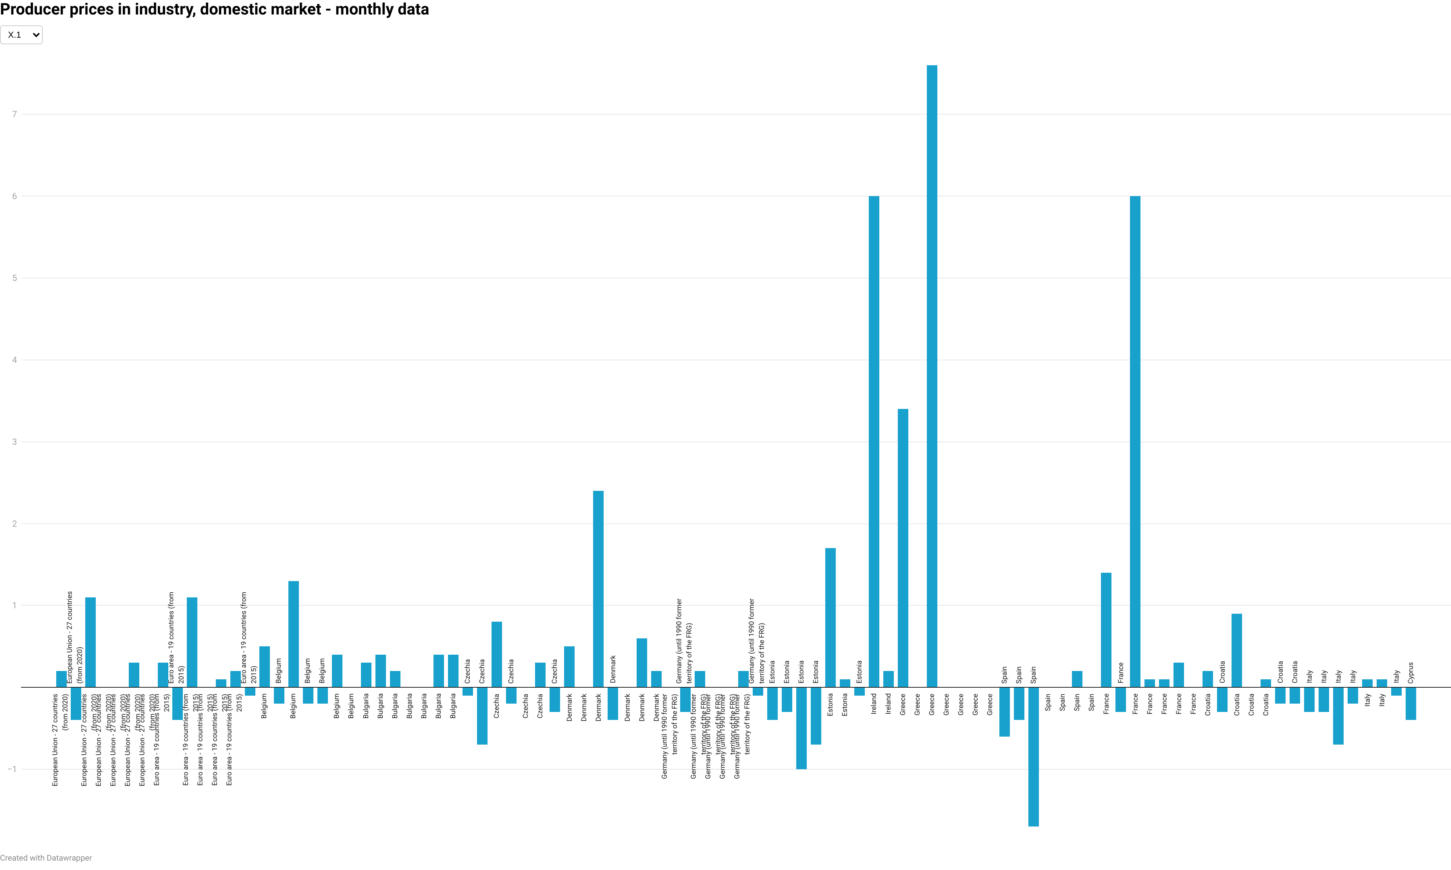

Slide 4
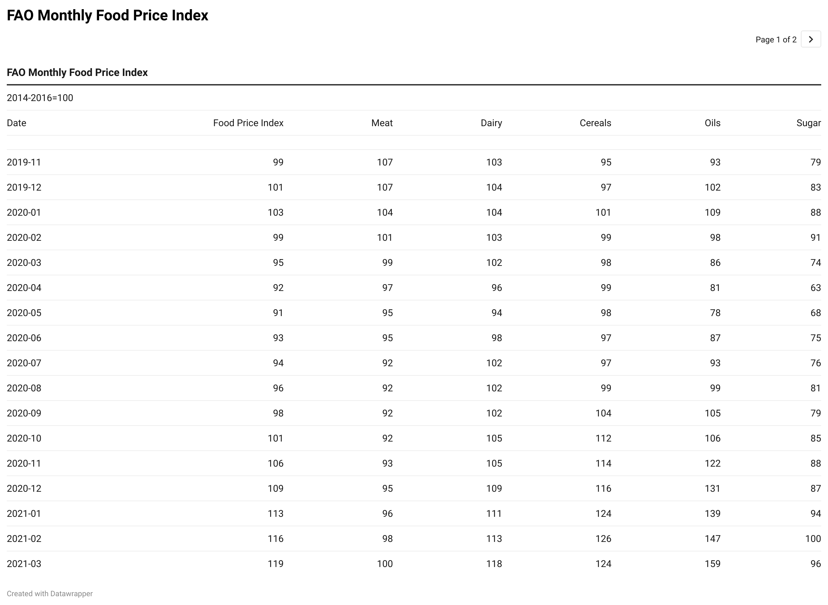

Slide 5
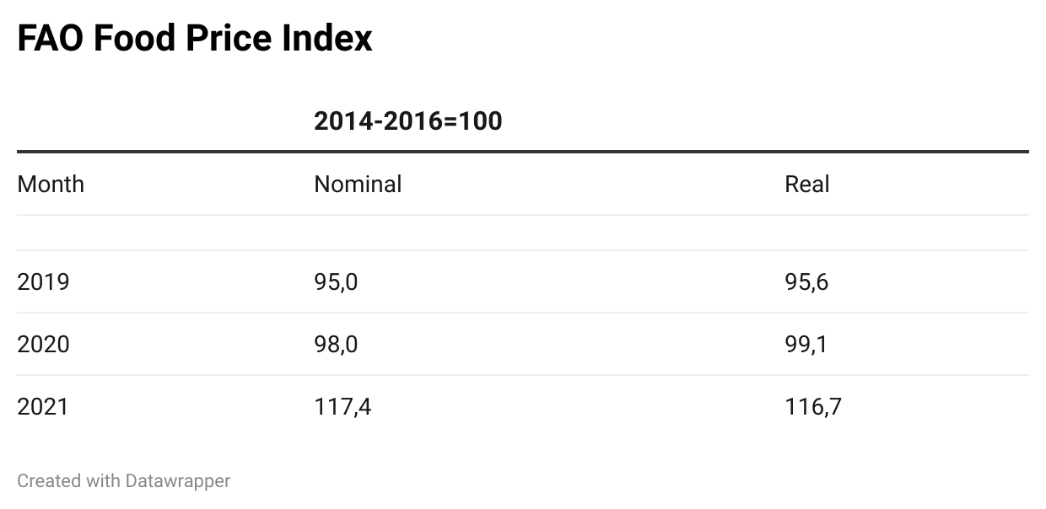

Slide 6
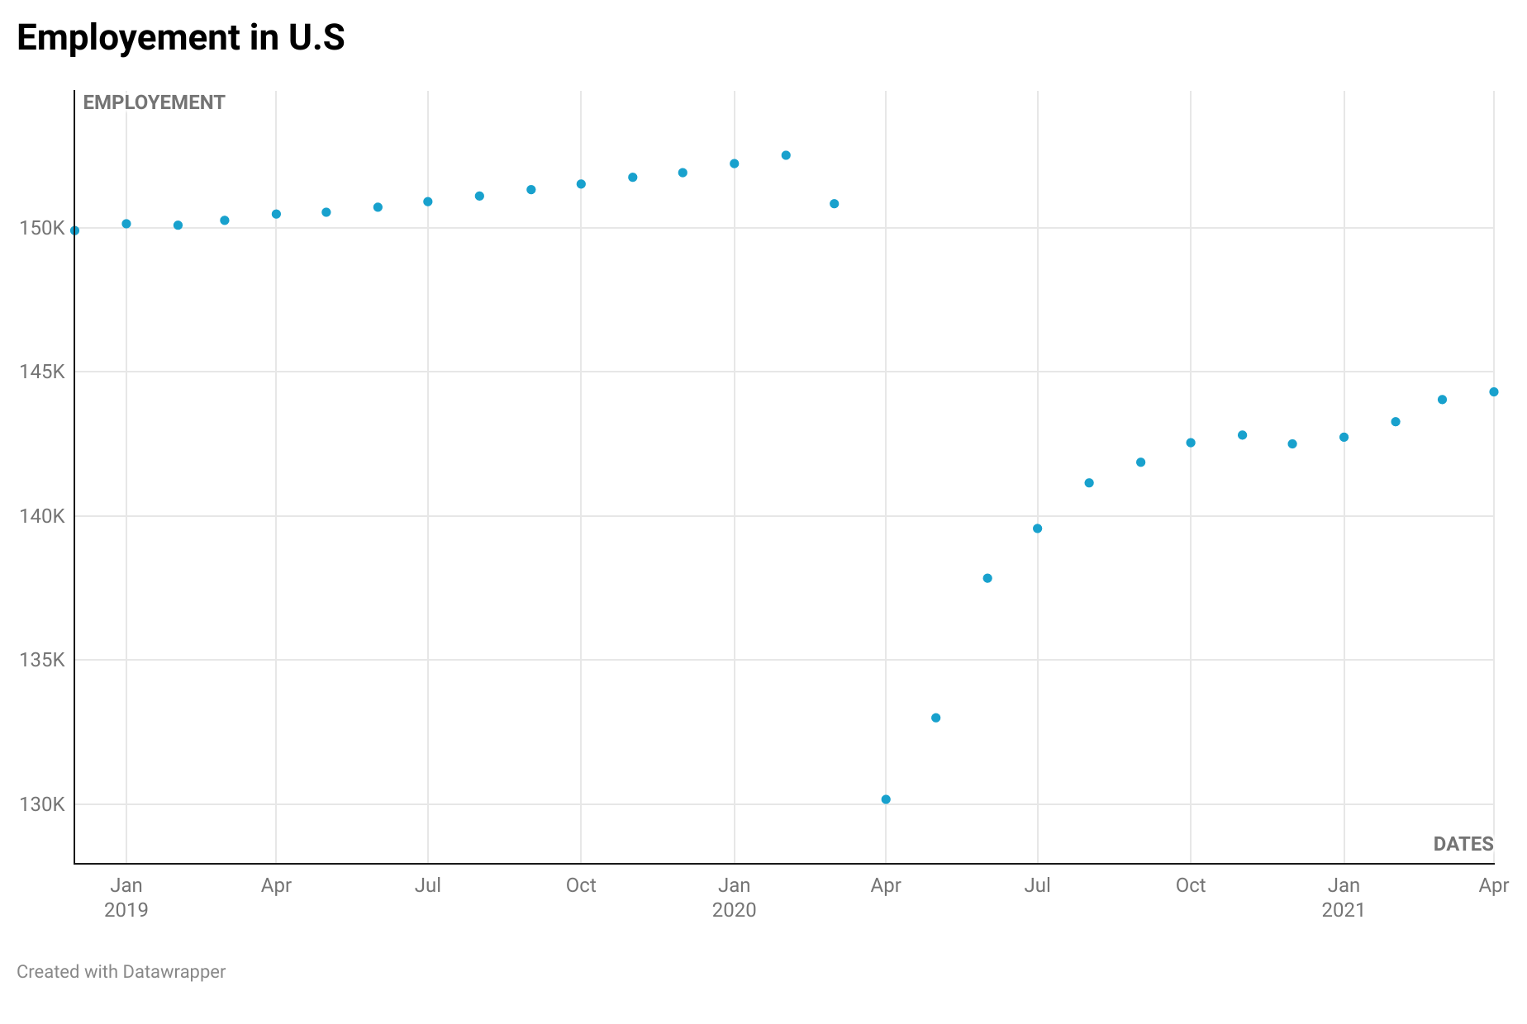

Slide 7
