Slide 1
Azure…
Joni Collinge

Slide 2

#containers
#microservices
#devops
#serverless

Slide 3
The cascading
disruption of IT
delay of IT

Slide 4

{…}
Technical
Organisational
Operational

Slide 5
Agility
The ability to [change] quickly and easily

Slide 6
Microsoft Azure

Slide 7

Azure Resource Manager
Functions
Marketplaces
Agility
App Service
Service Fabric
Container Service
Virtual Machine Scale Sets
Virtual Machines
Control
Azure compute stack

Slide 8
Azure Resource Manager
Functions
Marketplaces
Agility
App Service
Service Fabric
Container Service
Virtual Machine Scale Sets
Virtual Machines
Control
Azure compute stack

Slide 9

Virtual Machines
CPU
100 ACU
Memory
140 GB
Storage
9000 IOPS
Network Grade
High
Premium Storage
Yes
Select the right SKU
Virtual Machines

Slide 10
Virtual Machines
A
D
Dv2
F
G
S
S
S
S
Premium Storage (P10, P20, P30)
Virtual Machines

Slide 11
Virtual Machines
A
D
Dv2
F
L
H
G
N
S
S
S
S
S
S
S
Accelerated Networking (25Gbps) & IPv6*
Virtual Machines

Slide 12
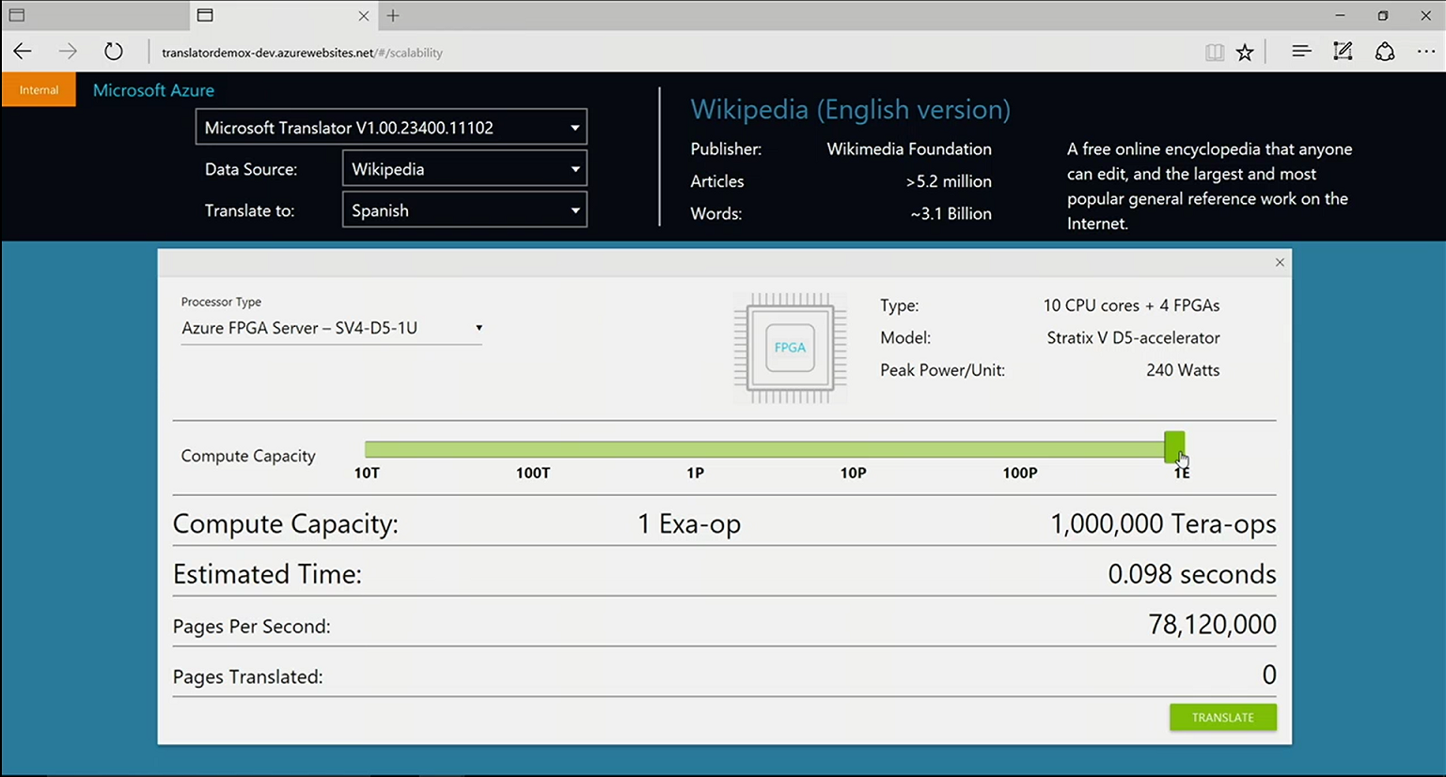

Slide 13

Disk Encryption
Encrypt both your OS and data disks at rest for Windows and Linux Standard VMs
Storage Encryption
Encrypt your blob storage across all redundancy types for no extra cost

Slide 14
Virtual Machines
Positives:
Control
Existing knowledge
Isolation
Negatives:
Agility
Cost
Speed
Favour scaling out over scaling up*
Virtual Machines

Slide 15
Azure Resource Manager
Functions
Marketplaces
Agility
App Service
Service Fabric
Container Service
Virtual Machine Scale Sets
Virtual Machines
Control
Azure compute stack

Slide 16
Azure Resource Manager
Functions
Marketplaces
Agility
App Service
Service Fabric
Container Service
Virtual Machine Scale Sets
Virtual Machines
Control
Azure compute stack

Slide 17
Applications
OS
Hardware
Containers

Slide 18
Hardware virtualisation
Applications
OS
Hypervisor
Hardware
Containers

Slide 19
OS virtualisation
Applications
Binaries/Libs
OS
Kernel
Hypervisor
Hardware
Containers

Slide 20
Applications
Container(s)
Binaries/Libs
Kernel
Hypervisor
Hardware
Containers

Slide 21
Container Runtime
A
B
Container(s)
Kernel
Hypervisor
Hardware
Containers

Slide 22
Linux only though, right?
Containers

Slide 23
Windows Server Containers
Hyper-V Containers
Applications
Applications
Container(s)
Binaries/Libs
Binaries/Libs
Kernel
Kernel
Hypervisor
Hypervisor
Hardware
Hardware
Containers

Slide 24
docker

Slide 25
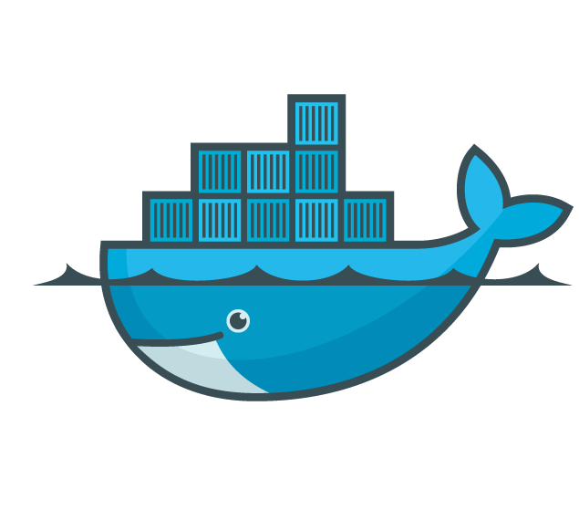
}
Docker
Universal Control Plane
Docker
CLI
Docker
POSH
Docker Compose
Docker Registry
Docker Swarm
Docker Engine
Operating System
kernel features
Docker

Slide 26
$ code Dockerfile
$ docker build –t me/myapp .
Dockerfile
Docker container
Docker registry
Docker image
Server listening on port 8080...
me/myapp
$ docker run –d me/myapp
511136ea3c5a Virtual Size: 0 B
1e8abad02296 Virtual Size: 113.2 MB
f106b5d7508a Virtual Size: 121.8 MB
0ae4b97648db Virtual Size: 690.2 MB
55a2d383d743 Virtual Size: 1.009 GB 367e535883e4 Virtual Size: 1.302 GB a47bb557ed2a Virtual Size: 1.154 GB
FROM Ubuntu:latest
RUN sudo apt-get install nodejs –y
RUN mkdir –p /myapp/
WORKDIR /myapp/
ADD . /myapp/
RUN npm install
EXPOSE 8080
CMD [“npm” “start”]
$ docker push me/myapp
me/myotherapp
me/mybetterapp
Docker

Slide 27


{/}
DEV
BUILD
UAT
STAGE
PROD
Docker

Slide 28
Docker for Windows
Windows Server Containers
Linux VM
Linux Container
Windows Container
HyperV
Docker Client
Docker Client
Docker

Slide 29
Container composition

Slide 30
Container Runtime
A
B
Kernel
Hypervisor
Hardware
Container composition

Slide 31
Service
docker-compose.yml
Container Runtime
A
B
A:
build: A\.
net: “default”
ports:
- “80”
B:
build: B\.
net: “default”
...
Kernel
Hypervisor
Hardware
Container composition

Slide 32
Service
docker-compose.yml
Container Runtime
A
B
A:
build: A\.
net: “default”
ports:
- “80”
B:
build: B\.
net: “default”
...
Kernel
Hypervisor
Hardware
Container composition

Slide 33
The cloud has changed the game…
High availability
High scalability
High reliability
High maintainability
High security
Low cost…

Slide 34
Container orchestration

Slide 35
Container Runtime
Apps
OS
Hardware
RUNTIME
A
RUNTIME
RUNTIME
SLAVE
A
B
SLAVE
A
C
SLAVE
B
C
Kernel
Kernel
Kernel
Hypervisor
Hypervisor
Hypervisor
Hardware
Hardware
Hardware
Container orchestration

Slide 36
RUNTIME
A
RUNTIME
RUNTIME
SLAVE
A
B
MASTER
A
C
SLAVE
B
C
Kernel
Kernel
Kernel
Hypervisor
Hypervisor
Hypervisor
Hardware
Hardware
Hardware
Container orchestration

Slide 37
Container Orchestration
Resource Management
Memory
CPU
Disk
GPU
Volumes (persistent/volatile)
Ports
IPs
Resource management

Slide 38
Container Orchestration
Scheduling
Placement
Scaling
Readiness Checking
Resurrection
Rescheduling
Rolling Deployment
Affinity
Scheduling
Resource management

Slide 39
Container Orchestration
Service Management
Labels
Groups
Dependencies
Load Balancing
Readiness Checking
Service management
Scheduling
Resource management

Slide 40


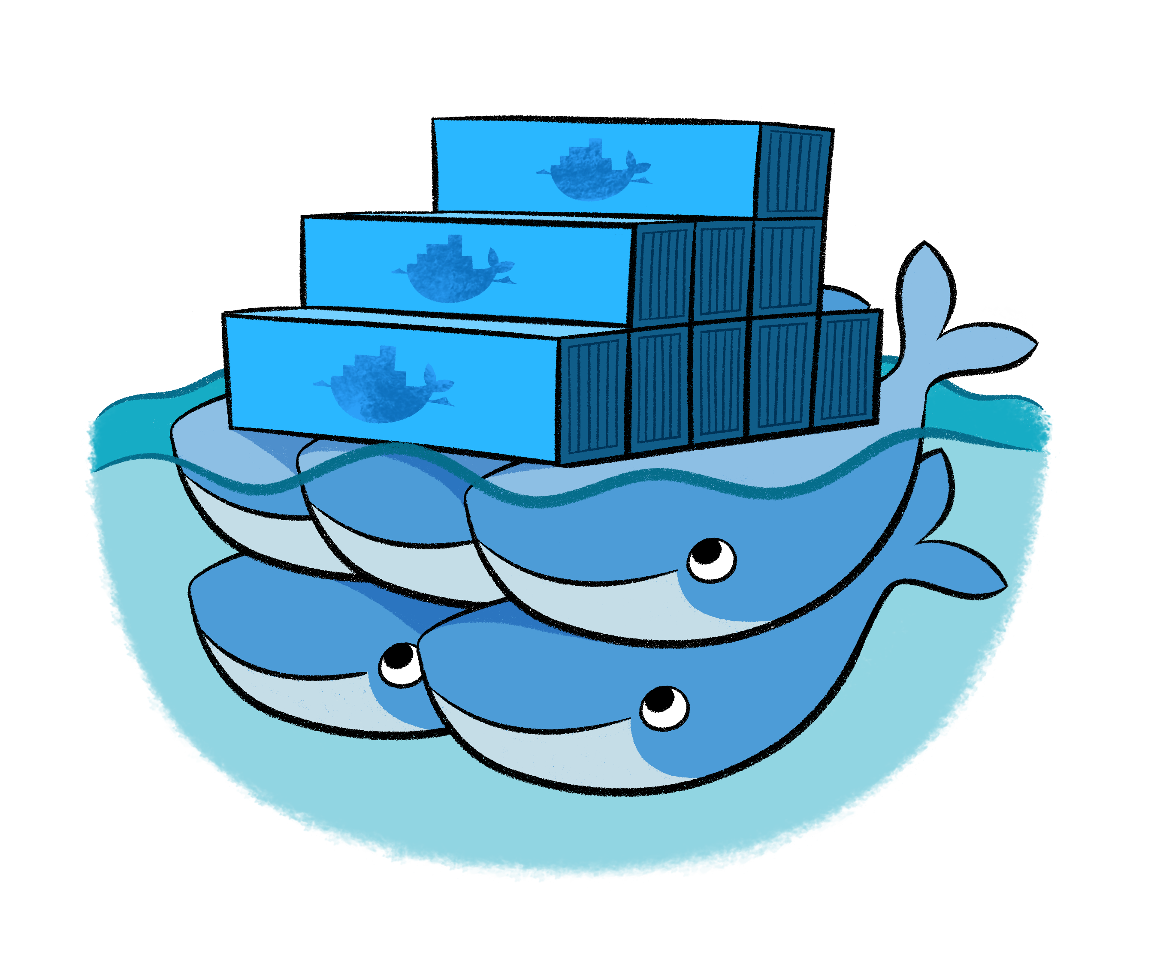

Container Orchestration on Azure

Slide 41
Azure Container Service
Deploy to Azure

Slide 42
Azure Resource Manager
Functions
Marketplaces
Agility
App Service
Service Fabric
Container Service
Virtual Machine Scale Sets
Virtual Machines
Control
Azure compute stack

Slide 43


Hyper-scale microservices platform
Service Fabric
Application frameworks
ALM
cross platform, cross cloud
State
Discovery
Health
Resource scheduling
Resource management

Slide 44
Hyper-scale microservices platform
Service Fabric
cross platform, cross cloud
App Models
Management
Communication
Reliability
Activation
Testability
Federation
Transport

Slide 45
3
2
1
6
5
4
9
8
7

Slide 46
3
2
1
6
5
4
9
8
7

Slide 47
3
2
1
6
5
4
9
8
7

Slide 48
Hyper-scale microservices platform
Service Fabric
Application frameworks
ALM
cross platform, cross cloud
State
Discovery
Health
Resource scheduling
Resource management

Slide 49
We need to address the monolith in the room…

Slide 50
CUSTOMER MANAGEMENT
CUSTOMER MANAGEMENT
INVOICING
INVOICING
NOTIFICATIONS
ORDER MANAGEMENT
RIDER MANAGEMENT
RIDER MANAGEMENT
PAYMENTS
PAYMENTS
ORDER MANAGEMENT
NOTIFICATIONS
Microservices

Slide 51

CUSTOMER SMARTPHONE
CUSTOMER MANAGEMENT
RIDER SMARTPHONE
6 NOTIFY ACTORS
2 STORE ORDER
4 FIND RIDER
THE KITCHEN
1 ORDER MADE
3 CREATE DELIVERY
NOTIFICATION
5 CONFIRM DELIVERY
CUSTOMER SMARTPHONE
ORDER MANAGEMENT
RIDER MANAGEMENT
RIDER SMARTPHONE
Microservices

Slide 52
Encourage:
Domain contexts
Small teams
Good API contracts
More agile development
Loose coupling and high cohesion
Data ownership and segregation
Single responsibility principle
Microservices

Slide 53
Encourage:
Domain contexts
Small teams
Good API contracts
More agile development
Loose coupling and high cohesion
Data ownership and segregation
Single responsibility principle
Enable:
Polyglot applications
Independent deployment and scale
Faster development cycle
Dynamic ALM
Dependency isolation

Slide 54
MONOLITH V 1.2.3

Slide 55
MICROSERVICE V 1.2.3

Slide 56
1
2
POLYGLOT
DEPENDENCY CONFLICT
DEPLOYMENT
SCALE
3
4

Slide 57
Application frameworks
Guest
Guest
Reliable Services
Reliable Actors
Reliable Actors
Service Fabric

Slide 58
Application frameworks
Guest
Guest
Reliable Services
Reliable Actors
Reliable Actors
Stateless | Stateful
Service Fabric

Slide 59
using (var tx = this.StateManager.CreateTransaction())
{
var myDictionary = await this.StateManager.
AddAsync<IReliableDictionary<string, long>>(“myDict”);
await myDictionary.AddAsync(tx, “Alex”, 1000L);
// Write to quorum of replicas now – update rest eventually
await tx.CommitAsync();
}
Service Fabric

Slide 60
Application frameworks
Guest
Guest
Reliable Services
Reliable Actors
Reliable Actors
Service Fabric

Slide 61
Application frameworks
Guest
Guest
Reliable Services
Reliable Actors
Reliable Actors
Service Fabric

Slide 62
// Close door
var door = ActorProxy.Create<IRoomDoor>($“{roomid}_r{doorid}”);
door.Close();
// Turn off lights
var lights = ActorProxy.Create<IRoomLights>($“{roomid}_l{lightid}”);
Lights.TurnOff();
// Make room available
RoomState state = RoomStates.Available;
await this.StateManager.SetStateAsync<RoomState>(“CurrentState”, state);
Service Fabric

Slide 63
Application frameworks
Guest
Guest
Reliable Services
Reliable Actors
Reliable Actors
Integration with Docker containers
Service Fabric

Slide 64
Cluster
App A
Service A
Code
App B
Service B
Config
App C
Service C
Data
Service Fabric

Slide 65
3
2
1
6
5
4
9
8
7

Slide 66
1
2
3
System Services
4
5
6
7
8
9

Slide 67
1
2
3
Your Services
4
5
6
7
8
9

Slide 68
S
C
C
1
2
3
A
A
P
P
P
P
4
5
6
S
P
S
7
8
9

Slide 69
S
S
1
2
3
Scaling state
Partitions:
3
2
P
1
P
S
S
4
5
6
P
S
S
7
8
9

Slide 70


Bake
DevOps
Build
Deploy
+
Define
Monitor
Development
Connect
datawire.io

Slide 71
Azure Resource Manager
Functions
Marketplaces
Agility
App Service
Service Fabric
Container Service
Virtual Machine Scale Sets
Virtual Machines
Control
Azure compute stack

Slide 72
>400K
Customers
>700K
Apps Hosted
>3.6 Billion
Requests per Day
>100K
Dedicated Cores
>60%
Paid Azure Customers
Use App Service
>40%
Revenue from
Enterprise Accounts

Slide 73
WEB APPS
Host your websites in a rich managed environment, with enterprise ready capabilities and developer centric tooling
MOBILE APPS
=
Bootstrap the development of your feature rich iOS, Android and Windows apps.
API APPS
Quickly build production ready APIs with authentication, client SDKs and first class API management integration
LOGIC APPS
Create business processes, workflows and integration solutions through our visual editor

Slide 74
Azure Resource Manager
Functions
Marketplaces
Agility
App Service
Service Fabric
Container Service
Virtual Machine Scale Sets
Virtual Machines
Control
Azure compute stack

Slide 75













Slide 76
Call to action
Visit
Microsoft Azure docs
https://aka.ms/azuredocs
Read
Building Microservices:
Designing Fine Grained Systems
Follow
Joni Collinge
@dotjson

Slide 77
Thank you!

