Slide 1
Future of the cloud
Joni Collinge
Notes:
Welcome and introduction

Slide 2

#containers
#microservices
#devops
#serverless
Notes:
As everybody in the industry will be aware, there is a whirlwind of technology buzzwords flying around, which seemingly come from nowhere and disappear just as quick.
This is becoming increasingly confusing and making it very hard for software companies to know when and how to adopt new technologies.
It’s becoming clear that one innovation leads to another innovation which is causing waves of disruption across IT, this is what I call…

Slide 3
The cascading
disruption of IT
delay of IT
Notes:
…the cascading disruption of IT.
This continuous disruption of technology leads companies into what I call….
…the cascading delay of IT.
Where IT organisations are waiting for the ‘right’ time to invest in technologies, but never actually committing. I see it a bit like buying a new phone, you always know a better, slimmer model is coming around the corner in 6 months – but that will always be the case so you might as well commit and start benefitting now.

Slide 4

{…}
Technical
Organisational
Operational
Notes:
The effects are felt right across a business.
On a technical level, you have to relentlessly adopt new technologies and methodologies to stay ahead of the competition.
Organisationally you have to adapt to facilitate personnel changes, rapid setup and tear down of projects and increasingly flat and autonomous company structures.
Operationally you have to cut costs whilst delivering higher quality in a shorter amount of time, which drives us towards a service oriented business.
I believe there is a common denominator here, and that is…

Slide 5
Agility
The ability to [change] quickly and easily
Notes:
Agility.
Your ability to succeed as a company is becoming increasingly reliant on your ability to be agile, transform and disrupt yourself.
Just look at the unicorns for example, it’s not enough for Facebook to just be a social network, they need to be AI and VR too.
It’s not enough for SnapChat to just be a picture sharing social platform, they need to build image processing algorithms and crunch big data.
It’s not enough for Twitter to be a social network – it has to be a live news broadcasting platform too.

Slide 6
Microsoft Azure
Notes:
We as a platform company, need to give you the resources you need to become as agile and productive as possible.

Slide 7

Azure Resource Manager
Platform as a Service
Marketplaces
Agility
Functions
App Service
Service Fabric
Container Service
Virtual Machine Scale Sets
Virtual Machines
Control
Azure compute
Notes:
Therefore we’ve built and are continuing to build services which we believe allow you to do this.
When I have a new workload, I tend to start at the top of this stack and ask myself, why can’t I run this workload on this service. Then work my way down if I need to.

Slide 8
Virtual Machines
Positives:
Control
Existing knowledge
Isolation
Negatives:
Agility
Cost
Speed
Favour scaling out over scaling up
Azure compute
Notes:
Why do Virtual Machines get so much stick?

Slide 9
Azure Resource Manager
Functions
Marketplaces
Agility
App Service
Service Fabric
Container Service
Virtual Machine Scale Sets
Virtual Machines
Control
Azure compute
Notes:
Most companies tend to have some estate in Virtual Machines and maybe experimenting with new code in services such as Azure Functions and Azure App Service.
With existing services, you should be trying to get them as high up this stack as possible.
I’m going to focus on these middle services – these services are suitable for moving new and existing workloads which require more control than is available in App Service and Functions.

Slide 10
Things to consider
Notes:
You can rehost on these platforms, but to truly exploit the capabilities of these services you’ll need to consider refactoring.

Slide 11
Microservices…
maybe
Notes:
As part of this refactor, or new project – you might want to investigate microservices. I say maybe, because microservices is an option and not the answer.

Slide 12
Microservices
Notes:
This works well.
Nothing inherently wrong with a service and a database.

Slide 13
Microservices
Notes:
This is the problem.
Using the database as an integration point causes all sorts of issues.
Updating the data schema is fraught with difficulty and any service has the ability to corrupt data for the entire system.

Slide 14
Magic
Microservices
Notes:
Sometimes we try to move the integration into a magic bus. Again, nothing fundamentally wrong with message buses – but the buses have a bad habbit of taking on responsibility for applying business rules and logic which should be found in the services.
Remember the mantra; smart endpoints and dump pipes

Slide 15
Microservices
Notes:
Microservices on the other hand takes a different approach.
You model the service around the business domain and encapsulate the implementation details behind an API.

Slide 16
A
B
Microservices
Notes:
If Service B wants to access data stored in Service A’s database, it now has to request it via Service A’s endpoint

Slide 17

Consumer driven contracts
DevOps
011001010
{/}
Microservices
Notes:
This allows us to change the implementation details without breaking any other services. It also allows you to choose different technology stacks to implement each service.
We have small teams that own that business capability .i.e. inventory service – and master the requirements of that service. The teams are usually between 2-5 people.

Slide 18
Write faster code
Deliver faster code
Notes:
This doesn’t enable us to write faster code… nor should it! This is not a metric you want to be monitoring.
It allows us to deliver faster code – shortening the feedback loop and making deployment as seamless as possible.

Slide 19
Host
Cost:
£350/pcm
Dependencies:
Baked
Performance:
Tuned
Hosting compute
Notes:
So from a ITPros or Sysadmin perspective how does this work out?

Slide 20
Host
Cost:
£350/pcm
Dependencies:
Baked
Performance:
?
Hosting compute
Notes:
You’ve taken a monolith and split it out so that now you have
Greater resource contention,
unreliable messaging and,
a bigger failure surface

Slide 21
Hosts
Cost:
£350*h/pcm
Dependencies:
?
Performance:
?
h0…hn
Hosting compute
Notes:
Expensive! £350 → £3150 /pcm
Hard to manage dependency versions
Performance impact
Resource contention

Slide 22
Containers
Application
Binaries + libraries
Base layer
Linux kernel
Notes:
Containers take advantage of some kernel level features to give a process an isolated view of the OS.
There is no boot process, there is no kernel – just files.

Slide 23
Containers
Application
Application
Binaries + libraries
Binaries + libraries
Base layer
Base layer
Windows kernel
Linux kernel
Notes:
Shared kernel allows higher density.

Slide 24
Containers
eth0
bridge
veth
veth
eth0
eth0
Application
Application
Binaries + libraries
Binaries + libraries
Base layer
Windows kernel
Linux kernel
Notes:
Shared layers and caching help performance.
Networking allows containers to talk to each other (if you want to, can be changed)

Slide 25
Containers
eth0
bridge
veth
veth
eth0
eth0
Application
Application
Binaries + libraries
Binaries + libraries
Base layer
Windows kernel
Windows NT kernel
Notes:
We’ve harnessed technology in the Windows NT kernel to deliver Windows Server Containers.

Slide 26
Containers
eth0
bridge
veth
veth
eth0
eth0
Application
Application
Binaries + libraries
Binaries + libraries
Base layer
Guest OS
Guest OS
Host OS
Notes:
Due to the concerns around container security we’ve also developed HyperV containers.
These are a hybrid between virtualisation and containerisation – giving you greater isolation and security without having the slow bootup times of traditional virtualisation.

Slide 27
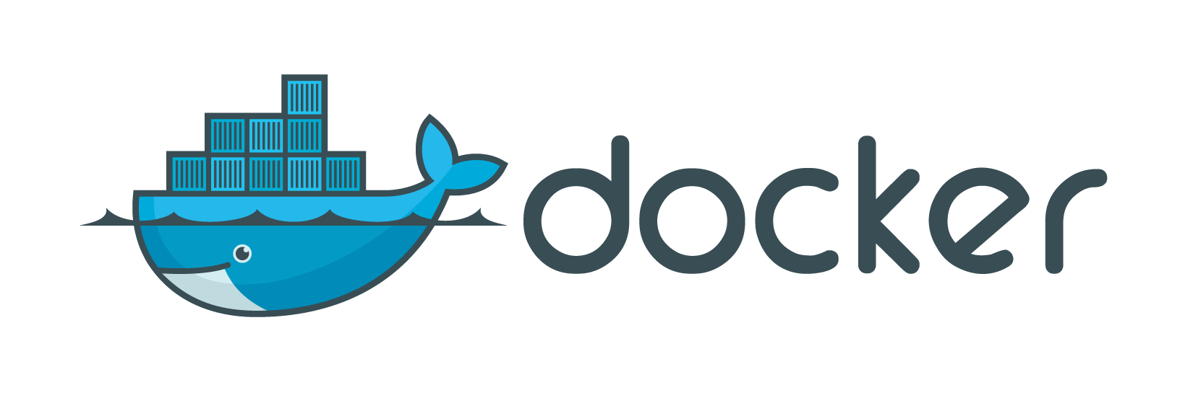
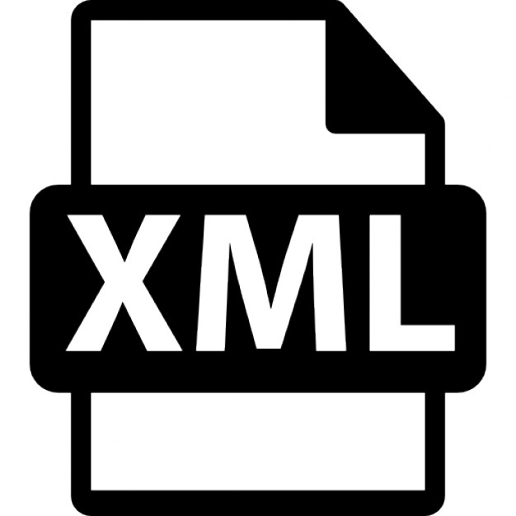


YML
Containers
Notes:
Docker – a name that I’m sure many of you are familiar with.
They’ve really stamped their mark on the industry using a 3 pronged approach.
They’ve helped standardise the technology
They continue to build a ecosystem of supporting tooling
They help seed and grow the community

Slide 28
$ code Dockerfile
$ docker build –t me/myapp .
Dockerfile
Docker container
Docker registry
Docker image
Server listening on port 8080...
me/myapp
$ docker run –d me/myapp
511136ea3c5a Virtual Size: 0 B
1e8abad02296 Virtual Size: 113.2 MB
f106b5d7508a Virtual Size: 121.8 MB
0ae4b97648db Virtual Size: 690.2 MB
55a2d383d743 Virtual Size: 1.009 GB 367e535883e4 Virtual Size: 1.302 GB a47bb557ed2a Virtual Size: 1.154 GB
FROM Ubuntu:latest
RUN sudo apt-get install nodejs –y
RUN mkdir –p /myapp/
WORKDIR /myapp/
ADD . /myapp/
RUN npm install
EXPOSE 8080
CMD [“npm” “start”]
$ docker push me/myapp
me/myotherapp
me/mybetterapp
Containers
Notes:
Can replace with a command line demo if needed

Slide 29
Docker for Windows
Windows Server Containers
Linux VM
Linux Container
Windows Container
HyperV
Docker Client
Docker Client
Containers
Notes:
What’s the story for Docker on Windows?
Well, there are actually 2 stories;
1. Docker for Windows allows you to run Linux containers in a VM on Windows.
2. Windows Server Containers run native Windows NT kernel containers.

Slide 30
Container host
Cost:
£350/pcm
Dependencies:
Baked
Performance:
~Tuned
Containers
Notes:
This allows us to isolate the workloads and manage dependencies in a much easier way – and keep the costs down by getting higher density.

Slide 31
Container hosts
Cost:
£350*m/pcm
Dependencies:
Baked
Performance:
~Tuned
Scalability
. . . . . . . . .
Availability
. . . . . . . . .
Reliability
. . . . . . . . .
Efficiency
. . . . . . . . .
Agility
m0…mn
Containers
Notes:
Typically you wouldn’t just host your workloads on a single machine as this is a single point of failures.
Therefore you can scale out the number of hosts to achieve;
Scalability,
Availability,
Reliability,
Efficiency,
Agility

Slide 32
“Just spin up another data centre…”
Abraham Lincoln

Slide 33
Azure Resource Manager
Functions
Marketplaces
Agility
App Service
Service Fabric
Container Service
Virtual Machine Scale Sets
Virtual Machines
Control
Azure compute
Notes:
In Azure we provide a number of services that really help leverage these technologies, today I’m going to focus on these 2;
- Container Service
- Service Fabric

Slide 34
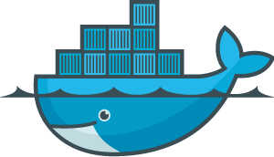
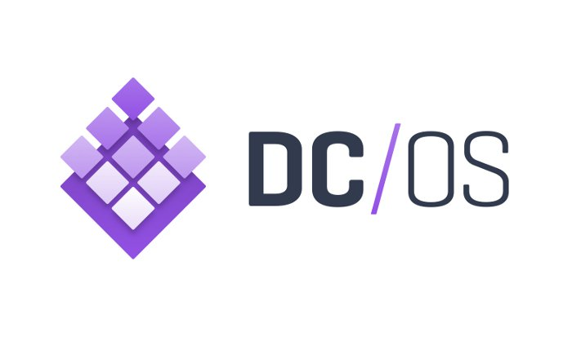
Container cluster optimised for Azure
Container Service
Notes:
Azure container service is a quick way to deploy containerised workloads in the Azure that can leverage open source orchestration engines such as Docker Swarm or DC/OS

Slide 35
Master
Master
Master
Notes:
Explain orchestration and scheduling

Slide 36


Hyper-scale microservices platform
Service Fabric
Application frameworks
ALM
x platform, x cloud
State
Discovery
Health
Resource scheduling
Cluster management
Notes:
Service Fabric is more than just an orchestration engine and scheduler, it has state persistence capability, service discovery, health management, fail over and application life cycle management. The real differentiator with this platform is that is comes with application frameworks available as an SDK.

Slide 37
Notes:
Service Fabric, is what some people call a chorographer rather than an orchestrator as it is itself part of the fabric (i.e. no masters).

Slide 38
Notes:
You can scale out the cluster by adding additional nodes

Slide 39
Notes:
…and scale it back down based on autoscaling rules

Slide 40
D4V2
D1V2
A2
Notes:
It is a heterogeneous cluster orchestrator and not a homogenous cluster orchestrator, meaning you can have different types of node in the cluster. Using placement constraints and anti-placement constraints you can limit where each service can be deployed to.

Slide 41
Application frameworks
Guest
Guest
Reliable Services
Reliable Actors
Reliable Actors
Service Fabric
Notes:
Guest executables; bring your own executable. Bring an existing exe and package it as a service fabric service; you still benefit from the elastic scale, high availability and ALM. However, you cannot interact with the fabric itself to report custom metrics or spin up new services or harness the state persistence sub system.

Slide 42
Application frameworks
Guest
Guest
Reliable Services
Reliable Actors
Reliable Actors
Stateless | Stateful
Service Fabric
Notes:
Reliable Services are a native Service Fabric framework which can support both stateless and stateful services. The stateful services leverage the built in persistence sub system to provide highly available and consistent data storage within the cluster. You can leverage the SDK features such as the Reliable Collections…

Slide 43
using (var tx = this.StateManager.CreateTransaction())
{
var myDictionary = await this.StateManager.
AddAsync<IReliableDictionary<string, long>>(“myDict”);
await myDictionary.AddAsync(tx, “Alex”, 1000L);
// Write to quorum of replicas now – update rest eventually
await tx.CommitAsync();
}
Service Fabric
Notes:
ReliableCollections are similar to .NET Collections and you interact with them in a similar way. The state manager is responsible for managing your reliable collections, here for example I am using a string identifier to get the dictionary, I am then adding a new Key Value pair. This is all wrapped in a transaction to support ACID operations. Once the commitAsync call returns the data has been persisted across the cluster.

Slide 44
Application frameworks
Guest
Guest
Reliable Services
Reliable Actors
Reliable Actors
Service Fabric
Notes:
Click

Slide 45
Application frameworks
Guest
Guest
Reliable Services
Reliable Actors
Reliable Actors
Service Fabric
Notes:
Reliable Actors brings the actor programming model to Service Fabric. It utilises the notion of virtual actors which are omnipresent and only need to be referenced to be activated. The model simplifies programming against a distributed system and in some ways captures the intended purpose of object oriented programming. Each actor can contain both compute and state and be evenly distributed across the cluster.

Slide 46
// Close door
var door = ActorProxy.Create<IRoomDoor>($“{roomid}_r{doorid}”);
door.Close();
// Turn off lights
var lights = ActorProxy.Create<IRoomLights>($“{roomid}_l{lightid}”);
Lights.TurnOff();
// Make room available
RoomState state = RoomStates.Available;
await this.StateManager.SetStateAsync<RoomState>(“CurrentState”, state);
Service Fabric
Notes:
Here I am simply activated actors and calling methods on their interface. No actor lookup, not serialisation of data, no interface inspection, this is all taken care of for you.

Slide 47
Application frameworks
Guest
Guest
Reliable Services
Reliable Actors
Reliable Actors
Integration with Docker containers
Service Fabric
Notes:
When Windows Server 2016 RTM is released with support for Windows Server Containers – Service Fabric will have support for docker containers.

Slide 48
Cluster
App A
Service A
Code
App B
Service B
Config
App C
Service C
Data
Service Fabric
Notes:
Everything can be versioned and rolling upgrades are supported

Slide 49
The cluster
Service Fabric
Notes:
A simple machine cluster with your services scattered across it

Slide 50
Resource balancing
Service Fabric
Notes:
Heatmap so that we can calculate the most efficient place to run your workloads.

Slide 51
State management
Service Fabric
Notes:
How does the data persistence sub system work

Slide 52
State management
P
C
S
S
A
P
S
P
Service Fabric
Notes:
CAP Therom
C – Consitency
A – Availability
P – Partition tolerance

Slide 53
Scalability
S
S
S
P
S
P
S
P
S
S
P
Service Fabric
Notes:
Scale by adding services/partitions/nodes

Slide 54
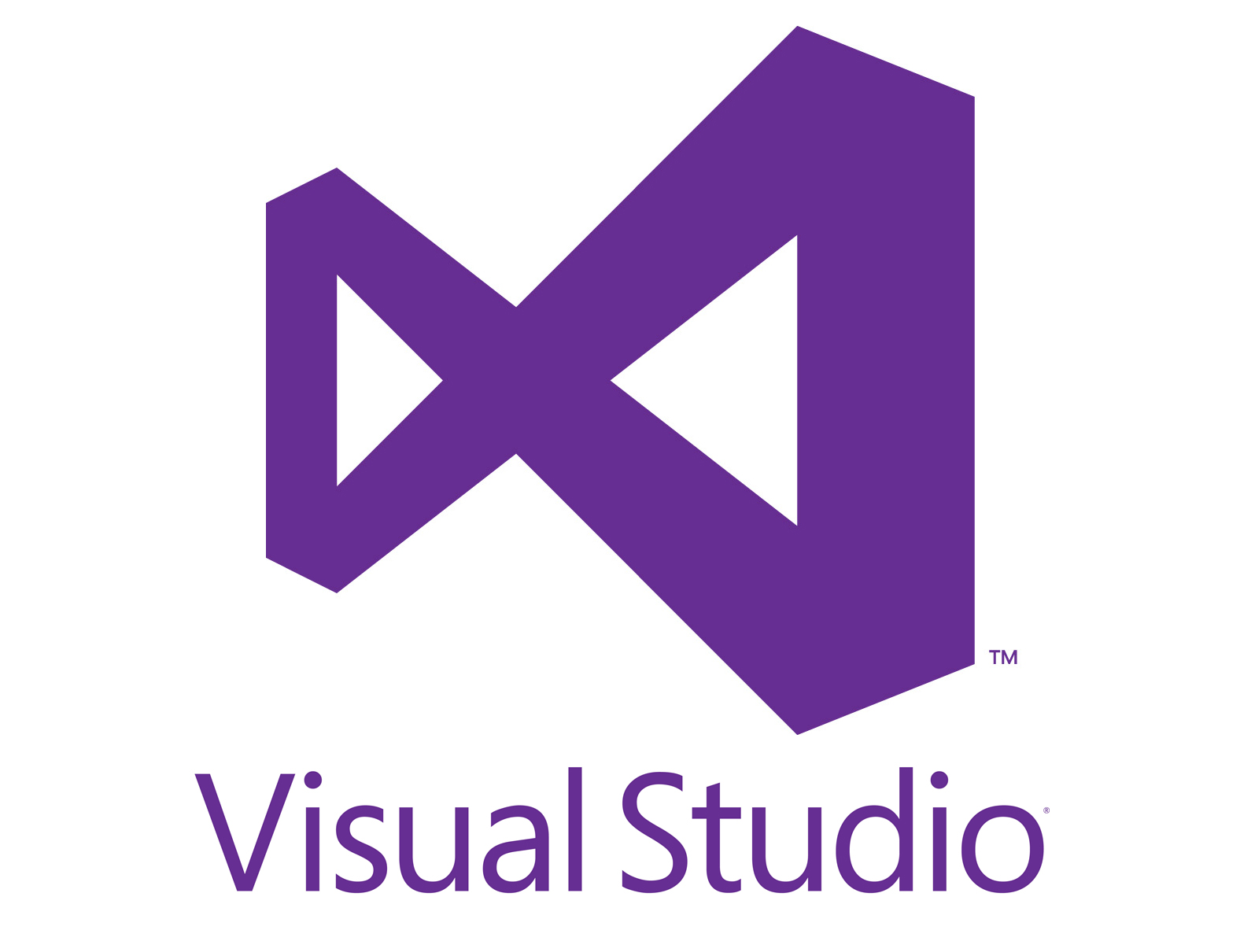
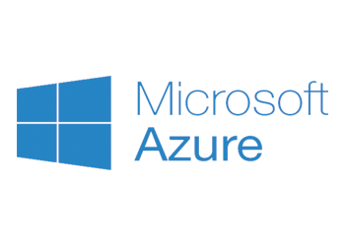
Bake
DevOps
Build
Deploy
+
Define
Monitor
Development
Connect
datawire.io
Notes:
Together Azure and Visual Studio offer services and tools which can help you achieve greatness across the entire life cycle of a microservices based application.
https://www.datawire.io/continuous-delivery-ecosystem-for-microservices/

Slide 55


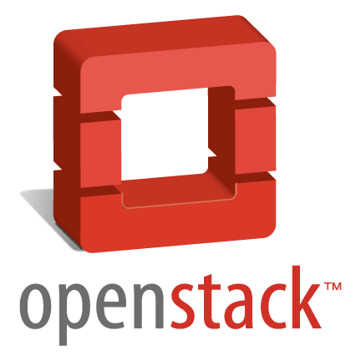
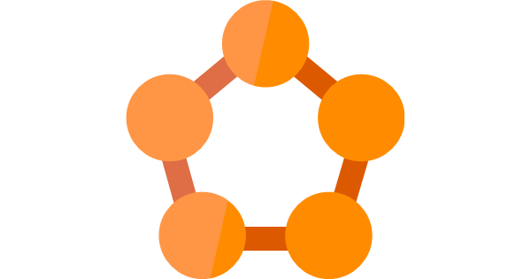
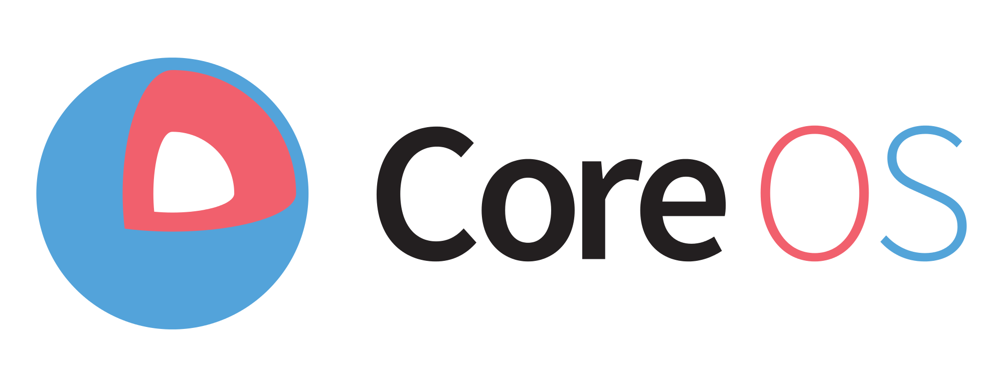

Azure
Notes:
Ultimately, run what you want!

Slide 56
Azure Resource Manager
Functions
Marketplaces
Agility
App Service
Service Fabric
Container Service
Virtual Machine Scale Sets
Virtual Machines
Control
Azure compute
Notes:
Hopefully now you understand the path you may need to take to start to move some of your existing VM workloads further up the Azure compute stack.

Slide 57
Call to action
Visit
Microsoft Azure docs
https://aka.ms/azuredocs
Read
Building Microservices:
Designing Fine Grained Systems
Follow
Joni Collinge
@dotjson

Slide 58
Thank you!

