Slide 1

Dental Clinic Problem
Abdullah Al Tamim
2020-1-60-127
Fatema Akter
2020-1-60-115
Fahad Ahammed
2020-2-60-174

Slide 2
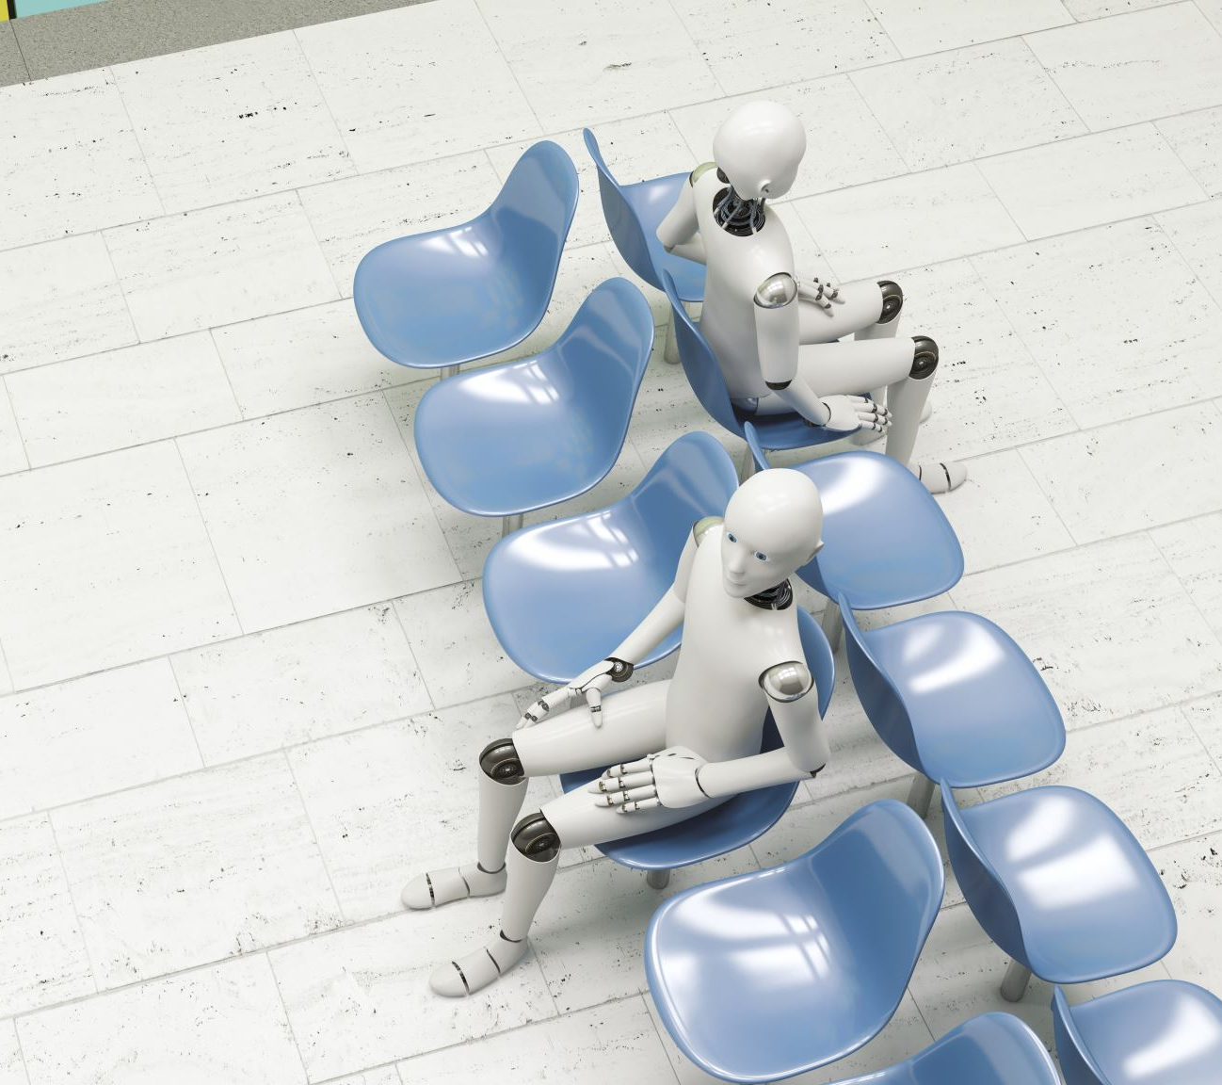
Project Description
There is a dental clinic which has one dentist with one dental chair and n chairs for waiting. When there are no patients, the dentist sleeps in his chair. When a patient arrives he has to wake up the dentist. Only one patient can take treatment from the dentist at a time. Other patients will wait if there are empty chairs. Otherwise, they will leave.

Slide 3

Topics we have used
POSIX thread
Mutex lock
Semaphore

Slide 4

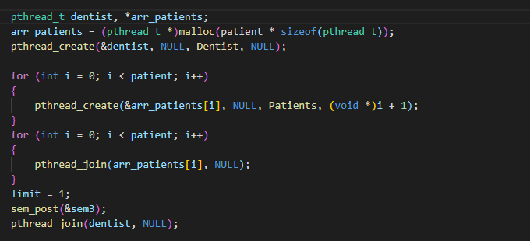
Threads

Slide 5

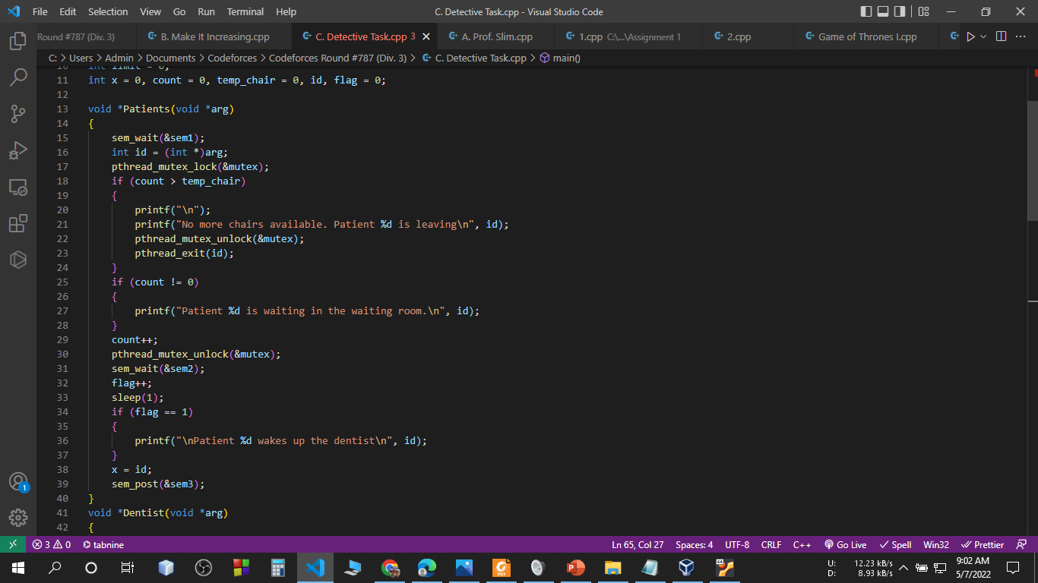
MUTEX LOCK

Slide 6

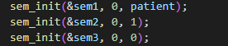
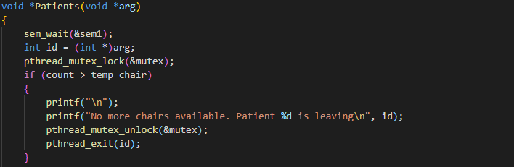
semaphores

Slide 7
Project’s Flowchart

Slide 8
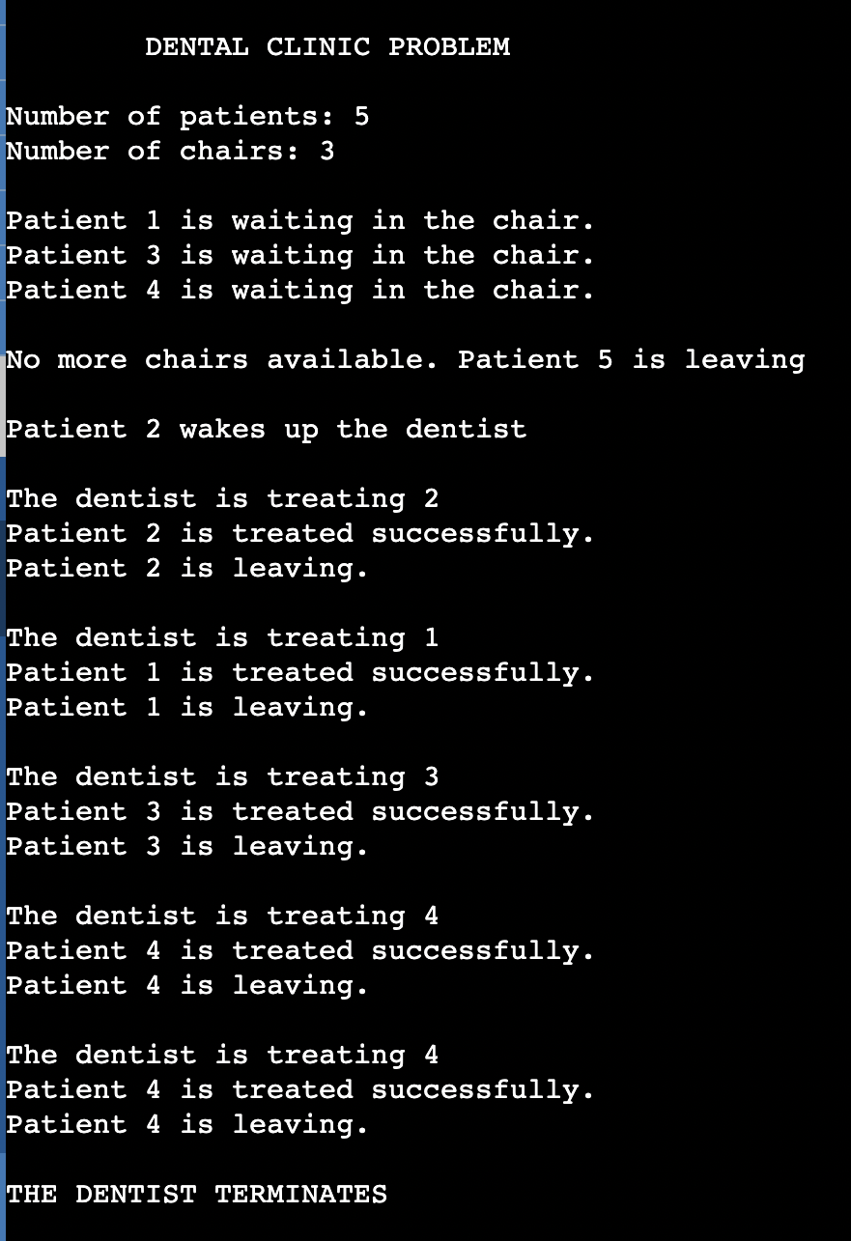

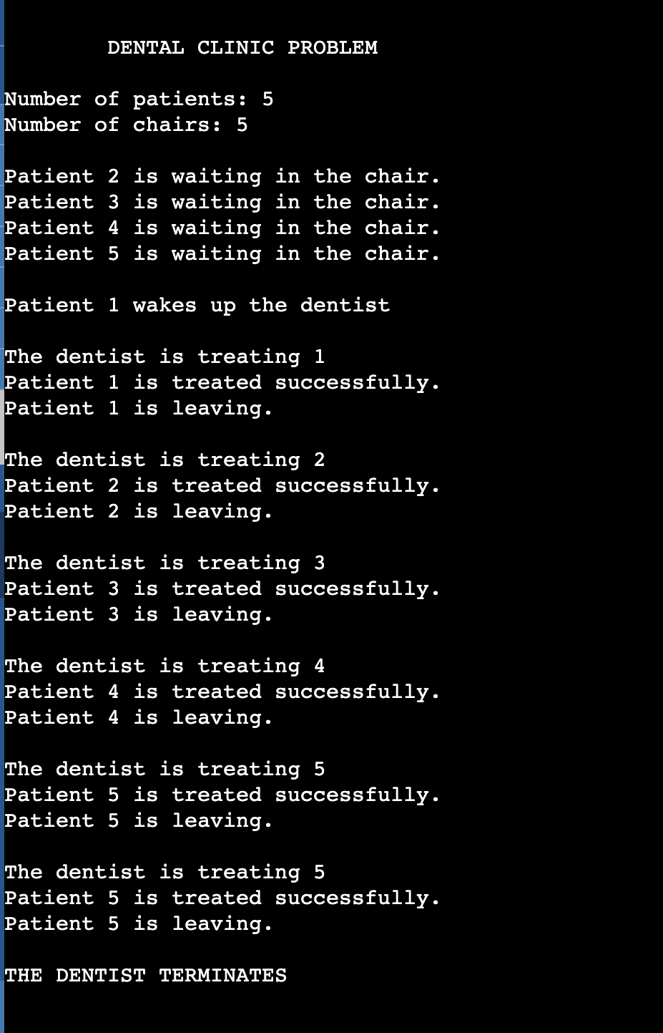
Output

Slide 9
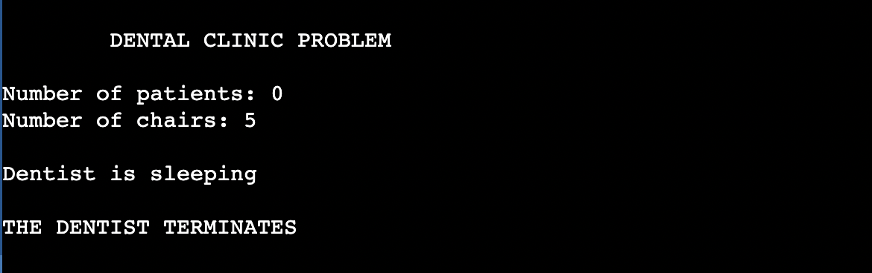
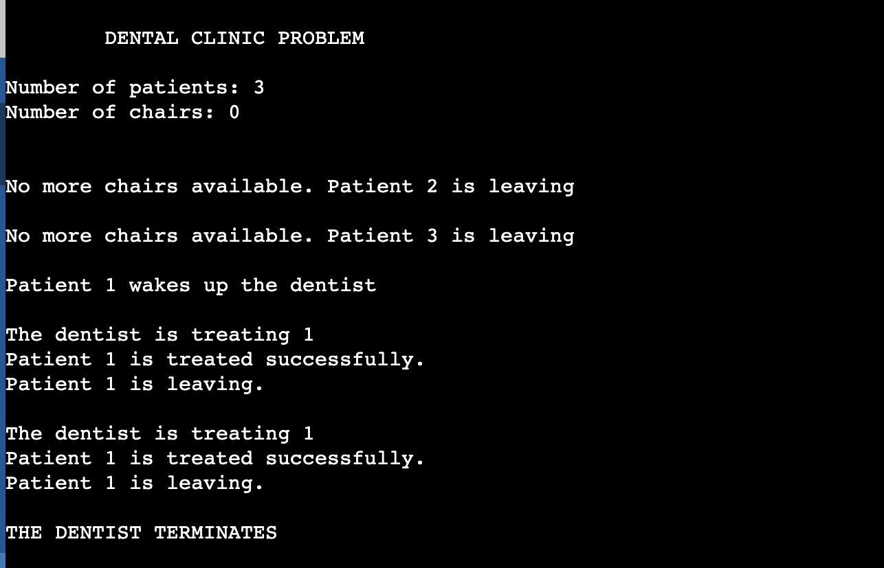
OUTPUT

Slide 10

Thank you!

