Slide 1
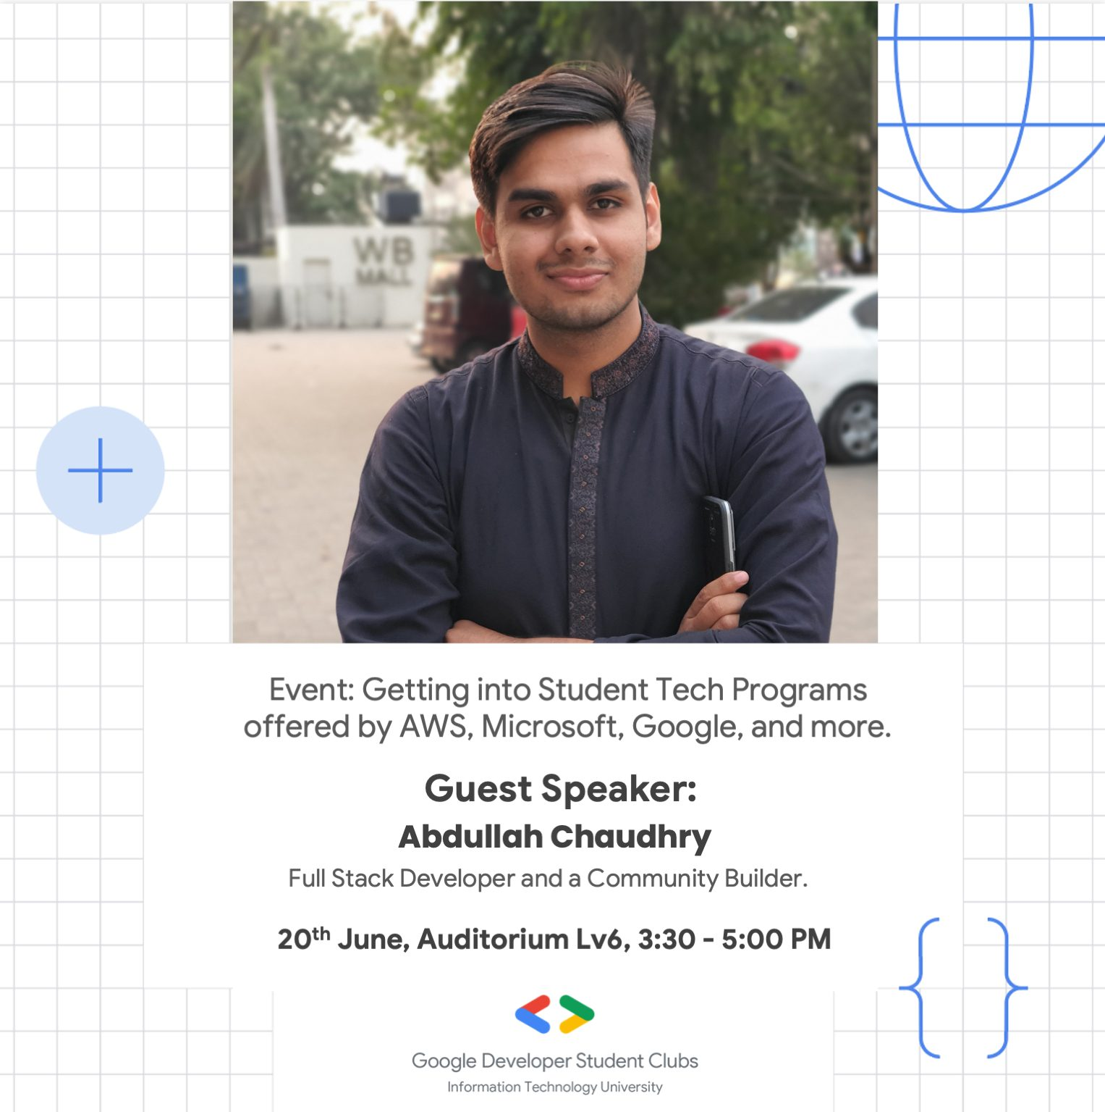
Venture For Pakistan

Slide 2
Venture For Pakistan
WORK In Top Startups of Pakistan
Roles in Engineering, Data Science, Growth, Product, Strategy, Venture

Slide 3
Perks (Venture For Pakistan)
95% of fellows have gotten return offers
Meet ups with different Top Startups’ Founders(Airlift, Abhi, Maqsad etc)
Y Combinator’s Mentorship

Slide 4
Application Timeline(VFP)
Applications open around May/June Time period
Application -> An Interview
40 Fellows out of a pool of 2k+ applicants for the inaugural Fellows S21 Cohort.

Slide 5
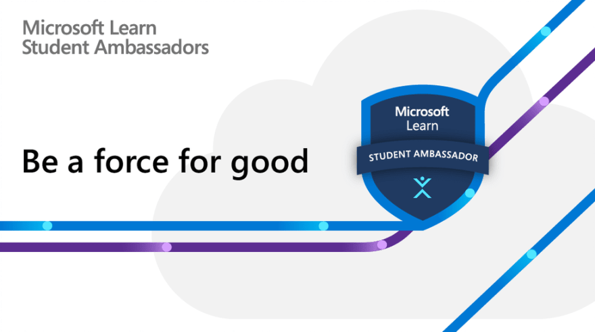
Microsoft Learn Student Ambassador
Become a Community Builder with Microsoft

Slide 6
Perks
Networking
HEC
Home - Visual Studio Subscriptions Portal
Xbox Game Pass, LinkedIn Premium etc

Slide 7
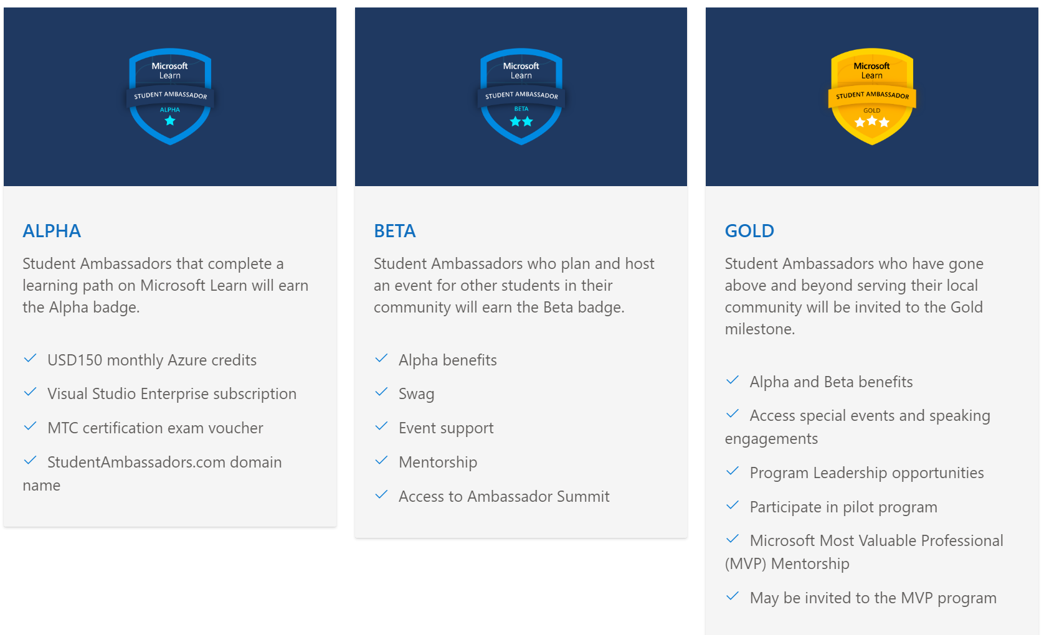

Slide 8
Application Timeline(MLS)
Applications are Open All Year Long
August 31, 2022 - Application Deadline Date
October 2022 - Application Decision Date
Referral System

Slide 9
Google Developer Student Clubs
Networking with Googlers
Networking with some of the Brightest Students from Pakistan

Slide 10
Application Timeline (GDSC)
Applications open around May-June
Application Form -> An interview with a Googler

Slide 11

Network with AWS Enthusiasts From All Over The World

Slide 12

Network with AWS Enthusiasts From All Over The World

Slide 13
PERKS AWS Community Builders
CERTIFICATION EXAM VOUCHERS: Each Community Builder is able to claim one Foundational, Associate, or Professional/Specialty Exams per 12 months.
AWS CREDIT: Within 30 days of joining, each member will receive a $500 AWS credit via email to help you learn, experiment, and grow by trying our new AWS services.
A FREE ONE-YEAR SUBSCRIPTION TO CLOUD ACADEMY: Cloud Academy is one of the leading global cloud learning platforms, and we’ve partnered with them to offer this fantastic benefit to our all Community Builders.
re:Invent 2022

Slide 14
Links
Venture for Pakistan | LinkedIn(Applications open around May-Summer Internship)
AWS Community Builders | Worldwide Cloud Community | AWS Developer Center (amazon.com)
Microsoft Learn Student Ambassadors

Slide 15
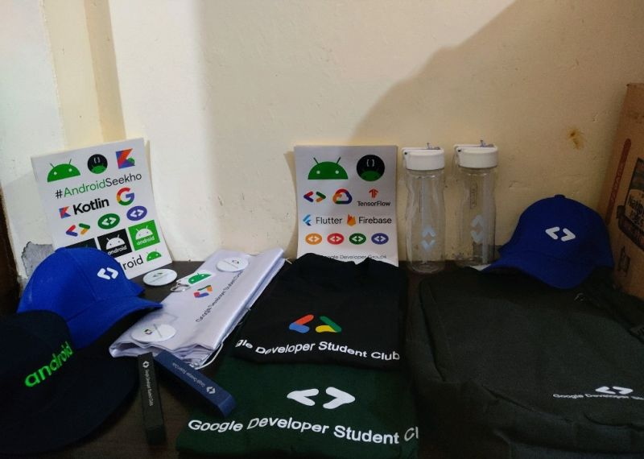
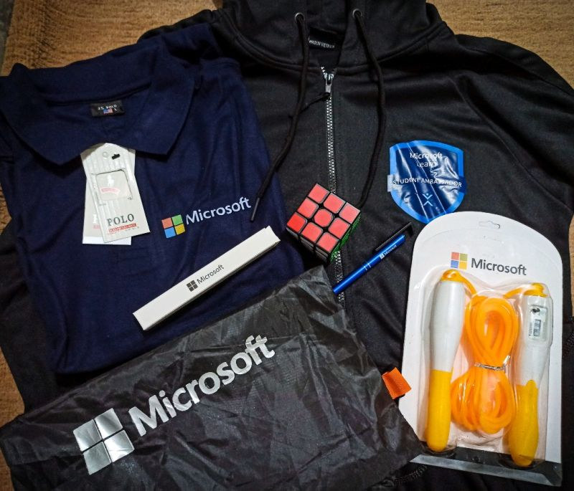
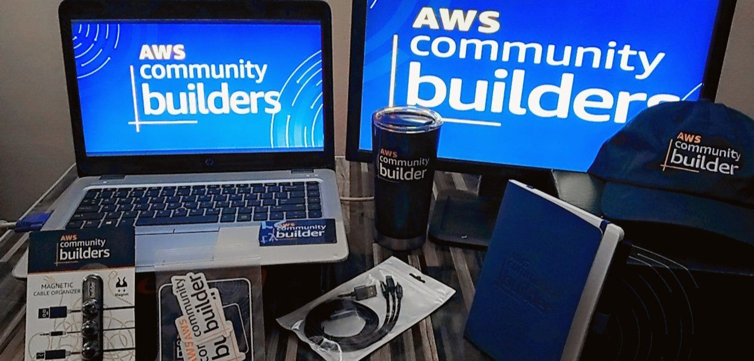
SWAGS

Slide 16
Some Heart to Heart
Programmer’s Credibility( Portfolio, GitHub, Stackoverflow)
Networking

Slide 17
Connect with me
LinkedIn
abdullah-ch (M.Abdullah Ch) (github.com) (FOLLOW)
M Abdullah Ch (@MAbdullahCh10) / Twitter
Technologies that I work with
React/Vue/Node/Firebase/Express/MongoDB/Git

