Slide 1

Week 11 - Java Collections
Ozacar Kasim, PhD | Assist. Prof. | Computer Engineering Department
Source: http://www.cs.washington.edu/education/courses/403/03wi/
http://java.sun.com/docs/books/tutorial/collections/index.html

Slide 2
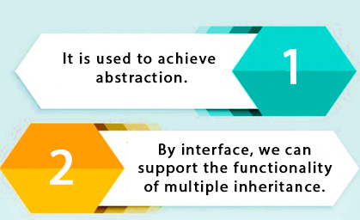
Interfaces: Definition
Week 10
An interface is a contract an implementing class needs to respect
interface contains behaviors that a class implements. (Contract)
Methods in an interface are by-default public. (Contract)

Slide 3
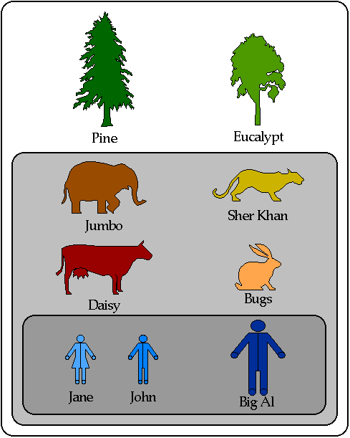
Abstraction
Week 10
organisms
The selection of significant attributes is abstraction.
We can abstract by appearance, structure, purpose, functionality, privilege etc.
Abstraction allows us to classify the items such as: organisms, mammals, humans
mammals
humans

Slide 4
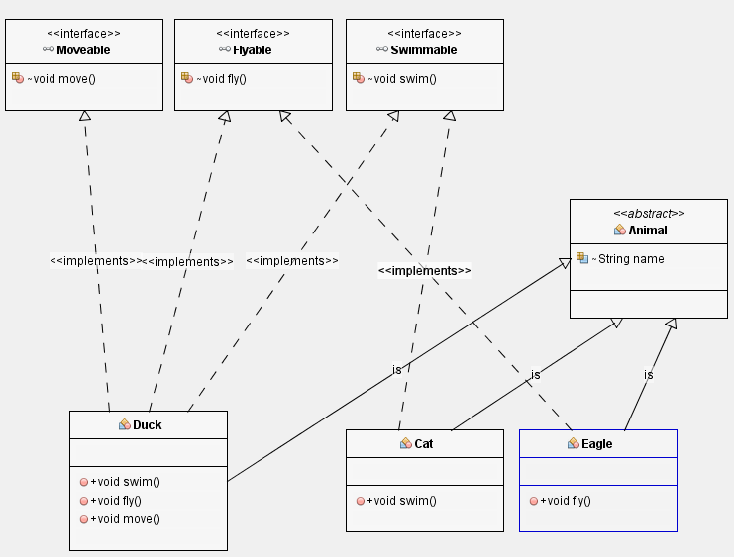
Multiple inheritance
Week 10
Multiple inheritance is not allowed in Java. But classes can inherit multiple interfaces.
Multiple inheritance allows a class to inherit the functionality of more than one interface
Thus allowing for modeling of complex relationships.

Slide 5
Week 11 - Java Collections
Ozacar Kasim, PhD | Assist. Prof. | Computer Engineering Department
Source: http://www.cs.washington.edu/education/courses/403/03wi/
http://java.sun.com/docs/books/tutorial/collections/index.html

Slide 6

Java 2 Collections
A collection is a very useful object that groups multiple elements into a single unit
store, retrieve and manipulate data
transmit data from one method to another
data structures and methods written by pioneers in the field
Joshua Bloch, who wrote the Java Collections Framework, the java.math package and many more...
Joshua Bloch

Slide 7
Java Collections Framework
Unified architecture for representing and manipulating collections.
A collections framework contains three things:
Interfaces
Implementations
Algorithms

Slide 8
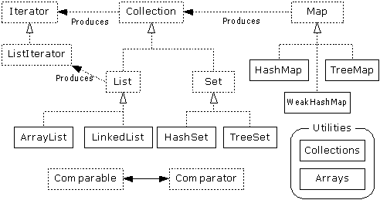
Collections Framework Diagram
Interfaces, Implementations, and Algorithms
From Thinking in Java, page 462

Slide 9
Collection Interface
Interfaces, Implementations, and Algorithms
From Thinking in Java, page 462

Slide 10
Collection Interface
This Interface defines fundamental methods
int size();
boolean isEmpty();
boolean contains(Object element);
boolean add(Object element); // Optional
boolean remove(Object element); // Optional
Iterator iterator();
These methods are enough to define the basic behavior of a collection
This Interface provides an Iterator to step through the elements in the Collection
// what is this?

Slide 11
Iterator Interface
Interfaces, Implementations, and Algorithms
From Thinking in Java, page 462

Slide 12
Iterator Interface
Defines three fundamental methods
Object next()
boolean hasNext()
void remove()
Iterator enables you to cycle through a collection, obtaining or removing elements.
These three methods provide access to the contents of the collection
An Iterator knows position within collection
Each call to next() “reads” an element from the collection. Then you can use it or remove it

Slide 13
Iterator Position
When next() is called
Iterator iterator = list.iterator();
while(iterator.hasNext()){
System.out.println(iterator.next());
iterator.remove();
}
element1
element2
element3
element4
list
hasNext ==false
iterator
returning element : iterator.next()
hasNext ==true

Slide 14
When to use Iterators?
If you only want to scan through the list, then this is enough: for(Object obj : objList) { System.out.println(obj.name); }
If you want to modify the list, then use the Iterator
while (iter.hasNext()) { //check if there is a next element
iter.next(); // go to next element
iter.remove(); // remove the returning element
}

Slide 15
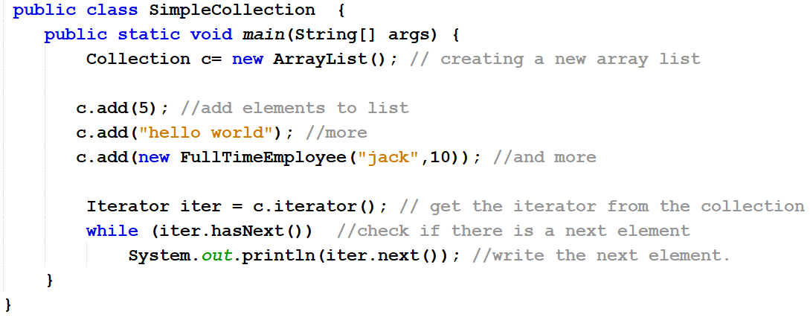
Example –A Simple Collection
You can put any types of data. But! Don’t do this.

Slide 16
Warning:
“Don’t use raw types” Joshua Bloch- Effective Java Third Edition. Ch. 5 Page 117
Let's say you want to put a single data type and If someone accidentally inserted an object of the wrong type, casts could fail at runtime.
With generics, you tell the compiler what types of objects are permitted in each collection (type-safety)
We are not going to use : List elements = new …
Rather we use, List<YourObjectType> elements = new …
This will be called as generics. Using generics, we will have type-safety.

Slide 17
List Interface

Slide 18
List Interface
The List interface adds the notion of order to a collection
The user of a list has control over where an element is added in the collection
Lists typically allow duplicate elements
Provides a ListIterator to step through the elements in the list.

Slide 19
ListIterator Interface

Slide 20
ListIterator Interface
Extends the Iterator interface
Defines three fundamental methods
void add(Object o) - before current position
boolean hasPrevious()
Object previous()
The addition of these three methods defines the basic behavior of an ordered list
A ListIterator knows position within list

Slide 21
ListIterator Position - next(), previous()
returning element : iterator.previous()
hasPrevious ==false
element4
element1
element2
element3
list
hasNext ==false
hasPrevious ==true
iterator
hasNext ==true
When hasPrevious() is called

Slide 22
public class ListIteratorExample {
public static void main(String[] args) {
// Create a LinkedList
LinkedList<String> linkedlist = new LinkedList<String>();
linkedlist.add(“Abant"); // Add elements to LinkedList
linkedlist.add(“Mengen");
linkedlist.add(“Gerede");
ListIterator listIt = linkedlist.listIterator(); // Obtaining ListIterator
System.out.println("Forward iteration:");
// Iterating the list in forward direction
while(listIt.hasNext())
System.out.println(listIt.next());
// Iterating the list in backward direction
System.out.println("\nBackward iteration:");
while(listIt.hasPrevious())
System.out.println(listIt.previous());
}
}

Slide 23
ArrayList and LinkedList

Slide 24
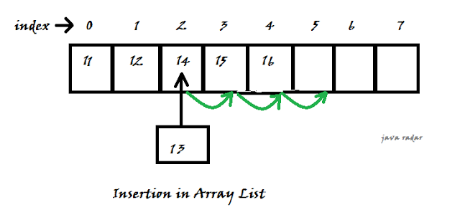
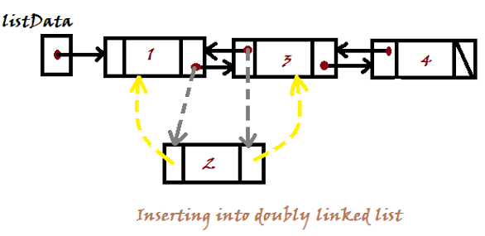
List Implementations
ArrayList
low cost random access
high cost insert and delete
LinkedList
sequential access
low cost insert and delete
high cost random access

Slide 25
ArrayList overview and methods
Constant time (O(1)) positional access (it’s an array)
The indexed get and set methods of the List interface are appropriate to use since ArrayLists are backed by an array
Object get(int index)
Object set(int index, Object element)
Indexed add and remove are provided, but can be costly if used frequently
void add(int index, Object element)
Object remove(int index)
May want to resize in one shot if adding many elements
void ensureCapacity(int minCapacity)
As elements are added to an ArrayList, its capacity grows automatically.

Slide 26
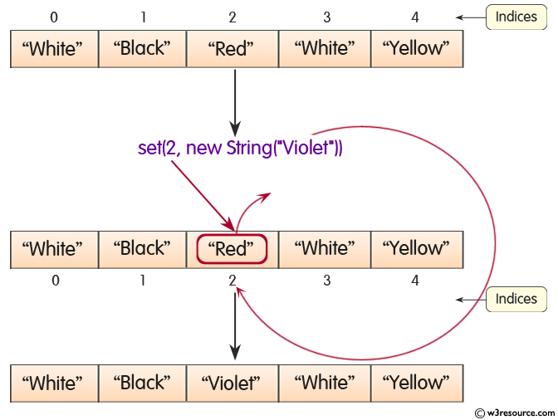
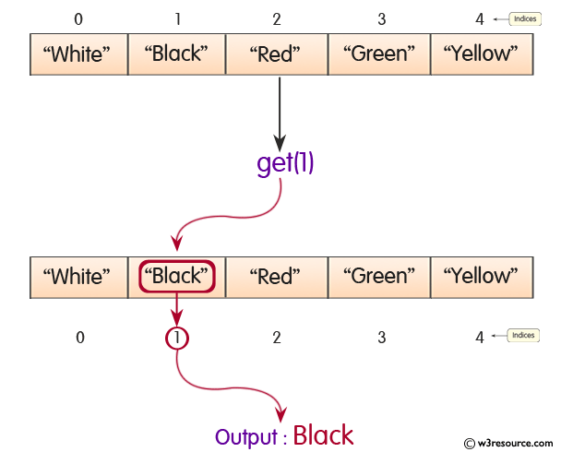
Set() and get() methods in ArrayList
set
get

Slide 27
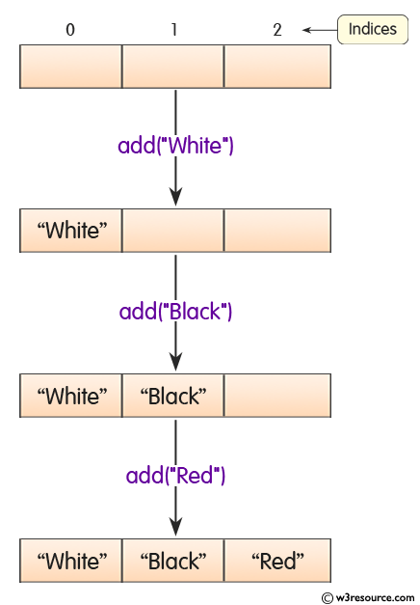
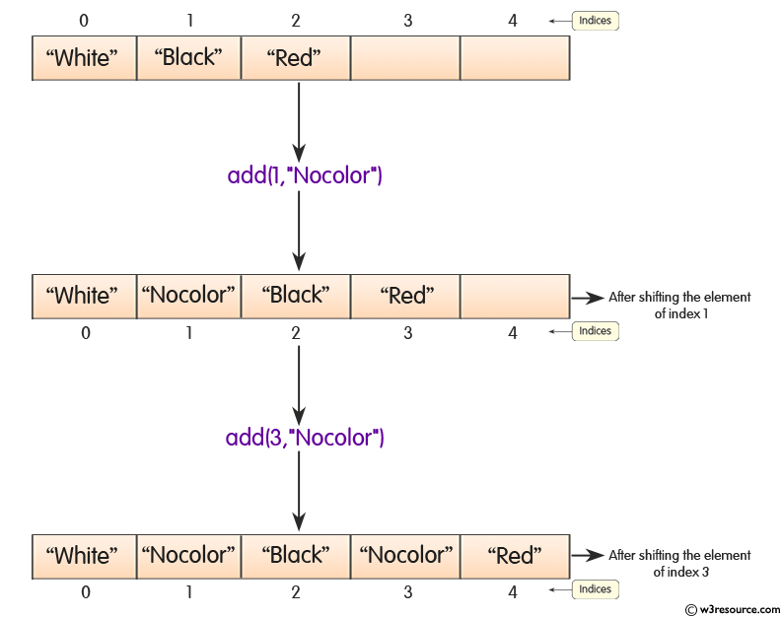
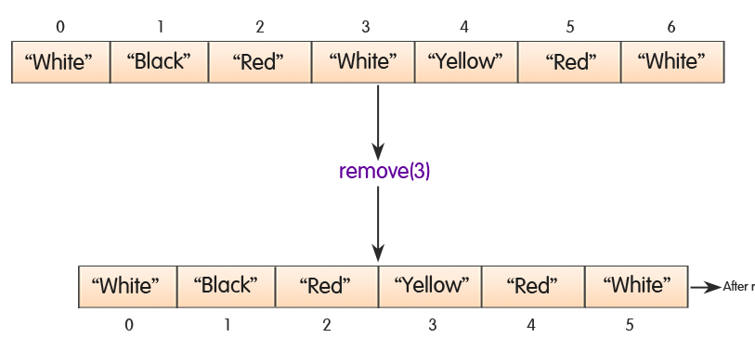
add() and remove() methods
add
remove

Slide 28
LinkedList overview
Stores each element in a node
Each node stores a link to the next and previous nodes
Insertion and removal are low-cost
just update the links in the surrounding nodes
Random access is expensive
Start from beginning or end and traverse each node while counting

Slide 29
LinkedList methods
The list is sequential, so access it that way
ListIterator listIterator()
ListIterator knows about position
use add() from ListIterator to add at a position
use remove() from ListIterator to remove at a position
LinkedList knows a few things too
void addFirst(Object o), void addLast(Object o)
Object getFirst(), Object getLast()
Object removeFirst(), Object removeLast()

Slide 30
import java.util.ArrayList;
import java.util.LinkedList;
import java.util.List;
public class ListExample {
public static void main(String[] args) {
//create ArrayList
Collection <String> list = new ArrayList<>();
//add element to ArrayList
list.add(“jack");
list.add(“mike");
list.add(“hulk");
//create LinkedList
Coladdlection <String> list2 = new LinkedList<>();
// elements to LinkedList
list2.add(“jade");
list2.add(“June");
list2.add(“April");
}
}

