Slide 1

Working with classes: Exception handling, static keyword
Week 4
Ozacar Kasim, PhD | Assist. Prof. Computer Engineering Department

Slide 2
Previously on OOP
Summary: week 3
Access Modifiers
Class Constructors,
UML
OOP Concepts: Encapsulation (Data Hiding)
set() and get() methods

Slide 3
Access Modifiers
Summary: week 3
Access modifiers set access levels for classes, variables, methods, and constructors.
Access levels are −
default: Visible to the package. No modifiers are needed.
private: Visible to the class only
public Visible to the world

Slide 4
Class Constructors
Summary: week 3
A constructor in Java is a method which is used to initialize object
Constructor method of a class has the same name as that of the class, they are called when an object of a class is created.
When Attributes of an object are not available while creating objects, the default constructor is called.
It is optional to write constructor method(s) in a class but due to their utility they are used.
public class MyClass{
//constructor (default constractor)
public MyClass(){
}
..
}
constructor doesn’t have a return type.

Slide 5
Example
public class Rectangle { private float length; private float width; private float xLocation; private float yLocation; public Rectangle() { length = 0.0f; width = 0.0f; xLocation =0.0f; yLocation=0.0f; } public Rectangle(float l, float w) { length = l; width = w; xLocation =0.0f; yLocation=0.0f; }
public Rectangle(float l, float w, float x, float y) { length = l; width = w; xLocation = x; yLocation =y; } public float getArea() { return length * width; } }

Slide 6
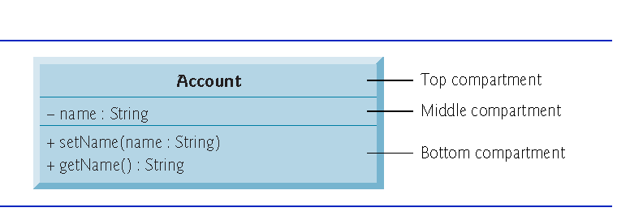
Summary: week 3
Class name
Attributes (variables)
Behaviors (methods)
Return Types
The UML indicates an operation’s return type by placing a colon and the return type after the parentheses following the operation name.
UML class diagrams do not specify return types for operations that do not return values.
Declaring instance variables private is known as data hiding or information hiding.
Parameters
The UML models a parameter of an operation by listing the parameter name, followed by a colon and the parameter type between the parentheses after the operation name
+:public -:private ~:default

Slide 7
Encapsulation(Data Hiding ): set() and get()
Summary: week 3
Why do we create methods to access variables, if we can access them directly?
Answer: security issue.
'private' variables can only be accessed in the class. It's as if they were invisible out of the scope of the class / object.
Using set() and get() methods, A class can have total control over what is stored in its attributes
Class Foo {
private String name;
public void setName(String name){
//put any condition
this.name = name;
}
public String getName(){
//put any condition
return name;
}
}

Slide 8
Benefits of Encapsulation
Summary: week 3
A class can have total control over what is stored in its attributes.
Attributes of a class can be made read-only or write-only.
The users of a class do not know how the class stores its data.
A class can change the data type of a attributes and users of the class do not need to change any of their code.

Slide 9
Week 5: Table of Contents
Exception handling in classes
Static keyword

Slide 10
errors
Compile Time Errors
Run Time Errors
-Syntax error
in a;
-Type mismatch, wrong casting
int x = “asdsad”;
…
Exceptions
-exceptions are events that disrupt the normal flow of the program's instructions during the execution of a program.
We must handle the Exception,
otherwise, the program will crash!!

Slide 11
Exception Handling:Try Catch
What is an exception(exceptional event)?
An exception is an event, which occurs during the execution of a program, that disrupts the normal flow of the program's instructions.
How do you throw and catch exceptions?
The object, called an exception object, contains information about the error, including its type and the state of the program when the error occurred. Creating an exception object and handing it to the runtime system is called throwing an exception.
What do you do with an exception once you have caught it?
We can handle the exception

Slide 12
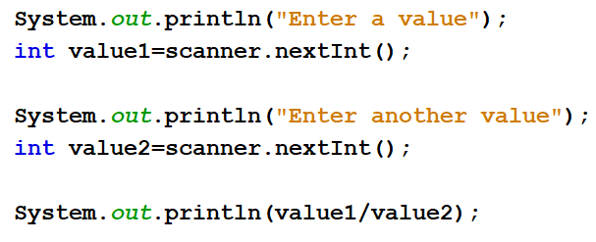
Exception Example
What if value2 is zero? This is an exception
Value1/value2 is undefined
This is an exception that disrupts the normal flow of the program's instructions

Slide 13
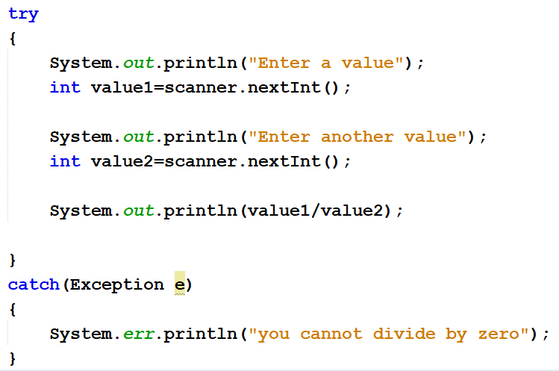
Exception Example

Slide 14
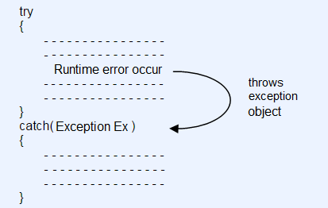
Exception Handling : Basic Concepts
Exception handling is a mechanism that allows you to take appropriate action to avoid run-time errors.
Java provides five keywords to support exception handling.
Try : The try block contain statements which may generate exceptions.
Catch :The catch block defines the action to be taken, when an exception occur.
Throw : When an exception occur in try block, it is thrown to the catch block using throw keyword.
Throws : Throws keyword is used in situation, when we need a method to throw an exception.
Finally : If exception occur or not, finally block will always execute. (Most of the time, optional to use)
The general form of try-catch block in Java.
Finally block can be used to put "cleanup" code such as closing a file, closing connection etc.

Slide 15
Exception Handling : Basic Concepts
This is accomplished using the keywords: try, catch, throw, throws, and finally
You try to execute the statements contained within a block of code.
If you detect an exceptional condition within that block, you throw an exception object of a specific type.
You catch and process the exception object using code that you have designed.
finally block is always executed whether exception is handled or not.
Finally block can be used to put "cleanup" code such as closing a file, closing connection etc.

Slide 16
Exception Handling: Syntax
try{
//statements that may cause an exception
}
catch (Exception(type) e(object))‏{
//error handling code
//System.out.println(e.getMessage());
}
public String getMessage()
-Returns a detailed message about the exception that has occurred. This message is initialized in the Throwable constructor.

Slide 17
What is the advantage of using try/catch versus if/else?
if/else is a conditional used for “normal” flow of control.
Exceptions break the “normal” flow of control.
if/else cannot handle this. try/catch is used to handle exceptions.
So, use try/catch to handle exceptions, not “normal” flow of control.
You can use if/else inside of the catch block if you need to.

Slide 18
Example for Exception Handling : Time1 class
Time1
-hour:int -minute:int -second:int
<<constructor>>Time1(hout:int, minute: int, second:int) +setHour(h: int) +setMinute(m: int) +setSecond(s: int) +toString():String +toUniversalString():Sting
Class Time1 represents the time of day.
private int instance variables hour, minute and second represent the time in universal-time format (24-hour clock format in which hours are in the range 0–23, and minutes and seconds are each in the range 0–59).
public methods setHour(), setMinute(), setSecond(), toUniversalString() and toString().
Notes:
If your code does something fatally weird (like trying to divide by zero), it will immediately fail.
In all the languages that I've worked in, a fatal error stops the program from running further. So it wouldn't get to your If/Else statement.

Slide 19
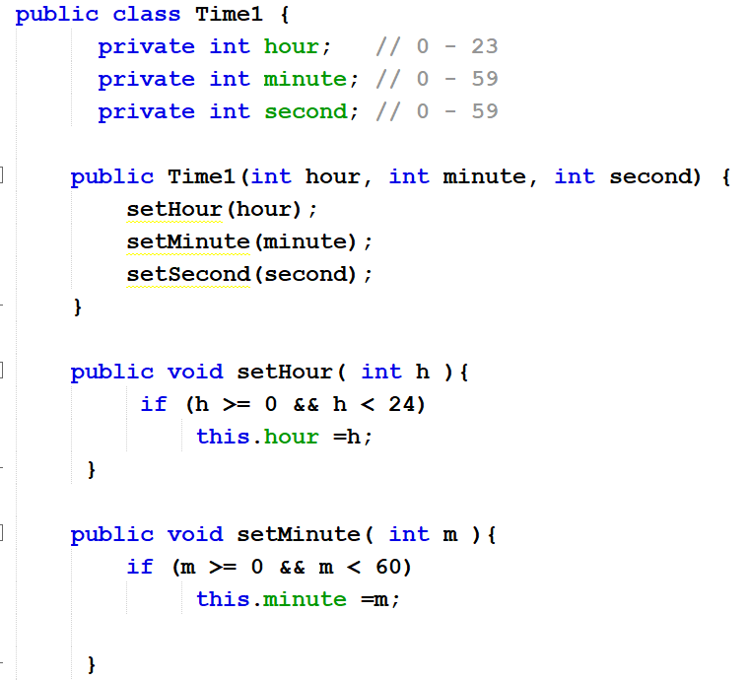
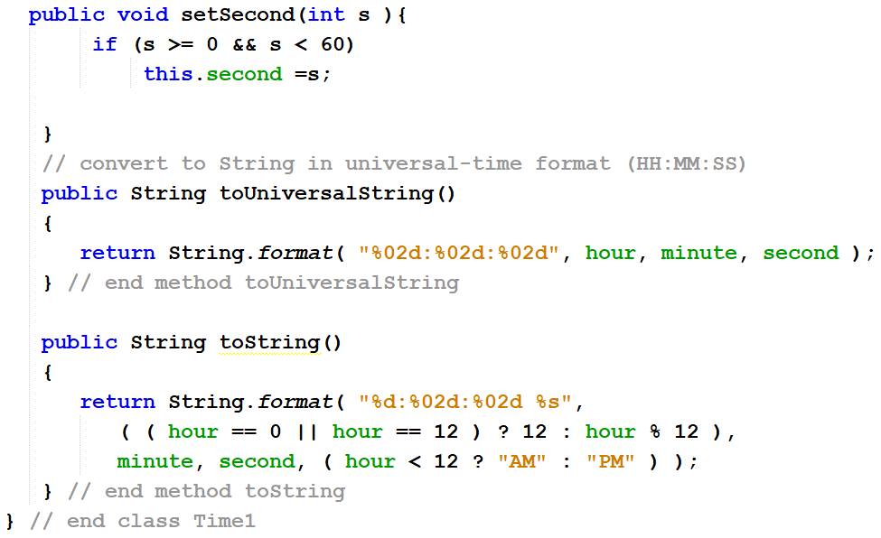
Time1 class : AM/PM vs 24-H
Notes:
there are conditions you can't test for in your code

Slide 20
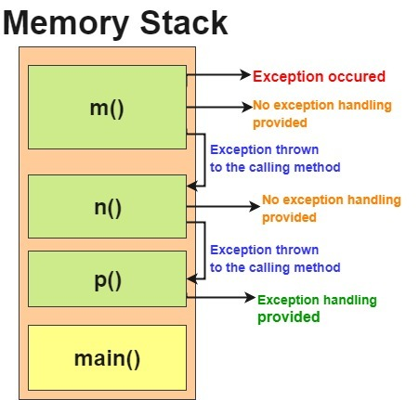
Java Exception propagation
class TestClass{
void m(){
int data=50/0;
}
void n(){
m();
}
void p(){
try{
n();
}catch(Exception e){
System.out.println("exception handled");}
}
public static void main(String args[]){
TestClass obj=new TestClass();
obj.p();
System.out.println("normal flow...");
}
https://simplesnippets.tech/throw-throws-in-java-exception-handling-part-3/

Slide 21
An example
Scanner scanner = new Scanner(System.in);
try{
int num = scanner.nextInt();
if (num > 100) {
throw new Exception("Out of bound");
}
} catch (InputMismatchException e) {
System.out.println("Not an integer");
} catch (Exception e) {
System.out.println("Error: "+ e.getMessage());
} finally {
System.out.println("DONE");
}
If there is no error in input, then no exception is thrown, and the output will be DONE If there is an error in input, one of the two exceptions is thrown, and the output will be Not an integer DONE or Error: Out of bound DONE

Slide 22
Static keyword
The static keyword is a non-access modifiers and used in java mainly for memory management. It is used with variables, methods, blocks and nested classes.
It is a keyword that are used for share the same variable or method of a given class.
This is used for a variable or a method that is the same for every instance of a class.

Slide 23
Stack memory
Heap memory
class Circle{
int x;
int y;
static int z;
}
A
X=5
Y=7
Permanent Generation area
Circle a
z
B
X=15
Y=4
Circle b
Here z is static variable: it belongs to class, not an object. It's shared by all the objects created by this class.

Slide 24
Static variable
If any variable, we declared as static is known as static variable.
Static variable is used for fulfill the common requirement. For Example, college name of students etc. Name of the college is common for all students.
A static variable is stored in the Heap’s Permanent Generation area.
The static variable allocate memory only once in class area at the time of class loading.
Only a single copy of the static variable is created and shared among all the instances of the class.
Using static variable, we make our program memory efficient (i.e it saves memory).

Slide 25
When and why we use static variable?
Suppose we want to store record of all employee of any company,
in this case employee id is unique for every employee but company name is common for all. So, use static variable to store the company name.
When we create company name as a static variable then only once memory is allocated. Otherwise, it allocate a memory space each time for every employee object.

Slide 26
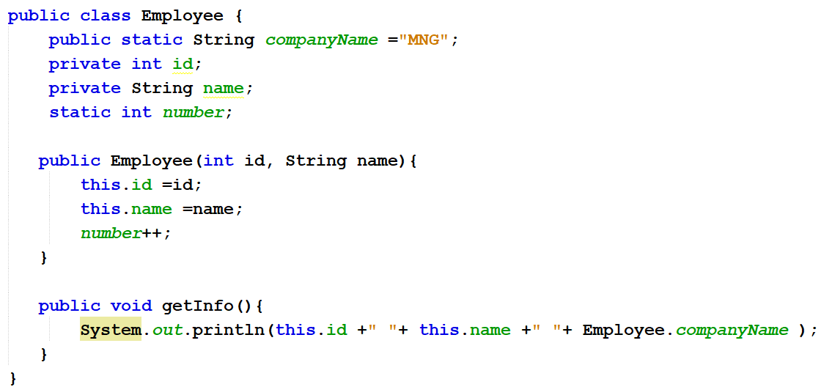
An example of static keyword

Slide 27
final Keyword
static keyword always fixed the memory that means that will be located only once in the program
final keyword always fixes the value that means it makes variable values constant
Note: As for as real time statement there concern every final variable should be declared the static but there is no obligation that every static variable declared as final.

Slide 28
Lab Exercise 1: Exception Handling
You need to read an integer value from keyboard. However, let's say a user typed a string value.
This will cause an input mismatch exception.
Handle this exception. (Hint: use InputMismatchException exception.)

Slide 29
Lab Exercise 2: Creating your own Exception
Create a Worker class which contains name salary attributes
Create setName and setSalary methods.
Your program should throw an exception when salary value is less than zero. (When you enter an illegal argument)
The exception message is “salary amount must be greater than zero”
In main method handle the exception and display the exception message.
Add another attribute (counter) which must be shared by all the instances of Worker class.
Create three workers and display number of total workers using counte variable.

Slide 30
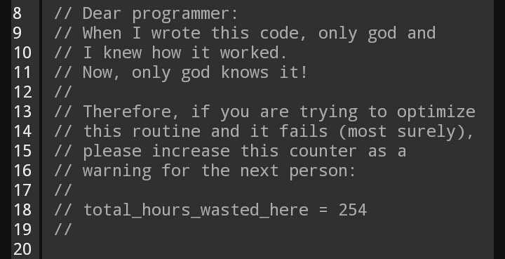
This is the end of lecture

