Slide 1


Week 5: Static variables and methods, Enum types,
week5
Ozacar Kasim, PhD | Assist. Prof.
Computer Engineering Department

Slide 2
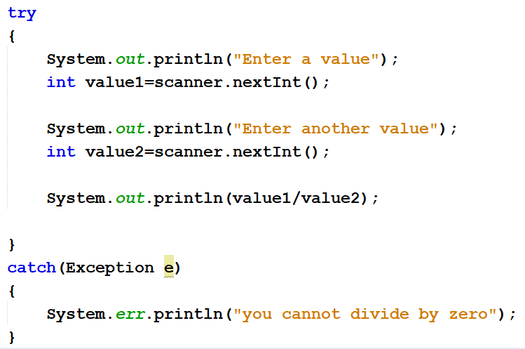
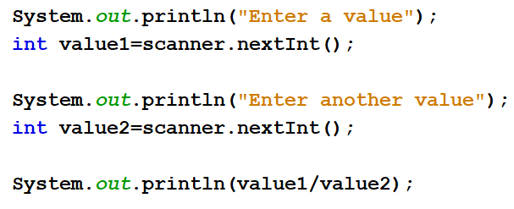
Exception Handling
Previously on OOP
Summary: week4
SYNTAX
USAGE
try{
//statements may cause an exception
}
catch (Exception(type) e(object))‏
{
//error handling code
}

Slide 3
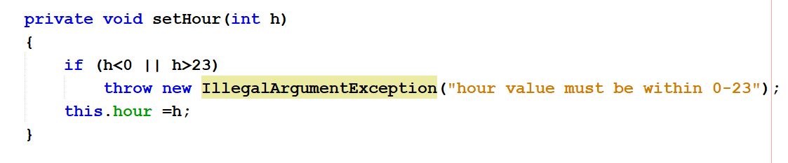
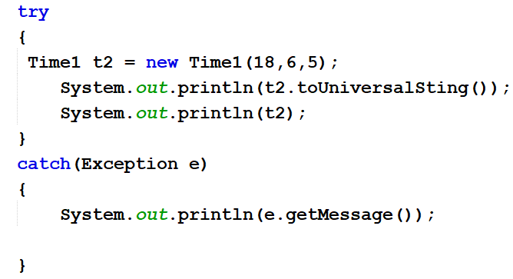
Throw a new custom Exception
Previously on OOP
Summary: week4
Time1Class
MainClass (Week4ThuDayClass)

Slide 4
class Circle{
int X; //4bytes
int Y;//4bytes
static int z; //4bytes
}
Stack memory
Heap memory
A
X=5
Y=7
Circle a
Z=10
B
X=15
Y=4
Circle a = new Circle(); //8bytes for x and y in heap
Circle b
Circle b = new Circle() //8bytes
for x and y in heap
//4bytes for z in class area
In total 8 +8+4 = 20bytes
Here z is static variable: it belongs to class, not an object. It's shared by all the objects created by this class.
Static is used for sharing the same variable of a given class among all the objects created from it.

Slide 5
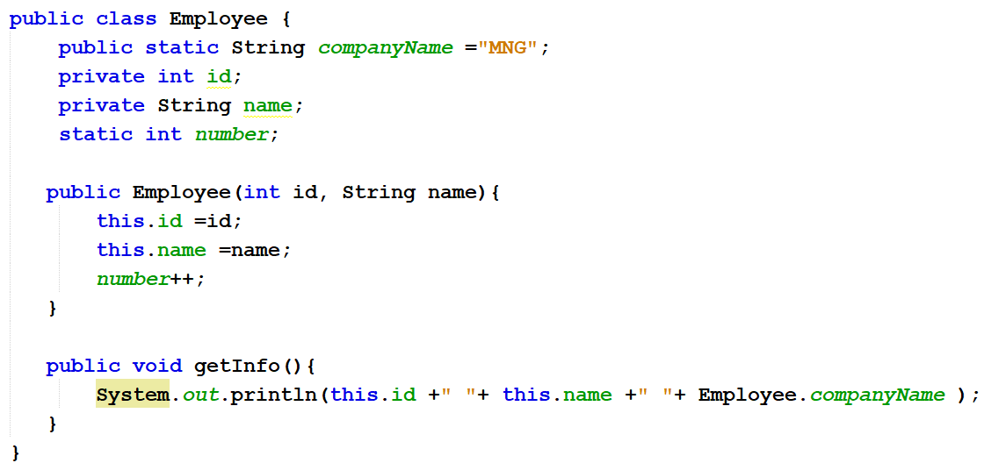
An example of static keyword

Slide 6
final Keyword
final keyword always fixes the value that means it makes variable values constant
Note: There is no obligation that every static variable declared as final.
If a variable is constant, then use “final static”

Slide 7

Week 5: Static methods, Enum types
week5
Ozacar Kasim, PhD | Assist. Prof. | Computer Engineering Department

Slide 8
What is Static Method in Java?
Static method is a method which belongs to the class and not to the object(instance)
A static method can access only static data. It can not access non-static data (instance variables)
A static method can call only other static methods and can not call a non-static method from it.
A static method can be accessed directly by the class name and doesn’t need any object
A static method cannot refer to "this“ keyword.

Slide 9
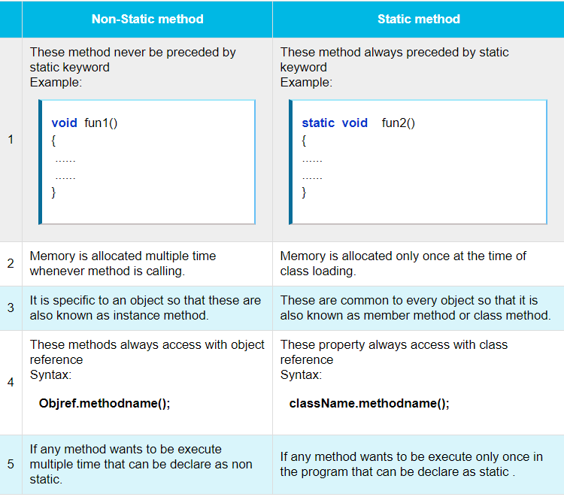
Notes:
Static methods are stored in Metaspace space of heap as they are associated to the class

Slide 10
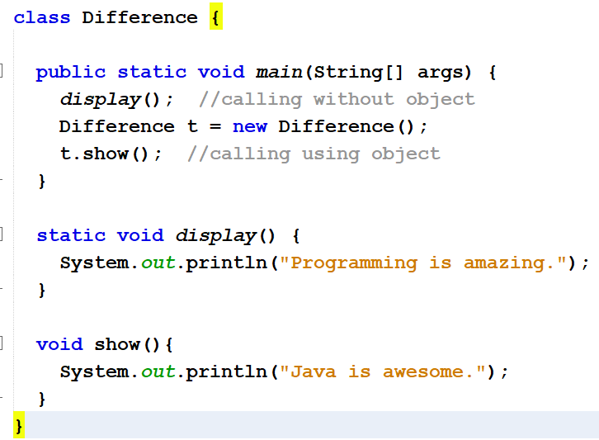
Static Method vs Non-Static (Instance) Method

Slide 11
Another Example
class MyClass{
private static int data;
public static void setData(int d) {
data = d;
}
public static int getData() {
return data;
}
}
public class JavaApp {
public static void main(String[] args) {
MyClass.setData(50);
System.out.println(MyClass.getData());
}
}
No need to create an object

Slide 12
We know the static keyword now.
So, why is the main method static?
public static void main(String[] args) {
…
}
Notes:
because keyword static allows main to be called without creating an object of the class in which the main method is defined.

Slide 13
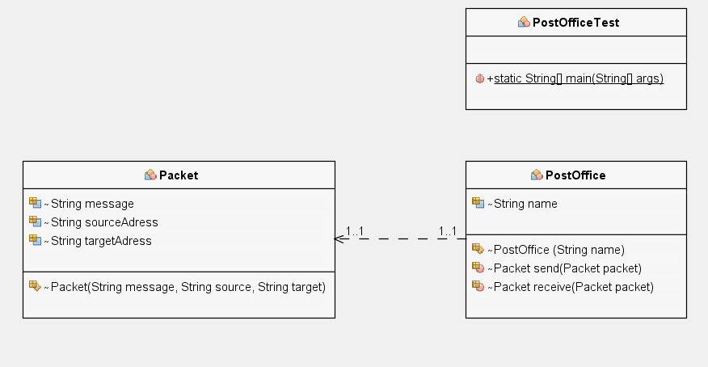
Exercise: Working with multiple object types
Post
void send(Post post)
Post
void receive(Post post)
We need two Post Offices; one to send and another to receive posts. To send a post, first we need to create one. Lets create them.

Slide 14
Enum Types
Syntax
An enum type is a special data type that enables for a variable to be a set of predefined constants.
The variable must be equal to one of the values that have been predefined for it.
Common examples include compass directions (values of NORTH, SOUTH, EAST, and WEST), the days of the week, months, seasons etc.
enum Day {
SUNDAY,
MONDAY,
TUESDAY,
WEDNESDAY,
THURSDAY,
FRIDAY,
SATURDAY
}
//simple enum

Slide 15
Enum Types with Constructor
A Java enum type can have a private constructor that can be used to initialize instance variables(attributes).
public enum Branch {
MATH(001),
PHYSICS(002),
GEOMETY(003)
private int fieldId;
Branch(int fieldId){
this.fieldId =fieldId;
}
}
values() method can be used to return all values present inside enum
Looping through enum items
Branch[] brunches= Branch.values() ;
for(Branch b : brunches) {
System.out.println(b);
}

Slide 16
Enum types with Classes: Making CompanyName
enum CompanyName{
GOOGLE(1995, "Google was founded in 1998 by Larry Page and Sergey Brin while"),
MICROSOFT(1975, "Microsoft Corporation is a technology company with headquarters in Redmond, Washington");
final private String description;
private int createdYear;
private CompanyNames(int cYear, String desc) {
this.description = desc;
this.createdYear = cYear;
}
public String getDescription(){
return this.description;
}
}

Slide 17
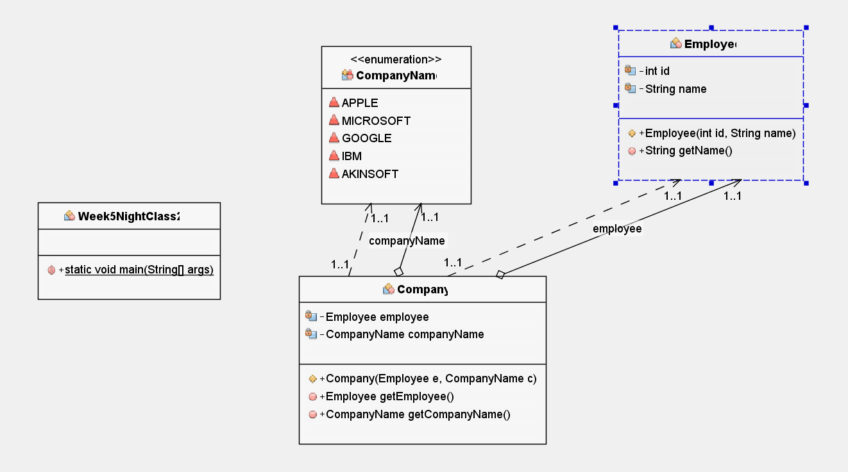
Example: Lets move to IDE!
Employee[] employees
Company(CompanyName cName, Employee[] emps)

Slide 18
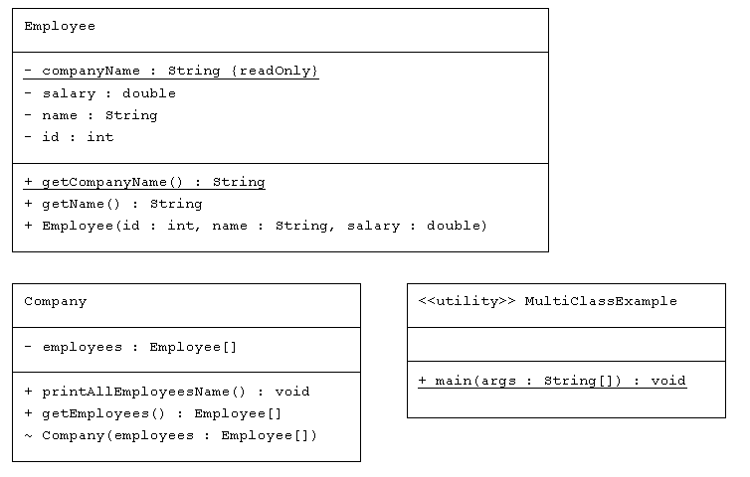
HW->Multi-class Example: Using one object in another class as an attribute

Slide 19
Lab Exercise-1: static keyword
Create a Circle class, where
declare a private constant double variable PI has value of 3,141519
declare a private variable called double radius.
class constructor will have an argument to set radius.
declare a method called computeArea() to compute area of a circle object.
create 3 different circle instances, with radiuses 5, 10, 15.
print all the areas using a foreach loop.

Slide 20
Lab Exercise-2: Enum types
Create Branch Enum type will contain following branches
MATH(“information regarding math”)
PHYSICS(“information regarding physics”)
CS(“information regarding cs”)
ENG(“information regarding eng”)
Create a Teacher Class which contains id (int), and branch (Enum) attributes. The class must have a constructor with these two parameters.
Create four teacher objects; each has different branch.
Put them all in an array, and print their branches using for loop.

