Slide 1

Week 8 OOP Concepts: Inheritance
Week 8
Ozacar Kasim, PhD | Assist. Prof. | Computer Engineering Department
I have benefited greatly from Smartherd channel @youtube

Slide 2

Overview
Object-Oriented Programming is a methodology to design a program using classes and objects. It simplifies the software development and maintenance by providing some concepts:
Class
Object
Encapsulation
Inheritance
Polymorphism
Abstraction

Slide 3
Table of Contents
Inheritance: Definition & Terms
Types of Inheritance
Inheritance for Code Reusability
Inheritance with Constructor
Super keyword
Inheritance for Method Overriding
Access Control

Slide 4


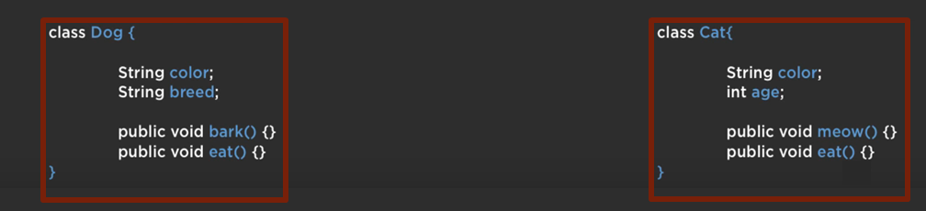
Need for Inheritance

Slide 5
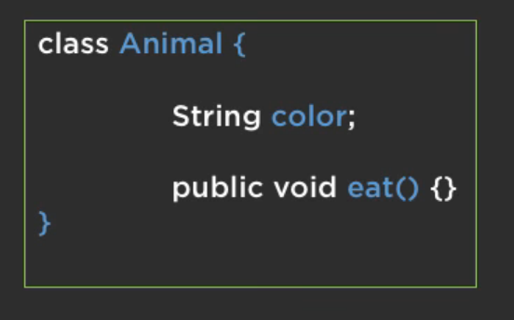
Need for Inheritance

Slide 6
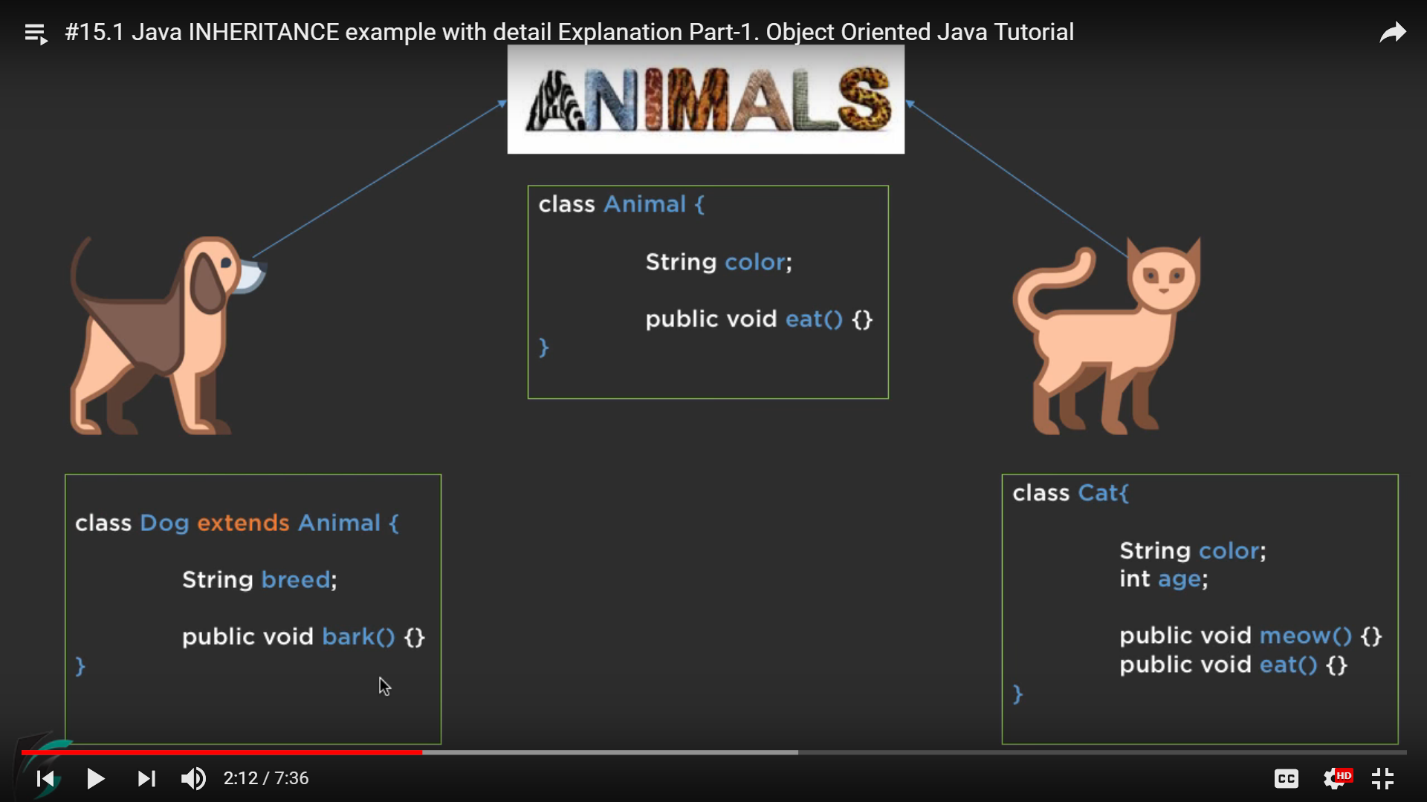
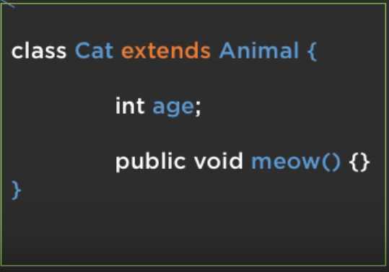
Need for Inheritance
Parent class
child class
child class

Slide 7
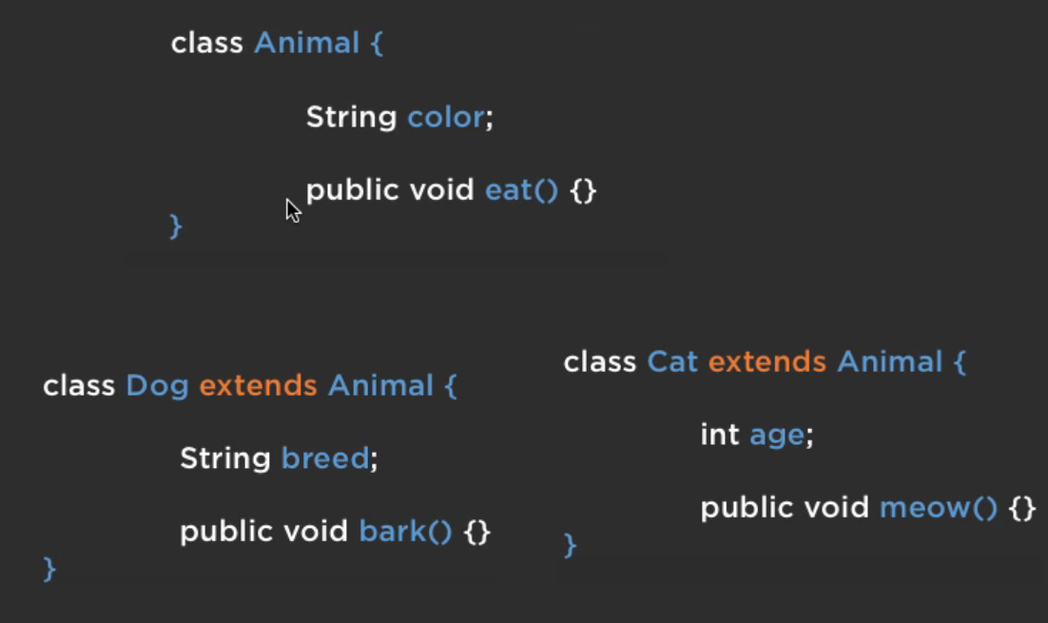
Inheritance terms
superclass
superclass, base class, parent class: terms to describe the parent in the relationship, which shares its functionality
subclass, derived class, child class: terms to describe the child in the relationship, which accepts functionality from its parent
extend, inherit, derive: become a subclass of another class
subclass
subclass

Slide 8
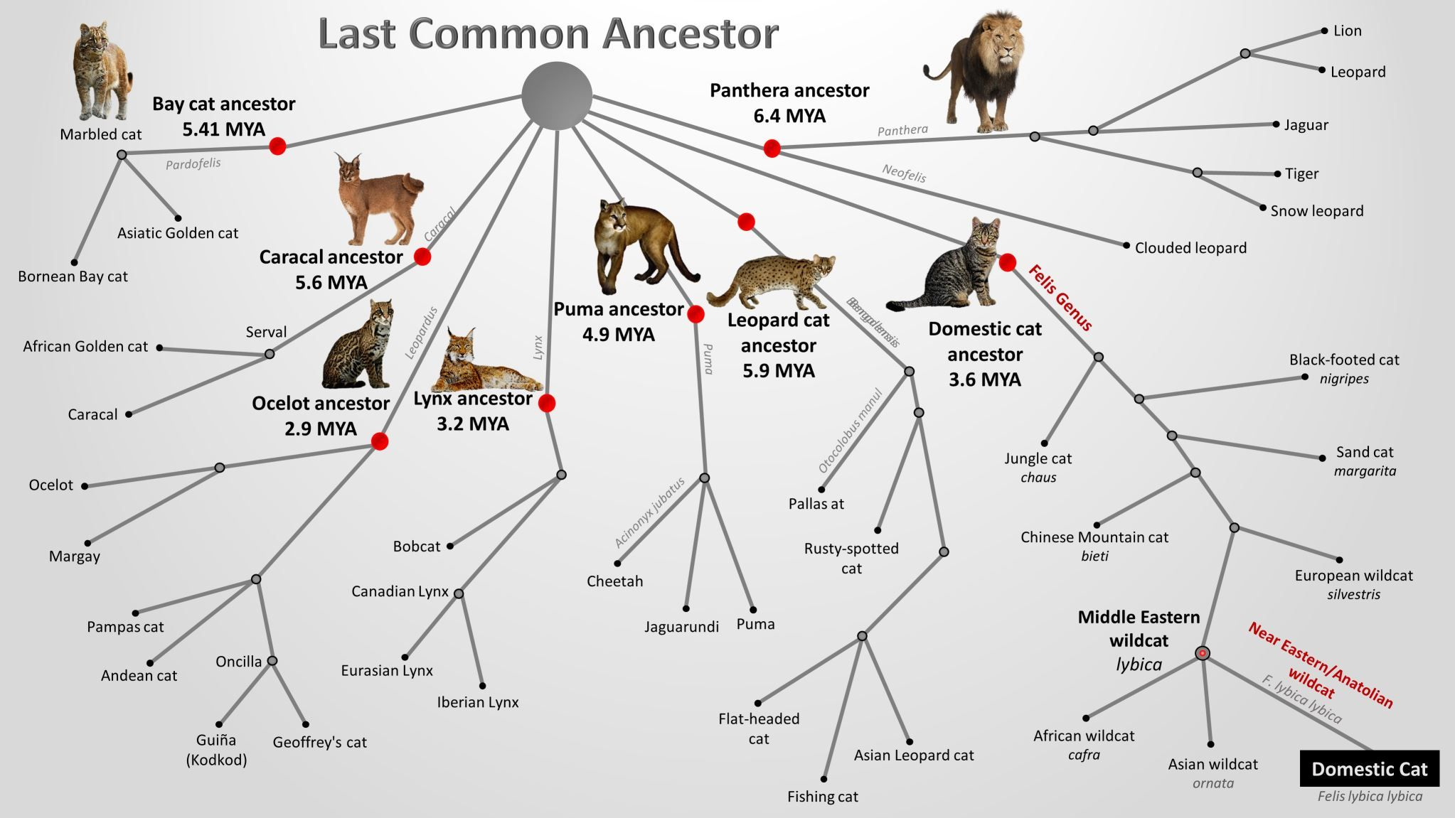
Inheritance: An example

Slide 9
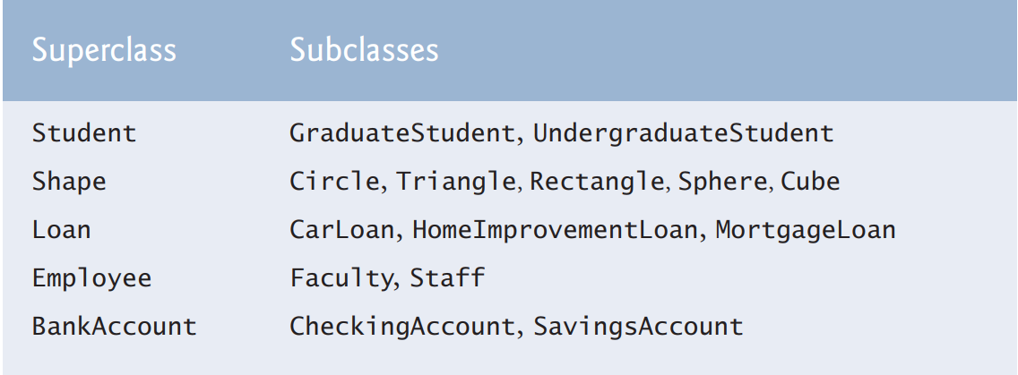
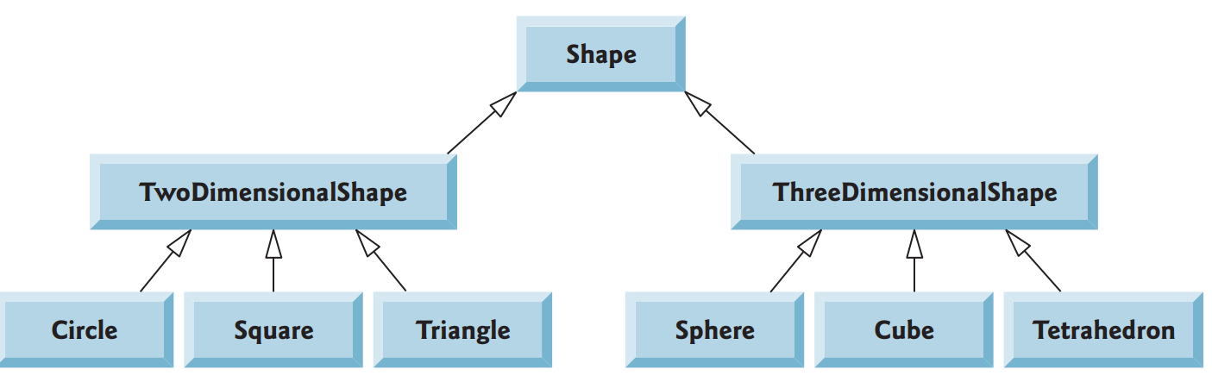
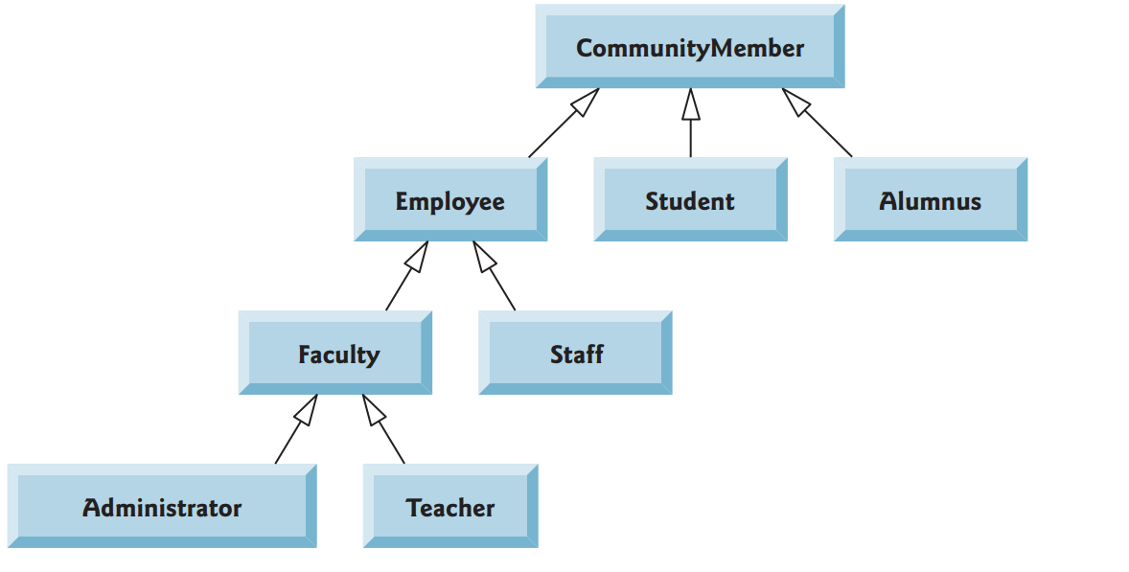
More examples

Slide 10
Definition
inheritance: a parent-child relationship between classes
Why use inheritance in java?
1. For Code Reusability
allows to reuse variables and methods of the existing class when you create a child from it.
2.For Method Overriding
child class can override existing behavior from parent

Slide 11
Table of Contents
Inheritance: Need for & Definition & Terms
Type of Inheritance
Inheritance for Code Reusability
Inheritance with Constructor
Super keyword
Inheritance for Method Overriding
Access Control

Slide 12
Types of Inheritance
Class A
Class A
Class A
Class A
Class B
Class B
Class B
Class C
Class C
Class B
Not exists in Java
Class C
Single
inheritance
Multilevel
inheritance
Hierarchical inheritance

Slide 13
Inheritance in Java
In Java, you specify a class as your parent by using ‘extends’ keyword
public class Cat extends Animal {
A Java child class has exactly one parent
Some other languages (C++) allow multiple inheritance
by default, a class's parent is Object
constructors are not inherited
because they are not members of a class
Class A
Class B
Class C

Slide 14
Table of Contents
Inheritance: Need for & Definition & Terms
Type of Inheritance
Inheritance for Code Reusability
Inheritance with Constructor
Super keyword
Inheritance for Method Overriding
Access Control

Slide 15
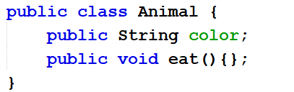
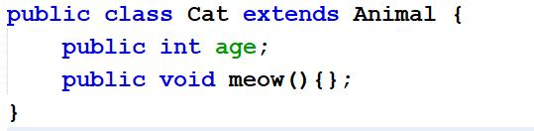
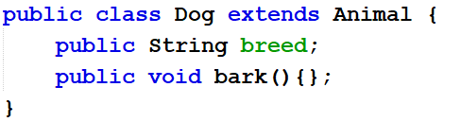
Inheritance for Code Reusability
A Cat object have
color
age
meow()
eat()
A Dog object have
color
breed
bark()
eat()
We reuse codes that in Parent class
Let's move to IDE!

Slide 16
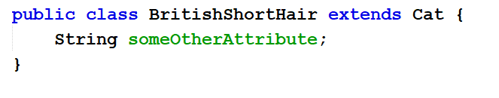
Multiple layers of inheritance
it is possible to extend a class that itself is a child class;
inheritance chains like this can be arbitrarily deep
Animal
Cat
BritishShortHair
MultiLevel inheritance

Slide 17
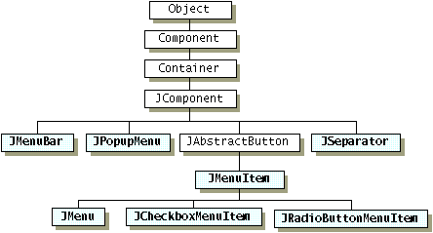
Hierarchical inheritance: An example
Deeper layered chain of classes,
Many children extending many layers of parents

Slide 18
Table of Contents
Inheritance: Need for & Definition & Terms
Type of Inheritance
Inheritance for Code Reusability
Inheritance with Constructor
Super keyword
Inheritance for Method Overriding
Access Control

Slide 19
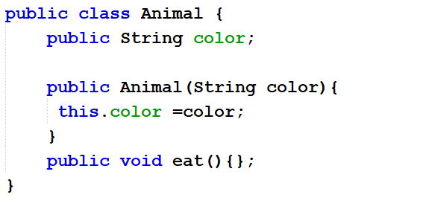
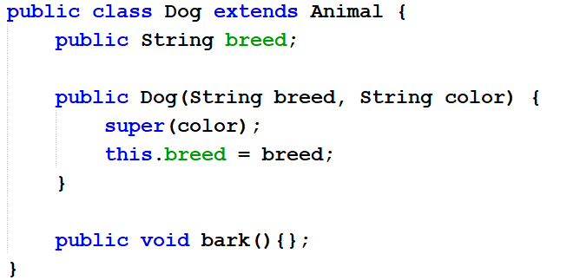
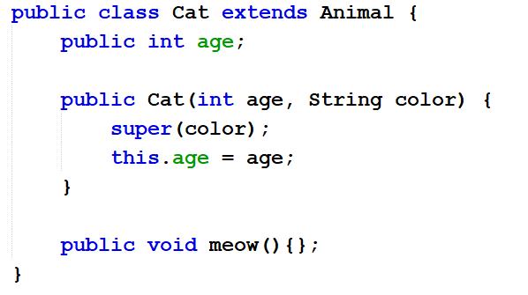
Inheritance with Constructor
public Animal(String color){ this.color = color;
}
Remark: if the superclass has a constructor that requires any arguments (not default constructor), you must put a constructor in the subclass and have it call the super-constructor (call to super-constructor must be the first statement)

Slide 20
Using super keyword
class Animal{
String color="white";
}
class Dog extends Animal{
String color="black";
void printColor(){
System.out.println(this.color);
//prints color of Dog class
System.out.println(super.color);
//prints color of Animal class
}
}
public class Test {
public static void main(String[] args) {
Dog d=new Dog();
d.printColor();
}
}

Slide 21
super keyword
used to refer to superclass (parent) of current class
can be used to refer to parent class's methods, variables, constructors to call them
needed when there is a name conflict with current class
useful when overriding and you want to keep the old behavior but add new behavior to it (method overriding)
syntax: super(args); // call parent’s constructor super.attributeName // access parent’s attribute super.methodName(args); // access parent’s method

Slide 22
Table of Contents
Inheritance: Need for & Definition & Terms
Type of Inheritance
Inheritance for Code Reusability
Inheritance with Constructor
Super keyword
Inheritance for Method Overriding
Access Control

Slide 23
Inheritance for Method Overriding
In OOP, overriding means to override the functionality of an existing method.
Child class can replace behavior of its parent's methods by redefining them
a subclass can implement a parent class method based on its requirement

Slide 24
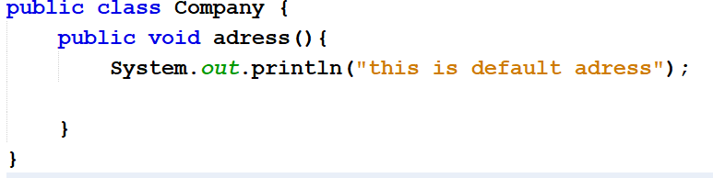
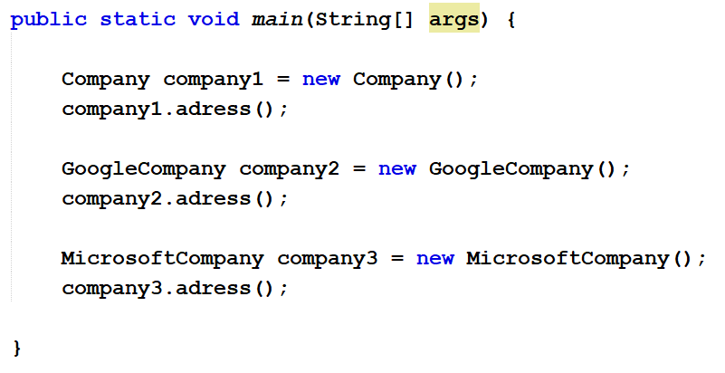
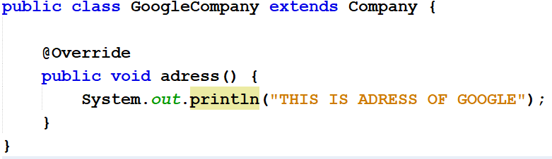
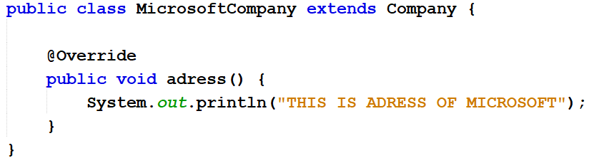
Method Overriding: Example

Slide 25
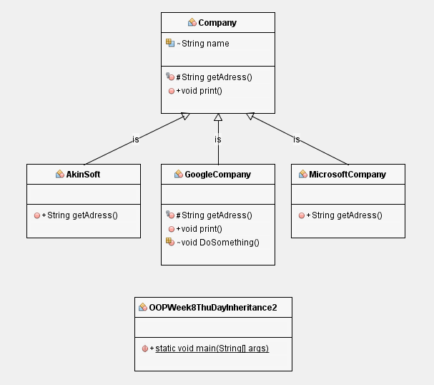
Apple

Slide 26
Table of Contents
Inheritance: Need for & Definition & Terms
Type of Inheritance
Inheritance for Code Reusability
Inheritance with Constructor
Super keyword
Inheritance for Method Overriding
Access Control

Slide 27
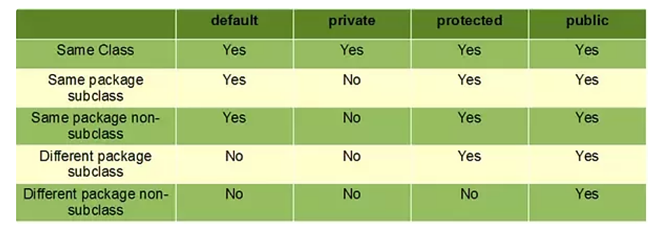
Access modifiers : protected
Access Control
public: visible to all other classes public class Animal
private: visible only to the current class, its methods, and every instance (object) of its class
a child class cannot refer to its parent's private members! private String name;
protected (this one's new to us): visible to the current class, and all of its child classes protected int age;

Slide 28
Access Control and Inheritance
Access Control
The following rules for inherited methods are enforced :
Public methods in a superclass also must be public in all subclasses.
Protected methods in a superclass must be protected or public in subclasses; they cannot be private.
Private methods are not inherited at all, so there is no rule for them.

Slide 29
Example: An Access modifier problem
Access Control
public class Parent {
private int attribute1; protected int attribute2; public int attribute3; protected final static int attribute5=1;
private void method1() {}
public void method2() {}
protected void setAttribute1(int value){
this.attribute1 = value;
}
}
public class Child extends Parent {
public int attribute4;
public Child() { // Which are legal?
attribute4 = 0; // _________
attribute1++; // _________
attribute2++; // _________
attribute3++; // _________
attribute5++; // _________
super.method1(); // _________
method2(); // _________
setAttribute1(attribute4); // _____
}
}

Slide 30
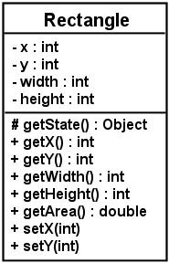
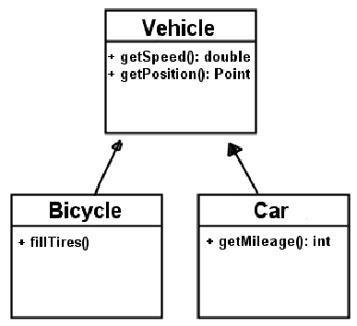
Class diagram: inheritance-1
classes that have inheritance relationships are connected by arrows
hierarchies drawn top-down with arrows from child to parent
Attributes accessModifier name : type
- for private
+ for public
# for protected

Slide 31
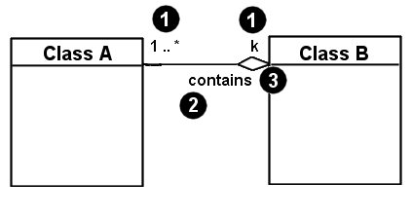
Class diagram: inheritance -2
inheritance relationships (is a relationship)
hierarchies drawn top-down with arrows from child to parent
associational relationships (has a relationship) 1. multiplicity (how many) 2. name (what relationship the objects have) 3. navigability (who has relationship with whom)

Slide 32
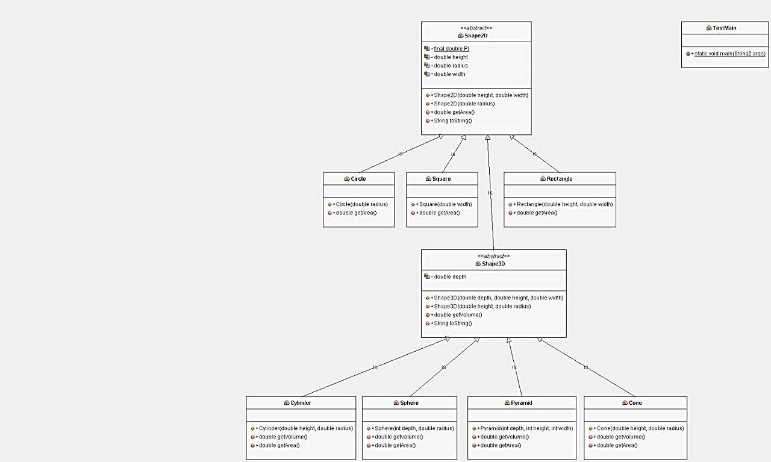

Slide 33
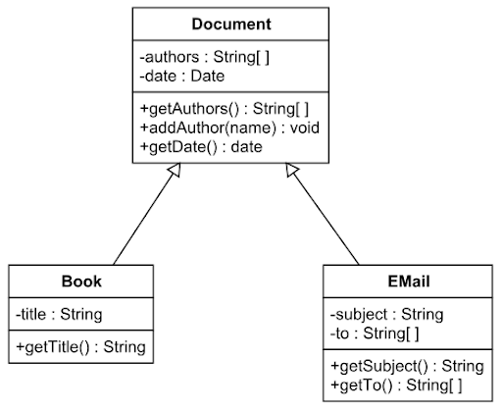
Exercise

Slide 34
LECTURE IS OVER!

