Slide 1

Week 12 - Collections: Set & Map Comparable & Comparator File operations: Write/Read objects
Ozacar Kasim, PhD | Assist. Prof. | Computer Engineering Department

Slide 2
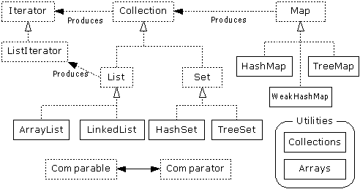
ArrayList and LinkedList
Week 11

Slide 3
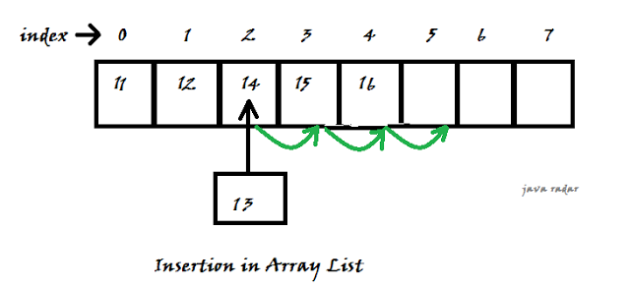
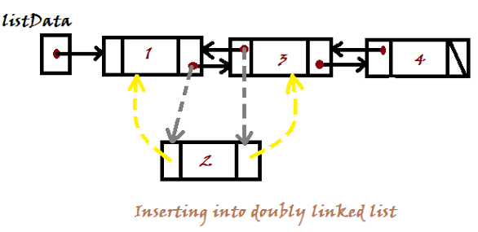
List Implementations
Week 11
ArrayList
low cost random access
high cost insert and delete
LinkedList
sequential access
low cost insert and delete
high cost random access

Slide 4
Week 12 - Collections: Set & Map Comparable & Comparator File operations: Write/Read objects
Ozacar Kasim, PhD | Assist. Prof. | Computer Engineering Department

Slide 5
Set Interface

Slide 6
Set Interface
Same methods as Collection
different contract - no duplicate entries
Defines two fundamental methods
boolean add(Object o) - reject duplicates
Iterator iterator()
Provides an Iterator to step through the elements in the Set
No guaranteed order in the basic Set interface
There is a SortedSet interface that extends Set

Slide 7
HashSet and TreeSet

Slide 8
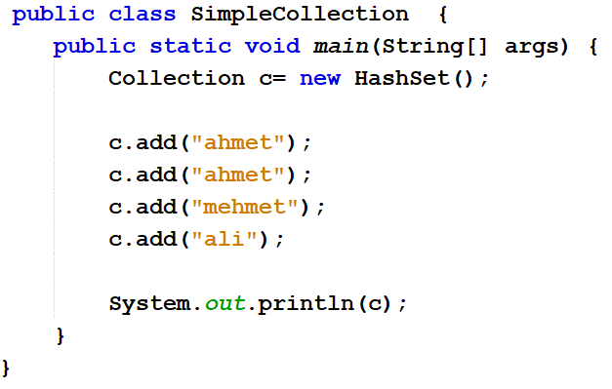

HashSet
Find and add elements very quickly
uses hashing implementation in HashMap
Hashing uses an array of linked lists
The hashCode() is used to index into the array
Then equals() is used to determine if element is in the (short) list of elements at that index
HashSet doesn’t maintain any order.
The hashCode() method and the equals() method must be compatible
if two objects are equal, they must have the same hashCode() value

Slide 9
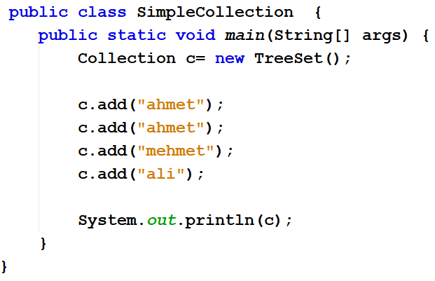

TreeSet
Elements can be inserted in any order
The TreeSet stores them in order
An iterator always presents them in order
Default order is defined by natural order
objects implement the Comparable interface
TreeSet uses compareTo(Object o) to sort

Slide 10
Map Interface Context
Map

Slide 11
Map Interface
Stores key/value pairs
Maps from the key to the value
Keys are unique
a single key only appears once in the Map
a key can map to only one value
Values do not have to be unique

Slide 12
map
value
key
ahmet
1
mehmet
2
jane
3
jane
4

Slide 13
Map methods
Object put(Object key, Object value)
Object get(Object key)
Object remove(Object key)
boolean containsKey(Object key)
boolean containsValue(Object value)
int size()
boolean isEmpty()

Slide 14
Map views
A means of iterating over the keys and values in a Map
Set keySet()
returns the Set of keys contained in the Map
Collection values()
returns the Collection of values contained in the Map. This Collection is not a Set, as multiple keys can map to the same value.
Set entrySet()
returns the Set of key-value pairs contained in the Map. The Map interface provides a small nested interface called Map.Entry that is the type of the elements in this Set.

Slide 15
HashMap and TreeMap
Map
HashMap
TreeMap

Slide 16
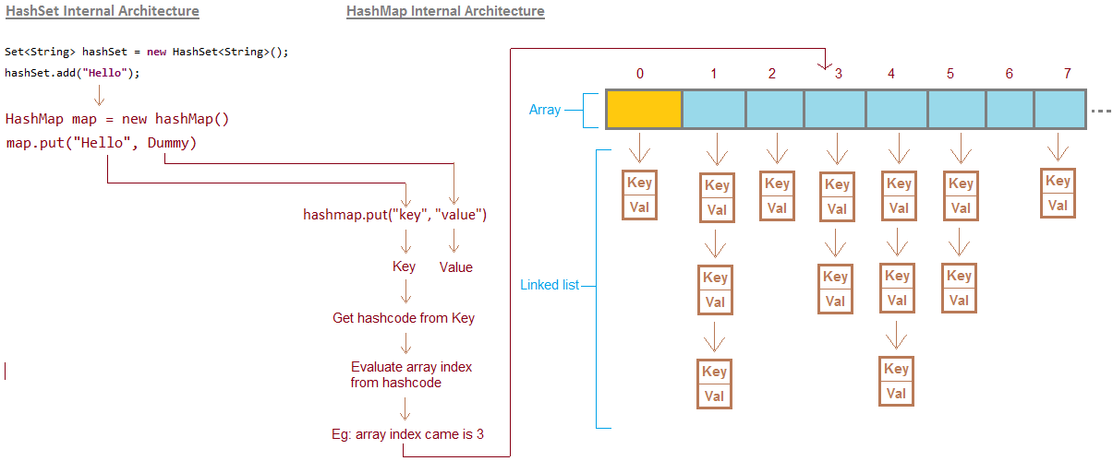
HashMap

Slide 17
HashMap and TreeMap
HashMap
The keys are a set - unique, unordered
Fast
TreeMap
The keys are a set - unique, ordered
Same options for ordering as a TreeSet
Natural order (Comparable, compareTo(Object))
Special order (Comparator, compare(Object, Object))

Slide 18
When to use List, Set and Map in Java?
If there is a need of frequent search operations based on the index values (random access) then List (ArrayList) is a better choice. O(1)
If there is a need of maintaining the insertion order, then also the List is a preferred collection interface.
If you do not want to have duplicate values in the database, then Set should be your first choice as all its classes do not allow duplicates.
If the requirement is to have the key & value mappings in the database, then Map is your best bet.

Slide 19
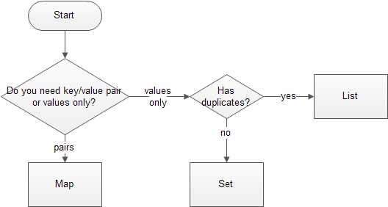
Choose the Right Java Collection

Slide 20
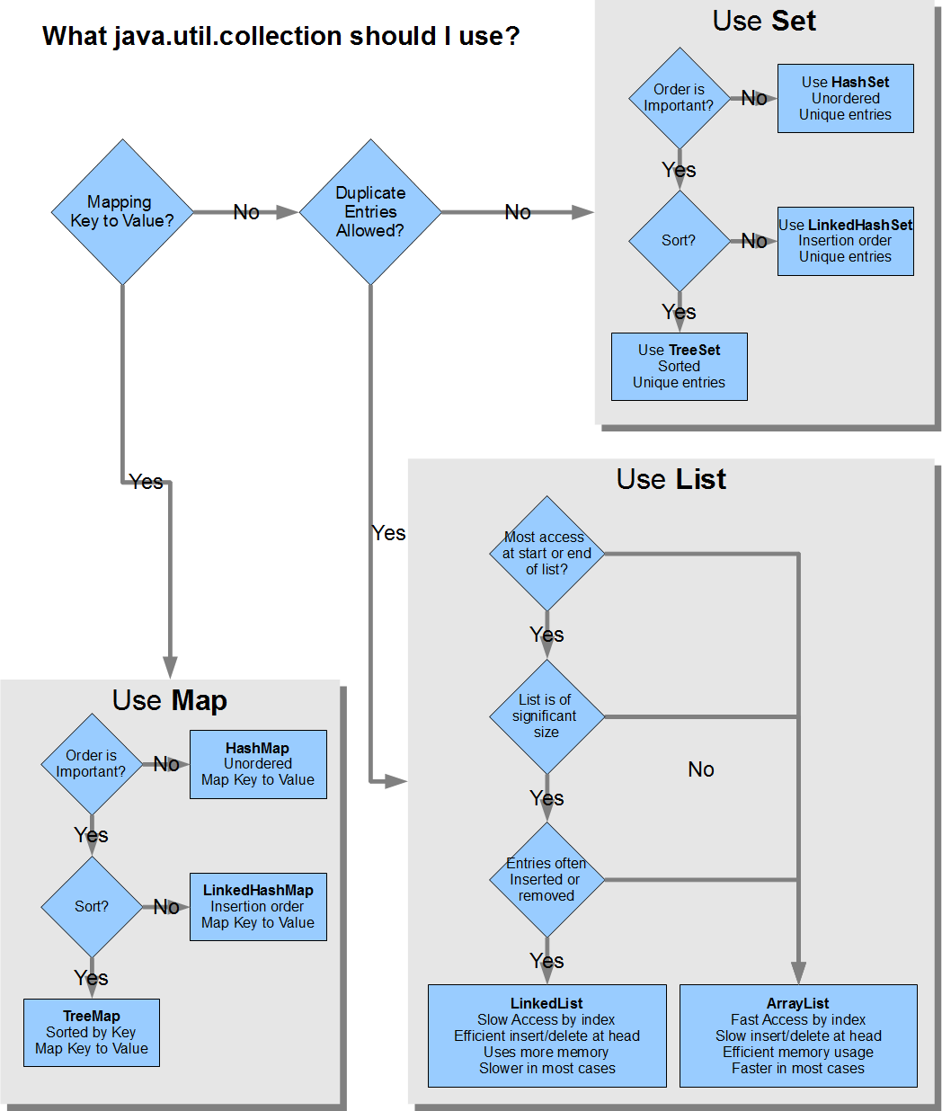
Use List
Choose the Right Java Collection

Slide 21
Use Set

Slide 22
Use Map

Slide 23
Comparing objects
The == operator can be used to check if two object references point to the same object.
if (objRef1 == objRef2) {
// The two object references point to the same object
}
To be able to compare two Java objects of the same class the boolean equals(Object obj) method must be overridden and implemented by the class.
The implementor decides which values must be equal to consider two objects to be equal. For example in the below class, the name and the address must be equal but not the description.

Slide 24
Example
class Worker {
private String name;
private int age;
private int weight;
public Worker(String name, int age, int weight) {
this.name = name;
this.age = age;
this.weight = weight;
}
@Override
public boolean equals(Object o) {
if (this == o) return true;
if (o == null || getClass() != o.getClass()) return false;
Worker worker = (Worker) o;
return age == worker.age && weight == worker.weight && name.equals(worker.name);
}
}

Slide 25
equals() versus ==
the == operator and equals() method may appear to do the same thing, but in truth they work differently. The == operator compares whether two object references point to the same object. For example:
Worker w1 = new Worker("Homer", 35, 120)
Worker w2 = new Worker("Homer", 35, 120)
System.out.println(w1 == w2); //false
System.out.println(w1.equals(w2)); //true

Slide 26
Sorting/Ordering objects: Comparable Interface
Java Comparable interface is used to order the objects of the user-defined class
you can sort the elements based on single data member only such as rollno, name, age or anything else.
compareTo(Object obj) method
compares the current object with the specified object. It returns
positive integer, if the current object is greater than the specified object.
negative integer, if the current object is less than the specified object.
zero, if the current object is equal to the specified object.

Slide 27
Comparable: Example
class Student implements Comparable<Student>{
int rollno;
String name;
int age;
Student(int rollno,String name,int age){
this.rollno=rollno;
this.name=name;
this.age=age;
}
public int compareTo(Student st{
return age – st.age;
}
public void toString(){
return st.rollno+" "+st.name+" "+st.age
}
}
public static void main(String args[]){
ArrayList<Student> students=new ArrayList<Student>();
students.add(new Student(101,"Vijay",23));
students.add(new Student(106,"Ajay",27));
students.add(new Student(105,"Jai",21));
Collections.sort(students);
for(Student st: students){
System.out.println(st);
}
}

Slide 28
Change Sorting/Ordering:Comparator Interface
Sometimes we may want to change the ordering of a collection of objects from the same class. We may want to order descending or ascending order. We may want to sort by name or by score, price etc.
We need to create a class for each way of ordering. It must implement the Comparator interface.
Java Comparator interface is used to order the objects of a user-defined class.
int compare(Object o1, Object o2) returns
positive integer, if the current object is greater than the specified object.
negative integer, if the current object is less than the specified object.
zero, if the current object is equal to the specified object.

Slide 29
Comparator Example
class AgeComparator implements Comparator<Student>{
public int compare(Student s1, Student s2){
return s1.age-s2.age; }
class NameComparator implements Comparator<Student>{
public int compare(Student s1, Student s2){
return s1.name.compareTo(s2.name); }
class Student{
int rollno;
String name;
int age;
Student(int rollno,String name,int age){
this.rollno=rollno;
this.name=name;
this.age=age;
}
}

Slide 30
Usage
public static void main(String args[]){
ArrayList al=new ArrayList();
al.add(new Student(101,"Vijay",23));
al.add(new Student(106,"Ajay",27));
al.add(new Student(105,"Jai",21));
System.out.println("Sorting by Name");
Collections.sort(al,new NameComparator());
Iterator itr=al.iterator();
while(itr.hasNext()){
Student st=(Student)itr.next();
System.out.println(st.rollno+" "+st.name+" "+st.age); }
System.out.println(("Sorting by Age");
Collections.sort(al,new AgeComparator());
Iterator itr2=al.iterator();
while(itr2.hasNext()){
Student st=(Student)itr2.next();
System.out.println(st.rollno+" "+st.name+" "+st.age); }
}

Slide 31
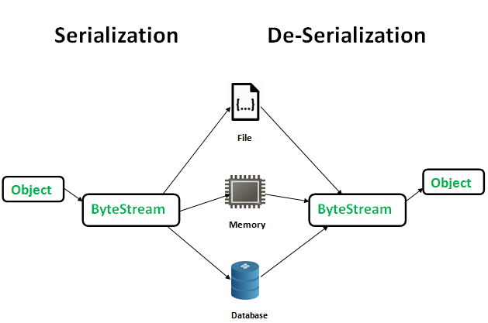
Saving Objects/ Loading objects

Slide 32
Saving objects to File
FileOutputStream fileOut = new FileOutputStream(filepath);
//FileOutputStream class is an output stream for writing data to a File
ObjectOutputStream objectOut = new ObjectOutputStream(fileOut);
//The Java ObjectOutputStream class (java.io.ObjectOutputStream) enables you to write Java objects to an OutputStream instead of just raw bytes
objectOut.writeObject(object);
//writes object to a file

Slide 33
Get saved objects from a file
FileInputStream fileIn = new FileInputStream(filepath);
ObjectInputStream objectIn = new ObjectInputStream(fileIn);
YourType obj = (YourType)objectIn.readObject();

Slide 34
Save and Load
public static void saveToFile(YourDataType s, String path) throws Exception{
FileOutputStream fileOut = new FileOutputStream(path);
ObjectOutputStream objectOut = new ObjectOutputStream(fileOut);
objectOut.writeObject(s);
objectOut.close();
}
public static YourDataType getFromFile(String path)throws Exception{
FileInputStream fileIn = new FileInputStream(path);
ObjectInputStream objectIn = new ObjectInputStream(fileIn);
YourDataType s = (YourDataType)objectIn.readObject();
objectIn.close();
return s;
}

