Slide 1

TOURIST GUIDE WEBSITE
A Digital Travel Companion for Modern Explorers
WEB DESIGN PROJECT
Team members
Mohammed Abdullah -Team Leader
Syed Inthiqhab Alam

Slide 2
PROJECT ABSTRACT
VISION
The Tourist Guide Website addresses real-world travel challenges by providing location-based guidance, personalized recommendations, and emergency assistance in one accessible platform.
Create a user-friendly, centralized platform that acts as a digital travel companion for tourists worldwide.
Designed for first-time tourists, international travelers, and trip planners, the system emphasizes simplicity, clarity, and responsiveness over visual complexity.

Slide 3




RESEARCH FOUNDATIONS
TARGET USER ANALYSIS
DESIGN EVALUATION
First-time tourists, international visitors facing language barriers, users with limited technical knowledge, and group travel planners.
Compared complex dashboards vs simple layouts, information-heavy pages vs categorized sections, and advanced animations vs fast-loading components.
CORE OBJECTIVES
SYSTEM IMPROVEMENTS
Minimize information overload, support pre-trip and on-trip needs, ensure accessibility, and integrate navigation with recommendations.
Centralized platform reducing dependency on multiple apps, cleaner tourist-focused interface, and inclusion of safety features.

Slide 4
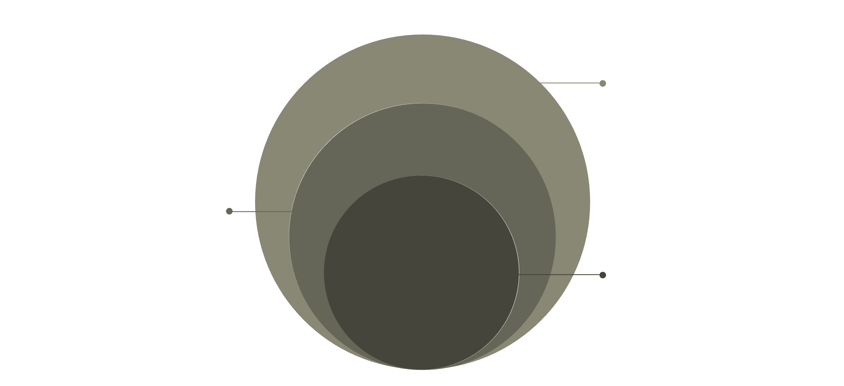
DESIGN ARCHITECTURE
PRESENTATION LAYER
Frontend UI with HTML/CSS/JS
APPLICATION LAYER
Backend services and business logic
DATA LAYER
Persistent database storage and backups
The system follows a modular three-tier architecture ensuring scalability, maintainability, and security while allowing independent updates to each layer.
VISUAL DESIGN PRINCIPLES
USABILITY FOCUS
Light background with calming blue/green tones
High contrast for readability
Simple, readable fonts with clear section separation
Universal icons and high-quality images
Responsive layout for desktop and mobile
Easy navigation with minimal clicks
Multi-language support
Accessible for all age groups

Slide 5
FRONTEND IMPLEMENTATION
1
HOME PAGE
Welcome message, search bar, quick category buttons (Nature, History, Culture, Food), and highlights of popular attractions.
2
EXPLORE PLACES
Category-based filtering with card layout displaying place images, names, ratings, and distances for improved readability.
3
PLACE DETAILS
Dedicated pages with images, descriptions, visiting hours, entry fees, user reviews, and map navigation buttons.
4
MAP & NAVIGATION
Integrated map showing current location, nearby attractions, and route guidance with simple essential controls.
5
ITINERARY PLANNER
Select travel days, choose interests, and generate day-wise plans supporting pre-trip planning and engagement.
6
EMERGENCY HELP
High-visibility page with nearest hospitals, police stations, emergency contacts, and embassy information.

Slide 6
SYSTEM MODULES
USER MANAGEMENT
TOURIST INFORMATION
RECOMMENDATION ENGINE
ITINERARY PLANNER
Registration, login, profile management, and language/preference settings.
Manage attractions, categories, descriptions, images, and timings.
Suggest places based on preferences, location, mood, or category filtering.
Create, store, and generate day-wise travel plans for users.
LOCATION & NAVIGATION
EMERGENCY ASSISTANCE
GPS integration, map display, and route guidance functionality.
Display emergency services, contacts, and safety information.

Slide 7
DATABASE STRUCTURE
The database design ensures data integrity, scalability, and efficient retrieval for system operations.
USERS TABLE:
PLACES TABLE:
REVIEWS TABLE:
ITINERARY TABLE:
user_id
name
email
password
preferred_language
place_id
name
category
description
location_coordinates
opening_hours
review_id
user_id
place_id
rating
comment
itinerary_id
user_id
travel_dates
selected_places

Slide 8
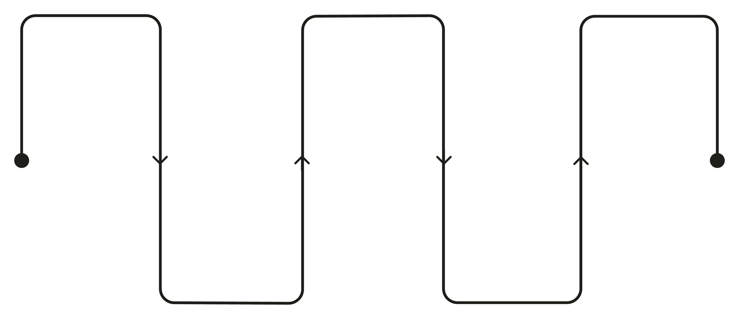
NAVIGATION FLOW
HOME
EXPLORE
ITINERARY
Start and access main features
Browse places and filters
Add to plan or open map
SEARCH
DETAILS
Choose category or enter query
View place info and options
The navigation flow ensures essential features are reachable within two to three clicks, minimizing confusion and improving user experience throughout the journey.

Slide 9




FUTURE ENHANCEMENTS
AI RECOMMENDATIONS
OFFLINE ACCESS
Implement machine learning algorithms for personalized attraction suggestions based on user behavior and preferences.
Enable offline map viewing and saved itinerary access for areas with limited internet connectivity.
SOCIAL FEATURES
EXPANDED COVERAGE
Add community reviews, photo sharing, and collaborative trip planning for enhanced user engagement.
Scale to include more destinations, local guides, and real-time event information for comprehensive travel support.

Slide 10
CONCLUSION
The Tourist Guide Website successfully addresses real-world travel challenges through careful planning and user-centered design principles.
USER-CENTERED
Designed with simplicity and accessibility at its core
By balancing simplicity with functionality and centralizing essential travel information, the platform serves as a strong foundation for development and future AI-based enhancements.
This design demonstrates how thoughtful architecture and modular structure can create an accessible, efficient digital travel companion for tourists.
tourist-guide-app.html
SCALABLE
Modular architecture allows future expansion
PRACTICAL
Feasible implementation within project constraints

