Slide 1
News Summarizer
Semester Project
Abdullah Hassan 01-134221-007
Maaz Hussain 01-134221-035
M. Sibtain 01-134221-051

Slide 2
Table of contents
Objectives
Front-end
Back-end/Apis
Summary Algorithm

Slide 3
Objectives
Automate News Aggregation Develop a system to automatically scrape and fetch the latest news articles from multiple trusted Pakistani news sources including Dawn, The News International, and The Express Tribune.
Extract and Summarize Content Use Natural Language Processing (NLP) techniques, specifically TF-IDF, to extract the most relevant content from each article and generate concise summaries.
Provide Unified Access via API Build API endpoints using Flask to serve news summaries in JSON format for frontend consumption.

Slide 4
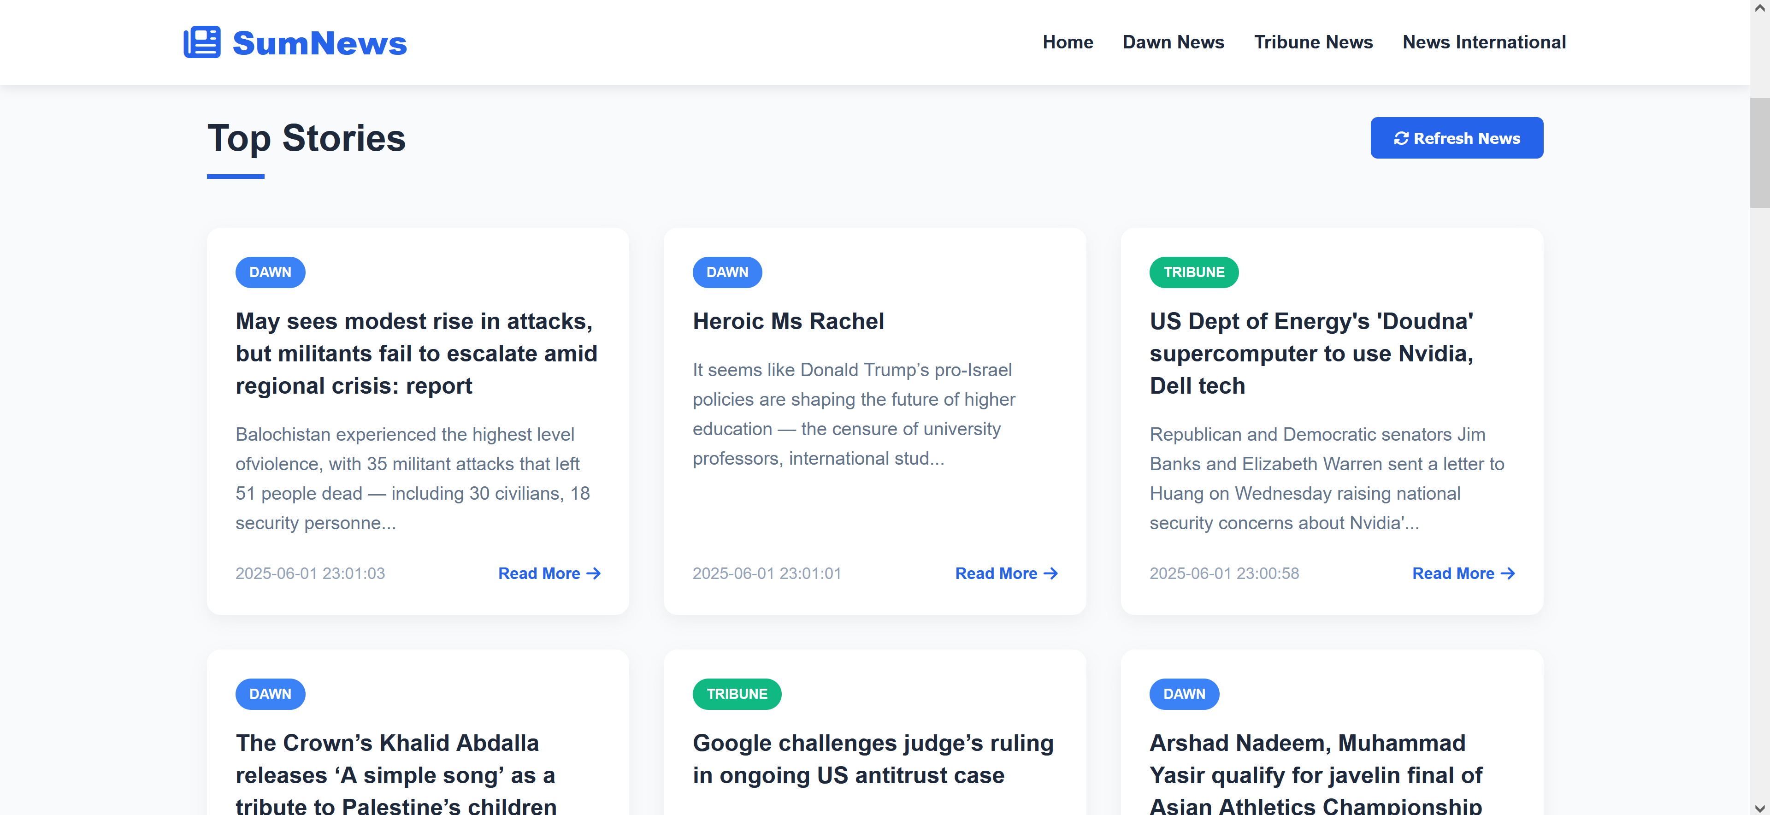
Front-end
Home Page

Slide 5
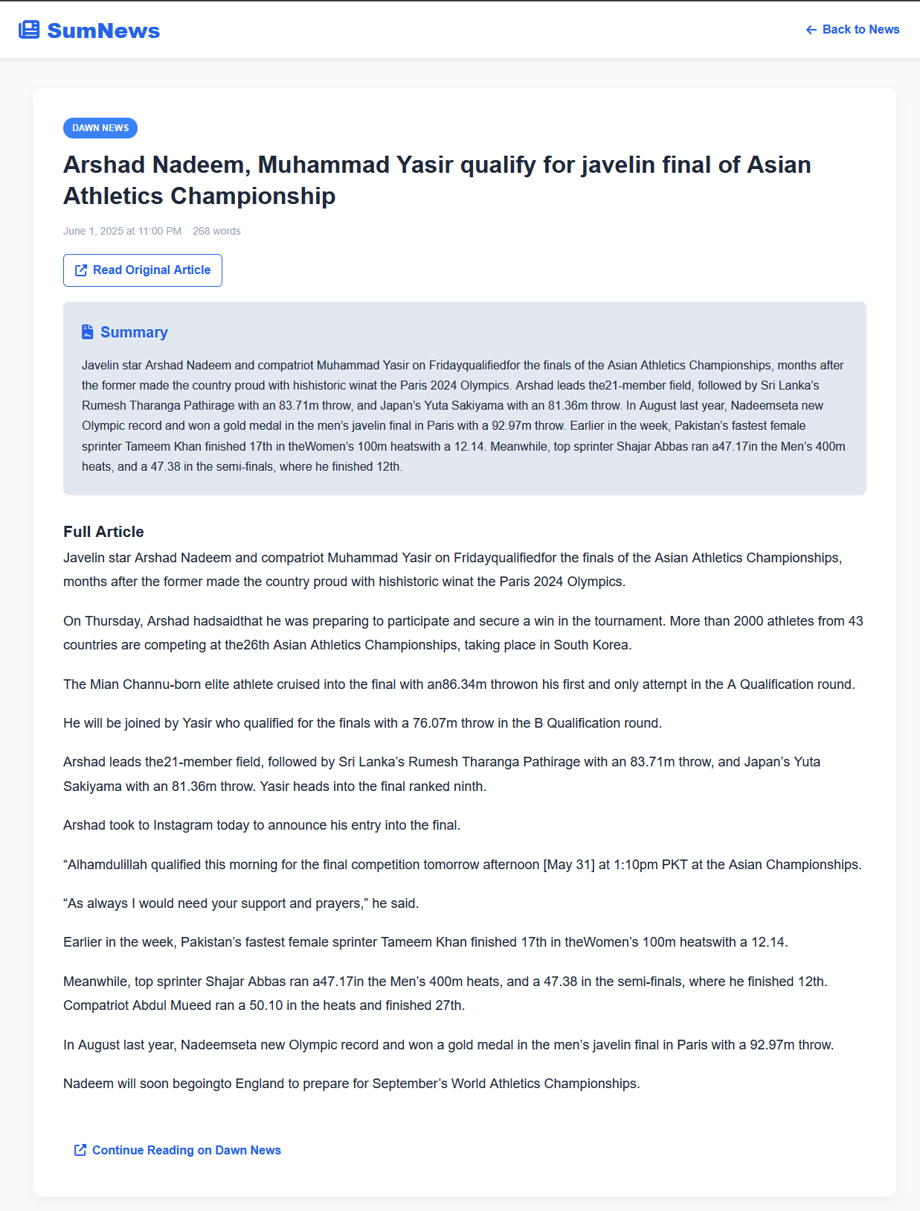
Front-end
Article Detail and Summary

Slide 6
Back-end/Apis
Dawn News Api
Key Features:
Scraping:
Extracts article links from Dawn News homepage using BeautifulSoup.
Filters URLs to include only relevant news paths (e.g., /news/).
Content Extraction:
Scrapes article titles (from <meta og:title>) and body text.
Cleans content by removing scripts, styles, and figures.
Summarization:
Implements TF-IDF algorithm to generate 5-sentence summaries.
Processes extracted text to retain key information while reducing length.
API Endpoint:
Exposes a GET endpoint (/api/dawn/latest) with customizable limit parameter.
Returns JSON response with article details (title, URL, content, summary, word count, and timestamp).

Slide 7
Back-end/Apis
The News International Api
Key Features:
Scraping:
Focuses on /latest/ news articles from The News International homepage.
Filters invalid links (e.g., javascript: URLs) and converts relative URLs to absolute.
Content Extraction:
Extracts titles using multiple fallback selectors (h1.detail-title, generic h1).
Handles diverse article layouts by checking multiple container classes (detail-story, story-detail, etc.).
Cleans content by removing non-article elements (scripts, social shares, related news, ads).
Summarization:
Applies TF-IDF algorithm to generate 5-sentence summaries.
Filters out boilerplate text (e.g., "Also Read", "Published on") before processing.
API Endpoint:
GET /api/thenews/latest?limit=5 returns structured JSON with:
Title, URL, full text, summary, word count, and timestamp.

Slide 8
Back-end/Apis
The Express Tribune News Api
Key Features:
Scraping:
Supports both main article formats (story-box-section and story-content layouts).
Implements fallback selectors for title extraction (3+ h1 class variations).
Content Cleaning:
Removes 10+ non-content elements (scripts, social shares, ads, iframes).
Filters short paragraphs (<30 chars) and boilerplate text.
Summarization:
Applies TF-IDF only when valid content exists.
Handles edge cases (missing content) gracefully.
Structured API Output:
GET /api/tribune/latest?limit=5 returns:
Title, URL, cleaned content, summary, word count, and timestamp.
Clear error states for failed scrapes.

Slide 9
Summary algorithm
TF-IDF
Workflow
Input Text
Raw document (e.g., article, report).
Preprocessing
Lowercase: Standardize text.
Tokenize: Split into words/sentences.
Clean: Remove stopwords (e.g., "the", "and") + punctuation.
TF-IDF Scoring
Term Frequency (TF): How often a word appears in a sentence.
Inverse Document Frequency (IDF): Penalizes words common across all sentences.
Score Calculation: TF * IDF for each word → Sum scores per sentence.
Rank & Select
Rank sentences by their TF-IDF scores (highest = most important).
Extract top N sentences to form the summary.

