Slide 1

Stock Market Data Analysis using Big Data Techniques
By:
Ali Hussain Alaswad
Abdullah Khadem Aljame
Supervisor:
Dr.Eng.Mouhib Alnoukari
Eng.Anas Abdulaziz
2023/2024_1

Slide 2
Outlines
01
05
ABOUT THE PROJECT
Performed Works
02
06
Project Goals
Unfinished Works
03
07
System Technologies
Project Plan
04
08
System Architecture
Future Works

Slide 3


ABOUT THE PROJECT
Big Data
Stock Market
Overview
Big data refers to the large, diverse sets of information that grow at ever-increasing rates. It encompasses the volume of information, the velocity at which it is created and collected, and the variety of the data points being covered
A stock market is a market where securities assets such as stocks, bonds and derivatives are traded and sold.
The stock market is an important part of the local and global economies, assisting finance companies and encouraging public investment

Slide 4
Project Goals
1.
Build a Real Big Data platform in SPU
2.
Analyzing Data using Big Data Techniques
3.
Make the environment ready to receive future big data projects
4.
Work on implementing financial analysis for financial companies
5.
Build a working environment for a Big Data system while applying distributed systems concepts

Slide 5






System Technologies
Apache Hadoop
Map Reduce
Apache Hive
Power BI
Apache Superset
Python

Slide 6
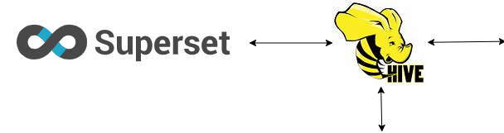

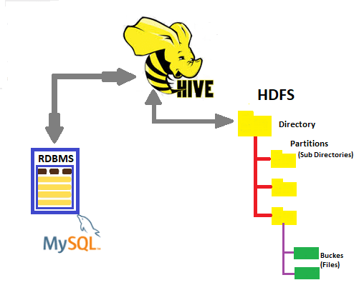
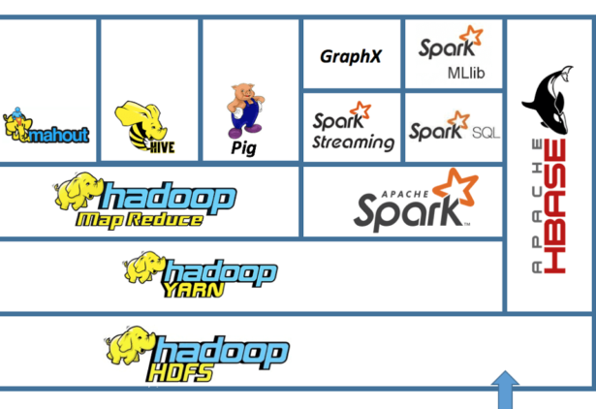
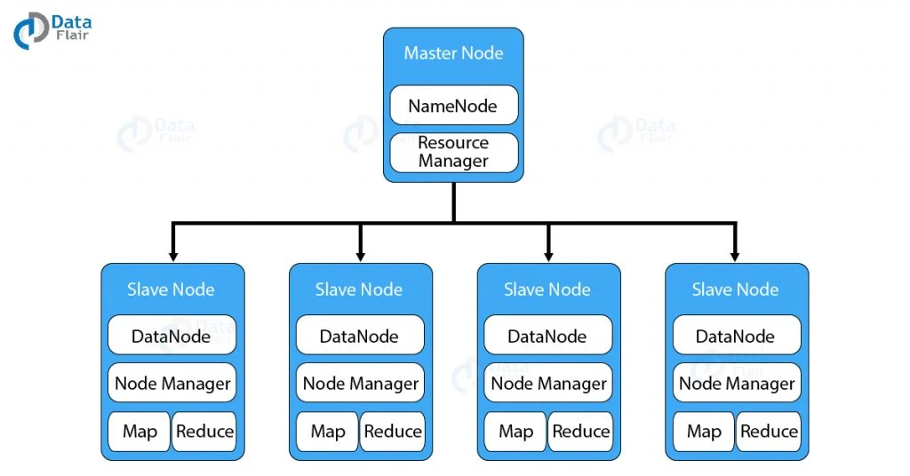
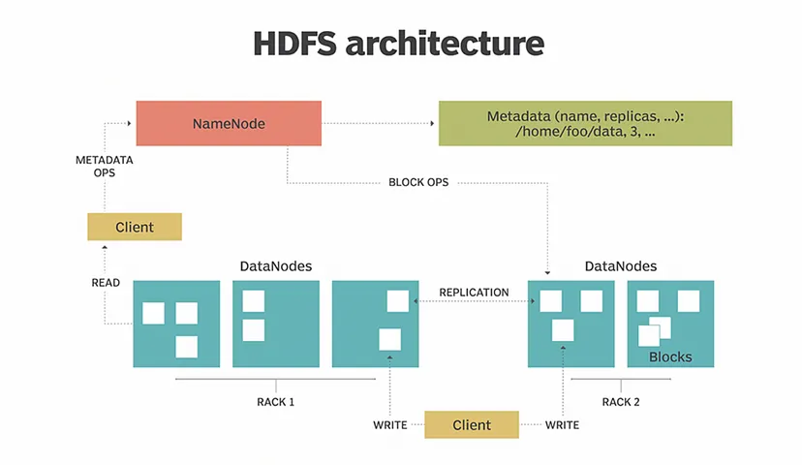
System Architecture & Hadoop EcoSystem

Slide 7
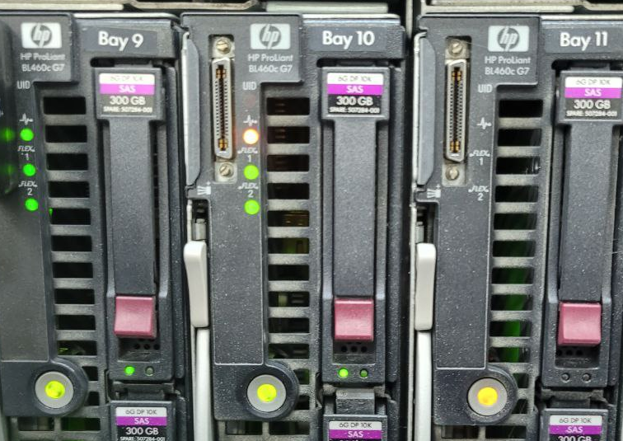
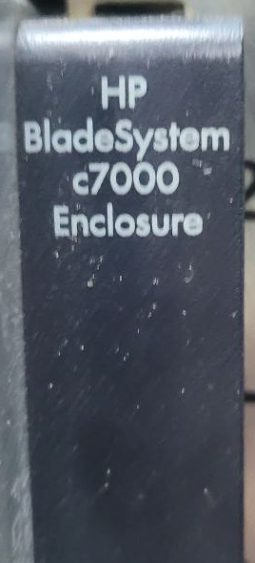
Performed works
1.
Get an Overview of the available servers
We were allowed to work on two HP servers
HP BladeSystem c7000 Enclosure: 2 HP ProLiant BL460c G7
Server specifications:
16 GB RAM
16 core CPU
300 GB Storage

Slide 8
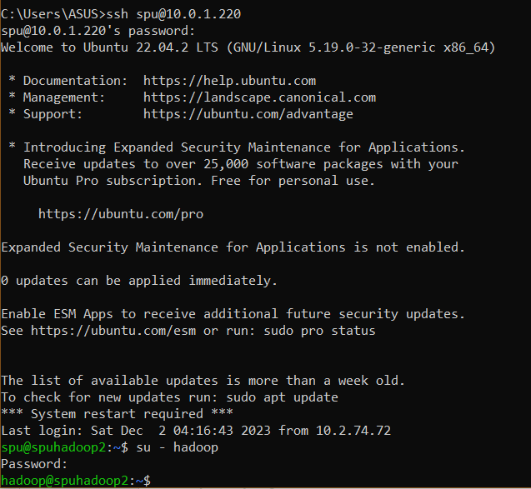
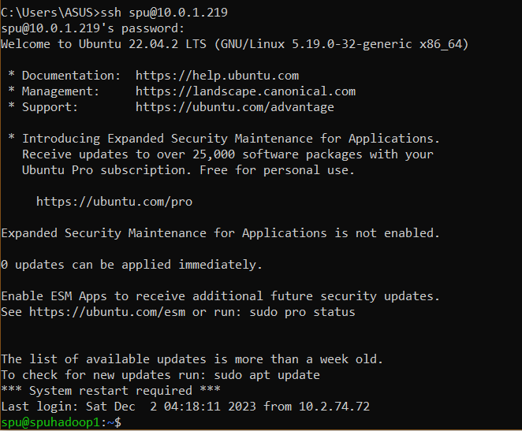
Performed works
2.
Start working on the servers and install the appropriate operating system (Ubuntu Desktop) while solving some system problems in ssh.

Slide 9
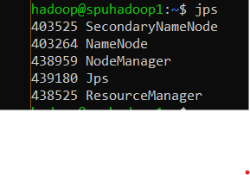
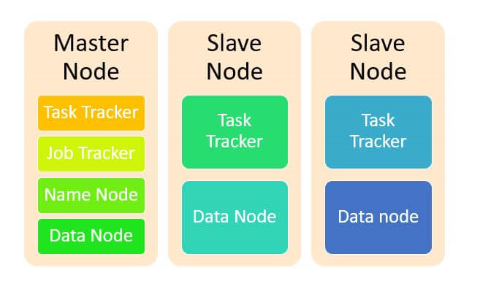

Performed works
3.
Worked on building the system architecture and installing the Hadoop environment, in addition to modifying the configuration files

Slide 10
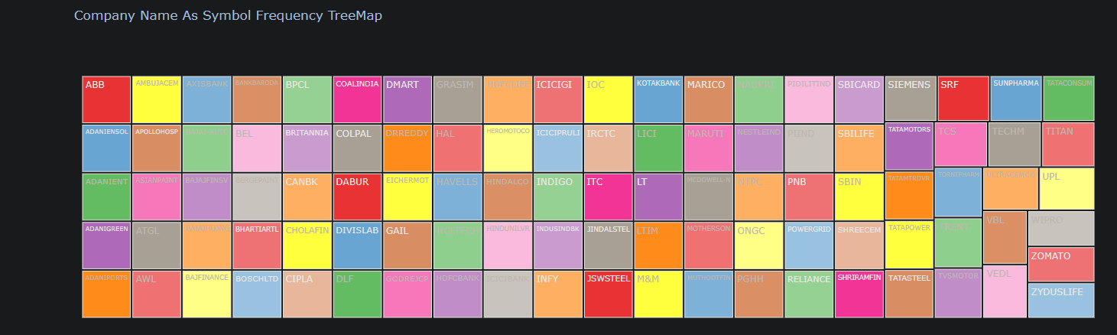
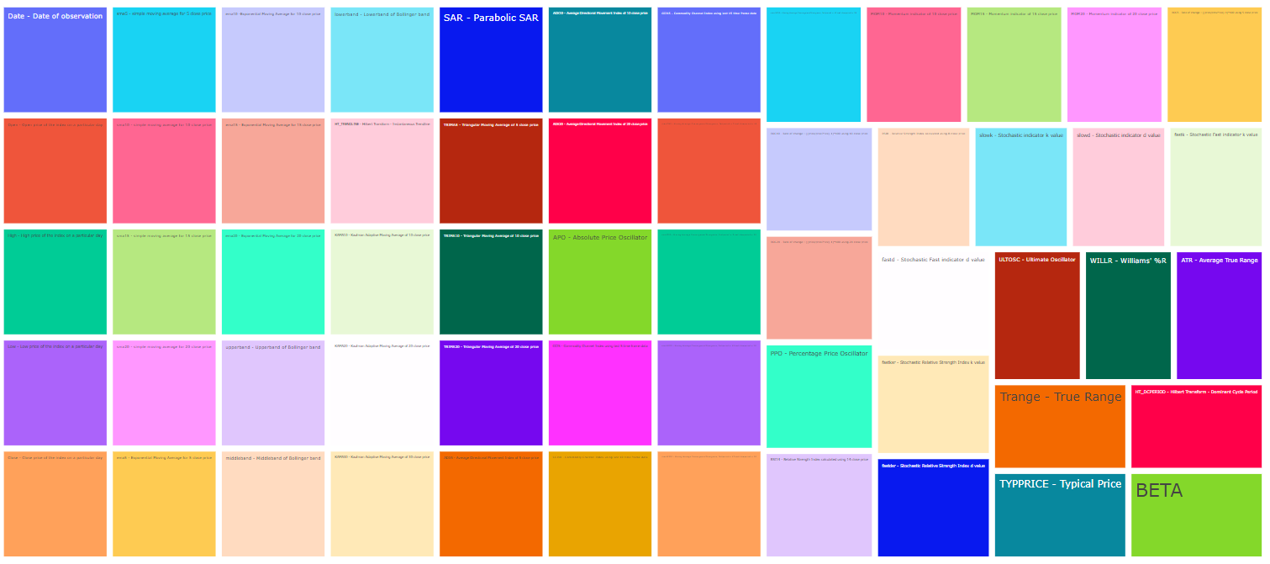
Performed works
4.
Find and extract data and start working on it
Stock Name in Nifty 100:
Technical indicator values:

Slide 11
About Data!
Nifty 100: top 100 companies listed on the National Stock Exchange (NSE) of India.
Data samples are of 1-minute intervals and the availability of data is from Jan 2015 to Feb 2022.
Source: https://www.kaggle.com/datasets/debashis74017/stock-market-data-nifty-50-stocks-1-min-data

Slide 12
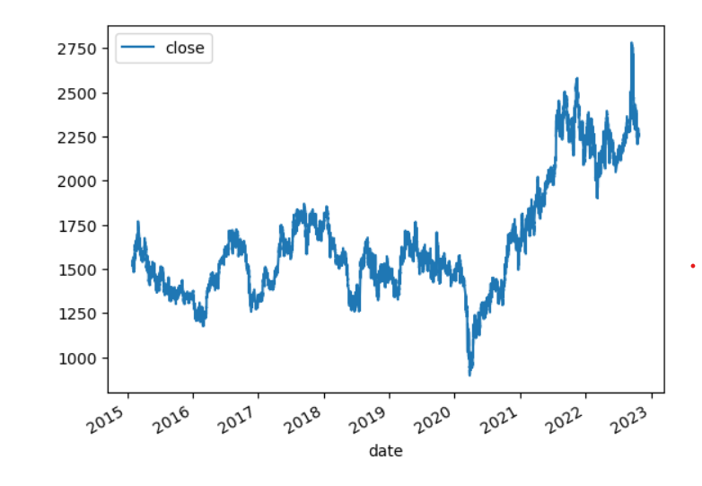
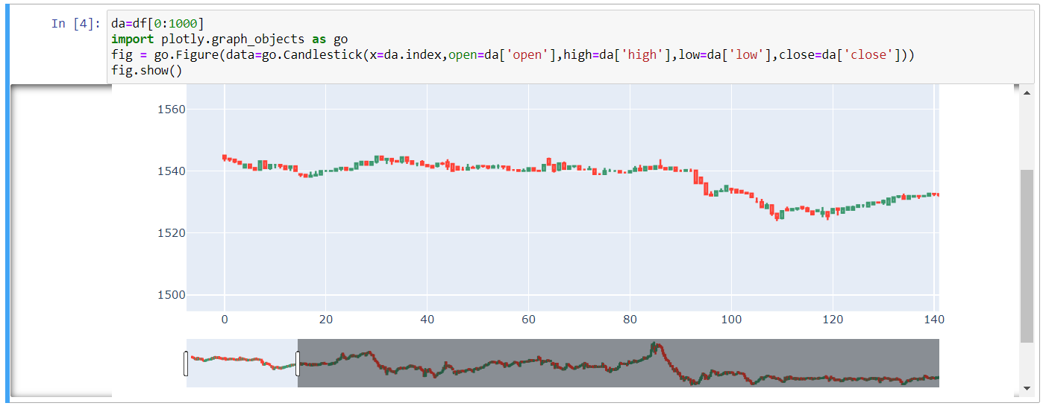
Performed works
5.
Worked on data visualization and descriptive analytics in Python
Simple visualize:

Slide 13
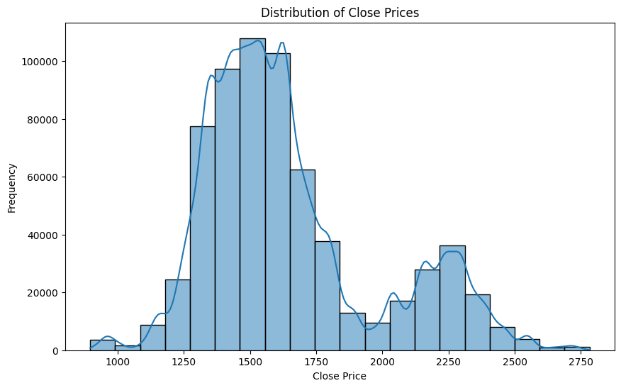
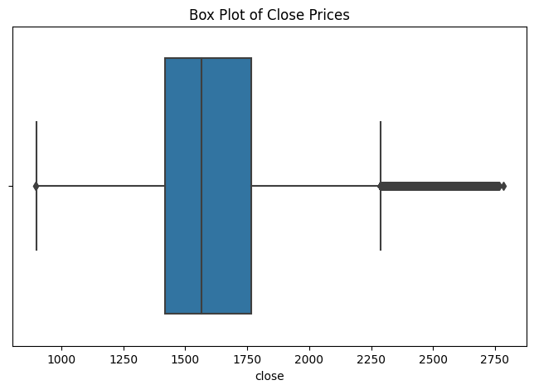
Performed works
Basic Descriptive Statistics

Slide 14
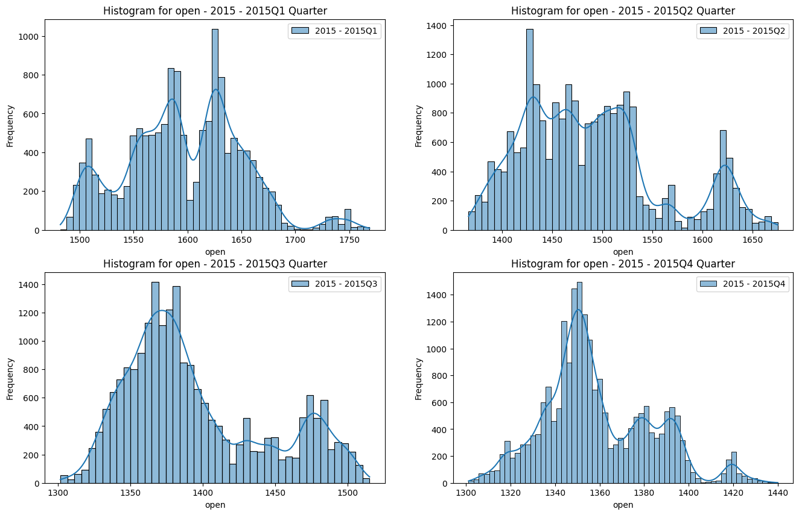
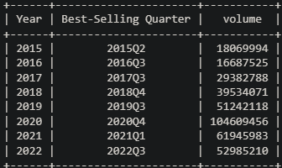
Performed works
Distribution for each quarter in 2015:
The best selling for each Quarter from 2015 to 2022:

Slide 15
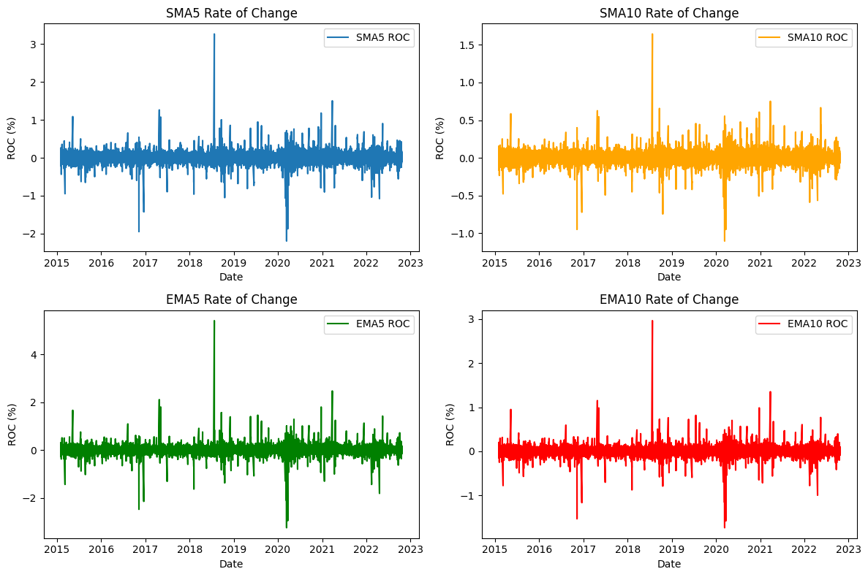
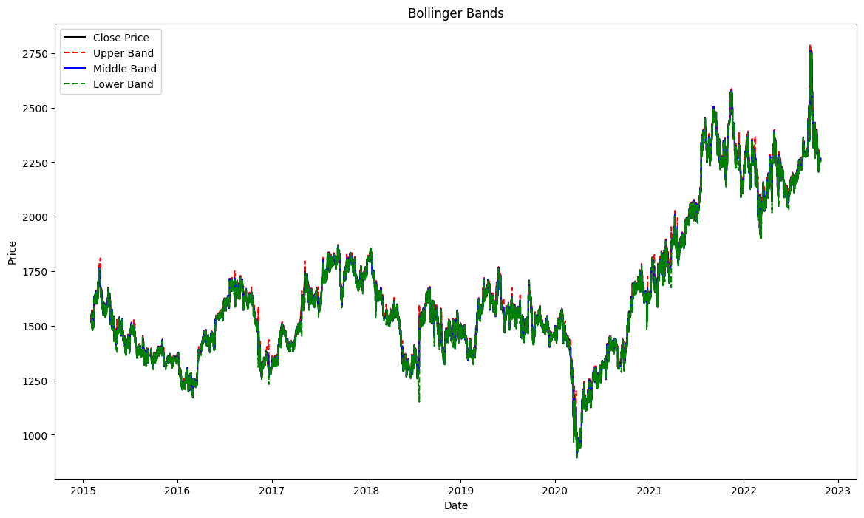
Performed works
Trend Indicators:
Bollinger Bands:

Slide 16
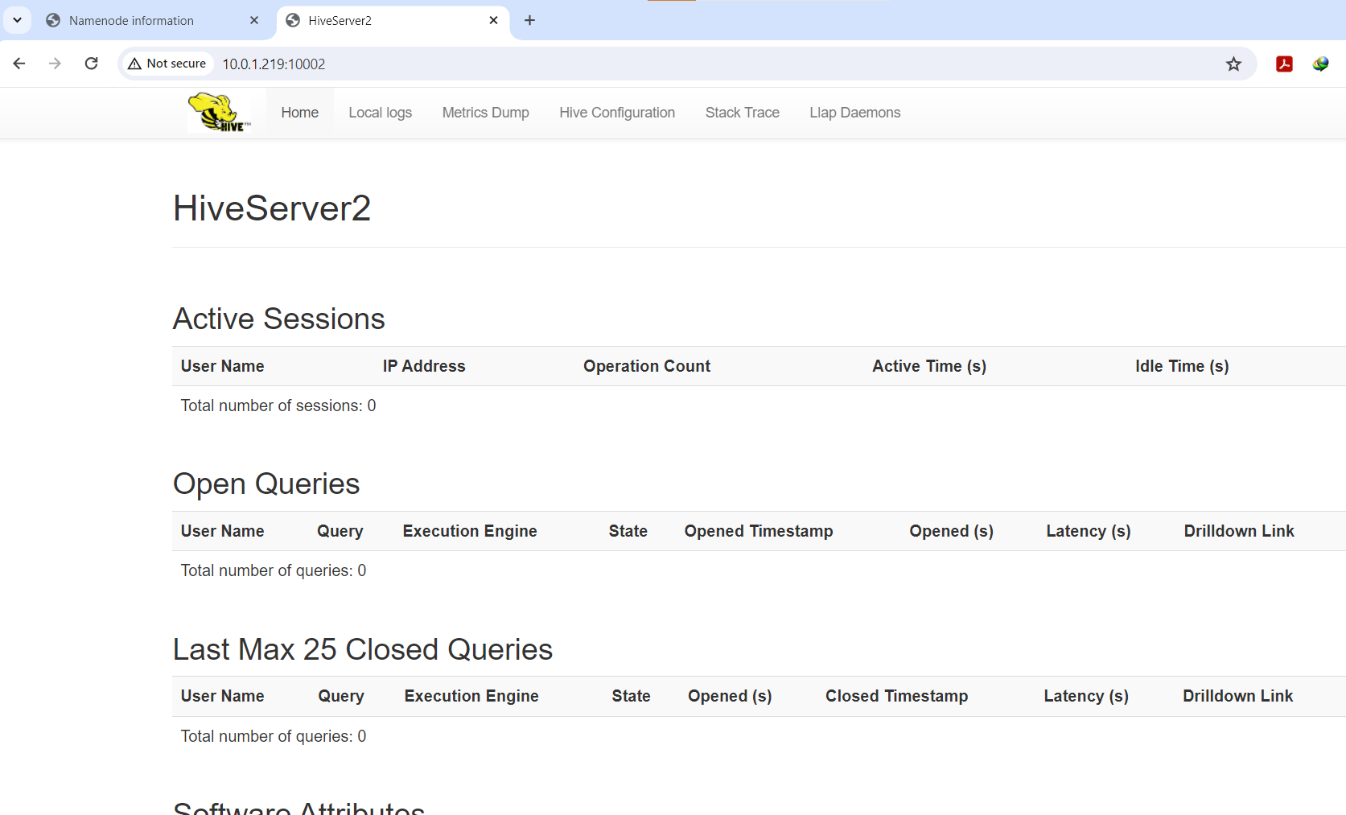
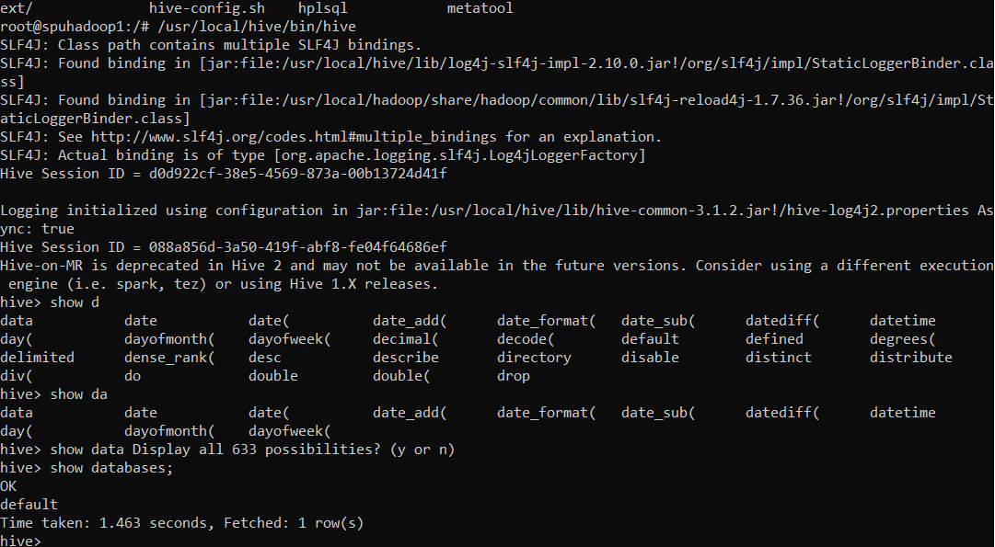
Performed works
6.
Installed Apache Hive on Hadoop environment and modified configuration files to start ELT processes and build data warehouse

Slide 17
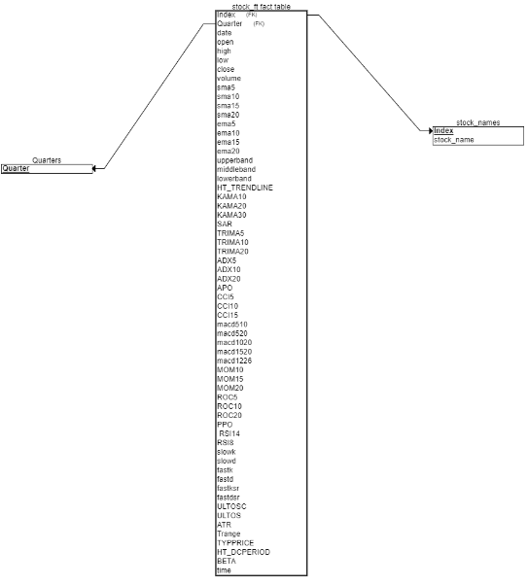
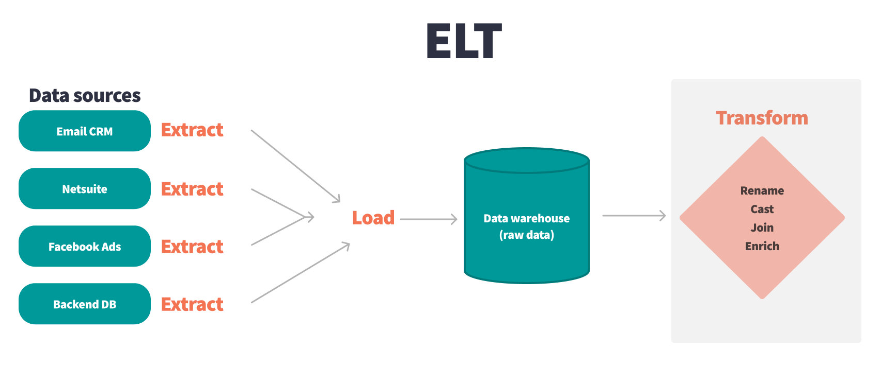
Performed works
ELT process and Data warehouse build
Build Data Warehouse:
ELT process
1-Extract (download and decompress( Data From Kaggle
2-Load the modify data in HDFS
3-Transformation By using Apache Hive:
The schema:

Slide 18
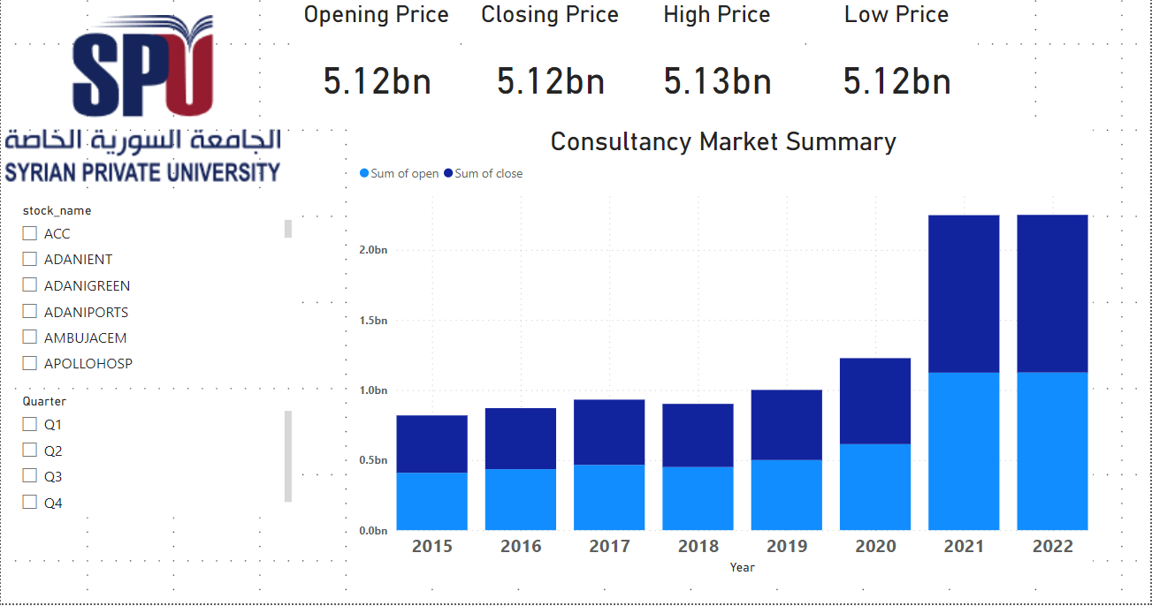
Performed works
7.
Dashboards were created for some of the following types of analysis:
Descriptive Analytics

Slide 19
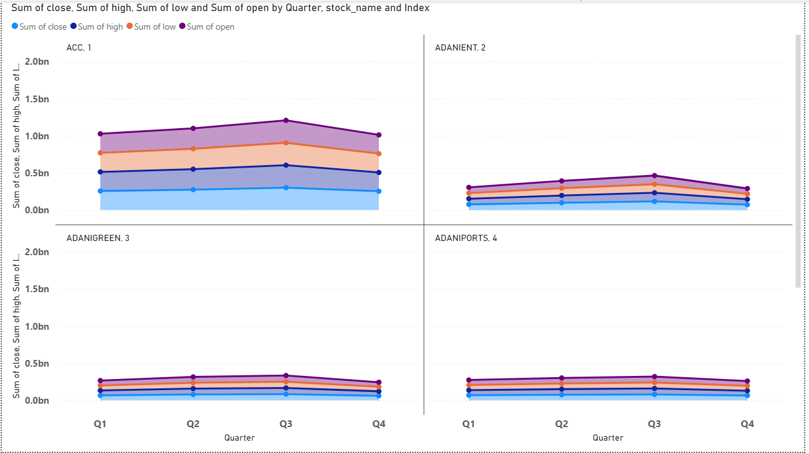

Slide 20
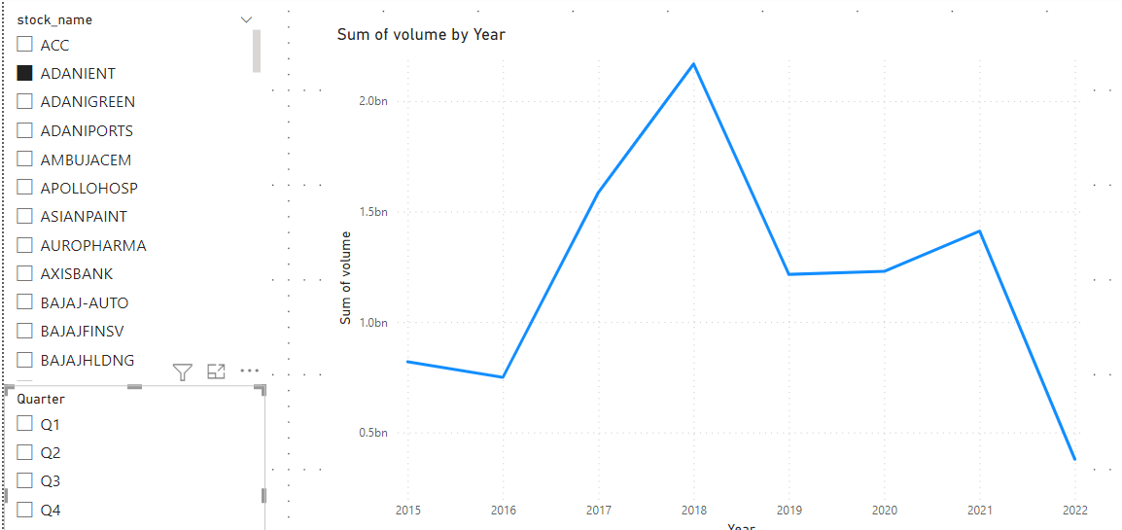

Slide 21
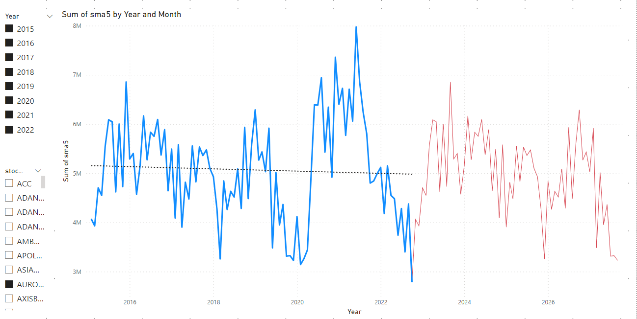
Predictive Analytics:
sma5-sma10-sma15-ema10-ema10-ema15) with Year

Slide 22

Unfinished Works
1.
Performing analyzes and dashboards from Power BI and Python to Apache Superset

Slide 23
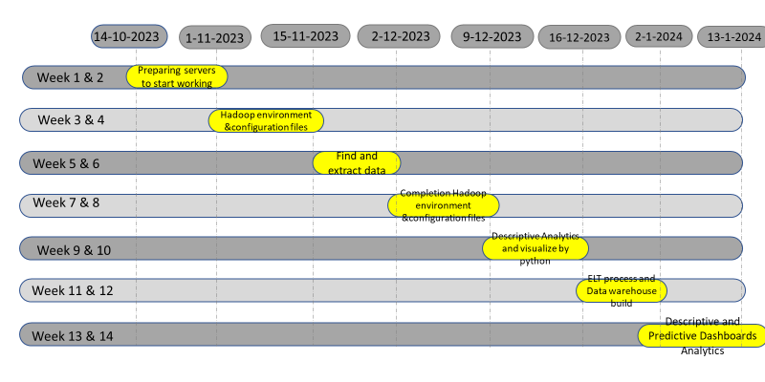
Project Plan

Slide 24
Future Works
There are many things that can be developed after this project, including:
Perform other analyzes on a real-time basis using big data techniques
Add some additional servers to make the environment more powerful
An additional backup server can be added to make the service more reliable and fault tolerant
You can start analyzing new and different types of data, such as images, videos, and audio files, by working with non-relational databases (NoSQL).

Slide 25
THANK YOU
Do you have any questions?

