Slide 1



Energy Efficiency in Smart Buildings Problem Statement:
SYMBIOSIS INSTITUTE OF TECHNOLOGY, NAGPUR
Abdullah Master (SEM VI)
Sanskruti Nerkar (SEM VI)
Devyani Balki (SEM VI)
Laxmi Khilnani (SEM VI)

Slide 2
Problem Statement
Brief Overview:
Problem: Buildings contribute to 40% of global energy consumption; improving efficiency, especially in commercial spaces, is critical for sustainability.
Solution: AI-powered systems optimize HVAC systems using real-time occupancy, weather forecasts, and historical data, reducing energy use and costs.
Case Study: A smart office building in Singapore cut energy consumption by 20% and operating costs by 10% with an AI-based HVAC management system.
Key Insight: AI-driven energy management offers measurable savings and aligns with sustainability goals, supported by two years of energy, occupancy, and weather data.
Key Objectives:
Analyze Energy Consumption Patterns
Optimize Energy Efficiency
Reduce Operating Costs
Enhance Sustainability
Utilize Data for Decision-Making
Demonstrate Measurable Impact
Source :
www.freepik.com/

Slide 3
Dataset Overview(Optional)
Dataset Description:
Timestamp
Represents the specific date and time of each recorded observation (values are masked but likely in a standard datetime format).
Occupancy
Integer values indicating the number of occupants present in the building at the given timestamp.
Energy_Cc
Continuous numeric values representing energy consumption in kilowatts (kWh) or a similar unit for the recorded period.
Temperature
Recorded indoor temperature in degrees Celsius (°C).
Humidity
Percentage (%) representing the relative humidity level within the building.
HVAC_Usage
Binary indicator (0 or 1): 0: HVAC system not in use. 1: HVAC system actively in use.
Source :
www.freepik.com/

Slide 4
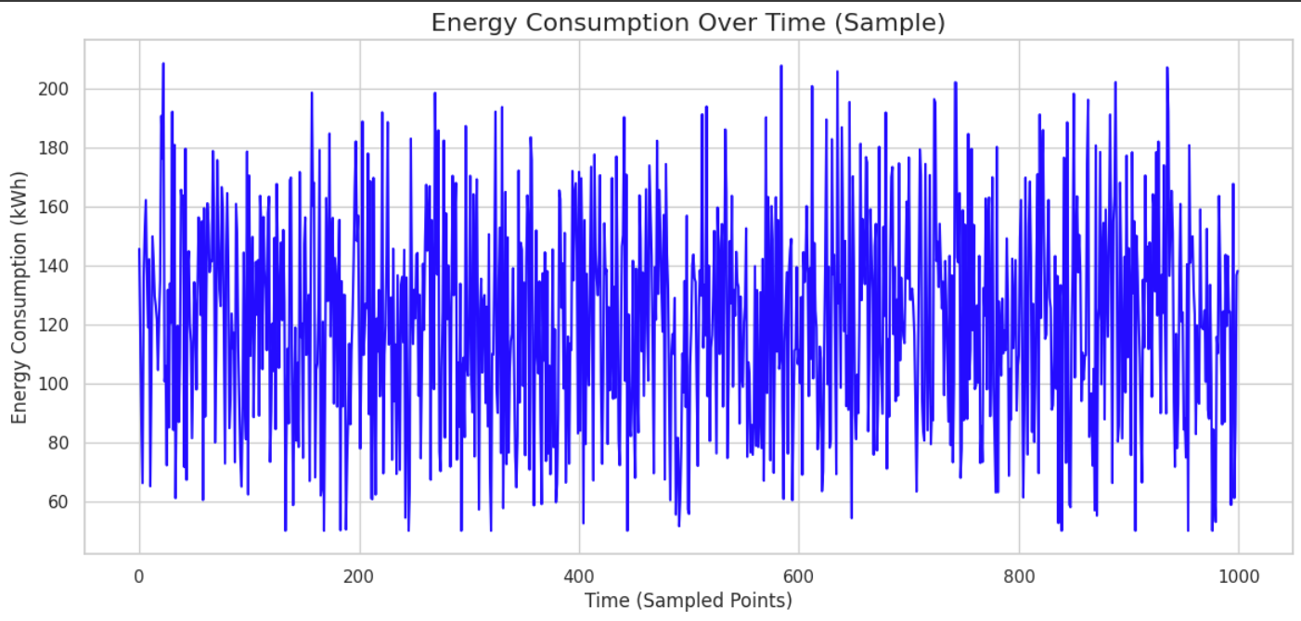
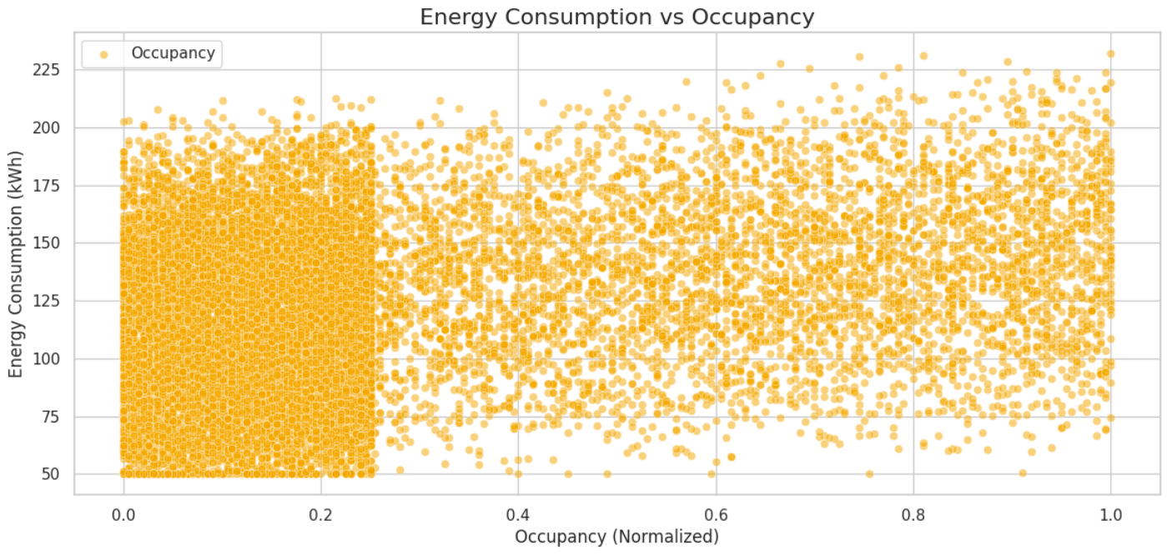
Dataset Overview(Optional)
Purpose: The plot shows sampled energy consumption (kWh) over time to analyze fluctuations and trends in usage.
Fluctuations: Energy consumption varies significantly between 50 kWh and 200 kWh, with visible peaks and troughs.
Sampling: A random subset of 1,000 points was chosen to simplify visualization while retaining key patterns.
Visualization: A blue line represents energy trends, created using Seaborn for a clean, professional look.
Purpose: Shows the relationship between Energy Consumption (kWh) and Occupancy (Normalized).
Observations: No clear trend; energy consumption ranges widely (50–225 kWh) regardless of occupancy levels.
Design: Scatter points are orange and semi-transparent to reduce overlap, showing density in certain areas.
Source :
www.freepik.com/

Slide 5
Methodology
Approach for Energy Efficiency in Smart Buildings
Problem Understanding:
The primary goal is to optimize energy efficiency by reducing energy consumption while maintaining occupant comfort.
The dataset provides critical features such as occupancy, energy consumption, temperature, humidity, wind speed, and HVAC usage.
Data Preprocessing:
Handle missing values, if any, in the dataset.
Normalize or standardize features like temperature, humidity, and wind speed to ensure uniform scaling for algorithms.
Convert the Timestamp column to usable datetime features (e.g., hour, day, month, or season).
Engineer additional features, such as "weather categories" or "occupancy trends."
Feature Selection:
Identify key predictors influencing HVAC usage and energy consumption (e.g., occupancy, temperature, and weather conditions).
Remove redundant or less significant features to improve model performance.
Source :
www.freepik.com/

Slide 6
Methodology
Algorithms Used
Predictive Models for Energy Usage:
Linear Regression:
To model relationships between energy consumption and factors like temperature, humidity, and occupancy.
Random Forest Regression:
To capture non-linear dependencies and interactions between features affecting energy usage.
XGBoost:
Advanced tree-based algorithm for higher accuracy and better handling of complex relationships.
Classification Models for HVAC Usage:
Logistic Regression:
Binary classification model to predict HVAC usage (0 or 1) based on occupancy, temperature, and other features.
Support Vector Machines (SVM):
To separate data into HVAC active/inactive zones using optimal hyperplanes.
Decision Trees and Random Forest Classifiers:
To handle non-linear relationships and feature interactions effectively.
Source :
www.freepik.com/

Slide 7
Methodology
Algorithms Used
Clustering for Occupancy Patterns:
K-Means Clustering:
To group similar occupancy levels or energy patterns for insights into usage trends.
DBSCAN (Density-Based Spatial Clustering):
To identify anomalies or unusual occupancy or energy usage patterns.
Time-Series Analysis (if predicting energy consumption over time):
ARIMA (AutoRegressive Integrated Moving Average):
For forecasting energy consumption based on historical data.
LSTM (Long Short-Term Memory Networks):
To capture long-term dependencies in time-series data for more accurate predictions.
Optimization Algorithms:
Genetic Algorithms or Particle Swarm Optimization:
For optimizing HVAC settings (temperature, airflow) to balance energy savings with occupant comfort.
Source :
www.freepik.com/

Slide 8
Hyperparameters for Models
1. Random Forest Hyperparameters
Number of Decision Trees: 100
Random Forest uses 100 individual decision trees to make robust predictions by averaging or majority voting
Increasing the number of trees improves performance but may increase training time
2. Polynomial Regression Hyperparameters
Polynomial Degree: 2
The regression model uses a quadratic polynomial (degree = 2) to fit non-linear relationships in the data
Higher degrees increase complexity but risk overfitting, while degree 2 balances simplicity and accuracy
Source :
www.freepik.com/

Slide 9

Conclusion
Impact of AI in Energy Efficiency:
The case study demonstrates how AI-powered systems significantly enhance energy efficiency in buildings by analyzing real-time and historical data.
The Singapore office building achieved a 20% reduction in energy consumption and a 10% decrease in operating costs, highlighting the potential of such systems in commercial spaces.
Optimization of HVAC Systems:
Dynamic adjustments to HVAC settings based on occupancy, weather forecasts, and energy usage patterns contribute to substantial savings while maintaining occupant comfort.
Sustainability Goals:
AI-based energy management aligns with global sustainability objectives by reducing the carbon footprint of buildings, which account for nearly 40% of global energy consumption.
Source :
www.freepik.com/

Slide 10
Conclusion
Future Work
Integration with Renewable Energy:
Combine AI systems with solar, wind, or other renewable energy sources for further optimization of energy usage.
Scalability:
Expand the deployment of AI energy management systems to other types of buildings, such as residential complexes, industrial facilities, and public infrastructure.
Advanced Forecasting Models:
Use advanced machine learning models (e.g., LSTMs or transformers) to improve predictions of energy consumption based on dynamic external conditions.
Occupant Behavior Modeling:
Incorporate behavioral patterns of occupants for better optimization, such as personal comfort preferences and activity levels.
IoT Integration:
Integrate Internet of Things (IoT) devices for more granular, real-time data collection and automation of energy systems.
Anomaly Detection:
Use clustering and anomaly detection algorithms to identify unusual energy consumption patterns, enabling proactive maintenance and energy savings.
Source :
www.freepik.com/

Slide 11
Results
Polynomial Regression Result:
Polynomial Regression - Mean Squared Error:
887.7785752924647
Polynomial Regression - R-squared:
0.29091738081569585
Metrics for Random Forest Model:
Mean Squared Error (MSE):
25.7196
Mean Absolute Error (MAE):
926.0522R-squared (R²): 30.4311

Slide 12
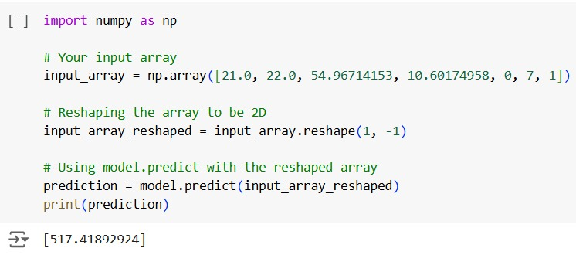
Prediction:

Slide 13
References
GitHub link : https://github.com/abdullah-master/Gen-AI-project

Slide 14
Thank You
Notes:
Thank You !!

