Slide 1

Algorithm Design and Implementation for Automated Timetable Scheduling
For GIKI
Presenters:
Muhammad Abdullah Mahsud 2023346
Mujeeb U Rehman 2023558
Faizan Ali 2023192
GIK Institute of Engineering Sciences and Technology (GIKI)
Course:
CS378 Design & Analysis of Algorithm

Slide 2
Introduction & The Problem
Challenge: University course timetabling is a notoriously complex, NP-hard combinatorial optimization problem.
The Scale: As the number of courses, student sections, faculty, and rooms grows exponentially, brute-force scheduling becomes computationally impossible.
Manual Limitations: Traditional manual scheduling is slow, highly prone to errors, and fails to scale with institutional growth.
Objective: To design and implement an automated, intelligent scheduler for GIKI that handles hundreds of constraints efficiently.

Slide 3
Project Overview & Core Entities
Approach: Modeled the timetable generation as a Constraint Satisfaction Problem (CSP) built in Python.
Problem Entities:
Courses & Teachers: Handled across multiple departments.
Rooms & Time Slots: Physical constraints and discrete Monday-Friday blocks.
Sections: Student cohorts grouped by department and semester.
Credit-Hour Expansion: A critical pre-processing step where a multi-credit course is automatically split into distinct, independent scheduling variables.

Slide 4
Algorithm Design
Core Algorithm: Backtracking Search. It methodically explores assignments and backtracks to the last choice point when a conflict is detected.
Partitioned Solving Strategy: To prevent the search space from exploding, the solver doesn't do everything at once.
Solves section-by-section and semester-by-semester independently.
Uses an "auto-bucketing" mechanism limiting batches to ~20 sessions to maintain speed.

Slide 5
Advanced Search Heuristics
To avoid the worst-case exponential time complexity (O(d^n)), two classic AI heuristics are used:
Minimum Remaining Values (MRV):
Selects the variable (course session) with the fewest valid room/time options left.
Tackles bottlenecks early to prevent massive failures later.
Forward Checking: Whenever a tentative assignment is made, the algorithm looks ahead and temporarily removes conflicting options from future variables.
Dramatically reduces the effective branching factor.

Slide 6
Managing Constraints
Hard Constraints:
Teacher Conflicts: Instructors cannot be double-booked, except for shared-curriculum courses taught simultaneously.
Room Conflicts: No double-booking rooms.
Building Routing: Forces specific courses to appropriate buildings (e.g., CS lectures strictly in FCSE/Academic Block; Labs strictly in Lab rooms).
Building Routing: Forces specific courses to appropriate buildings (e.g., CS lectures strictly in FCSE/Academic Block; Labs strictly in Lab rooms).
Soft Constraints:
Morning Preferences: Prioritizes early slots for junior semesters.
Capacity Utilization: Scores rooms to match class sizes tightly, punishing both wasted space and overcrowded seating.

Slide 7

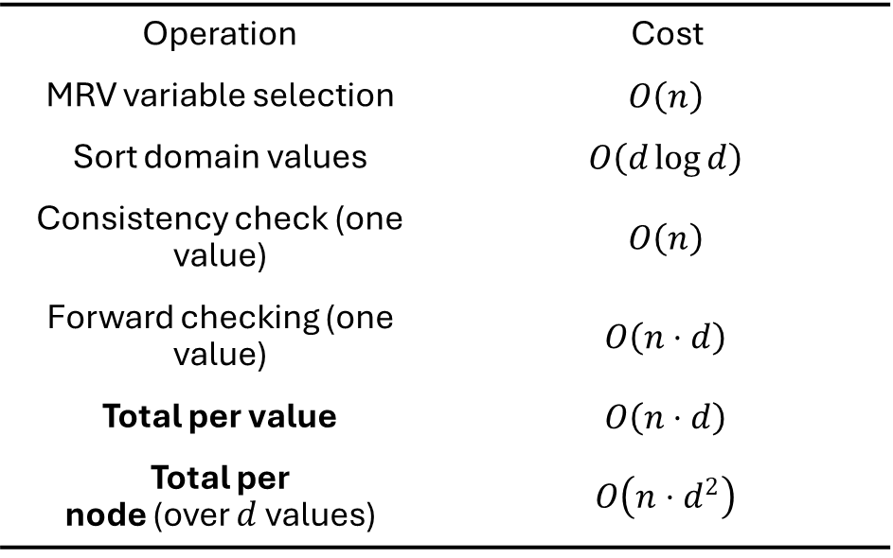
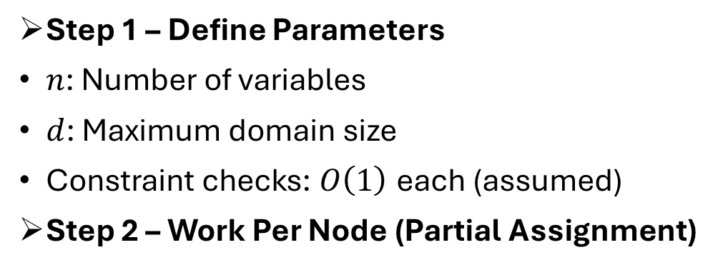
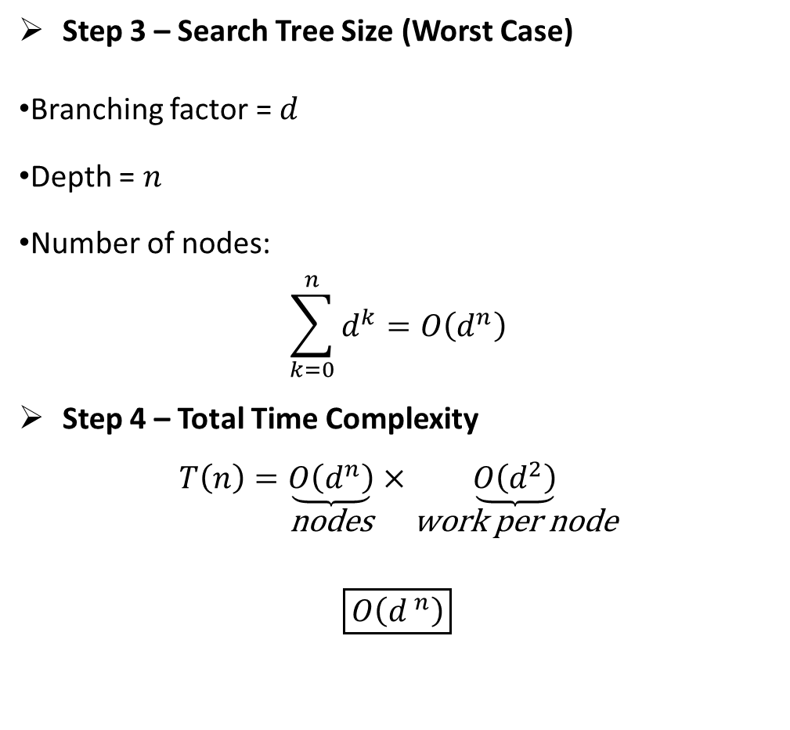
Time Complexity Analysis of BACKTRACK Algorithm
Step 3 – Search Tree Size (Worst Case)
Branching factor = $d$
Depth = $n$
Number of nodes:
$$\sum_{k=0}^{n}{d^{k}}=O\left(d^{n}\right)$$
Step 4 – Total Time Complexity
$$T\left(n\right)=\underset{\begin{aligned}\text{nodes} \\ \\ \end{aligned}}{\underbrace{O\left(d^{n}\right)}}×\underset{\text{work} \text{per} \text{node}}{\underbrace{O\left(d^{2}\right)}}$$
$$\boxed{O\left(d^{ n}\right)}$$
Step 1 – Define Parameters
$n$: Number of variables
$d$: Maximum domain size
Constraint checks: $O\left(1\right)$ each (assumed)
Step 2 – Work Per Node (Partial Assignment)
Operation | Cost
MRV variable selection | $$O\left(n\right)$$
Sort domain values | $$O\left(d\log{d}\right)$$
Consistency check (one value) | $$O\left(n\right)$$
Forward checking (one value) | $$O\left(n⋅d\right)$$
Total per value | $$O\left(n⋅d\right)$$
Total per node (over $d$ values) | $$O\left(n⋅d^{2}\right)$$

Slide 8
Tech Stack & System Architecture with Complexity
Language & Logic: Python
Data Ingestion: Uses pandas and openpyxl to read and parse structured Excel/CSV files containing curriculum and room data.
User Interface: A custom, interactive desktop GUI built with Tkinter.
Output Generation: Utilizes ReportLab to export formally styled, multi-page PDF documents.
Time Complexity: Worst O(d^n), Best O(n). Where n is session variables and d is size of room, slot pairs.

Slide 9
Thank You!

