Slide 1

DATABASE CASE STUDY
Coinbase:
AI-Assisted
Recruitment
Management System
Subject: Database
Presented by: Noor Abbas, Abdullah Jamil
Roll Number : BSCS-113, BSCS-104
Submitted to: Sir sharique
Department: Computer Science

Slide 2




CASE NO. PL - 0426
THE CASE FOR CENTRALIZATION
Recruitment Data Needs One Reliable Record
Coinbase is a cryptocurrency and financial technology company. Professional hiring generates candidates, resumes, vacancies, interviews, and decisions. A centralized database keeps recruitment information organized and connected.
Job vacancy
Candidate
Interview
Decision
Role requirements enter the system.
Applications and resumes are linked.
Progress and scheduling stay visible.
The record ends with a documented outcome.
PROJECT LEDGER
PUBLIC INTEREST REPORT
02 / 10

Slide 3
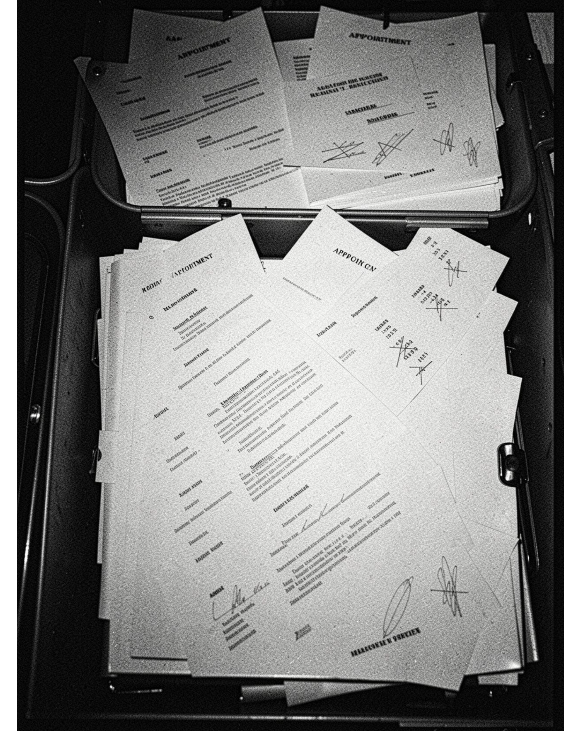




CASE NO. PL - 0426
THE CURRENT FRICTION
Manual Recruitment Creates Gaps
Resume screening
Interview scheduling
Takes time.
Difficult to coordinate.
Records & tracking
Candidate privacy
Sensitive candidate data needs protection.
Records can become outdated or duplicated. Application status is hard to track.
PROJECT LEDGER
PUBLIC INTEREST REPORT
03 / 10

Slide 4
CASE NO. PL - 0426
DESIGN PRINCIPLE
AI Assists the Process. People Make the Decision.
CAPABILITY | ROLE IN RECRUITMENT
Storage | Centralized storage for recruitment data.
Skill extraction | AI-assisted skill extraction from resumes.
Candidate matching | Candidate matching against job requirements.
Coordination | Interview scheduling and application tracking.
Human oversight | Human review remains required for final hiring decisions.
PROJECT LEDGER
PUBLIC INTEREST REPORT
04 / 10

Slide 5
CASE NO. PL - 0426
DATABASE ARCHITECTURE
Six Tables Organize the Recruitment Record
Each table stores one category of recruitment information. Together, they create a connected record that can be queried and reported.
Candidates
Jobs
Applications
Interviews
Recruiters
Hiring Decisions
PROJECT LEDGER
PUBLIC INTEREST REPORT
05 / 10

Slide 6
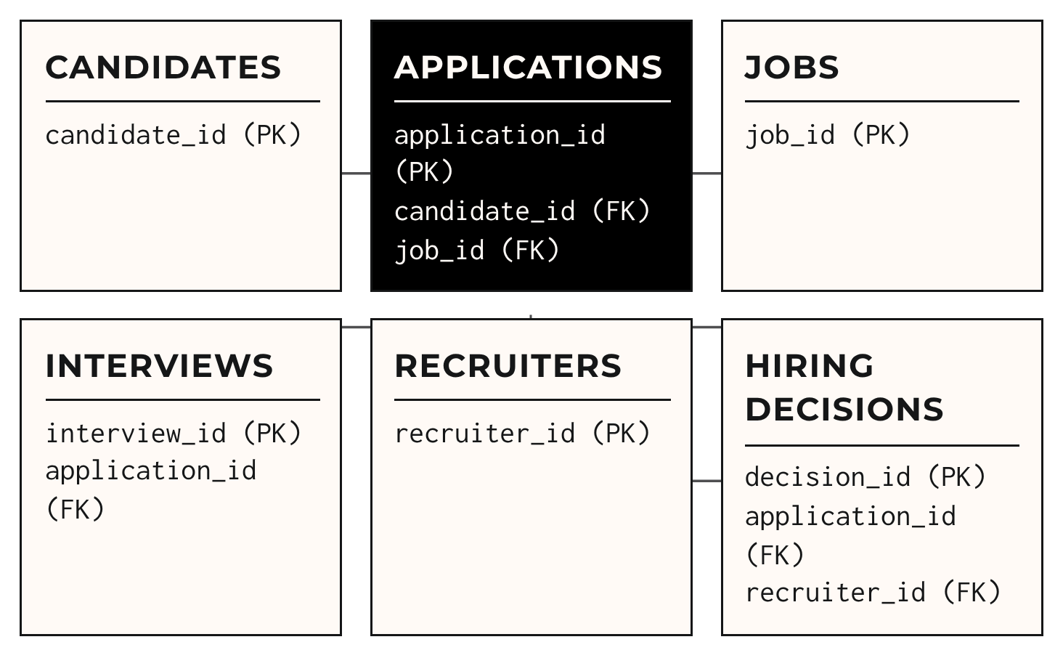
CASE NO. PL - 0426
RELATIONSHIP MODEL
Applications Connect Candidates to Jobs
The application record is the bridge between a candidate and a vacancy. Interviews and hiring decisions then connect back to that application.
PROJECT LEDGER
PUBLIC INTEREST REPORT
06 / 10

Slide 7
CASE NO. PL - 0426
SQL STATEMENTS
IMPLEMENTATION
CREATE DATABASE CoinbaseRecruitment;
USE CoinbaseRecruitment;
SELECT * FROM Candidates;
SQL Turns the Design into a Working Database
SELECT C.full_name, J.job_title
FROM Applications A
JOIN Candidates C
ON A.candidate_id = C.candidate_id
JOIN Jobs J
ON A.job_id = J.job_id;
SQL creates tables, inserts records, retrieves information, and joins related data.
CREATE DATABASE creates the database.
SELECT retrieves stored records.
JOIN combines related table data.
PROJECT LEDGER
PUBLIC INTEREST REPORT
07 / 10

Slide 8





SELECT C.full_name, J.job_title
FROM Applications A
JOIN Candidates C
ON A.candidate_id = C.candidate_id
JOIN Jobs J
ON A.job_id = J.job_id;
REPORTING LAYER
Reports Turn
Recruitment
Data into Insight
Once the records are connected, reports can show where applications are moving, where they stall, and what outcomes follow.
Applicants per job
Interview completion
Recruitment time
Compare demand across vacancies.
Track interviews that reach completion.
Review the time taken across stages.
SELECT status, COUNT(*) AS total_interviews
FROM Interviews
GROUP BY status;
Hiring outcomes
Application status
Summarize documented decisions.
See each candidate's current stage.
PROJECT LEDGER
PUBLIC INTEREST REPORT
08 / 10

Slide 9
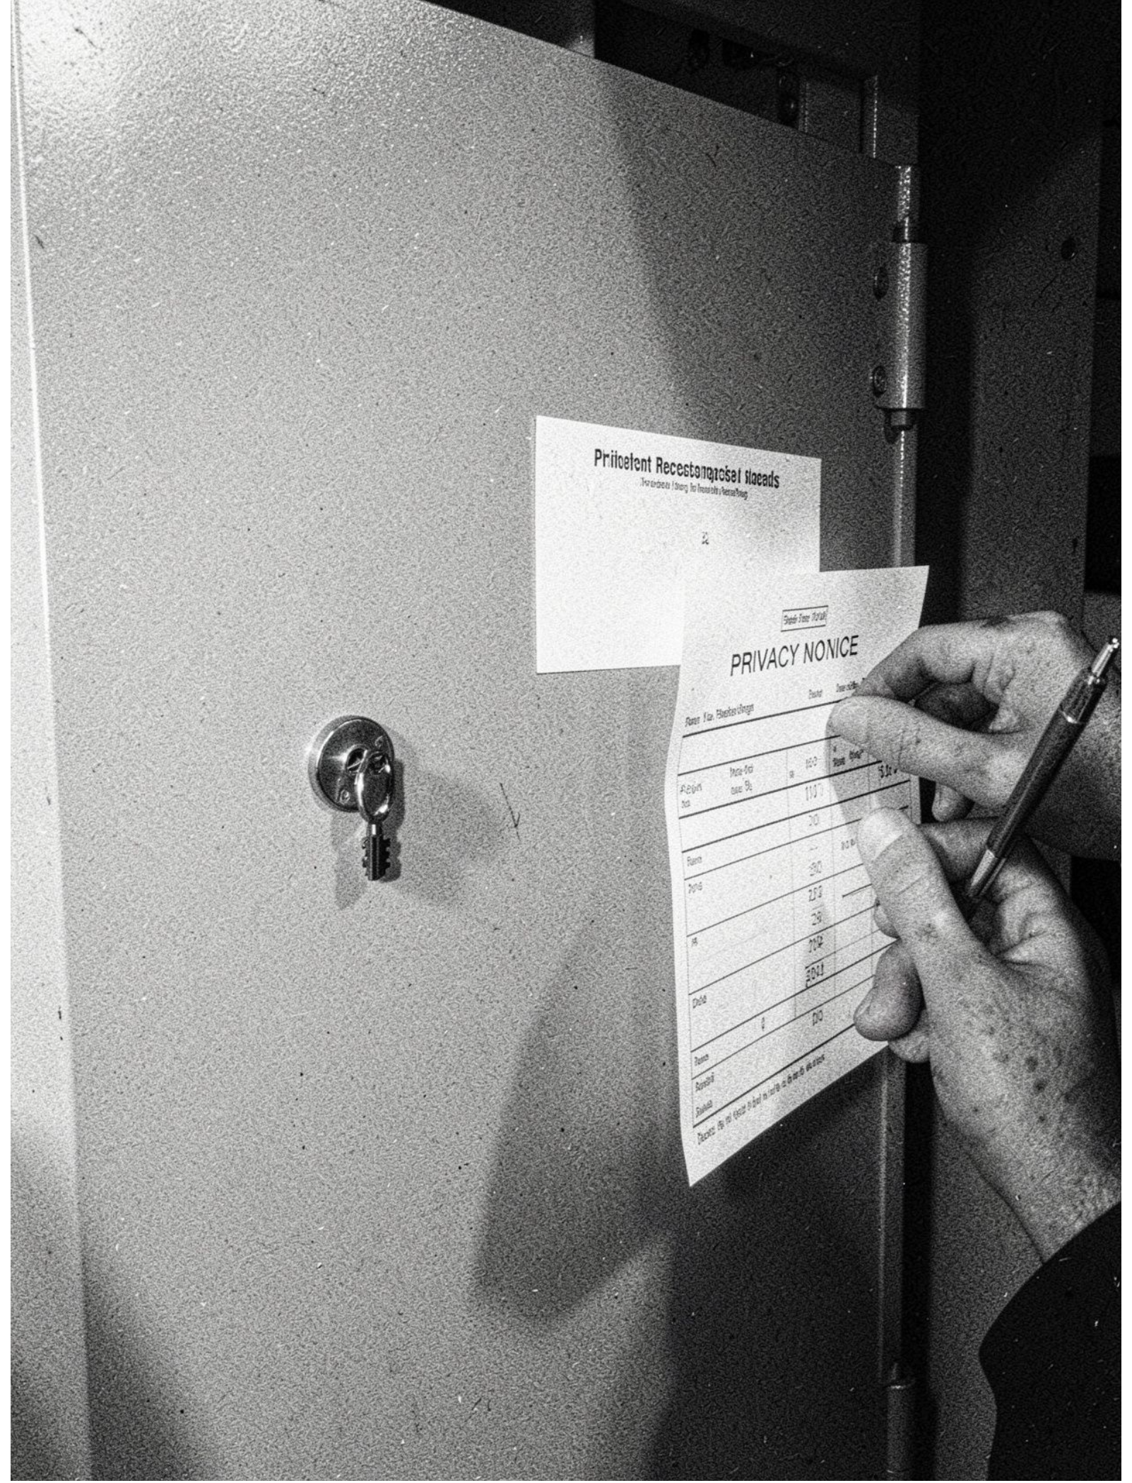




CASE NO. PL - 0426
GOVERNANCE
Candidate Data Requires Strong Controls
Access controls
Privacy
Apply appropriate access controls. Prevent unauthorized access.
Protect candidate personal information.
Transparency
Human oversight
Record AI-generated recommendations transparently.
Keep final hiring decisions subject to human review.
PROJECT LEDGER
PUBLIC INTEREST REPORT
09 / 10

Slide 10
FINAL TAKEAWAY
A Centralized Database Makes Recruitment Consistent
Centralized storage organizes recruitment records. Relationships maintain consistency between tables. SQL supports retrieval and reporting. AI can assist routine tasks, while privacy, security, and human oversight remain essential.
Thank You — Questions & Answers

