Slide 1
MATH PROJECT
Project Presentation
DONE BY
Mohamed Shaddad · 19003873
Mohab Nassar · 19003767
Abdullah Saad · 19009338
Mohamed Hamza Ali · 19008496
Lana Hatem · 13004852
Siraj Kandil · 16009213
Steven Raouf · 700284
01 / 12

Slide 2







MATH PROJECT
Motivation
Project Implementation
02 / 12

Slide 3
MATH PROJECT
Motivation
How does AI get trained on petabytes of data?
While… You can download high end models ranging anywhere from 10 to 200GB
Project Implementation
02 / 12

Slide 4
MATH PROJECT
Motivation
Principal
Component
Analysis
How does AI get trained on petabytes of data?
While… You can download high end models ranging anywhere from 10 to 200GB
Project Implementation
02 / 12

Slide 5
MATH PROJECT
(PCA)
Principal
Component
Analysis
Project Implementation
03 / 12

Slide 6



MATH PROJECT
(PCA)
What are the Issues?
03
Slower computations
01
Introduction
Cost grows with dimensionality
High-dimensional data is complex
04 / 12
Feature counts explode quickly
02
Hard to visualize
Beyond 3 dimensions, intuition fails

Slide 7
MATH PROJECT
What are the Issues?
01
02
03
Hard to visualize
Slower computations
High-dimensional data is complex
Introduction
Feature counts explode quickly
Beyond 3 dimensions, intuition fails
Cost grows with dimensionality
04 / 12

Slide 8
MATH PROJECT
Reduces dimensionality
How can we solve them?
Compresses many features into a few axes
Keeps most important information
Preserves the directions of greatest variance
Transforms data into new axes
Introduction
Re-expresses points in a new coordinate system
05 / 12

Slide 9
MATH PROJECT
How can we solve them?
Reduces dimensionality
Compresses many features into a few axes
Keeps most important information
Preserves the directions of greatest variance
Transforms data into new axes
Re-expresses points in a new coordinate system
05 / 12

Slide 10
MATH PROJECT
Standardize data
Compute covariance matrix
Find eigenvalues & eigenvectors
Center the data
How does it work?
Introduction
06 / 12

Slide 11
MATH PROJECT
How does it work?
Standardize data
Compute covariance matrix
Find eigenvalues & eigenvectors
Center the data
06 / 12

Slide 12
MATH PROJECT
Standardize data
Compute covariance matrix
Find eigenvalues & eigenvectors
Center the data
feature 2 (std)
feature 1 (std)
06 / 12
06 / 12

Slide 13
Standardize data
Compute covariance matrix
Find eigenvalues & eigenvectors
Center the data
feature 2 (std)
Every feature is rescaled to mean 0 and std 1, so no single feature dominates just because of its scale.
Subtract the mean, divide by the standard deviation — column by column.
main.py
feature 1 (std)
# mean=0, std=1 per feature
X_scaled = (X - X.mean(axis=0)) / X.std(axis=0)
06 / 12

Slide 14
Standardize data
Compute covariance matrix
Find eigenvalues & eigenvectors
Center the data
feature 2 (std)
Shift the cloud so its centre of mass sits at the origin. PCA draws axes through the origin, so this alignment is required.
We subtract the column mean explicitly. After standardization the mean is already near zero, but we don't take that for granted.
main.py
feature 1 (std)
# shift centre of mass to origin
mean = np.mean(X_scaled, axis=0)
X_centered = X_scaled - mean
06 / 12

Slide 15
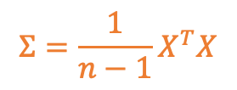
Standardize data
Compute covariance matrix
Find eigenvalues & eigenvectors
Center the data
$$Σ=\frac{1}{n−1}X^{T}X$$
feature 2 (std)
A features×features table that captures how every pair of features co-varies across all samples..
The shape of Σ tells us how stretched and tilted the cloud is. Diagonal entries are the variances of each feature; off-diagonals are the covariances.
main.py
feature 1 (std)
# features × features co-variation
cov_matrix = np.cov(
X_centered,
rowvar=False,
)
06 / 12

Slide 16

Standardize data
Compute covariance matrix
Find eigenvalues & eigenvectors
Center the data
$$Σv = λv$$
We need vectors v where Σv = λv. Power iteration finds the dominant one by repeatedly multiplying by Σ and normalizing.
feature 2 (std)
Any starting vector decomposes into eigenvectors. Each iteration scales each component by its eigenvalue, so the largest λ dominates exponentially — after a couple thousand iterations the direction stops changing.
v₁ (PC1)
main.py
vec = np.random.rand(n)
vec /= np.linalg.norm(vec)
for _ in range(2000):
vec = M @ vec
vec /= np.linalg.norm(vec)
if np.linalg.norm(new_vector - vector) < tol: break
feature 1 (std)
06 / 12

Slide 17

Standardize data
Compute covariance matrix
Find eigenvalues & eigenvectors
Center the data
$$\left(A−λvv^{T}\right)v=0$$
To find PC2, we remove PC1's contribution from the matrix and run power iteration again.
feature 2 (std)
Subtracting λvvᵀ zeroes out the eigenvalue we just found without disturbing the others, so the next power iteration locks onto the second-largest direction. Repeat k times for k components.
v₁ (PC1)
main.py
# remove the direction we just found
matrix = matrix - lam * np.outer(vec, vec)
# next call finds PC2
lam2, vec2 = power_iteration(matrix)
feature 1 (std)
v₂ (PC2)
06 / 12

Slide 18
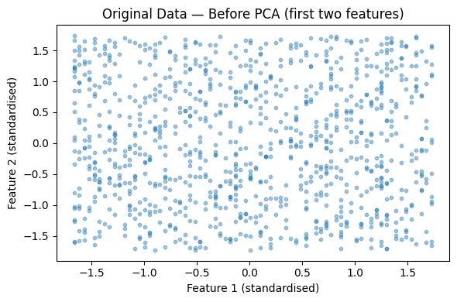
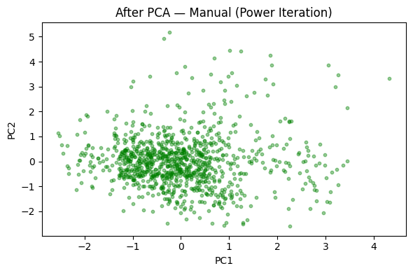
Standardize data
Compute covariance matrix
Find eigenvalues & eigenvectors
Center the data
MATH PROJECT
feature 2 (std)
The results?
Reduced to 2D
v₁ (PC1)
Structure preserved
feature 1 (std)
Noise reduced
Original dataset before PCA showing unstructured distribution across features
Data projected onto the first two principal components using manual PCA implementation
v₂ (PC2)
Introduction
08 / 12
Σ
Covariance matrix
λ
Eigenvectors = directions
The new axes of the rotated coordinate system
Eigenvalues = importance
→
Eigenvectors = directions
How features co-vary across the dataset
Variance captured along each eigenvector
Eigenvalues = importance
Covariance matrix

Slide 19
MATH PROJECT
The results?
Reduced to 2D
Structure preserved
Noise reduced
Original dataset before PCA showing unstructured distribution across features
Data projected onto the first two principal components using manual PCA implementation
Introduction
08 / 12

Slide 20

MATH PROJECT
The variance we captured.
Reduced to 2D
Structure preserved
Noise reduced
Introduction
09 / 12

Slide 21
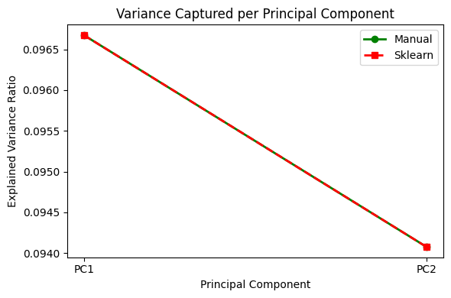

MATH PROJECT
The variance we captured.
First component has most variance
Helps choose dimensions
$$\text{EV}{\text{R}}_{\text{i}}=\frac{λ_{i}}{\sum_{j}{λ_{j}}}$$
Each principal component's eigenvalue, divided by the total variance, tells us what fraction of the data's spread it captures.
The variance ratio of principal components (manual PCA), showing decreasing contribution of each component.
09 / 12

Slide 22
MATH PROJECT
How do we validate?
Introduction
10 / 12

Slide 23
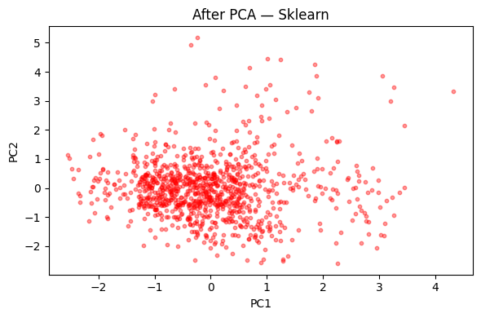
MATH PROJECT
How do we validate?
MANUAL
SKLEARN
Manual (power iteration) vs sklearn — both methods recover the same structure.
10 / 12

Slide 24
MATH PROJECT
How do we validate?
Manual (power iteration) vs sklearn — both methods recover the same structure.
10 / 12

Slide 25
MATH PROJECT
Where is this applied?
Introduction
11 / 12

Slide 26



MATH PROJECT
Where is this applied?
Machine Learning
Data Compression
Visualization
Feature reduction for faster, more robust models
Smaller representations with minimal loss
Project high-dimensional data onto 2-D or 3-D
Thank you
11 / 12

Slide 27
MATH PROJECT
Thank you...
Thank you
12 / 12

