Slide 1
A Naïve Bayes Approach to Identify Users Gender, Age and Religion Based on their Facebook Snippets
Submitted by
Farzad Bin Fazle
2012331005
Mohammed Abdullah Al Awal
2012331055
supervised by
Md. Saiful islam khan
Assistant professor
Dept. of computer science & engineering, sust

Slide 2
Overview
Motivation
Background Study
Data Collection and Processing
Methodology
Result and Analysis
Future Scopes and Conclusion

Slide 3
Why User Classification?

Slide 4
Purpose
To Identify Gender
Identify Unknown Person
Level of Users Age

Slide 5
Related Works
Zhenhui Li, Ding Zhou, Yun-Fang Juan and Jiawei Han. Keyword Extraction for Social Snippets. Proceedings of the 19th international conference on World wide web, pp. 1143-1144, 2010.
S. P. Thomas Theodoridis and Y. Kompatsiaris. Assessing the reliability of Facebook user profiling. Proceedings of the 24th International Conference on World Wide Web, pp. 129-130, 2015.
Aparna Garimella and Rada Mihalcea. Zooming in on Gender Differences in Social Media, 2016.
Notes:
Keyword paper
Twitter
Gay
Sir er ta
curiosity

Slide 6
Data Collection

Slide 7
Data Collection
We collected data of 250+ Facebook users.
Data contains users Bangla Status, Sex, Religion & Age.

Slide 8
Data Ratio of Gender

Slide 9
Data Ratio of Religion

Slide 10
Data Ratio of Age

Slide 11
Data Processing

Slide 12

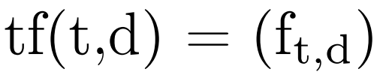

TF-IDF
Equation for TF-IDF
Where,

Slide 13
Flow Chart
Raw Status
Filtering and Tokenizing
TF-IDF Vectorization
Build Feature Matrix
Train Classifier
Final Model

Slide 14
Methodology

Slide 15
Algorithms
Naïve Bayes Classifier
Linear Regression
Logistic Regression
Support Vector Machine
Artificial Neural Network

Slide 16

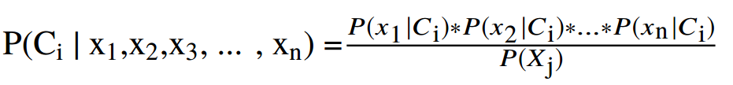
Gaussian Naïve Bayes
For single feature data:
For multiple featured data:

Slide 17
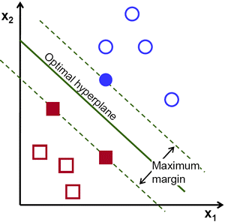
SVM

Slide 18
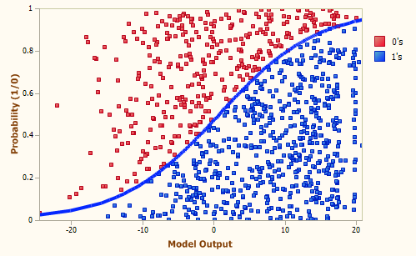
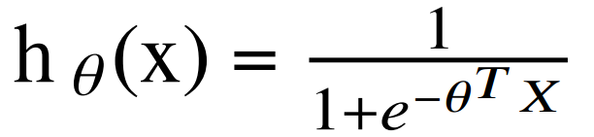
Logistic Regression
Hypothesis function:
Cost function:

Slide 19
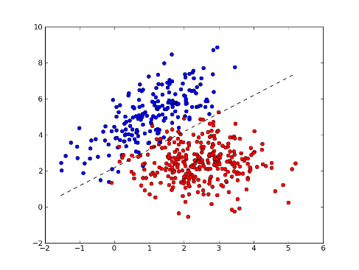
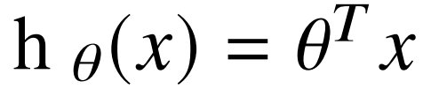
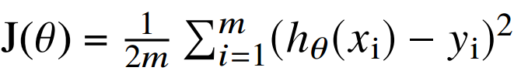
Linear Regression
Hypothesis function:
Cost function:

Slide 20
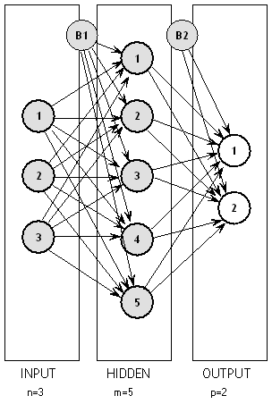

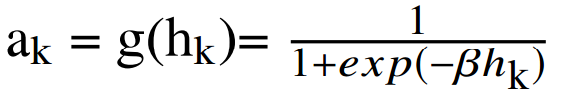

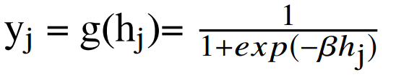
Artificial Neural Network
Forward Phase equations:
Input layer to hidden layer:
Hidden layer to output layer:

Slide 21




Artificial Neural Network (Cont.)
Backward Phase equations:
Output layer to hidden layer:
Hidden layer to input layer:

Slide 22
Parameters of Artificial Neural Network
1 hidden layer
200-500 iterations
Hidden layer size 3000
6000 as input features
Activtion function: Identity, Relu, Tanh, Sigmoid
70% of the data set was used to train

Slide 23
Parameter for other Algorithms
70% of the data set was used to train
30% was used to test
6000 features was used as input

Slide 24
Result and Analysis

Slide 25
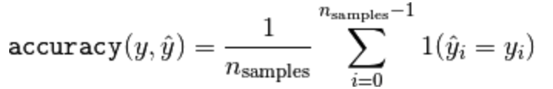
Accuracy measurement

Slide 26
Analysis with SVM

Slide 27
Analysis with Gaussian Naïve Bayes

Slide 28
Comparison

Slide 29
Future Scopes and Conclusion
Facebook Emoticon
Consider Timestamp
Feelings

Slide 30
Thank You

