Slide 1

AI-Powered Cloud Scheduler for Hospitals
Abdullah Farghaly
Pierre Fouad
Mohamed Mahmoud
Ibrahim Ayman
Hazem Waleed

Slide 2
Problem Statement
What problem are we solving?
Hospitals suffer from :
  Long patient waiting times
  Unpredictable patient arrivals
  Poor resource and staff scheduling
Traditional systems are :
  Static
  Not scalable
  Unable to adapt to real-time demand
Need :
An intelligent, cloud-based solution to predict ER wait time and scale automatically.

Slide 3
Objectives
Predict
Predict ER waiting time using Machine Learning
Deploy
Deploy the model as a cloud-native application
Use
Use Docker for containerization
Use
Use Kubernetes for deployment and management
Implement
Implement health checks for reliability
Enable
Enable autoscaling based on workload

Slide 4
Dataset
ER Wait Time Dataset
Real-world hospital data
Features include:
  Urgency level
  Nurse-to-patient ratio
  Facility size
  Registration & triage times
Target:
  Total ER wait time (minutes)
Why this dataset?
Directly represents hospital congestion
Matches our problem and objectives

Slide 5
Methodology / Approach
Data preprocessing
Train Machine Learning model
Save trained model
Build REST API using FastAPI
Containerize using Docker
Deploy on Kubernetes
Add health checks & autoscaling
Test and evaluate results

Slide 6

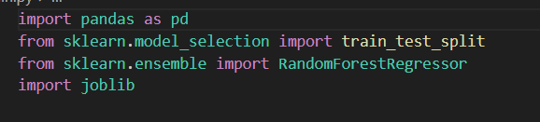
Machine Learning Model
Model Used: Random Forest Regressor
Supervised regression model
Predicts numeric ER wait time
Chosen because:
  Handles complex relationships
  Works well with tabular data
  Reliable and widely used
Output:
Predicted waiting time in minutes

Slide 7
implementation Details
Application Layer
Built a REST API using FastAPI
/predict endpoint performs real-time ER wait time prediction
/healthz endpoint provides system health status
Swagger UI used for interactive testing and validation
Containerization
Application and dependencies packaged using Docker
Dockerfile defines runtime environment and startup command
Image built locally and pushed to Docker Hub
Ensures portability and consistent execution across environments
Kubernetes Deployment
Deployment : manages application lifecycle and ensures availability
Service (NodePort) : exposes the application to external users
Liveness Probe : restarts the container if the app becomes unresponsive
Readiness Probe : ensures traffic is sent only to healthy pods
Outcome
Reliable, scalable, and production-like cloud-native ML system
Automatically adapts to workload changes

Slide 8
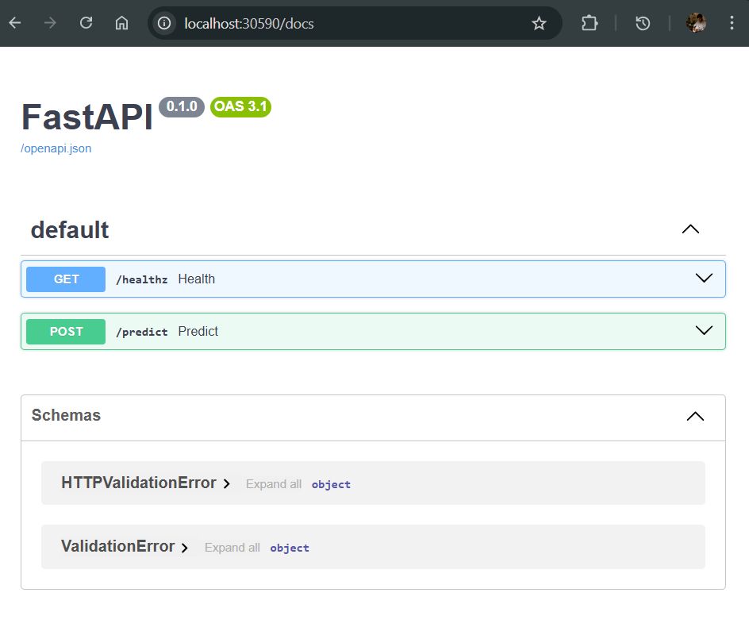
Results / Findings
Testing Results
/healthz returned "status: ok"
/predict returned valid numeric predictions
  Example: 94.72 minutes
Application accessible via browser
Autoscaler created successfully
What this means
Model works correctly
Cloud deployment is successful
System is scalable and reliable

Slide 9
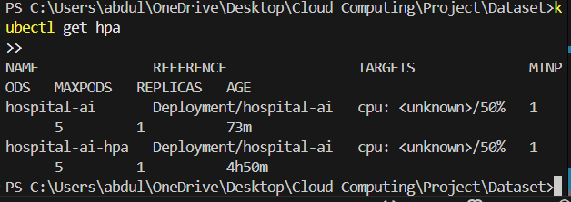
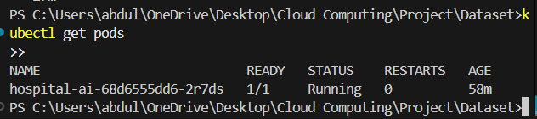
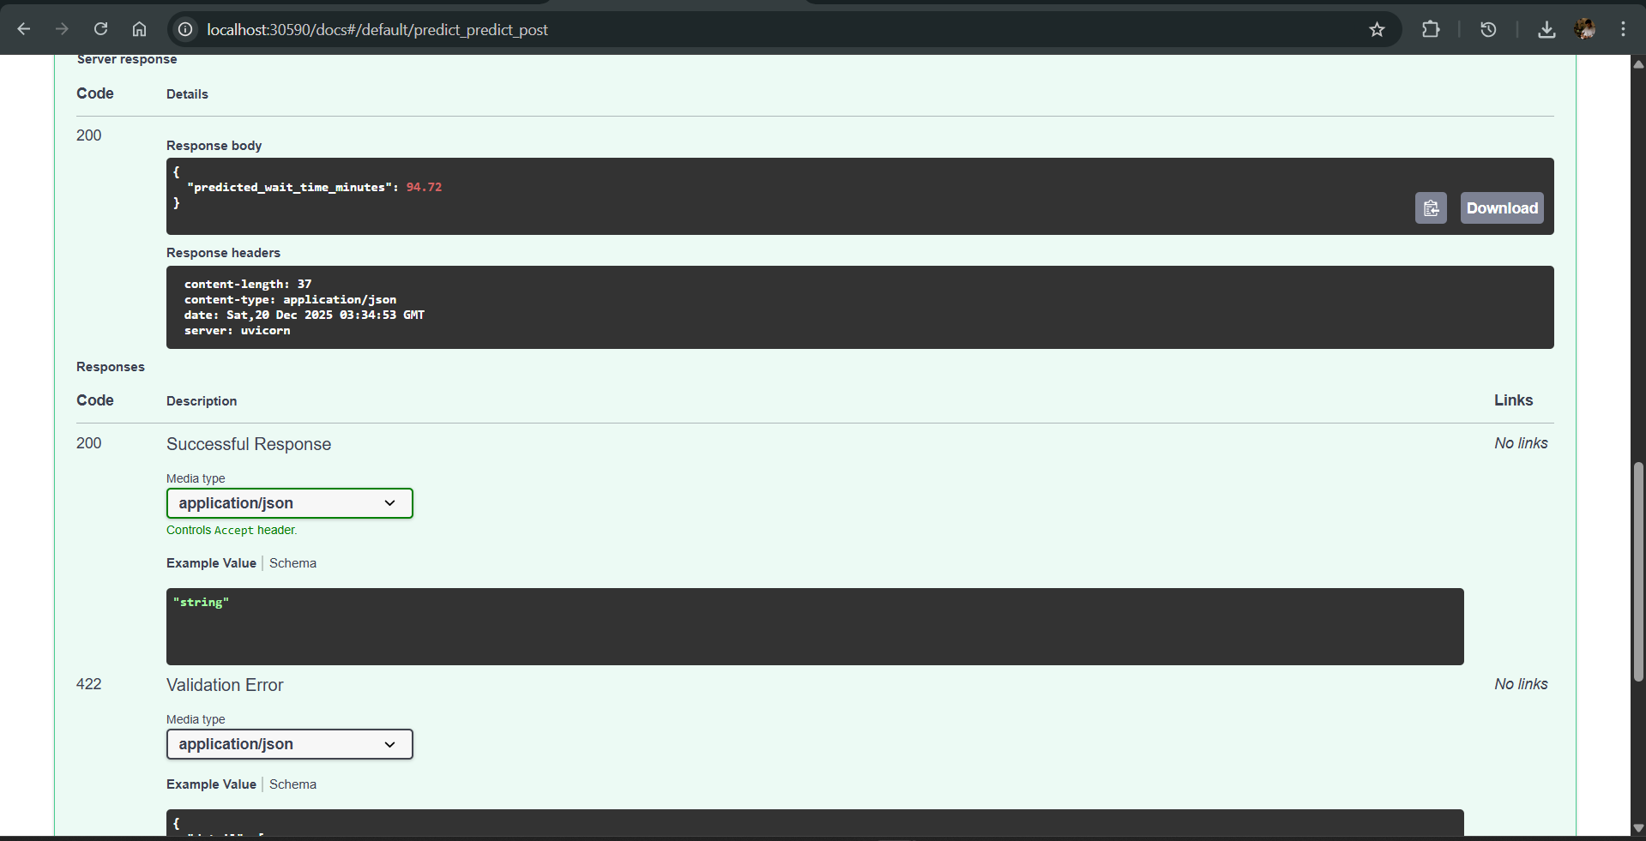
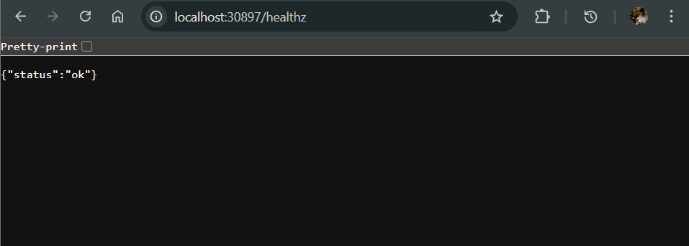
The /healthz endpoint confirms that service was running correctly
The /predict endpoint returned valid ER wait time predictions, proving that machine learning model works.
Kubernetes pods were running successfully without errors
The HPA was configured and active, enabling automatic scaling based on CPU usage

Slide 10
Conclusion
This project successfully implemented an AI-powered cloud scheduler to predict ER waiting times using machine learning. The solution was deployed as a cloud-native application with Docker and Kubernetes, including health checks and autoscaling for reliability and scalability. The results confirmed correct model predictions and a stable, production-like deployment, demonstrating the effectiveness of combining AI with cloud technologies in healthcare systems.

