Slide 1
D
C
Presentation about our Project Ideas
B
A
A

Slide 2
Our project Idea
It facilitates communication with both doctors in clinics, hospitals, pharmacies and laboratories
Shorten a lot of time in getting treatment, radiation and medical analysis
Use smart card as a modern way to communicate with doctors in clinics or hospitals, pharmacies and laboratories
The Smart Card has an id contains all the patients' history, including radiotherapy, medical analysis and ...
A

Slide 3
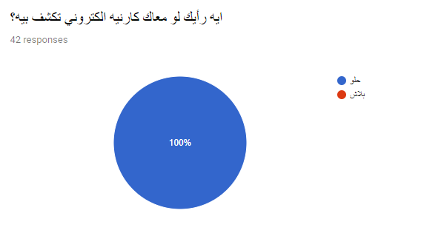
Survey Question 1
B
A

Slide 4
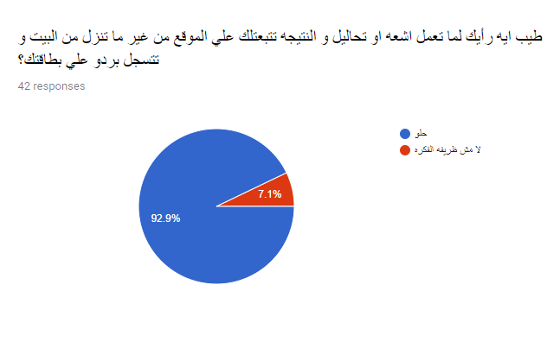
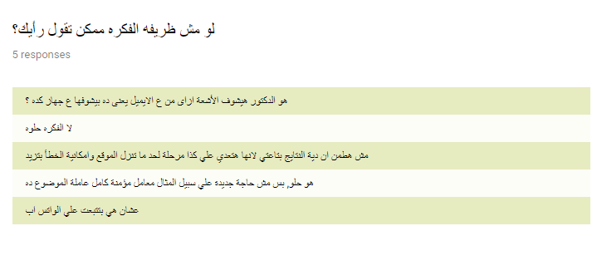
Survey Question 2
B
A

Slide 5
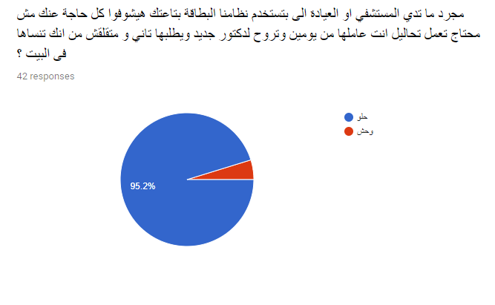
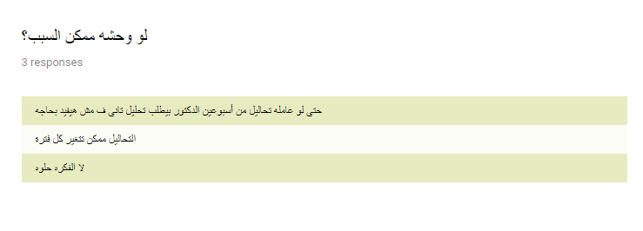
Survey Question 3
B
A

Slide 6
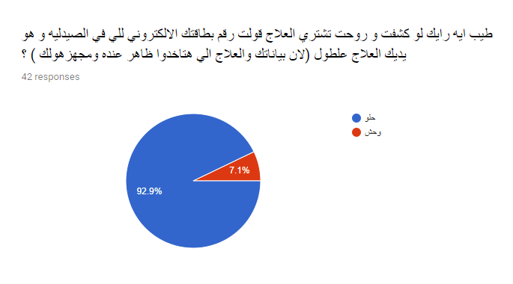
Survey Question 4
B
A

Slide 7
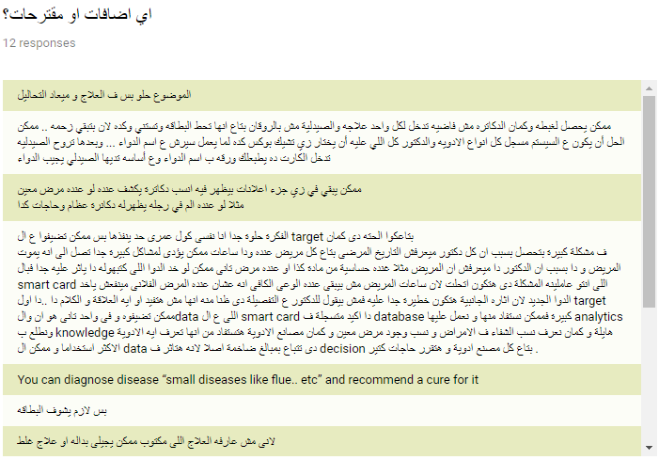
Survey Question 5
B
A

Slide 8
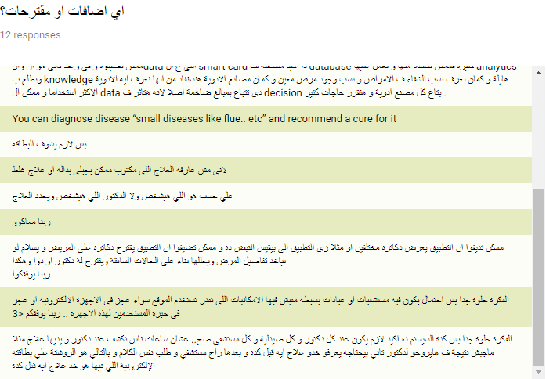
Survey Question 5
B
A

Slide 9
Client
Doctor
C
HR
B
A
Pharmacy
Laboratory

Slide 10
D
C
THANKS
B
A

