Slide 1
Language Analytics in Spam Detection

Slide 2

What is Spam?
Unwanted or malicious email commonly called spam
Spam also called junk email or bulk email can be defined as unsolicited email, often of a commercial nature, sent indiscriminately multiple mailing lists, individuals and groups
The intention it to frustrate the receiver and also to income money.

Slide 3
Motivation
Spam is a serious security threat as it affects every internet user directly or indirectly
Other types of spam messages can spread malware, trick you into divulging personal information,
Phishing and pharming attack
Implementing spam filtering is extremely important for any organization.

Slide 4
Security Analysis: Strength of Spam Classifier
Increases security control
Reduces IT administration costs
Reduces network administration and usage costs
Considers complete message instead of specific words
Serves as an additional layer for protection of Mail server

Slide 5
Security Analysis: Weaknesses in sentiment classifiers
Kiritchenko and Mohammad (2018) found that most sentiment classifiers assign lower sentiment and more negative emotion to sentences with African American names in them.
This perpetuates negative stereotypes that associate African Americans with negative emotions
Toxicity detection is the task of detecting hate speech, abuse, harassment, or other kinds of toxic language
But some toxicity classifiers incorrectly flag as being toxic sentences that are non-toxic but simply mention identities like blind people, women, or gay people.

Slide 6
What causes these?
Can be caused by:
Problems in the training data; machine learning systems are known to amplify the biases in their training data.
Problems in the human labels
Problems in the resources used (like lexicons)
Mitigation of these harms is an open research area

Slide 7
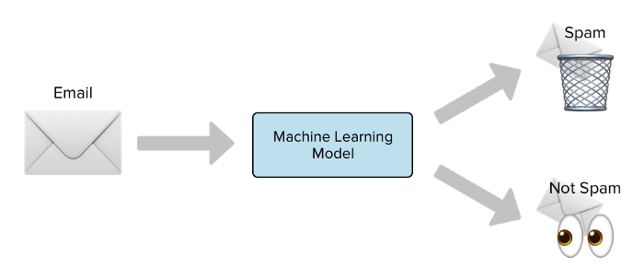
Technical Details: Naive Bayes Intuition
Simple ("naive") classification method based on Bayes rule
Relies on very simple representation of document
Bag of words

Slide 8
The Bag of Words Representation

Slide 9
Bayes’ Rule Applied to Documents and Classes
For a document d and a class c

Slide 10
Multinomial Naive Bayes Independence Assumptions
Bag of Words assumption: Assume position doesn’t matter
Conditional Independence: Assume the feature probabilities P(x_{i}|c_{j}) are independent given the class c.

Slide 11
Problems with multiplying lots of probs
Multiplying lots of probabilities can result in floating-point underflow!
.0006 * .0007 * .0009 * .01 * .5 * .000008….
Idea: Use logs, because log(ab) = log(a) + log(b)
We'll sum logs of probabilities instead of multiplying probabilities!

Slide 12
Stop words
Some systems ignore stop words
Stop words: very frequent words like the and a.
Sort the vocabulary by word frequency in training set
Call the top 10 or 50 words the stopword list.
Remove all stop words from both training and test sets
As if they were never there!
But removing stop words doesn't usually help
So in practice most NB algorithms use all words and don't use stopword lists

Slide 13
Live Demo

