Slide 1

Feasibility
Analysis

Slide 2
Our
Team
Abduallah Al Sakib ( 011201240 )
Mirza Hasan ( 011201247 )
Md.Arshadul Mokaddis (011201260 )

Slide 3
Table of content
01. 02.
Survey Attendee Statistics Survey Result Table
03. 04.
List of selected features SWOT & Strategy

Slide 4
Information gathering method
We used Google Forms to conduct survey in order to gather information for our feasibility analysis. We distributed our form to via social media. We had a total of 111 attendees.

Slide 5
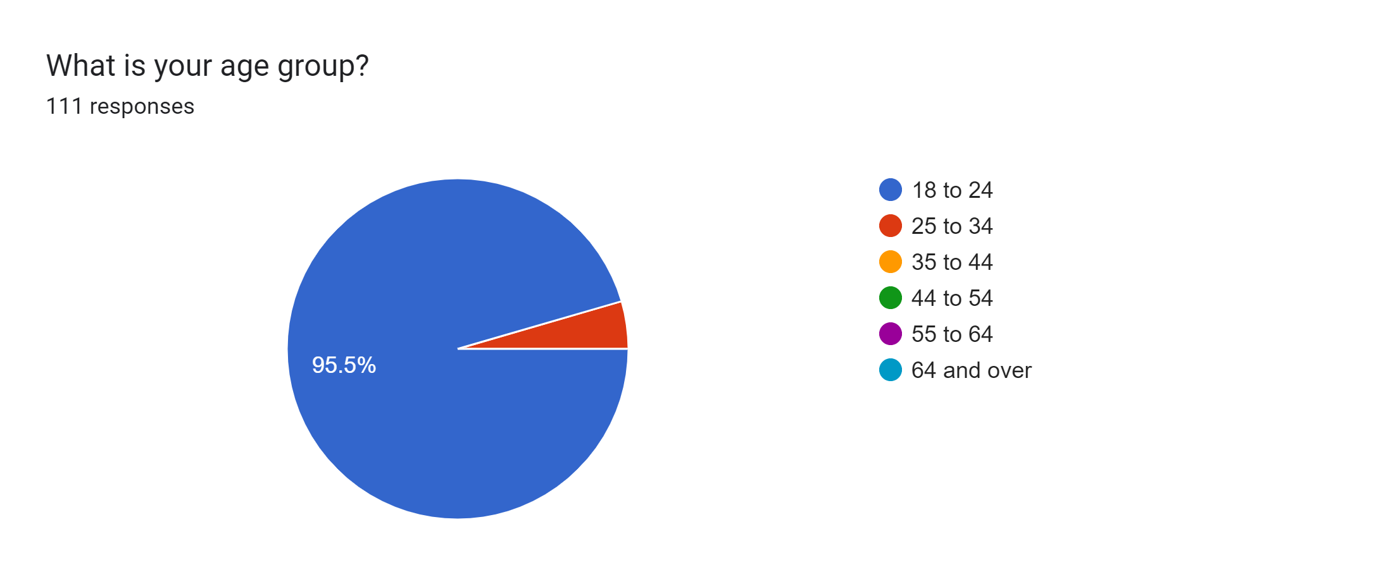
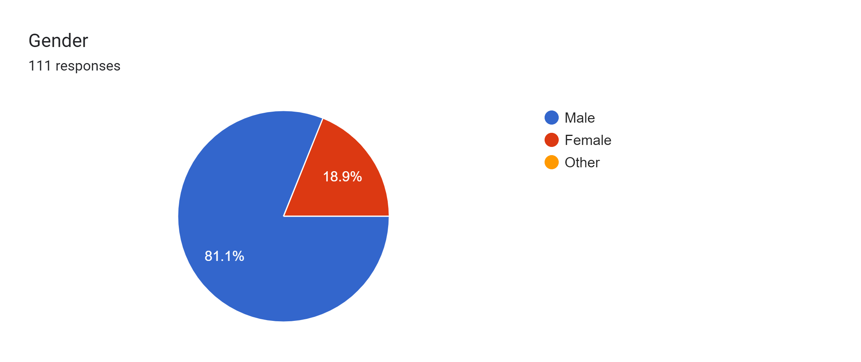
Age
Gender

Slide 6
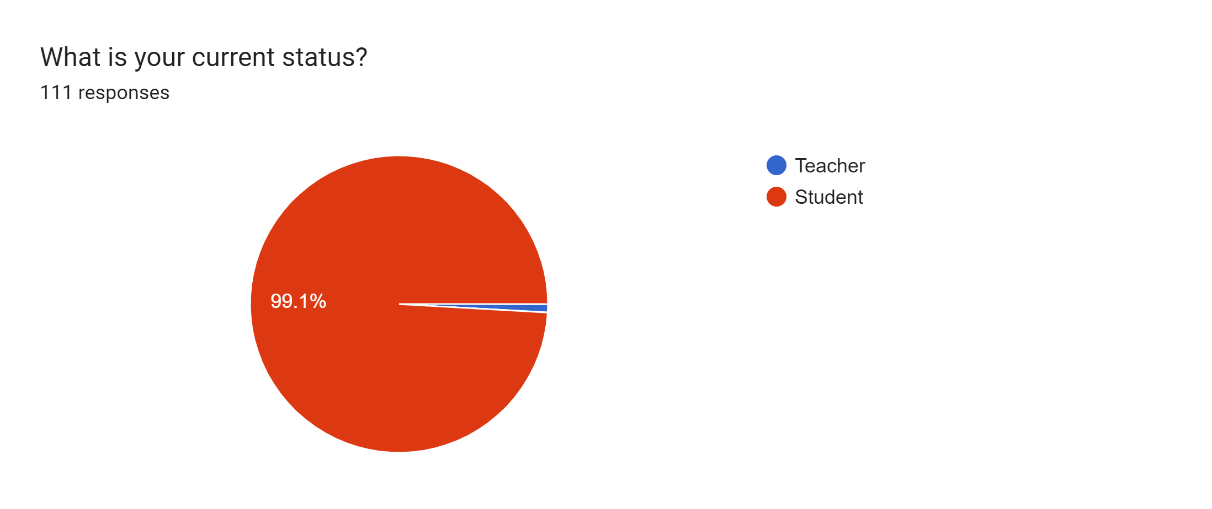
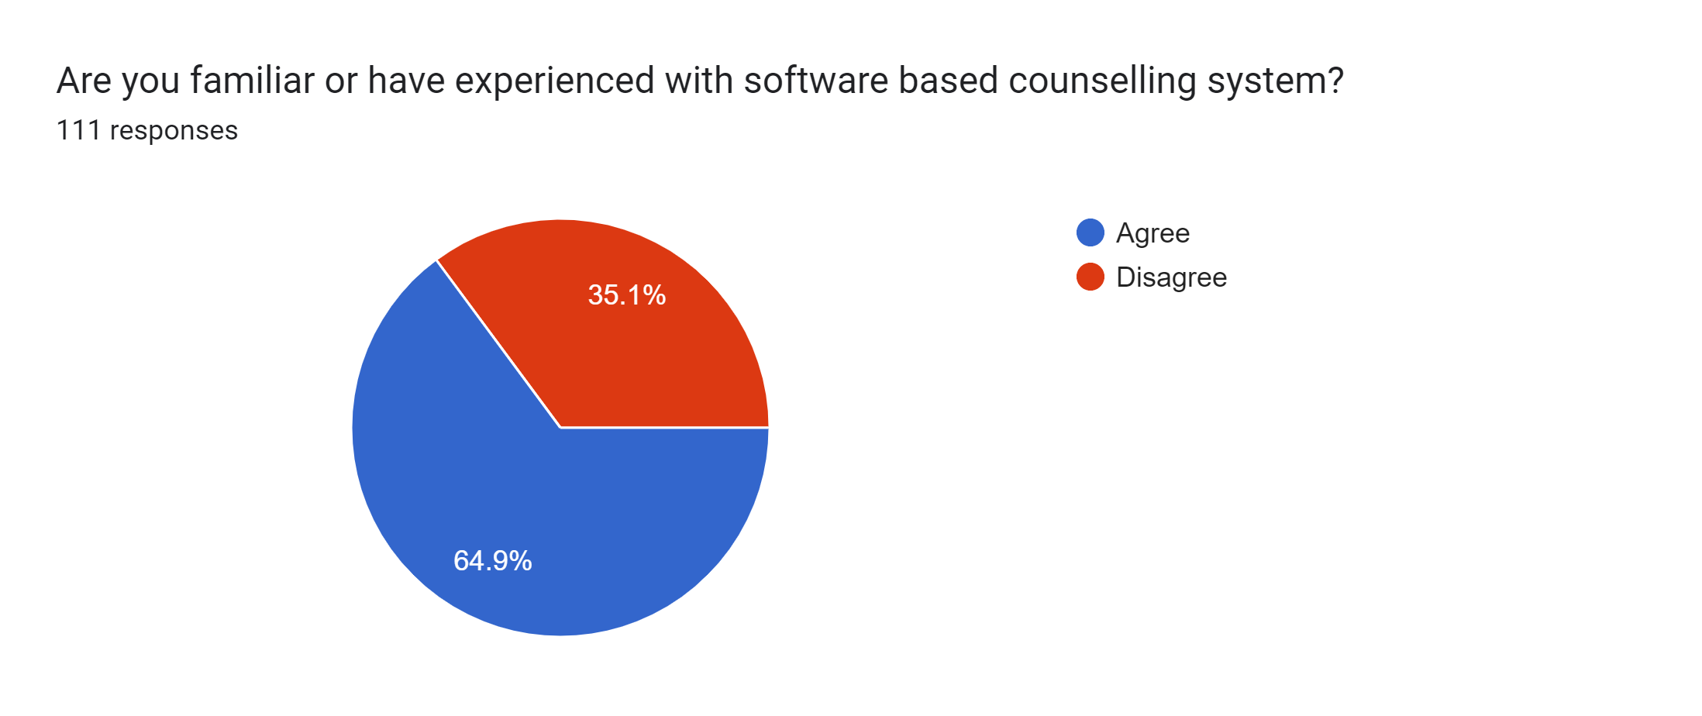
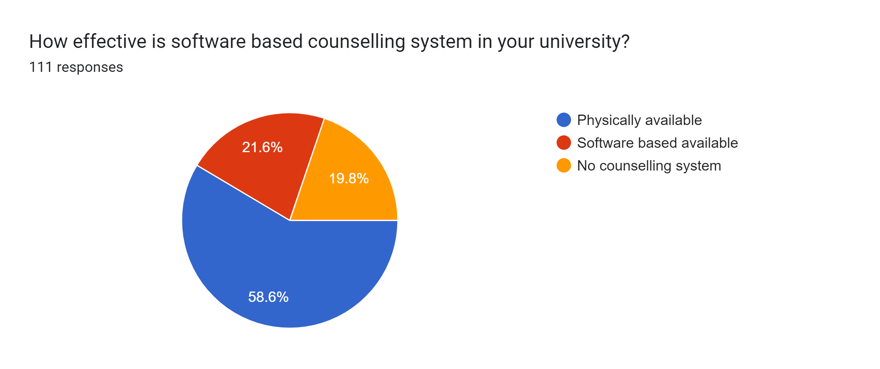
Occupation
Experience in software based counselling system
Available counselling in university

Slide 7
Result analysis
Question | Decision
Which of the following features do you think is more important? Time to time counselling [ 87.5 %] Paid short course [33 % ] Faculty can order lunch [ 25.9 % ] Visit faculties profile [ 43.8 % ] Verified projects by faculties [ 57.1 %] Course enrolment [ 48.2%] Show total participation [ 36.6 % ] Faculty activity status in room [ 0.9 %] Other [ 0.9 % ] | We will implement all of these features that are preferred by more than 30% of our attendees. About 51% attendees are interested for those features.

Slide 8
Question | Decision
What new features would you like to see on our website? Get instant test and results [ 79.5 % ] Students order lunch [ 36.6 % ] Automated undergraduate assistant [ 47.3 % ] Course wise pdf book [ 63.7 % ] | we must be implemented Get instant test and results , Automated undergraduate assistant ,Course wise pdf book those features .
Question | Decision
Is it helpful to get instant result in your short course exam? Yes ( 96.5 % ) | we must be implemented short course exam . This will be key feature in our project.
Question | Decision
Do you need to apply online for course drop and grade change? Yes ( 86.9 % ) | we should implemented course drop and grade change. This will be also key feature in our project.

Slide 9
List of selected features:
Our system will have mainly those features:
Time to time counselling
CV formatting
Course enrolment
4. Find course mate and total participation
5. Short course and given certificate
6. Find course based pdf books
7. Automated UA selection system
8. Course drop and grade change

Slide 10
SWOT analysis
Strengths
We are implementing optimized time to time counselling, optimized CV format, short course and get instant result with certificate, course wise pdf book and Automated UA selection system. Those fractures are strength point in our project.
weakness
Elms course enrolment system is better then our project.

Slide 11
Opportunities
Automated getting result from short course exam ( using our own compiler )
Without going to department students can drop courses and apply for grade change
create automated custom CV
Threats
We cannot verify the Cgpa that is included in our printable CV format because students are input it before. And that is not verified by the authority.

Slide 12
Strategy:
If these features can be implemented properly then we think the students will benefit a lot and the future path will be easier.
If we will get Ucam API in future ,then we will solve the verified Cgpa system.

Slide 13
Thank you

