Slide 1


Slide 2
Numerical analysis: Lagrange's Interpolation for Data Reconstruction
By:
Muhammad Abdullah (02-131202-054)
Tahir zaman (02-131202-027)
Jawad ahmed (02-131202-036)

Slide 3
Problem statement
In various fields like signal processing, data analysis, and computer graphics, there's often a need to estimate values between given data points or reconstruct missing data.
Missing data can occur due to mistakes in data entry or data collection processes. This may include typos, misinterpretations, or oversights during data entry.
Problems with measurement instruments or data collection tools can contribute to missing data. Malfunctioning equipment or incomplete recording of information can result in missing values.
Errors in data processing, transformation, or integration can result in missing values. This may occur during the cleaning or merging of datasets.

Slide 4
What is Lagrange’s Interpolation?
Interpolation is the technique of estimating the values between established data points
The Lagrange interpolation formula is a way to find a polynomial, called a Lagrange polynomial.
This polynomial helps estimate the values of a function at points between the given ones.
It's like connecting the dots with a smooth curve to make predictions about the function's values in between.
Lagrange's theorem may be used for both equally and unequally spaced data points.

Slide 5
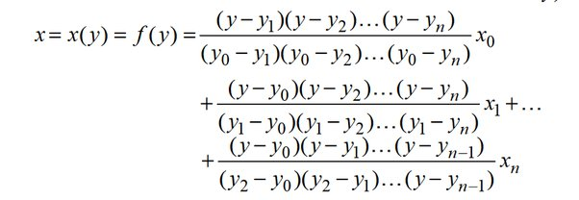
Formula:

Slide 6
WHY Use Lagrange’s Interpolation?
Simplicity and Ease of Implementation:
Lagrange's interpolation is a simple polynomial interpolation method that can be easily implemented without the need for sophisticated algorithms or extensive computational resources.
Computational Efficiency:
Lagrange's interpolation can be computationally more efficient, as it directly calculates the coefficients of the interpolating polynomial.

Slide 7
WHY Use Lagrange’s Interpolation?
Precision and Accuracy:
If the underlying relationship between data points is well-understood and can be accurately represented by a polynomial, Lagrange's interpolation may provide precise and accurate results.
Interpretability:
Lagrange's interpolation provides a clear mathematical formula (polynomial) that represents the interpolated function. This can be advantageous in situations where interpretability and understanding of the underlying model are crucial.

Slide 8
Example
Find the missing values using Lagrange’s Interpolation.
Github: https://github.com/abdullah36901/NumericalAnalysis
X | 1 | 2 | 3 | 4 | 5 | 6 | 7 | 8
Y | 32.0 | ? | 35.4 | 36.8 | 35.1 | ? | 43.4 | 49.8

Slide 9
Code:
import numpy as np
# Define a class to represent data points with x and y values
class DataPoint:
def __init__(self, x, y):
self.x = x
self.y = y

Slide 10
# Function for Lagrange Interpolation
def lagrange_interpolation(data_points, x_value):
result = 0.0
# Iterate through each data point
for i in range(len(data_points)):
term = data_points[i].y
# Calculate the Lagrange term for the current data point
for j in range(len(data_points)):
if j != i:
term *= (x_value - data_points[j].x) / (data_points[i].x - data_points[j].x)
# Add the term to the result
result += term
return result

Slide 11
if __name__ == "__main__":
# Provide x and y values as arrays
x_values = [1, 3, 4, 5, 7, 8]
y_values = [32.0, 35.4, 36.8, 35.1, 43.4, 49.8]
# Create DataPoint instances based on the arrays
data_points = [DataPoint(x, y) for x, y in zip(x_values, y_values)]
# Input the x value for interpolation
x_value = float(input("Enter the x value for interpolation: "))
# Calculate and print the interpolated value
interpolated_value = np.round(lagrange_interpolation(data_points, x_value), decimals=1)
print(f"Interpolated value at {x_value} is: {interpolated_value}")

Slide 12


Output:
x=2
x=6

Slide 13


