Slide 1
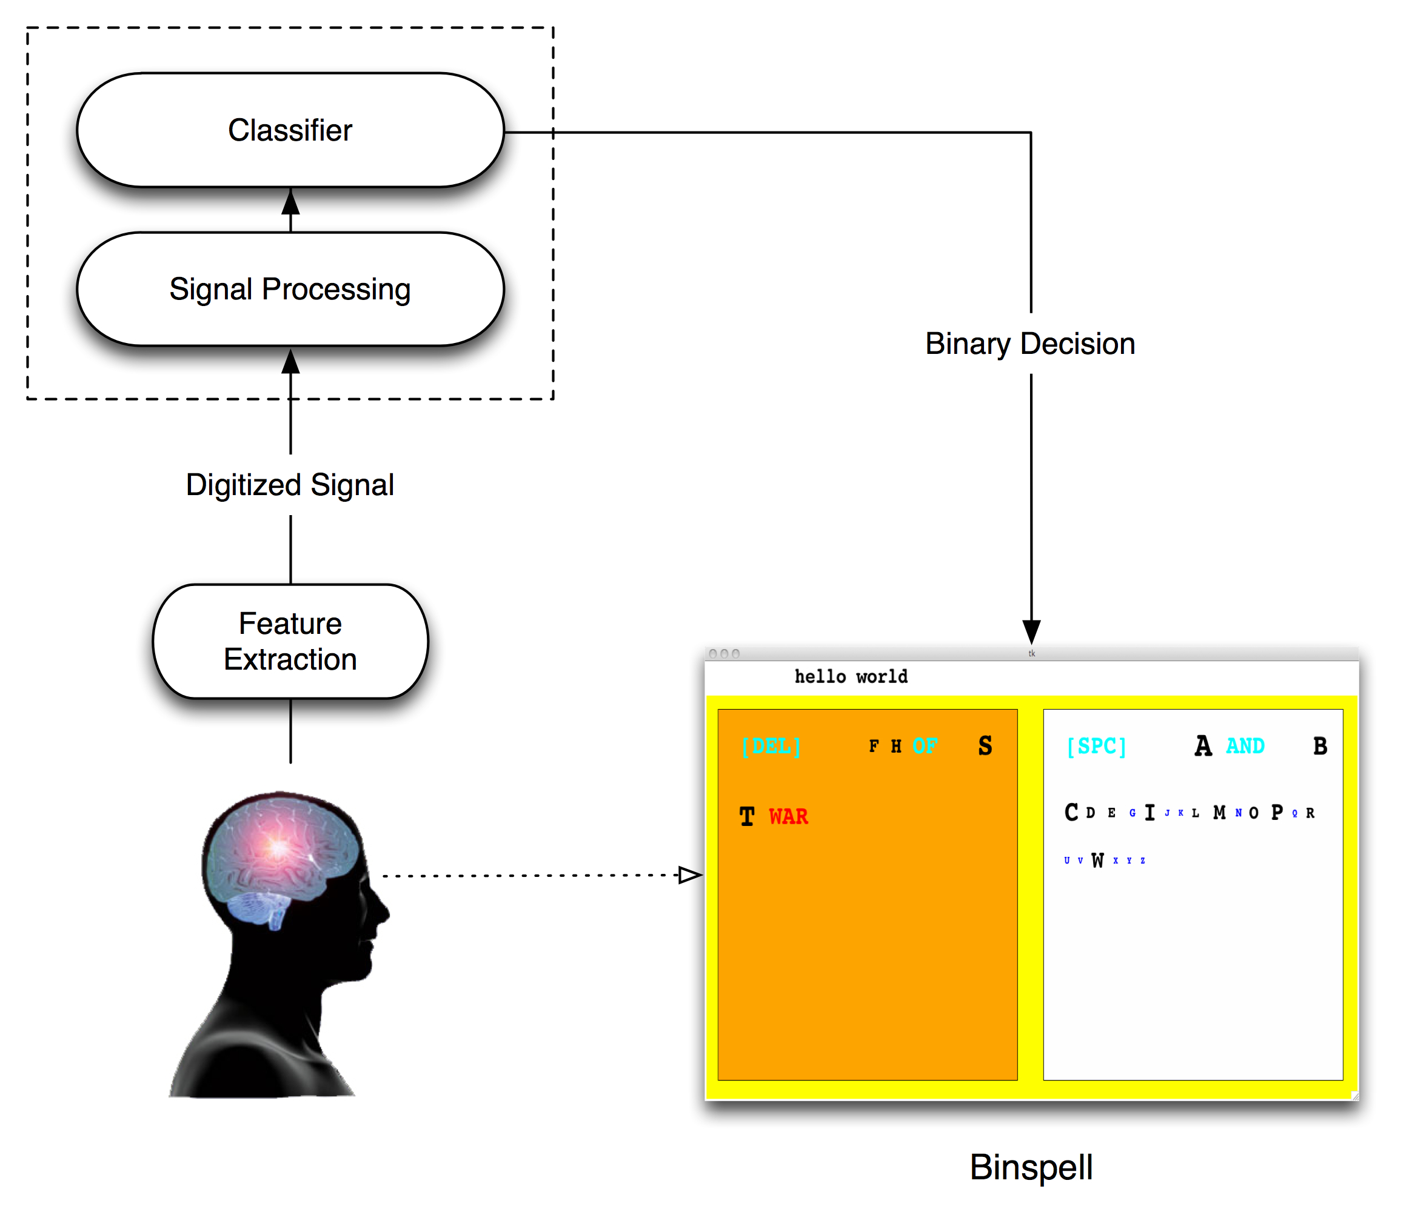
Virtual Keyboards
We want to enable communication to individuals with severely limited motor capabilities
BCI controlled virtual keyboards can enable communication
Virtual keyboards must get past the limited bandwidth and high noise of BCI

Slide 2
Problem Statement
Extremely limited bandwidth (1 binary classification every 3 seconds = 0.33 bit/s)
Extremely noisy channel (20% misclassification rate)
Existing virtual keyboards are not well suited for this problem

Slide 3
Existing Virtual Keyboards
 | Hex-O-Spell^{[4]} | P300^{[5]} | P300^{[6]} | Dasher^{[7]}
Classifier (accuracy > 90%) | LDA | Stepwise LDA | SVM | Classification Matrix
Average spelling rate (chars/min) | 4.24 | ~4 | 11.1 | ~5.6
Achieved spelling rates (chars/min) | 2.3 – 7.6 | 2.8 – 7.8 (offline testing) | 6.67 - 16.7 | 3.2 - 14.4 (Avg.)

Slide 4
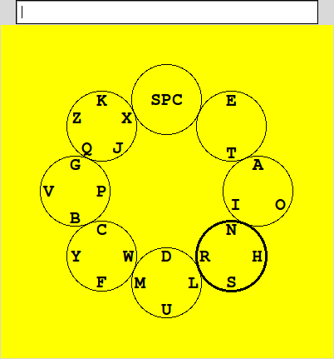
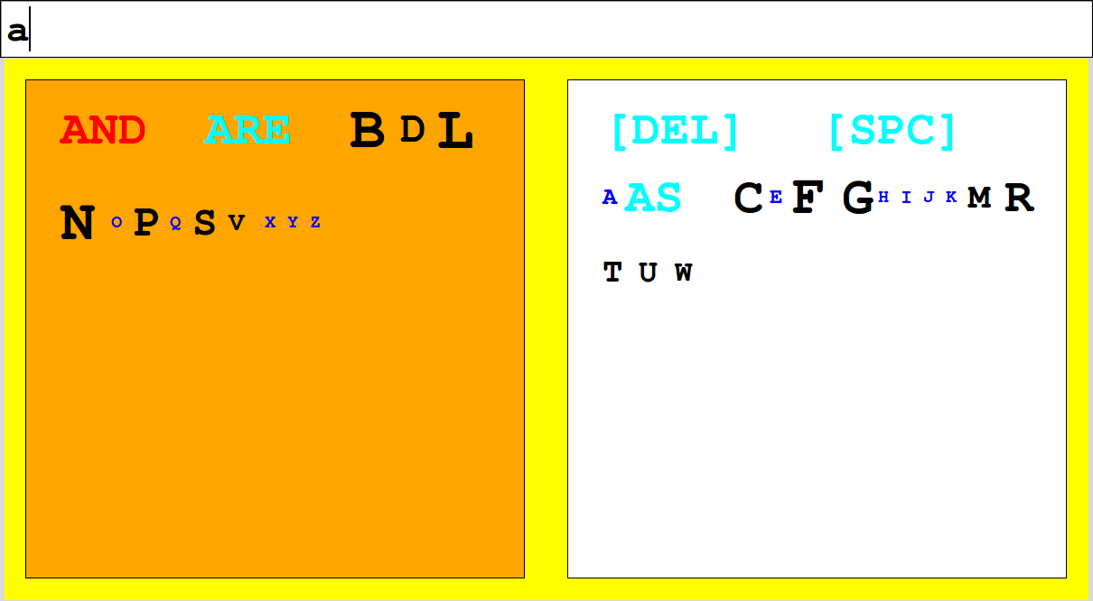
Our Contributions
Circ-O-Spell
BinSpell

Slide 5
Circ-O-Spell
Extension of Hex-O-Spell^{[1]} virtual keyboard
Controlled by output from binary classifier
  State 0: Rotation
  State 1: Selection
Layout of letters is based on probability of use

Slide 6
Hex-O-Spell
vs
Circ-O-Spell
Uses prolonged motor imagery for a selection | Designed for abbreviated motor imagery
Requires tailoring user interface parameters for each user | Does not require any additional tuning for users
Fixed at 5 symbols per set | Flexible number of symbols per set

Slide 7
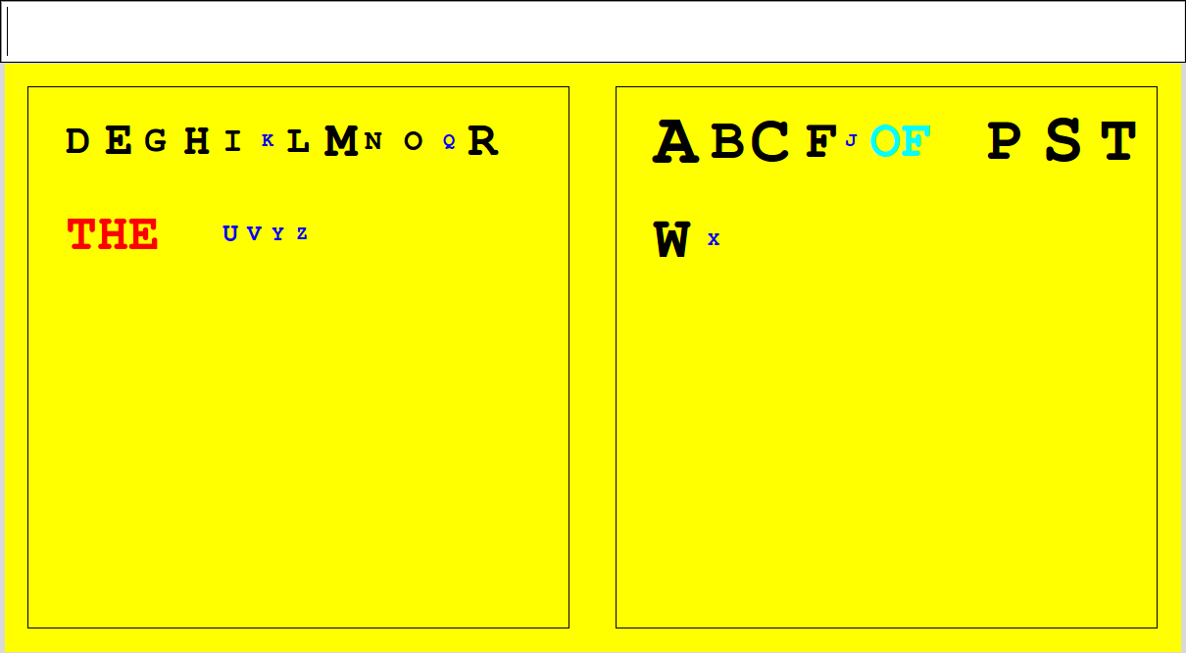
BinSpell
Controlled by BCI:
  State 0: rotation
  State 1: selection
Select box with symbol of choice

Slide 8
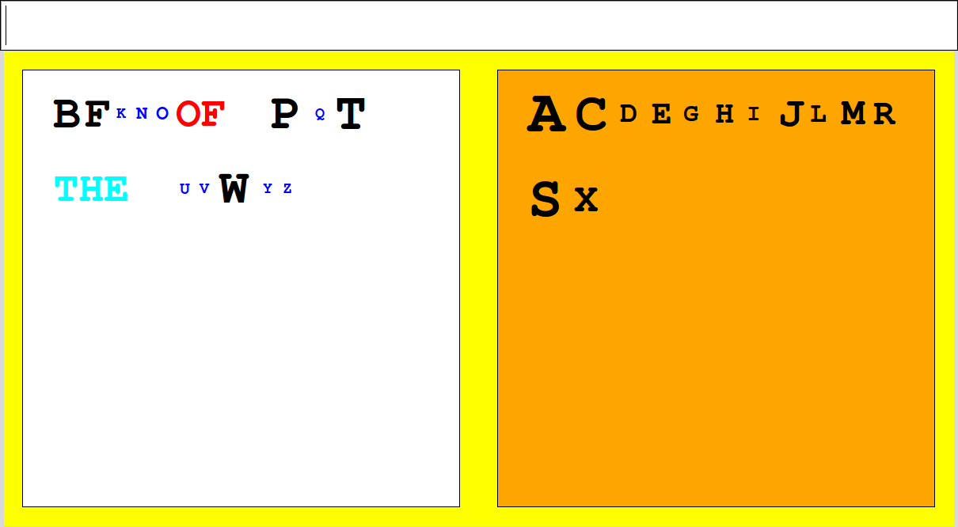
BinSpell
Symbols reordered
Selection process is repeated until probability surpasses a threshold
Most likely word completions suggested

Slide 9
BinSpell
Most likely word completions suggested
2nd order character-level Markov process in parallel with 1st order word-level Markov process

Slide 10
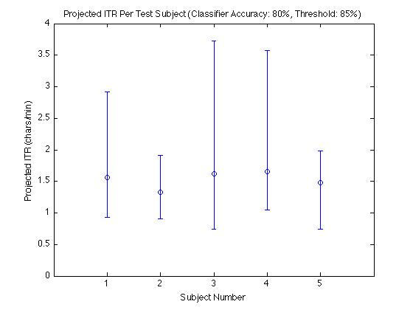
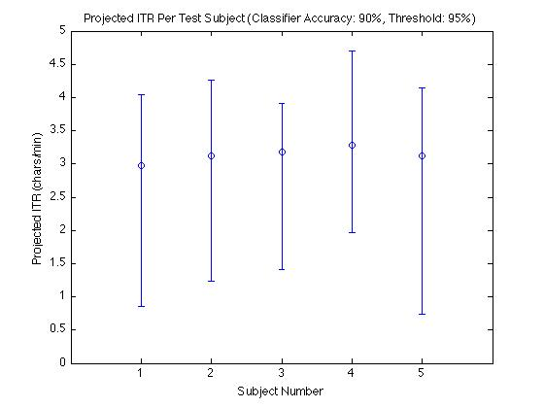
Performance
Simulation performance with 5 test subjects typing top 10 Google search phrases for 11/13/09^{[8]}
Average: ~1.5 chars/min
Range: ~1 - 3.5 chars/min
Average: ~3 chars/min
Range: ~2 - 5 chars/min

Slide 11
BinSpell
vs
Dasher^{[9]}
Designed for discrete noisy inputs such as BCI | Designed for control with cursor (better suited for continous relatively noise-free input)
Designed to be controlled with low bandwidth (e.g., 0.33 bit/s) | Difficult to control mouse pointer with 0.33 bit/s
5-10 minute training time | ~2 hours of training time (+ ~6 hours BCI cursor control training)

Slide 12
BinSpell
vs
Hex-O-Spell
Requires user to be able to switch states | Additionally requires user to reliably maintain a state^{[9]} (Increase in training time)
No extra tuning: Better suited for wider population | Requires outside expert or trained user to tune parameters to user for optimal performance
Open layout allows for words, phrases, pictures | Limited layout flexibility

Slide 13
BinSpell
vs
P300 Speller^{[10]}
Moderate symbol presentation rate | Rapid rate of stimulus flashes in the 6x6 matrix presents difficulty to disabled users^{[11]}
Can potentially be extended to work with any type of brain signal | BCI approach may not be the best suited for the user^{[12]}
Open layout allows for words, phrases, pictures | Not as easily adapted to additional selection options

Slide 14
Conclusion
Despite the severely limited bandwidth and high noise, our approach suggests typing speeds comparable to other virtual keyboards can be attained.

Slide 15
Future Work
  Higher order language model
  Bayesian inference approximation
  Error-correction
  Phrases, Images

Slide 16
References
[1] B. Blankertz, et al., “The berlin brain-computer interface presents the novel mental typewriter hex-o-spell,” Proceedings of the 3rd International Brain-Computer Interface Workshop and Training Course, 2006, pp. 108–109.
[2] G.E. Rawlinson, “Bigram frequency counts and anagram lists,” Quarterly Journal of Experimental Psychology, vol. 28, 1976, pp. 125-142.
[3] G. Zweig and S. Russell, “Speech recognition with dynamic Bayesian networks,” PROCEEDINGS OF THE NATIONAL CONFERENCE ON ARTIFICIAL INTELLIGENCE, 1998, pp. 173–180.
[4] J. Williamson, R. Murray-Smith, B. Blankertz, M. Krauledat, and K.R. Müller, “Designing for uncertain, asymmetric control: Interaction design for brain–computer interfaces,” International Journal of Human-Computer Studies, vol. 67, 2009, pp. 827–841.

Slide 17
References
[5] E.W. Sellers, A. Kübler, and E. Donchin, “Brain–computer interface research at theUniversity of South Florida Cognitive Psychophysiology Laboratory: the P300 speller,” Biomed. Eng, vol. 51, 2004, pp. 647–656.
[6] P. Meinicke, M. Kaper, F. Hoppe, M. Heumann, and H. Ritter, “Improving transfer rates in brain computer interfacing: a case study,” Advances in Neural Information Processing Systems, 2003, pp. 1131–1138.
[7] E.A. Felton, N.L. Lewis, S.A. Wills, R.G. Radwin, and J.C. Williams, “Neural Signal Based Control of the Dasher Writing
System”, Proceedings of the 3rd International IEEE EMBS Conference on Neural Engineering, 2007, pp. 366-370.
[8] “Google Trends: Nov 13, 2009.”

Slide 18
References
[9] S.A. Wills and D.J. MacKay, “DASHER-an efficient writing system for brain-computer interfaces?,” IEEE Transactions on Neural Systems and Rehabilitation Engineering, vol.14, 2006, p. 244.
[10] E. Donchin, K.M. Spencer, R. Wijesinghe, and others, “The mental prosthesis: Assessing the speed of a P300-based brain-computer interface,” IEEE Transactions on Rehabilitation Engineering, vol. 8, 2000, pp. 174–179.
[11] E.W. Sellers and E. Donchin, “A P300-based brain–computer
interface: initial tests by ALS patients,” Clinical Neurophysiology, vol. 117, 2006, pp. 538–548.
[12] B. Allison, “The I of BCIs: Next Generation Interfaces for Brain- Computer Interface Systems That Adapt to Individual Users,” Proceedings of the 13th International Conference on Human- Computer Interaction. Part II: Novel Interaction Methods and Techniques, 2009, p. 568.

