Slide 1
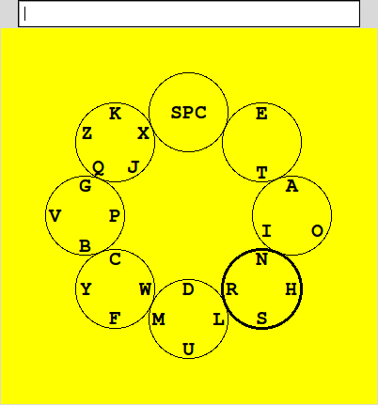
Circ-O-Spell
Extension of Hex-O-Spell^{[1]} virtual keyboard
Letters arranged in their order of frequency
Highlighted circle contains the letter with the highest probability

Slide 2
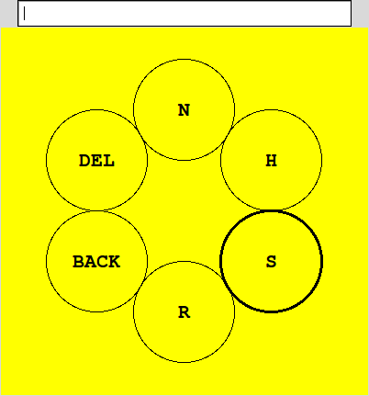
Circ-O-Spell
Binary BCI control
  one state = rotation
  2nd state = selection
New layout presented with selection of a circle-set
  Only letters in selected set
  Delete and backspace

Slide 3
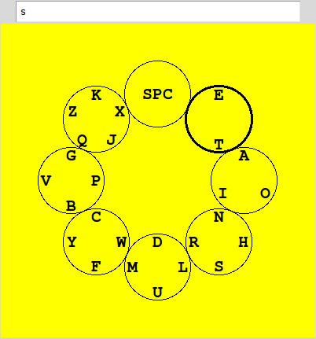
Circ-O-Spell
Selection of a circle-set containing single letter causes ouput
Returns to original layout
Probabilities conditioned on the last letter typed

Slide 4
Circ-O-Spell
1st order HMM language model
Bigram frequency counts based on position of bigram in a word
  Research shows a marked difference in bigram frequencies, depending on their positions within words^{[2]}
  More realistic bigram frequencies^{[2]}
New HMM with each new word

Slide 5
Hex-O-Spell vs Circ-O-Spell
Uses sustained motor imagery for a selection
  Requires tailoring graphical parameters to the user
Limited to 5 letters per set means a best case 2 steps per selection
Designed for discontinous motor imagery
  Reduces time for a selection
Flexible number of letters per set means a best case, 1 step selection

Slide 6
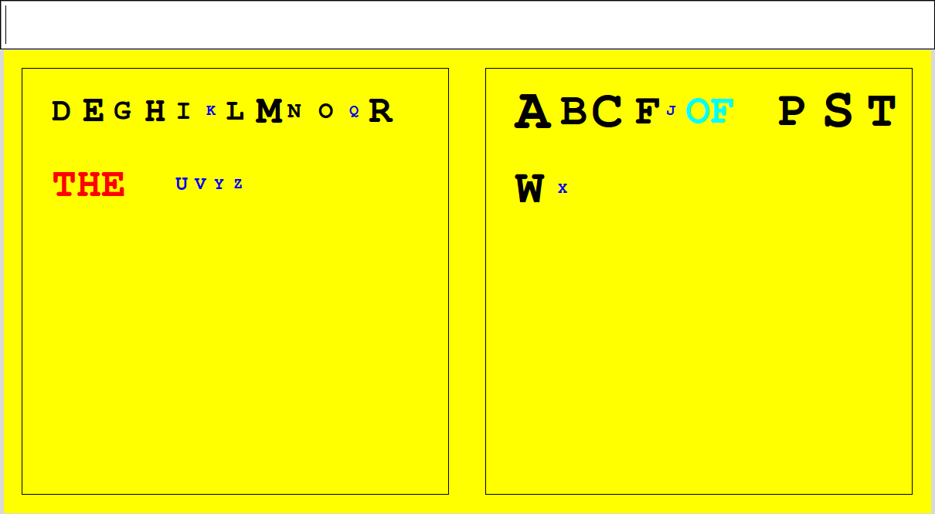
BinSpell
Size and color of symbols are determined by their probabilities.
Huffman Coding determine in which box a letter is found.

Slide 7
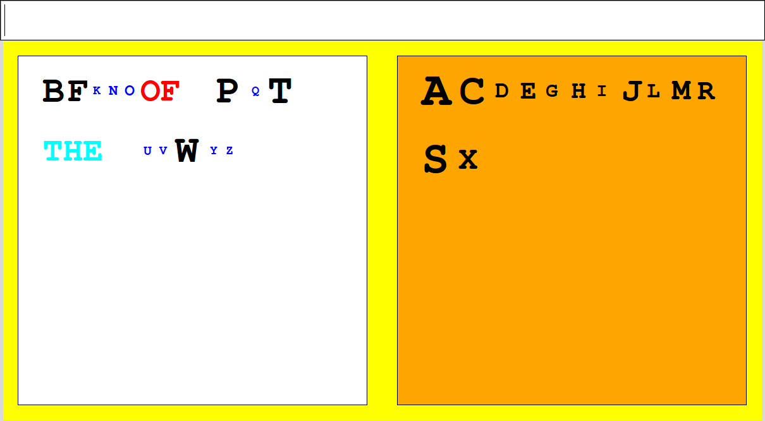
BinSpell
Probabilities of symbols in selected box weighted by classifier accuracy
  Non-selected letters weighted by 1-classifier accuracy
Shuffling: New Huffman tree with every selection

Slide 8
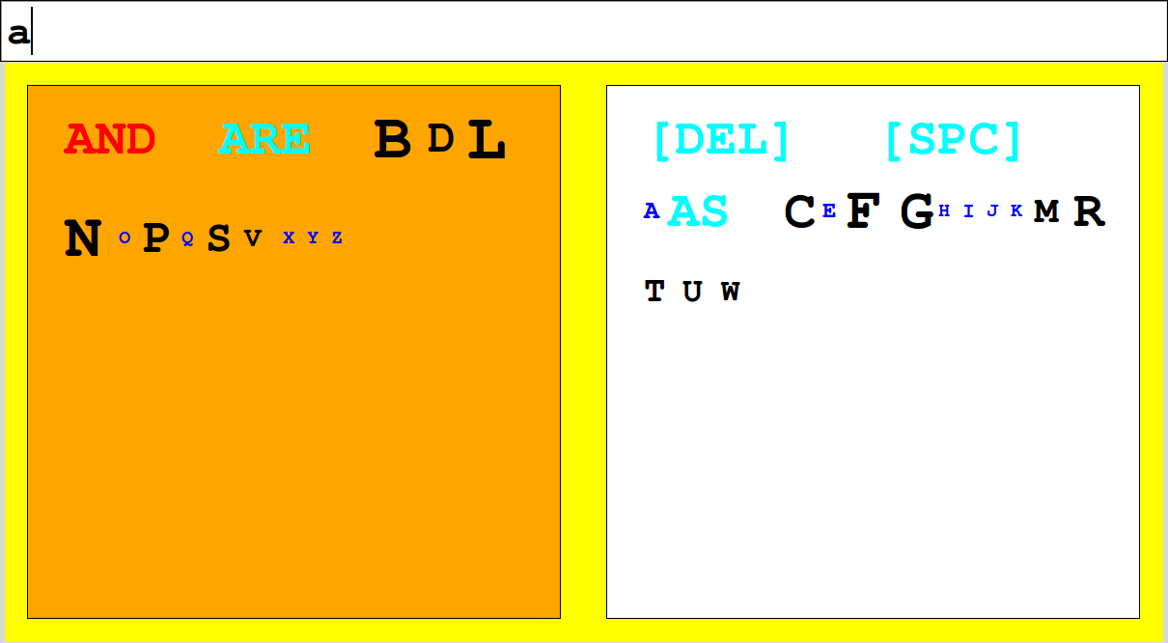
BinSpell
Thresholding determines typed symbol
Prefix matching against dictionary for simple inference

Slide 9
BinSpell
Dynamic Bayes Net language model
  Allows for arbitrary set of hidden variables
  Fewer parameters than HMM to represent same amount of information^{[3]}
  Trigram letter and Bigram word

Slide 10
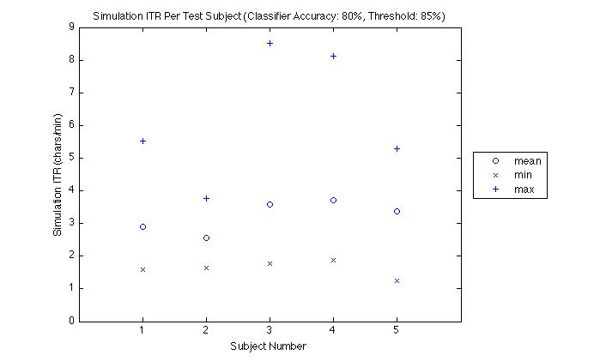
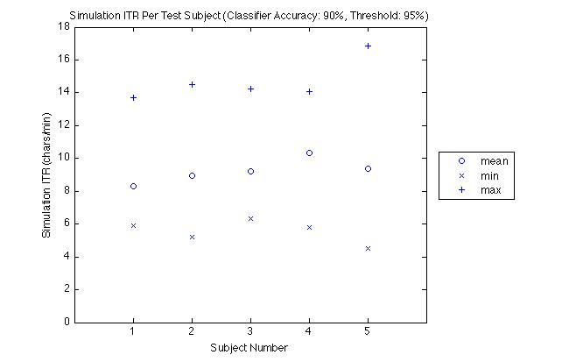
BinSpell
Simulation performance with 5 test subjects typing top 10 Google search phrases for 11/13/09^{[4]}

Slide 11
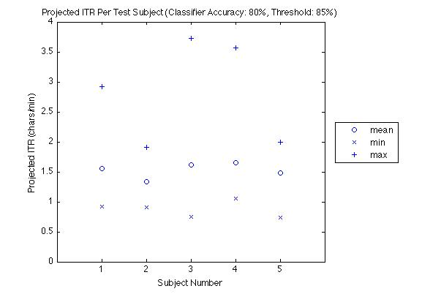
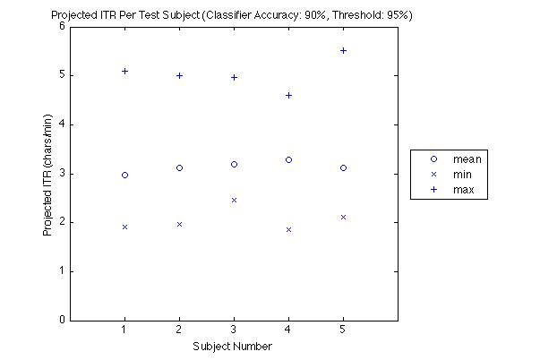
BinSpell
Projected performance with BCI using same subjects and phrases

Slide 12
BinSpell
Simulated 80% classifier:
  Subjects achieved between 1 and 8.5 chars/min
    Average: ~3 chars/min
  Projected ITR (assuming 3s per trial) was between ~1 and 3.5 chars/min
    Average: ~1.5 chars/min

Slide 13
BinSpell
Simulated 90% classifier:
  Subjects achieved between 4.5 and 17 chars/min
    Average: ~9 chars/min
  Projected ITR (assuming 3s per trial) was between 2 and 5 chars/min
    Average: ~3 chars/min

Slide 14
BinSpell vs Dasher^{[5]}
Easy: Each bit used to make a selection
Simple interface reduces cognitive load
5-10 minute training time
Designed for discrete noisy inputs such as BCI
Difficult to control mouse pointer with 1 bit
Requires sustained attention and focus
6 – 25 hours of training time
Better suited for continous relatively noise-free input

Slide 15
BinSpell vs Hex-O-Spell
Discrete input for discrete control is more efficient use of bits
No extra tuning: Better suited for general population
Open layout allows for words, pictures, etc.
Discrete input for continous control is not as efficient
Parameters have to be tuned to user for optimal performance
  Requires an outside expert or trained user
Limited layout flexibility

Slide 16
BinSpell vs Hex-O-Spell
BCI control only requires user to be able to switch states
BCI control requires user to reliably maintain a state, in addition to switching^{[6]}
  Increase in training time
  Arrow overshooting

Slide 17
References
[1] B. Blankertz, et al., “The berlin brain-computer interface presents the novel mental typewriter hex-o-spell,” Proceedings of the 3rd International Brain-Computer Interface Workshop and Training Course, 2006, pp. 108–109.
[2] G.E. Rawlinson, “Bigram frequency counts and anagram lists,” The Quarterly Journal of Experimental Psychology, vol. 28, 1976, pp. 125-142.
[3] G. Zweig and S. Russell, “Speech recognition with dynamic Bayesian networks,” PROCEEDINGS OF THE NATIONAL CONFERENCE ON ARTIFICIAL INTELLIGENCE, 1998, pp. 173–180.
[4] “Google Trends: Nov 13, 2009.”

Slide 18
References
[5] S.A. Wills and D.J. MacKay, “DASHER-an efficient writing system for brain-computer interfaces?,” IEEE Transactions on Neural Systems and Rehabilitation Engineering, vol. 14, 2006, p. 244.
[6] J. Williamson, R. Murray-Smith, B. Blankertz, M. Krauledat, and K.R. Müller, “Designing for uncertain, asymmetric control: Interaction design for brain–computer interfaces,” International Journal of Human-Computer Studies, vol. 67, 2009, pp. 827–841.

