Slide 1

ASIC Physical Design: From Custom RTL to GDSII
NIPIS '26 Internship at NUST Chip Design Centre (NCDC)
Abdullah Ahmed Sayed Abdelsamea

Slide 2

The Full-Stack TSMC 65nm Flow
01
02
Front-End
Logic Synthesis
Behavioral RV32I datapath RTL and functional testbenches
Cadence Genus mapping to TSMC 65nm standard cells
03
04
Formal Verification
Physical Implementation
100% boolean equivalence via Cadence Conformal LEC
Floorplanning, power planning, placement, CTS, and routing in Cadence Innovus
05
Signoff
MMMC static timing analysis with Cadence Tempus

Slide 3
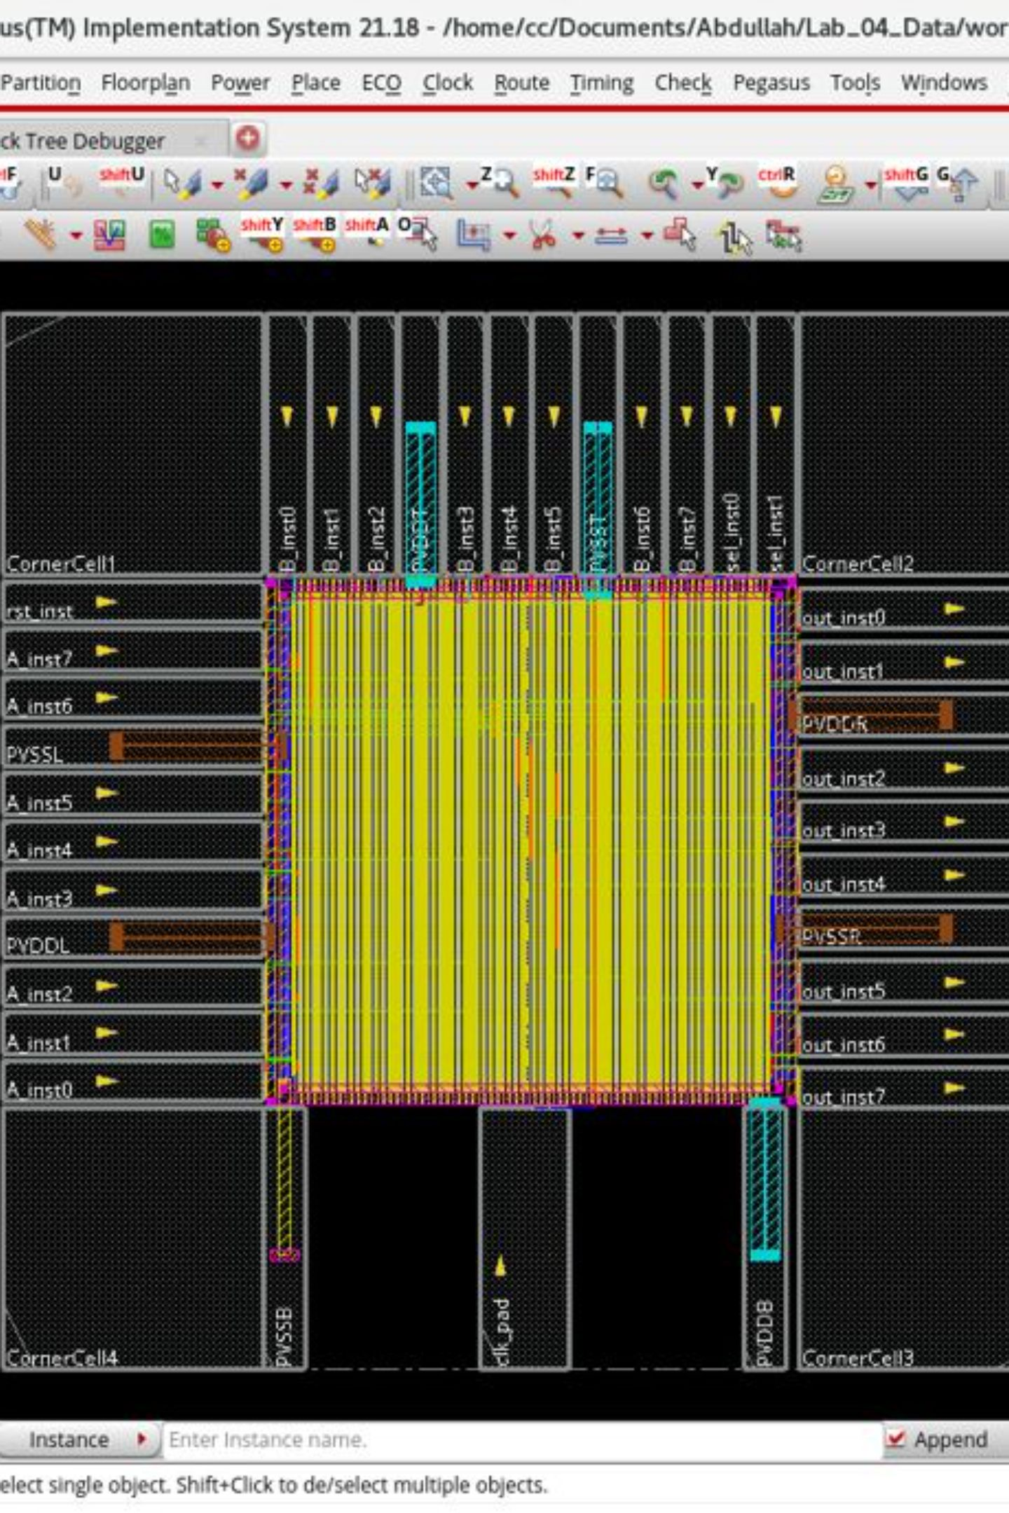
Foundational Training: 4-bit Counter & 8-bit ALU
Physical Design Constraints
I/O Pad Ring Integration
Mastered placement rules, design rule checks, and layout hierarchies through hands-on custom block design
Deployed TSMC 65nm bidirectional pads and corner cells for full I/O ring closure
80.8% Via Insertion Rate
Multi-cut via strategy applied for DFM yield enhancement across all metal layers

Slide 4
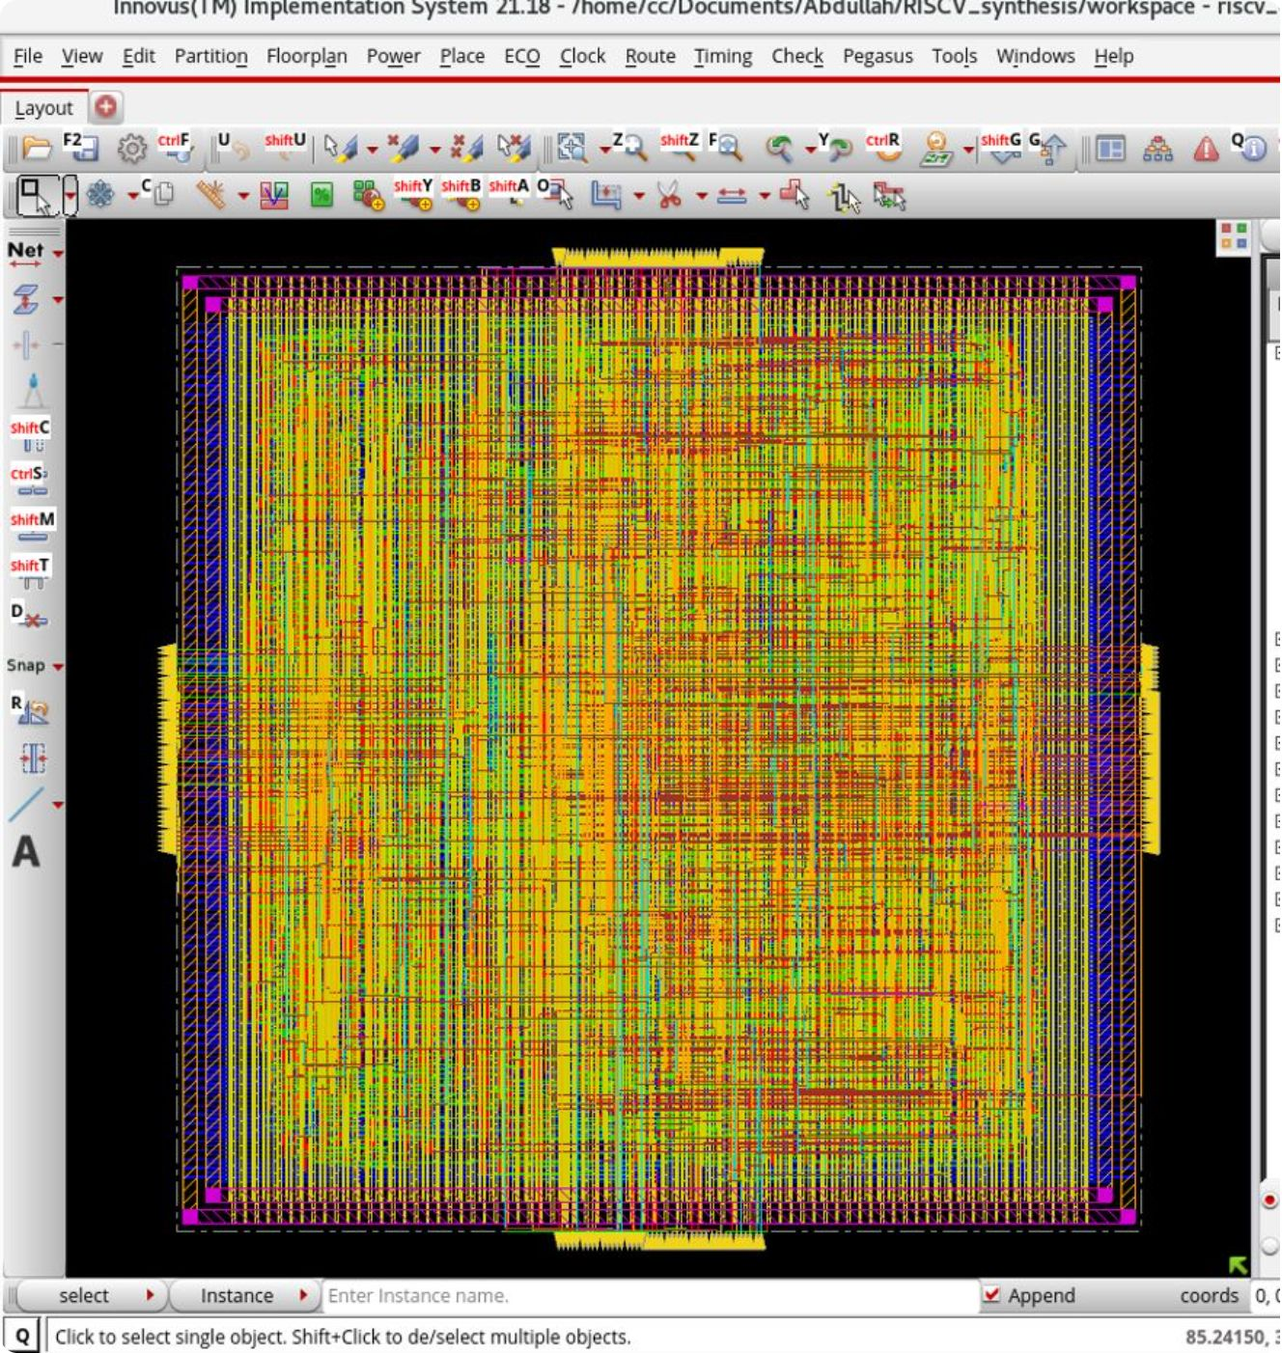
Capstone: 32-bit RISC-V Processor Core
1
2
Floorplan
PDN
350µm × 350µm macro with 168 boundary I/O ports on M3/M4 metal layers
High-density mesh — M6/M7 global rings and 152 M4 vertical stripes delivering 47,000+ vias
3
4
Clock Tree
Routing
Zero-skew CTS feeding 1,024 sequential flip-flop sinks across the full core
100% completion across 10,983 nets with zero congestion violations

Slide 5
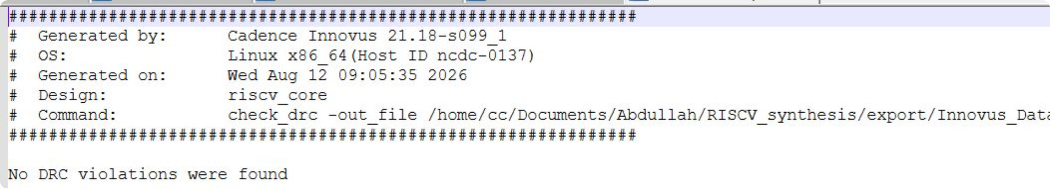

Signoff Results & Timing Closure
174.52
5.41
+1.70
MHz
mW Power
ns Slack
Clock frequency achieved (5.73 ns period)
Total power consumption at signoff
Positive slack on all Reg2Reg paths
Clean Signoff
0 DRC violations and 0 LVS violations confirmed full physical and electrical correctness of the RISC-V core layout.
Recommendation: Develop an automated MMMC TCL generation script to minimize manual setup errors and streamline the Genus-to-Innovus handoff for future tape-outs.

Slide 6
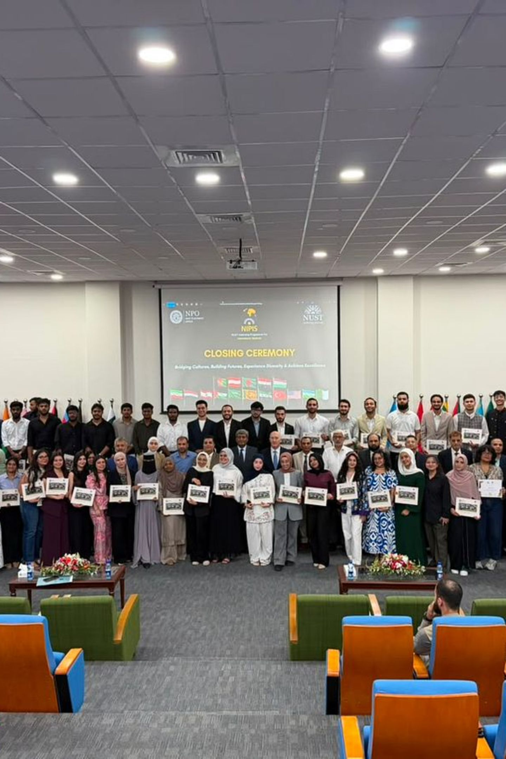
Key Takeaway
RTL to Silicon, End-to-End
Successfully bridged behavioral software logic all the way to physical silicon manufacturing constraints — completing a full GDSII-ready design.
Foundry Methodology at Zewail City
Foundry-level physical design methodologies and TSMC 65nm know-how will directly inform upcoming on-chip hardware accelerator projects at Zewail City of Science and Technology.

