Slide 1

Natural Language Processing
Dr. Karen Mazidi
Notes:
look at graphic syllabus

Slide 2
Part One:
Foundations
Topics
Python data structures
Python control structures
Quizzes
Python Basics
Homework
Homework 1

Slide 3
Agenda
Python control structures:
Conditionals
Loops
Functions
Python data structures:
Strings
Lists
Tuples
Dicts
Sets

Slide 4
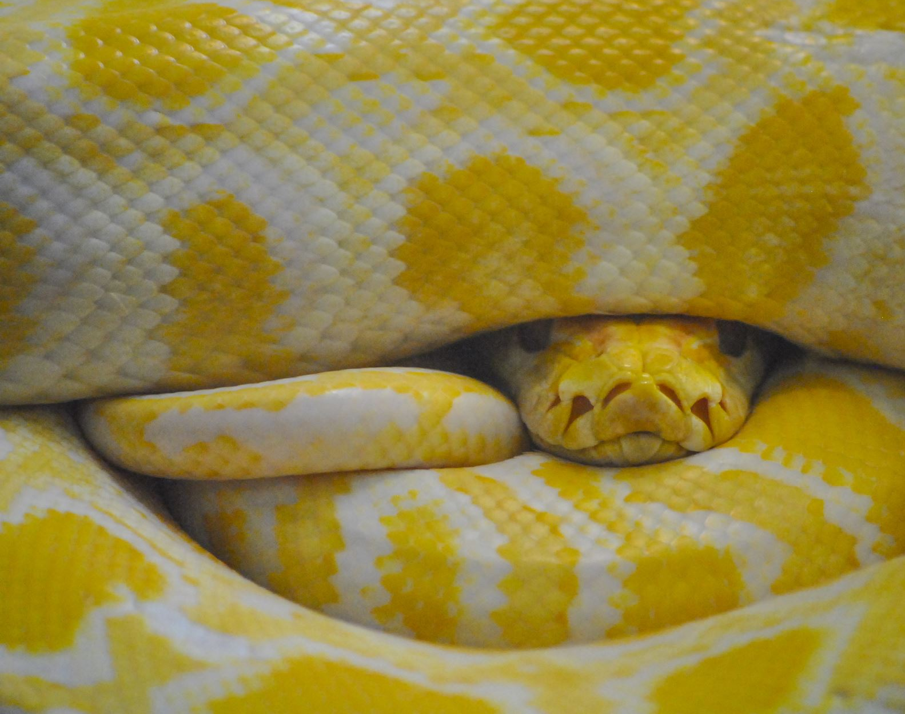
Chapter 2: Python Basics
Read Chapter 2 and Code Along
Optionally watch videos
See GitHub Notebooks

Slide 5

To Do
Quiz 1 on Python Basics
Practice Python coding, getting comfortable with an IDE
Probably best to avoid Visual Studio since it will cause you compatibility pains for certain packages
Install Anaconda only if you have tons of disk space
Don’t uninstall Python 2 if it exists on your system
For next class: follow instructions to install NLTK in Chapter 3

