Slide 1
Explainable Diabetes Risk Screening
A leakage-safe comparison of three machine-learning models on 253,680 CDC health-survey answers, with SHAP explanations and a working web app
Abdullah Mahmood
[Course code] · [University] · github.com/abdullah5341/Big_Data_Project
Notes:
TIME: ~10 seconds.
SAY: "Good morning. My project is an explainable diabetes risk screening tool. I built and compared three machine-learning models on CDC health-survey data, explained them with SHAP, and turned the best one into a web app."

Slide 2
Many people have diabetes and don't know it
Why it matters
Blood test
Undiagnosed diabetes leads to heart, kidney and eye damage that early action can delay
Population surveys (CDC BRFSS) already collect hundreds of thousands of answers each year
A screening tool must be honest about its accuracy and explain why it flags someone
needed for diagnosis (HbA1c / glucose) → requires a clinic visit
21 questions
a cheap survey anyone can answer in two minutes
Can ML help?
rank people by risk, refer the high-risk ones for a test
Notes:
TIME: ~50 seconds.
SAY: "A lot of adults with diabetes have not been diagnosed. Diagnosis needs a blood test, and that needs a clinic visit. But a health questionnaire is cheap, and the CDC already collects hundreds of thousands of answers every year. So my question was: can a machine-learning model use just 21 survey answers to rank people by risk, so we know who should get a blood test? And because this affects health decisions, the tool must be honest about how accurate it is and must explain why it flags someone."
POSSIBLE QUESTION: Why survey data and not blood tests? → Because the goal is screening BEFORE a test, to decide who needs one.

Slide 3
Same dataset, very different published results
The gap
0.99 results used oversampling (SMOTE); when it happens vs. the split is often not reported
Duplicates and error analysis rarely discussed
My objectives
Honest, leakage-safe comparison of 3 models
Explain predictions with SHAP + analyse errors
Working web prototype
Notes:
TIME: ~40 seconds.
SAY: "Several recent papers used the exact same dataset, but look at their results: from 0.83 up to 0.99 ROC-AUC. The 0.99 results used oversampling like SMOTE, and they don't always say whether it was done before or after splitting the data. If it's done before, the test set contains synthetic copies of training data, so the score looks better than reality. So my objectives were: an honest, leakage-safe comparison of three models, explaining the predictions and the errors, and a working prototype."
POSSIBLE QUESTION: Are you saying those papers are wrong? → No. I only say their protocol isn't comparable to evaluating on the real, imbalanced data.

Slide 4
Dataset and leakage-safe pipeline
253,680
21
13.9%
9.5%
survey answers (CDC BRFSS 2015, UCI #891)
health & lifestyle features
have diabetes (imbalanced)
exact duplicates → removed
Remove
duplicates
Split 70/15/15
(stratified)
Tune on train
(5-fold CV)
Threshold on
validation
Test once
Every step that learns from data uses training data only. Two new features: BMI category (WHO) and number of chronic conditions.
Notes:
TIME: ~30 seconds.
SAY: "The data is the CDC Diabetes Health Indicators dataset: 253,680 survey answers, 21 features, and only 14% have diabetes, so it's imbalanced. 9.5% of rows were exact duplicates, so I removed them BEFORE splitting, otherwise the same person could be in training and test. Then a stratified 70/15/15 split. Settings were tuned only on training data, the decision threshold was chosen on validation, and the test set was used only once."
POSSIBLE QUESTION: How did you prevent data leakage? → These five steps, plus scaling inside an sklearn Pipeline and class weights instead of SMOTE.

Slide 5
Three models, from simple to powerful
1
2
3
Logistic Regression
Random Forest
XGBoost
Baseline
Bagging
Boosting
A weighted sum of the answers. Fully transparent: each weight shows the direction of risk.
Hundreds of decision trees vote. Captures non-linear patterns.
Trees built one after another, each fixing the last one's mistakes. Usually best on tables.
Imbalance: class weights (mistakes on diabetics count ~5.5× more) — no synthetic rows, so nothing can leak. No deep learning: on 21 tabular features, trees match it and are easier to explain.
Notes:
TIME: ~20 seconds.
SAY: "I compared three models: Logistic Regression as a transparent baseline, Random Forest where many trees vote, and XGBoost where trees are built one after another to fix earlier mistakes. For the imbalance I used class weights instead of SMOTE, so no fake rows are created."
POSSIBLE QUESTION: Why not deep learning? → 21 mostly yes/no features; tree models match neural networks here and are cheaper and easier to explain.

Slide 6
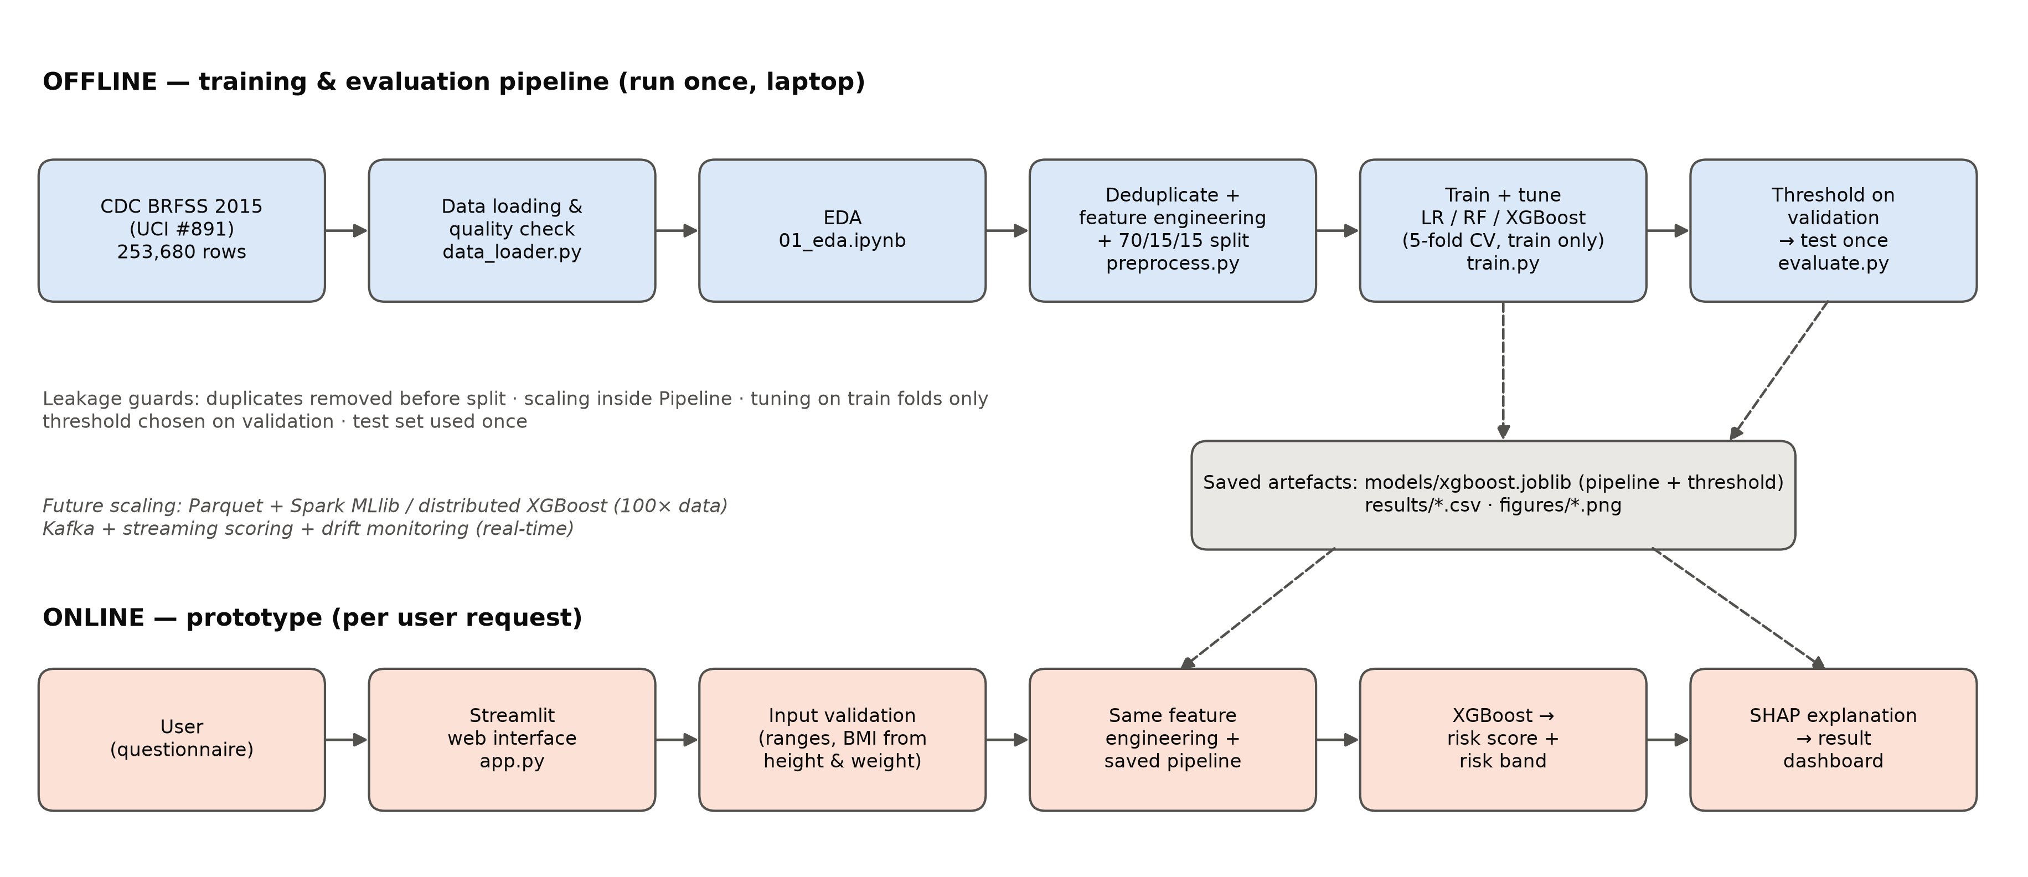
System architecture
Notes:
TIME: ~10 seconds.
SAY: "Offline, the pipeline trains and evaluates the models and saves the best one with its threshold. Online, the web app reuses exactly that saved pipeline, so the app behaves exactly like the model I evaluated."

Slide 7
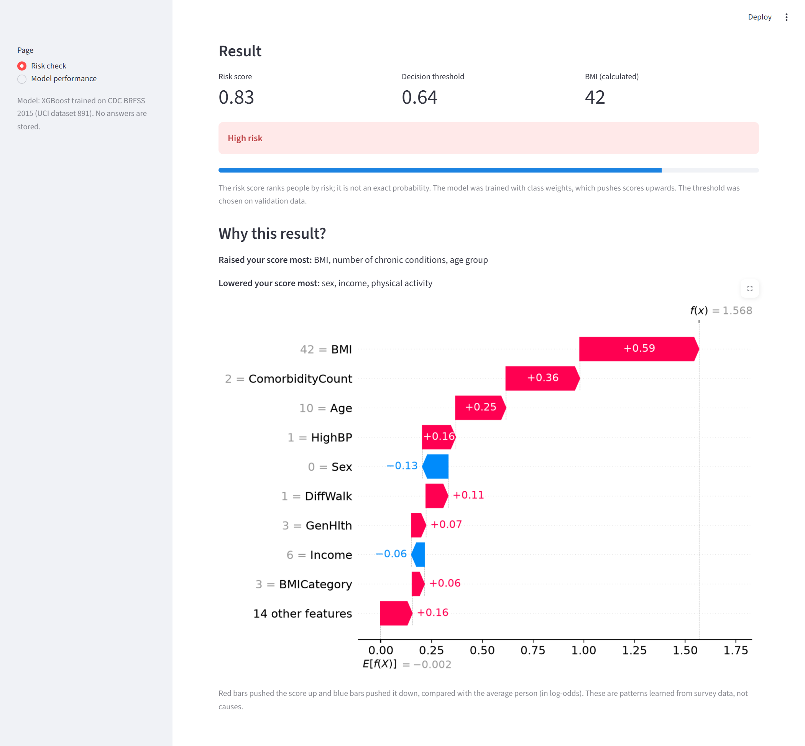
Live demo: Streamlit web app
Demo script
Default person → score 0.37 → Low risk
Change: age 65-69, weight 120 kg, high BP, high cholesterol, difficulty walking → score 0.83 → High risk
Read "Why this result?": BMI, chronic conditions, age raised the score
Show the Model performance page
Run: streamlit run app/app.py · Backup: screenshots in figures/
Notes:
TIME: ~2 min 30 s (live in the browser).
BEFORE CLASS: run 'streamlit run app/app.py' and keep the tab open. If the demo fails, show this slide's screenshot instead.
SAY / DO:
1. "This is a normal person with default answers." Click Estimate my risk → 0.37, Low risk.
2. "Now a higher-risk person." Age 65-69, weight 120 kg, tick high blood pressure, high cholesterol and difficulty walking → about 0.83, High risk.
3. "The app explains why: BMI, number of chronic conditions and age pushed the score up."
4. "Scores close to the threshold are shown as Borderline, because the model is often wrong there."
5. "It always says this is not a diagnosis — the next step is a blood test."
6. Click Model performance to show the test results.
POSSIBLE QUESTION: What if I enter BMI 200? → The app rejects BMI outside 12–98, the range the model was trained on.

Slide 8
Results on the untouched test set (34,422 people)
0.822
ROC-AUC (XGBoost) — matches leakage-safe study (0.83)
84.7%
accuracy of a model that says "no" to everyone — finds 0 diabetics
Notes:
TIME: ~1 min 15 s.
SAY: "On the test set, which was never used for training or tuning, XGBoost was best: ROC-AUC 0.822, F1 0.48, and it finds 62% of diabetics. But Logistic Regression is only 0.008 lower, so the complex model adds very little. Our 0.82 matches the paper that also evaluated on the real, imbalanced data. And notice: a dummy model that always says 'no diabetes' has 84.7% accuracy but finds nobody. That's why I used recall, F1, ROC-AUC and PR-AUC instead of accuracy."
POSSIBLE QUESTIONS: Why is your accuracy lower than 94%? → Those studies used oversampling; our test set is real and imbalanced. Why is precision only 0.39? → For screening, a false alarm costs one cheap blood test; a missed case is worse.

Slide 9
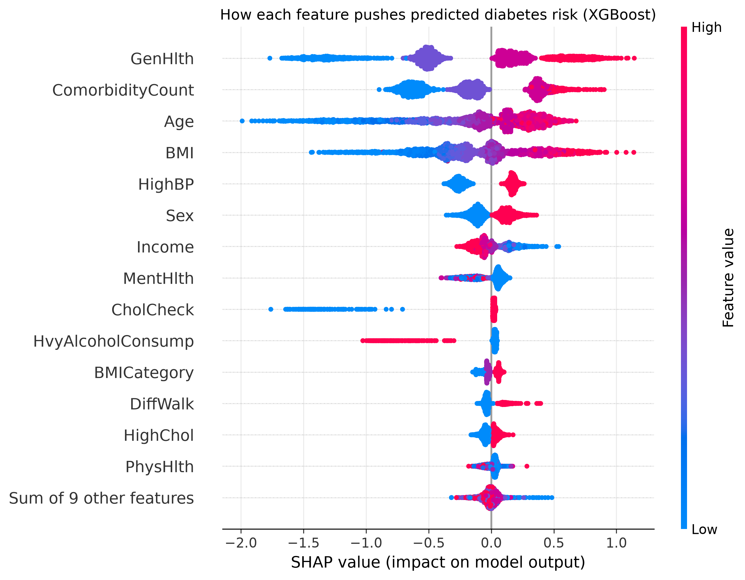
What drives the model, and who it misses
SHAP: top drivers
General health, number of chronic conditions, age, BMI, high blood pressure — match medical knowledge
Error analysis
84%
0.28
of misses are also missed by the other 2 models
recall for ages 18–44 (missed most)
Missed people look healthy on paper: good self-rated health, normal BMI, no high BP. The limit is the data (no blood tests), not the algorithm.
Notes:
TIME: ~45 seconds.
SAY: "SHAP shows what the model learned: general health, number of chronic conditions, age, BMI and blood pressure matter most, which matches medical knowledge. Each dot is a person; red means a high value. For errors: the people we miss look healthy on paper. 84% of XGBoost's misses are also missed by the other two models, so the limit is the survey data itself, not the algorithm. And young adults are missed most, recall only 0.28, which is a fairness limitation I report."
POSSIBLE QUESTION: Does SHAP prove BMI causes diabetes? → No. It shows associations the model learned. Example: heavy drinking LOWERS predicted risk, probably because diagnosed people stop drinking.

Slide 10
Conclusion
1
Honest
ROC-AUC 0.822 with a leakage-safe protocol — matches comparable published work
2
Explainable
SHAP for every prediction; 10 features keep almost all accuracy
3
Working
Streamlit app with risk bands, explanations and a clear disclaimer
Limitations: self-reported 2015 US data, no lab values, lower recall for young adults, scores not calibrated.
Future work: other BRFSS years, calibration, prediabetes as a 3rd class, a 12-question version.
Notes:
TIME: ~20 seconds.
SAY: "To conclude: the results are honest — 0.822 ROC-AUC with a leakage-safe protocol, matching comparable published work. Every prediction is explained, and only 10 features are really needed. And the web app works. The main limitations are self-reported 2015 US data with no blood tests, and lower recall for young adults. Next I would test other survey years and calibrate the scores. Thank you — I'm happy to take questions."
POSSIBLE QUESTIONS: Which model would you deploy? → XGBoost (best on validation, SHAP available); Logistic Regression is a defensible simpler alternative. What if data is 100× bigger? → Parquet + Spark MLlib or distributed XGBoost; streaming via Kafka.

