Slide 1


A Project of
An I.T. Solution Company

Slide 2


Python with Django Framework
Beginner To Pro Course

Slide 3


What is Python ?
Worlds Fastest growing Programing Language.
A Multi-purpose Language with a simple, and beginner-Friendly Syntax.
Created by Guido Van Rossum in 1989.

Slide 5
Usage of Python ?
Web Apps
Data Analysis
AI / ML
Desktop Apps
Automation
Web Scraping
Hacking
Testing

Slide 6
Why Python ?
Solve Complex Problems in Less Time with Few Lines of Code.
Hi-Level Language
Cross-Platform
Huge-Community
Large-Libraries

Slide 7
Python Features
Open Source
Portability
Huge Libraries
Object Oriented
Interpreted
Simplicity

Slide 8








Where Python is Use

Slide 9




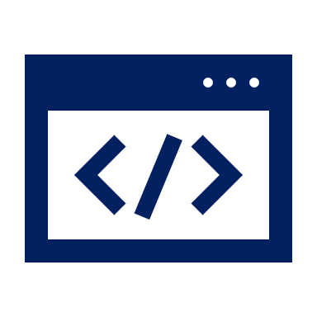

Python career Opportunities ?
Web Development
Web Testing
IOT (Smart Device)
Game Development
AI / Data Science
Big Data

Slide 10
What is Django?
Django: The web Framework for Perfectionists with Deadlines.
Python Based.
Open Source.
Secure
MVT
Scalable
Fast-Development

Slide 11



Django Based Websites

Slide 12
What We Learn in Course ?
Introduction
Getting Setup
Python Fundamentals
Project01 – Password Generator
Git Basics
Project02 – Personal Portfolio
Deployment
Project03 – Todo App
Project04 – Wallpapers Website
Introduction to Django Framework
Final Project from Students

Slide 13
Introduction
Welcome to the course
What is python
What is Django
Look into the projects

Slide 14
Getting Setup
Python 3 Windows Installation
Python 3 Mac Installation
VS-Code & Pycharm Setup

Slide 15
Python Language Fundamentals
Data types & Variable | OOP Concepts
List, Tuple, Sets & Dictionary | Modules
Flow Control | Classes
Loops | Inheritance
Functions | Exception Handling
Anonymous Functions | File Handling

Slide 16
Start with Django & 1st Project
Installing Django
Running the server
Project Structure
Apps
URLs
Templates
Forms
Making random Password
Using form data

Slide 17
Getting into Git
Introduction
Initializing Git
Commit
Creating Repository
Pushing Code

Slide 18
Project02 - Personal Portfolio
New Project & Apps | Models
Admin site | Displaying Objects
Another Set of URLs | Static Files
Details Page | Extracting Base Template
Bootstrap | Pushing code to GitHub

Slide 19
Deployment
Python Anywhere
Creating Virtual Environment
Running the server
Static & Media Files
Deploying changes

Slide 20
Project03 – ToDo App
Introduction | New Project
Signup Form | Creating User
Creating User | Authentication Module
Todo Model | Creating todos
Listing to todos | Styling
Deployment

Slide 21
Final Project
Every student submit it’s own project and deploy in order to get completion certificate.
5 students get internship opportunity on bases of final project.

Slide 22
Course Duration
2 Month Training / 2 Days in week
+
2 Month Internship / 5 Days in week
Investment
PKR. ----

Slide 23
Questioning Session

Slide 24


