Slide 1
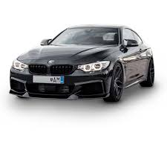
online car custumization and purchasing
Presented to
Engr. Said Nabi
Presented by
Essa Faisal
Mohmmad Abdullah
Ali Hussnain Tariq
Mir Abdul Hadi

Slide 2
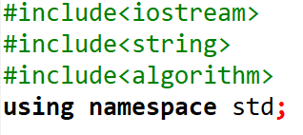
>Input/output library. >library provides useful functions and operations >Algorithm library contains a collection of algorithms that can be used on data structures, such as sorting, searching, and modifying.

Slide 3
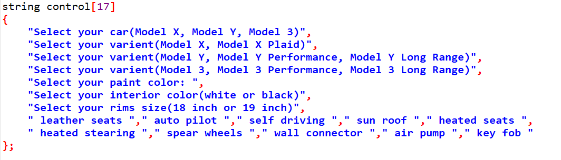
>string` is the data type used to declare an array of strings. In this case, we have an array called `control` that contains 17 elements, where each element is a string. >Each element represents a different control option or feature for selecting car attributes.

Slide 4
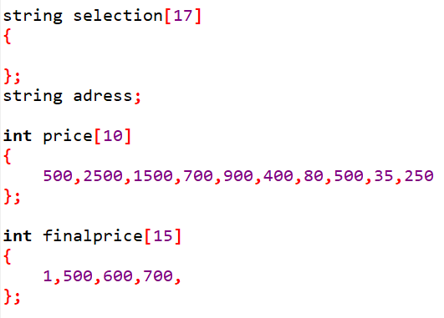
>This line declares an array called `selection` of type `string` with a size of 17. >This variable will be used to store the delivery address chosen by the user. >The array is initialized with specific prices for each element in the list. >This line declares an array called `finalprice` of type `int` with a size of 15.

Slide 5
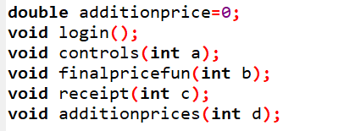
>Function prototype

Slide 6
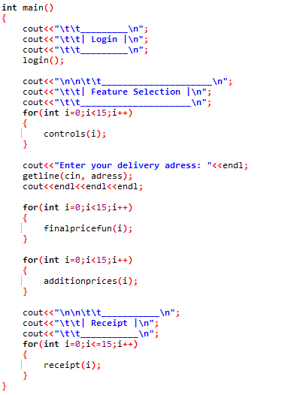
>Calling the functions >getline use to get complete line with spaces >For loop for itreation

Slide 7
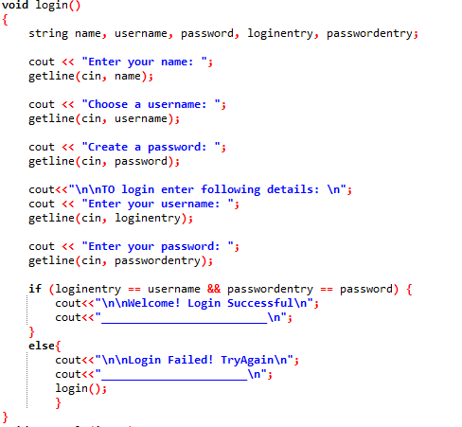
>function for login to look like a website

Slide 8
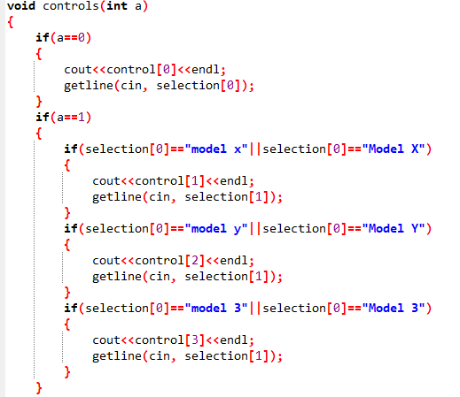
>function use to select th car varient

Slide 9
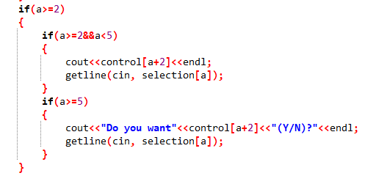
cont...

Slide 10
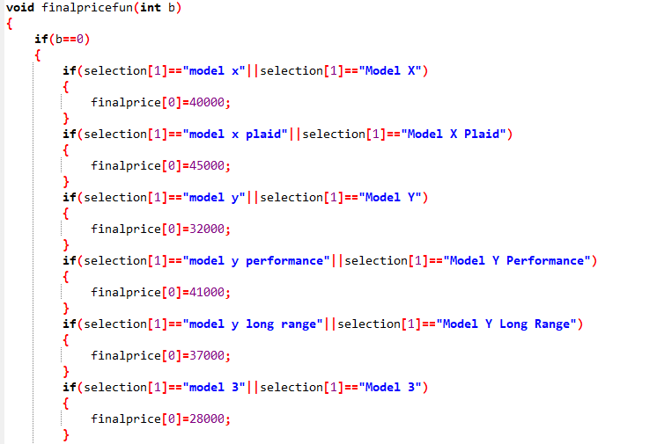
>Function for price count

Slide 11
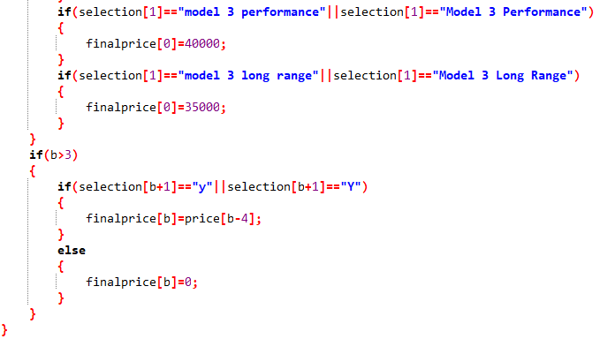
cont...

Slide 12
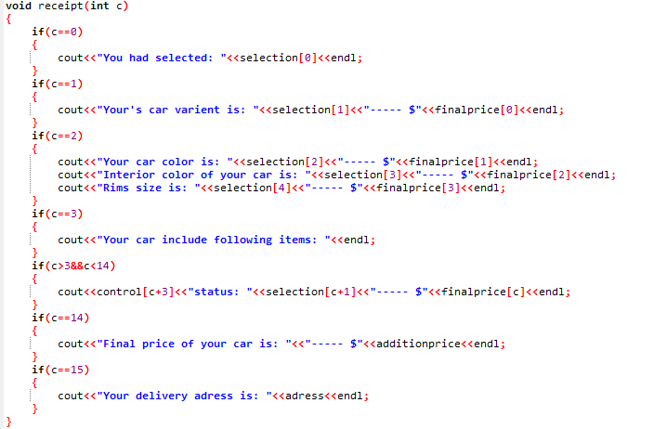
>function for final outputs

Slide 13
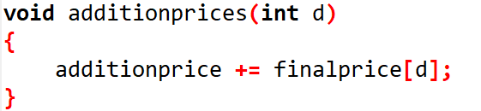
>function for final price

Slide 14


