Slide 1
Why Are Flights Late?
FINAL PROJECT · UNIT 3 · DATA EXPLORATION & DASHBOARD DEVELOPMENT
Exploratory data analysis and an interactive dashboard of 100,000 U.S. flights, 2019–2023
Presented by: Abdullah Alluhaidan
100,000 flights · 18 airlines · Jan 2019 – Aug 2023
Notes:
Opening (about 20 seconds). Introduce yourself and the project: an exploratory analysis of 100,000 U.S. flights, plus an interactive Streamlit dashboard. Tell the audience the question we answer: why are flights late, and when? Replace Abdullah Alluhaidan on this slide with your name.

Slide 2
Dataset overview
Column | What it holds
FL_DATE | Flight date
AIRLINE | Carrier name
CRS_DEP_TIME | Scheduled departure (hhmm)
DEP_DELAY, ARR_DELAY | Delay in minutes (negative = early)
TAXI_OUT, TAXI_IN | Minutes on the ground
CANCELLED, DIVERTED | Status flags (0 or 1)
DISTANCE | Flight distance in miles
100,000
18
U.S. domestic flights
airlines
56
11
months of data, Jan 2019 – Aug 2023
columns kept after cleaning (32 in the raw file)
97,164 completed · 2,649 cancelled · 187 diverted. No exact duplicates; missing arrival delays were not set to zero.
2 / 7 · Flight Delays EDA · Abdullah Alluhaidan
Notes:
About 45 seconds. Dataset: 100,000 U.S. domestic flights from January 2019 to August 2023 across 18 airlines. The raw file has 32 columns; we kept the 11 we need for the analysis. Point out the key columns on the right. We found no duplicate rows, and we kept delays blank for the 2,836 cancelled or diverted flights instead of filling them with zero. The raw data source URL was not included with the supplied files; provide one only if you have a verified link.

Slide 3
Problem definition
What is the data about?
What do we ask?
What do we expect?
How often are flights late or cancelled?
Which airlines and times of day are worst?
Do departure delay or distance relate to arrival delay?
Evening flights and budget airlines are late more often
Delays that start at departure carry through to arrival
Distance alone does not explain delays
Scheduled U.S. domestic flights, 2019–2023
Delay, taxi, distance and cancellation data for each flight
“Late” means arriving more than 15 minutes after schedule
3 / 7 · Flight Delays EDA · Abdullah Alluhaidan
Notes:
About 40 seconds. Three parts. What the data is about: scheduled flights with delays, taxi times, distance and cancellations. The questions we explore: how often flights are late or cancelled, which airlines and times of day are worst, and what relates to arrival delay. What we expected before looking: evening flights and budget airlines are late more often, delays carry from departure to arrival, and distance alone does not explain delays. These are our starting hypotheses; the next slides test them.

Slide 4
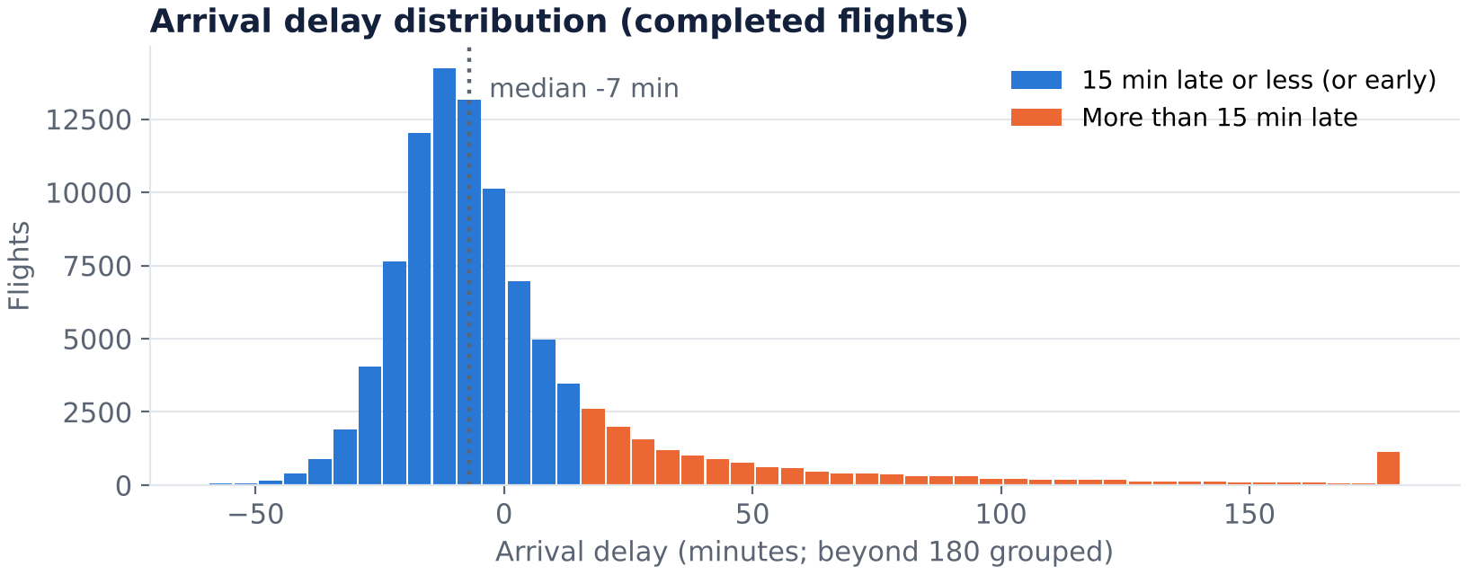
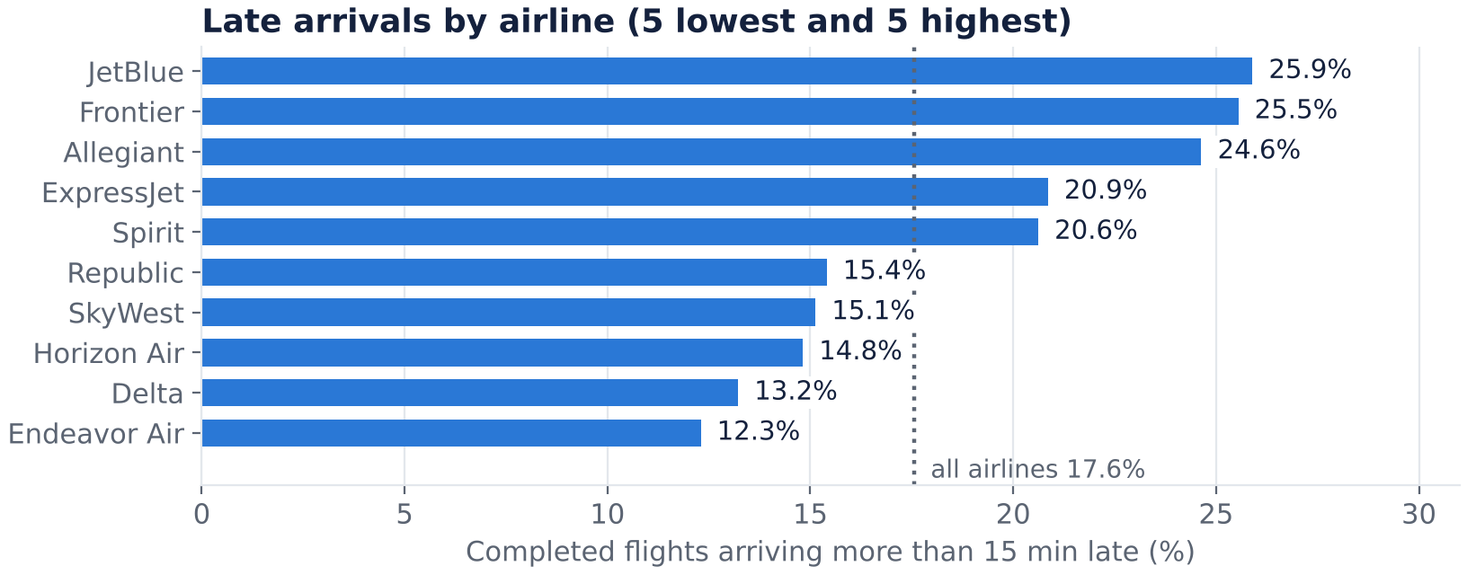
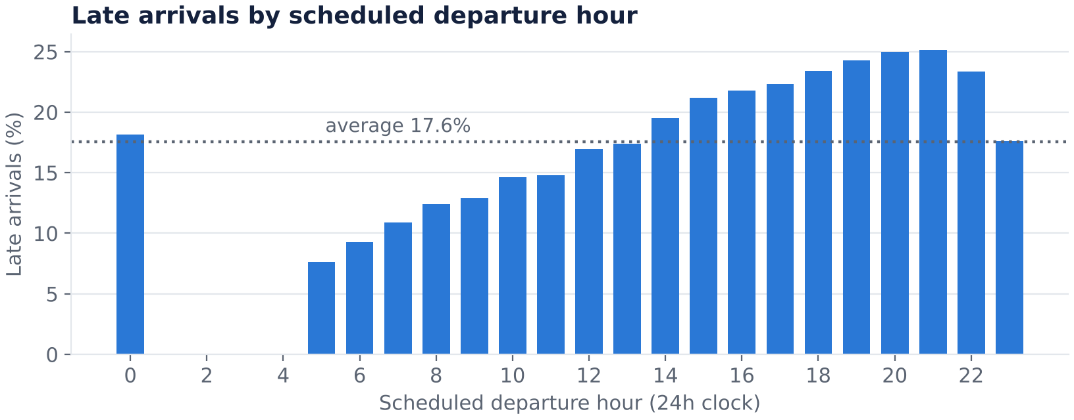
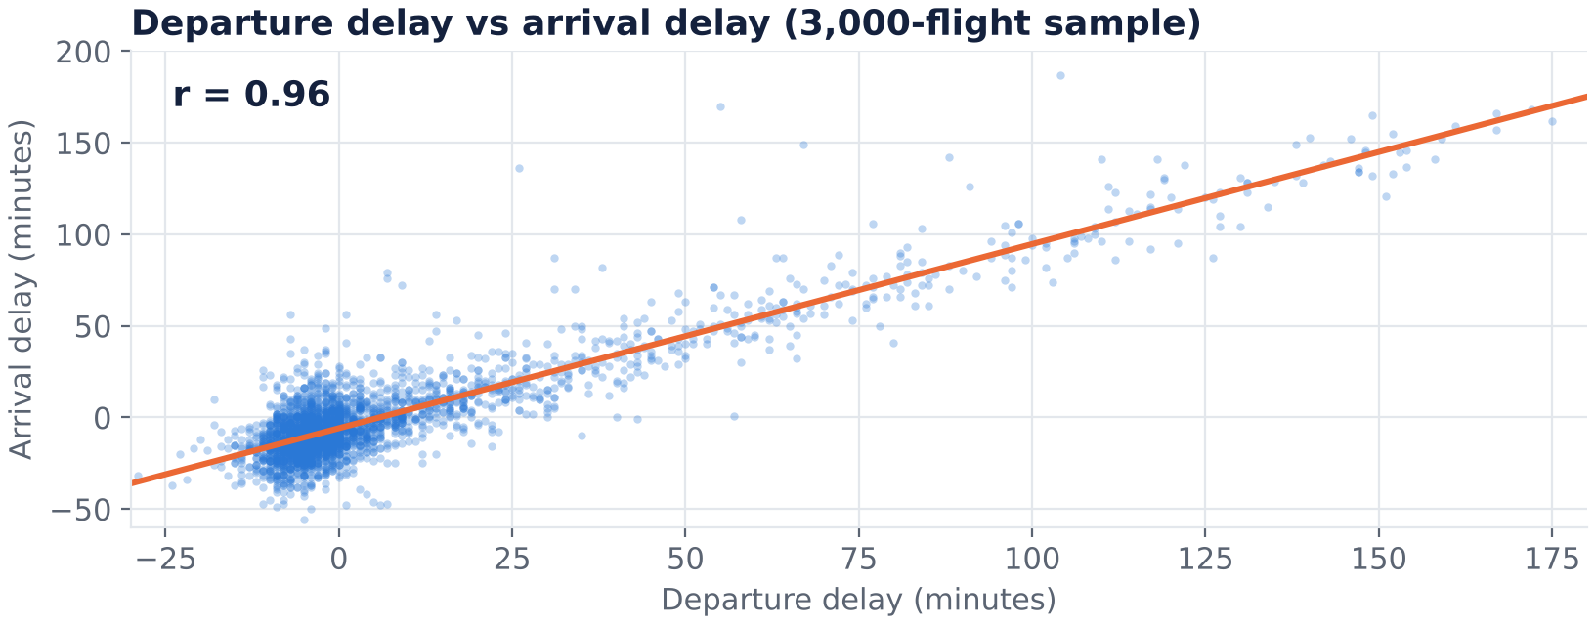
EDA results
Most flights land early; a long tail of big delays.
Late rates range from 12% to 26% across airlines.
Delays build through the day, peaking at 8–9 pm.
Departure and arrival delays move together (r = 0.96).
4 / 7 · Flight Delays EDA · Abdullah Alluhaidan
Notes:
About 60 seconds. Four plots from the notebook. Top left: the arrival-delay histogram. The typical flight lands 7 minutes early, but a long tail of big delays pulls the average up to about 4 minutes. Top right: late rates by airline, from about 12% for Endeavor Air to about 26% for JetBlue. Bottom left: late rate by scheduled departure hour. It climbs from under 8% for early-morning flights to about 25% at 8 to 9 pm. Bottom right: departure delay against arrival delay with a correlation of 0.96, so a flight that leaves late usually arrives late. Outliers: some delays exceed 3 hours (1.1% of completed flights); we kept them because they may be real.

Slide 5
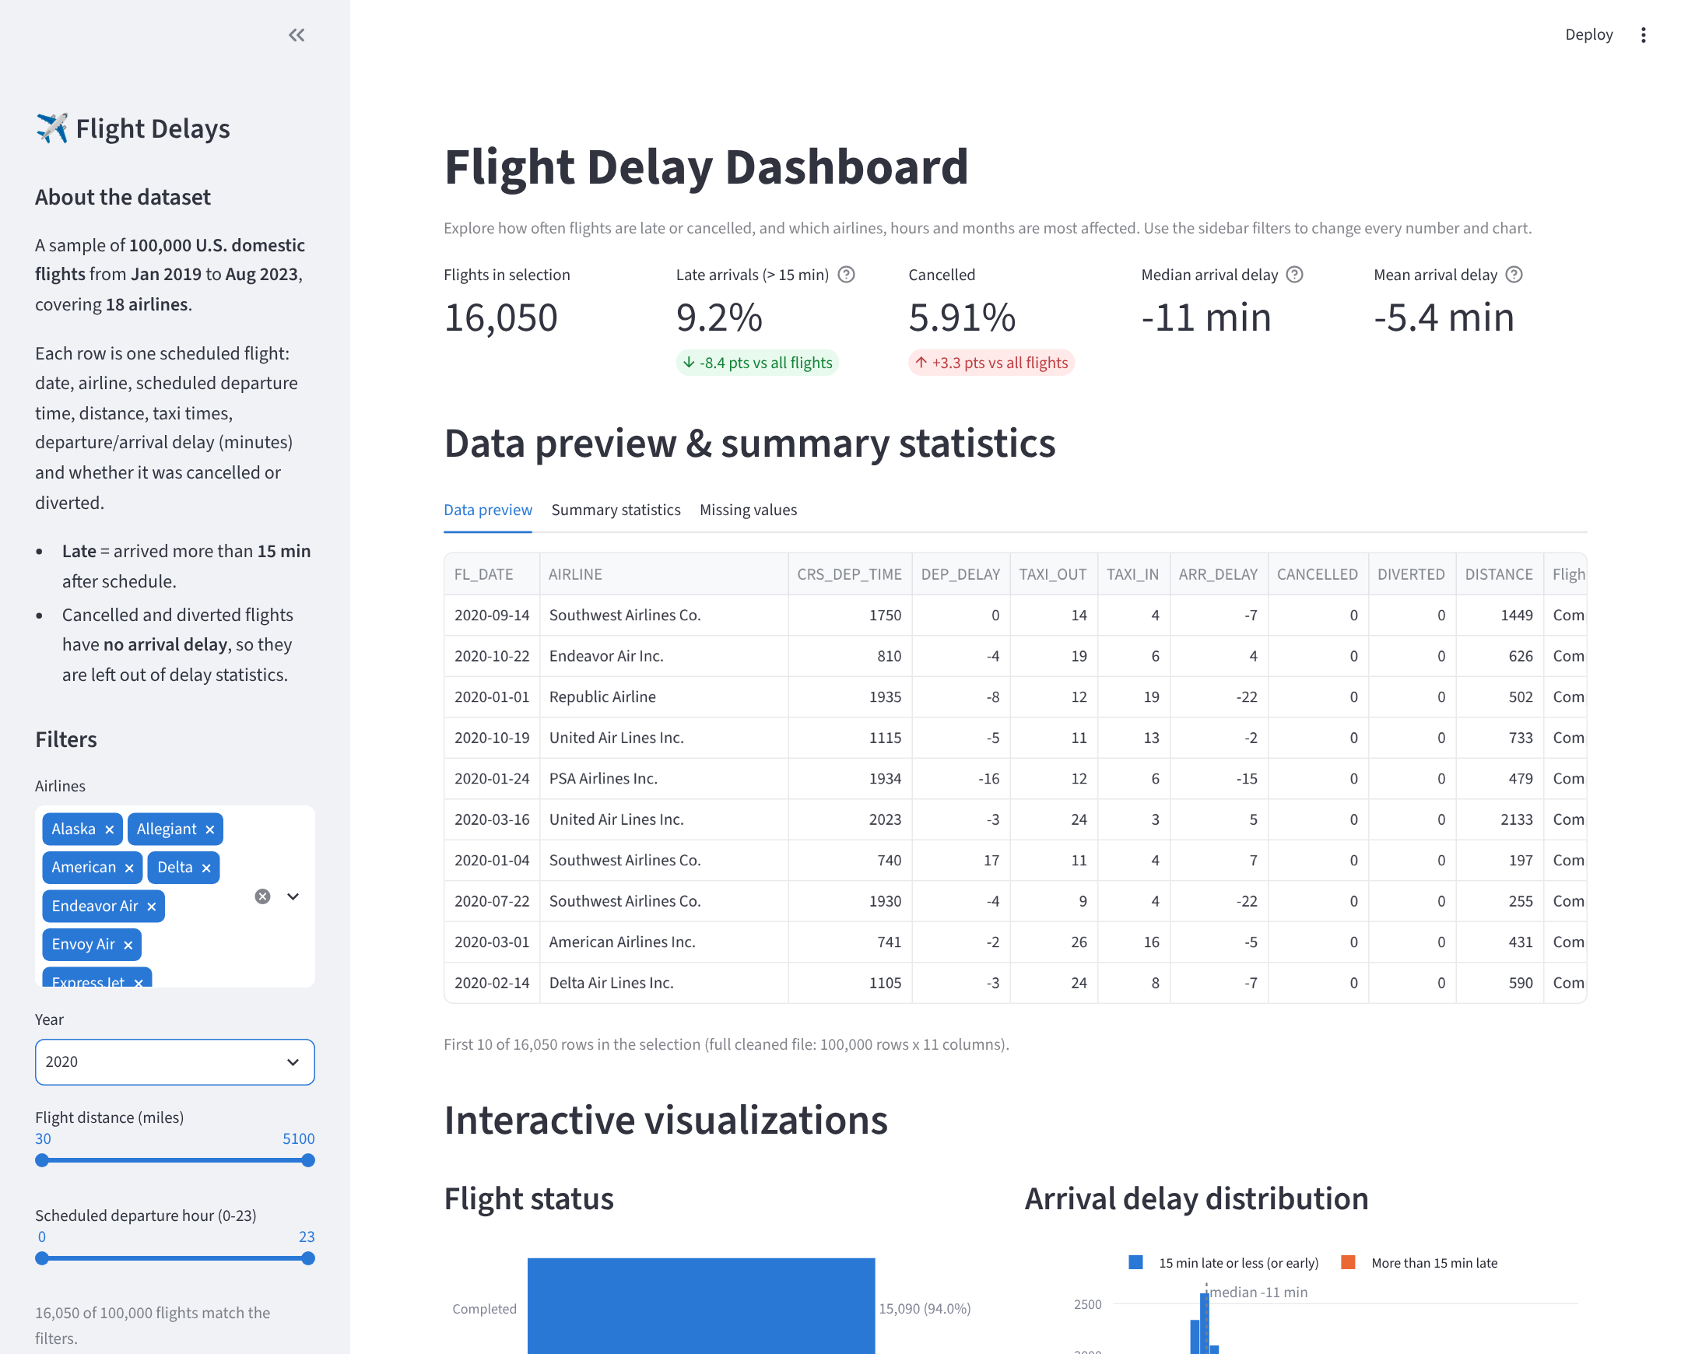
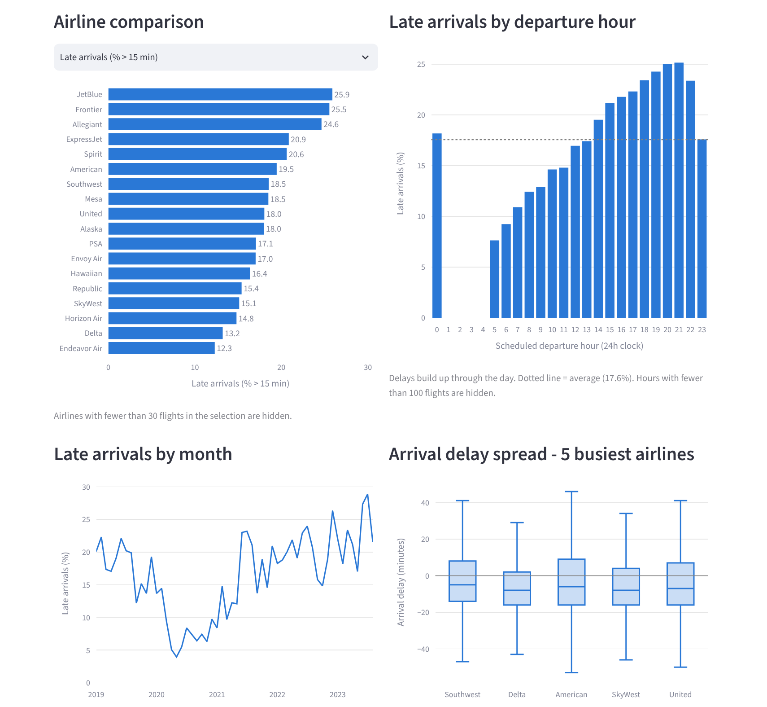




Dashboard demo
What’s inside
Sidebar: dataset info and 4 filters
5 KPI cards, data preview and summary statistics
8 interactive charts
Insight boxes that update with the filters
streamlit run app.py
Sidebar filters and KPI cards (Year = 2020 selected)
Interactive charts: hover, zoom, change the airline measure
5 / 7 · Flight Delays EDA · Abdullah Alluhaidan
Notes:
About 75 seconds; this is the demo slide. If you can, switch to the live app now (run: streamlit run app.py). Left screenshot: the sidebar has a dataset description and four filters (an airline multiselect, a year dropdown and two sliders for distance and departure hour). Choosing Year = 2020 updates every KPI card: late arrivals drop to 9.2% while cancellations rise to 5.9%, and the small badges show the change against all flights. Right screenshot: eight interactive charts; the airline chart has a dropdown to switch between late rate, mean delay, median delay and cancellation rate. Below the charts are insight boxes that recalculate from the filters.

Slide 6
Final insights
17.6%
7.6% → 25%
of completed flights arrive more than 15 minutes late, yet the typical flight lands 7 minutes early.
late rate for 5 am vs 9 pm departures: delays build through the day.
12% – 26%
r = 0.96
late rate by airline, from Endeavor Air (12.3%) to JetBlue (25.9%).
between departure and arrival delay; distance has almost no link (r = 0.01).
2020 stands out: the fewest late arrivals (9.2%) but the most cancellations (5.9%). Late arrivals have risen every year since, to 22.5% in 2023.
6 / 7 · Flight Delays EDA · Abdullah Alluhaidan
Notes:
About 60 seconds. Four numbers to remember. One: 17.6% of completed flights arrive more than 15 minutes late, but the median flight lands 7 minutes early, so a few long delays distort the average. Two: lateness grows through the day, from 7.6% for 5 am departures to about 25% for 9 pm departures. Three: airlines differ a lot, from 12.3% for Endeavor Air to 25.9% for JetBlue. Four: departure delay and arrival delay move almost together (r = 0.96), while distance has almost no link. The orange note: 2020 had the fewest late arrivals but the most cancellations, and late arrivals have risen every year since. These are patterns in this sample; they do not prove cause and effect.

Slide 7
Conclusion
Most flights arrive on time, but lateness is predictable: it grows through the day, differs by airline and starts at departure.
Limitations
Next steps
A 100,000-flight sample, not every flight
Correlation is not cause and effect
Cancelled flights have no arrival delay
Add airports, weather and delay causes
Build a simple model to predict late arrivals
Compare patterns before and after 2020
Thank you.
7 / 7 · Flight Delays EDA · Abdullah Alluhaidan
Notes:
About 40 seconds. Main message: flights are mostly on time, but when they are late it follows patterns we can see: time of day, airline and a late departure. Be honest about limits: this is a sample, and the findings show relationships, not causes. For next steps, say what you would add (airports, weather, delay causes) and that a simple predictive model of late arrivals is the natural extension. Then invite questions and offer to open the dashboard again.

