Slide 1

E-commerce MVC Project

Slide 2
Table of contents
01
02
03
04
05
06
Introduction
Key Features
Class and Use Case Diagram
Sequence Diagram
State Diagram
Visual Paradigm

Slide 3
01
Introduction

Slide 4

What is ?
It is a web application that facilitates the process of buying and selling various services over the internet.
It provides a virtual marketplace where businesses can showcase their products and customers can browse and purchase items from their homes.

Slide 5
02
Key Features

Slide 6
BuyBye Key Features
(Customer / Seller) Registration, Login and Authentication
Products categories
Shopping cart
Payment Gateway Integration
Search for specific products or filter various products
Admin Panel to manage categories, and orders
Wishlist
Reviews

Slide 7
03
Class and Use Case Diagrams

Slide 8
04
Sequence Diagram

Slide 9
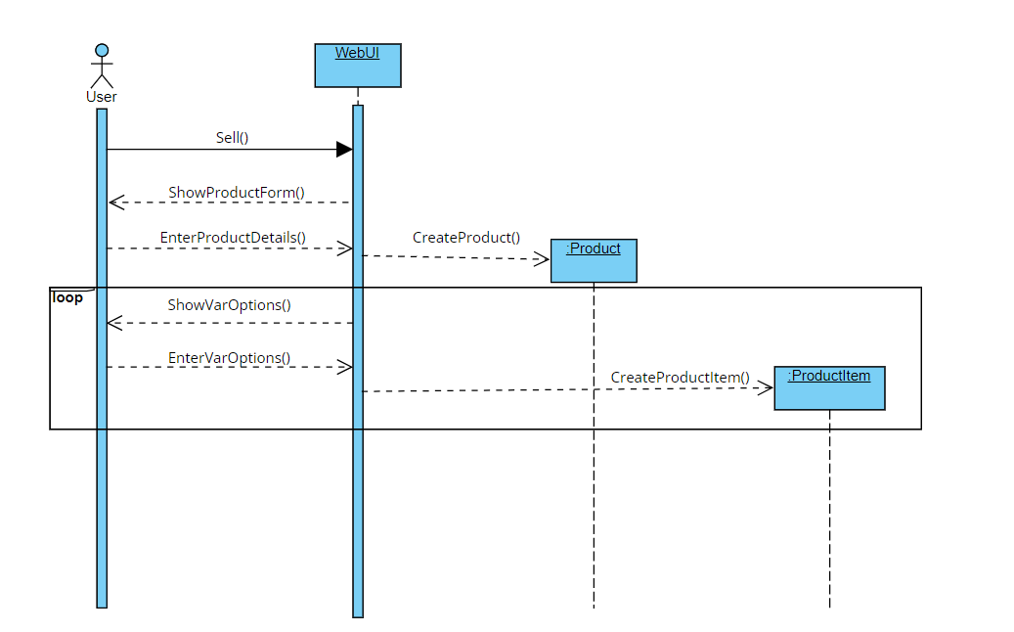
1- Seller add product sequence

Slide 10
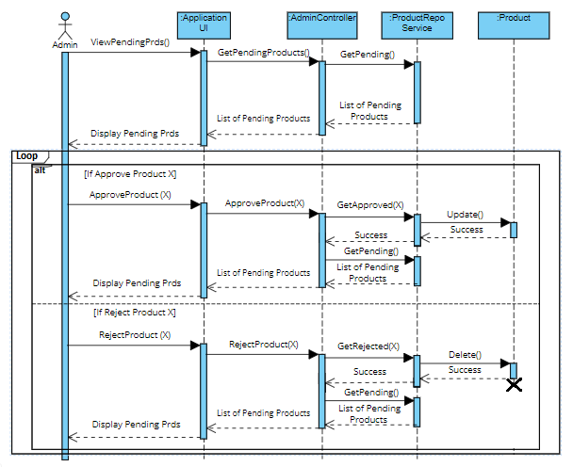
2- Admin approve product sequence

Slide 11
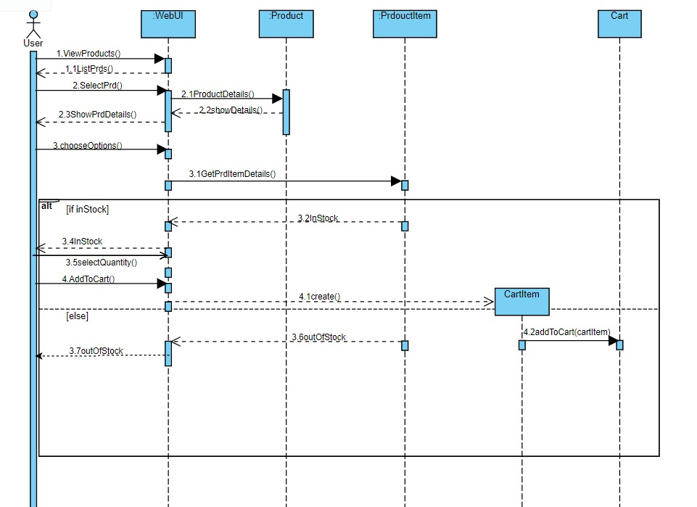
3- User add to cart sequence

Slide 12
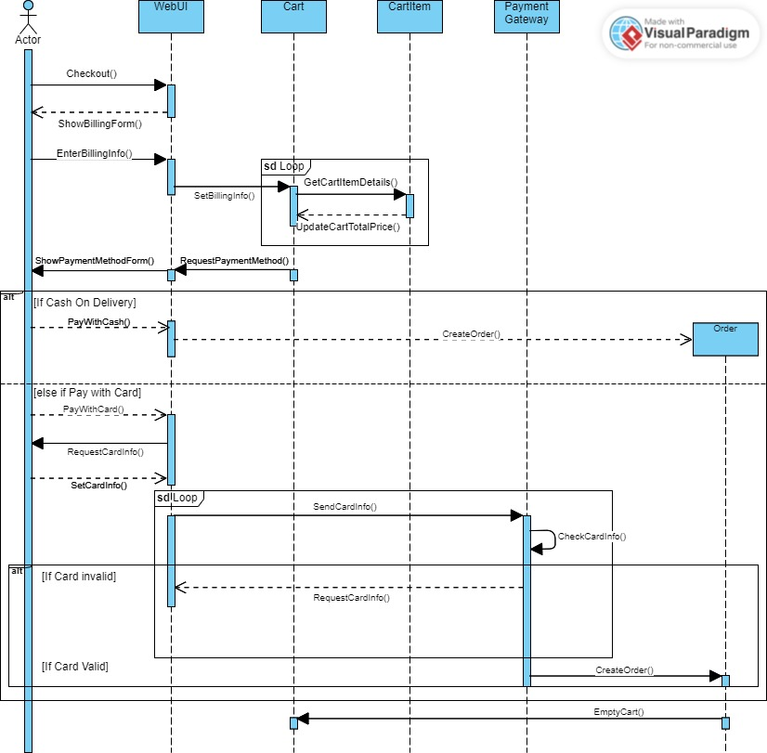
4- User checkout sequence

Slide 13
05
State Diagram

Slide 14


State Diagram
It is one of the behavioral diagrams used to represent the condition of the system.
Elements :
Initial State
Exit point
State

Slide 15



State Diagram Cont’d
Elements :
4. Choice pseudostate
5. Terminator
6. Transition

Slide 16
State Diagram vs. Activity Diagram
State Diagram | Activity Diagram
Shows a flow control within a system based on events | Used to model a business process that involves a sequence of activities.
Elements : states, transitions, events | Elements: actions, activities and transitions nodes representing activities, decision points (branches), forks and joins (synchronization points).
Focus : Internal state of an object | Focus : Sequence of activities involved in a process

Slide 17
06
Visual Paradigm

Slide 18
Visual Paradigm
Visual Paradigm is a widely used UML (Unified Modeling Language) tool.
Introduced in 1998
Features:
Supports a massive number of diagrams like state, activity, class, sequence , use case diagrams……etc.
Includes agile project management tools such as sprint planning and task management.
It integrates with popular agile project management tools like Jira, Trello, and Azure DevOps.
Supports code engineering features, enabling developers to generate code from models and vice versa. It supports various programming languages and frameworks, including Java, C#, C++, Python, and more.
Allows users to generate documentation from models automatically.
Integrates with popular IDEs such as Eclipse, IntelliJ IDE, and Visual Studio.

Slide 19
Visual Paradigm cont’d
Disadvantages :
Platform Dependency.
Cost : as the full-featured versions come with a price tag.

